Slide 1

DESIGN THINKING
AND INNOVATION
PRESENTED BY:-
K.VASAVI
B.SHIVAMANI
G.BHANUPRASAD
K.HARSHAVARDHINI

Slide 2
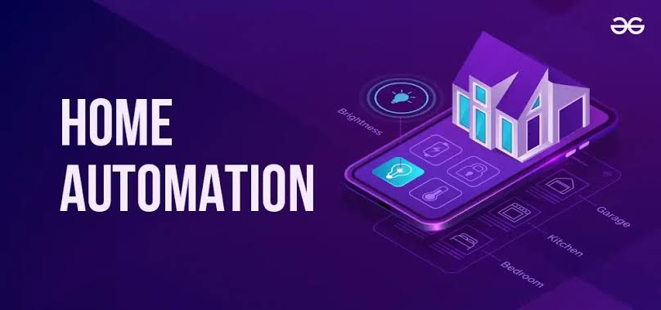
UNDER THE GUIDENCE OF:
Mr. B. Ram Vara Prasad,(Ph.D)
Assistantprofessor,
Department of EEE,

Slide 3
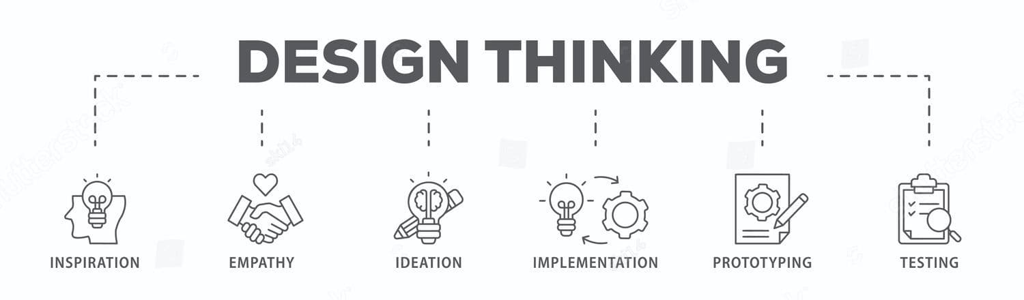
WHAT IS DESIGN THINKING AND INNOVATION ?
Design Thinking is a simple, people-focused way to solve problems by understanding what users really need, coming up with creative ideas, and testing them to see what works. It helps you look at problems from a user’s point of view and try different solutions before choosing the best one. Innovation is about creating new and useful things—like products, services, or ways of doing things better. When you use Design Thinking, it often leads to innovation because you're focusing on real problems and testing ideas that make a difference.

Slide 4

PROBLEM STATEMENT
In the modern era, convenience, energy efficiency, and security have become essential aspects of daily living. Traditional home appliances and systems require manual operation, which can lead to energy wastage, inefficiency, and inconvenience—especially in scenarios where users forget to turn off appliances or want to control them remotely. Moreover, with the rise in demand for smart technologies, there is a growing need for cost-effective, scalable, and user-friendly automation systems.
The problem lies in the lack of an integrated system that allows users to remotely control and monitor household appliances such as lights, fans, and other electronic devices using mobile devices, voice commands, or automated schedules.

Slide 5
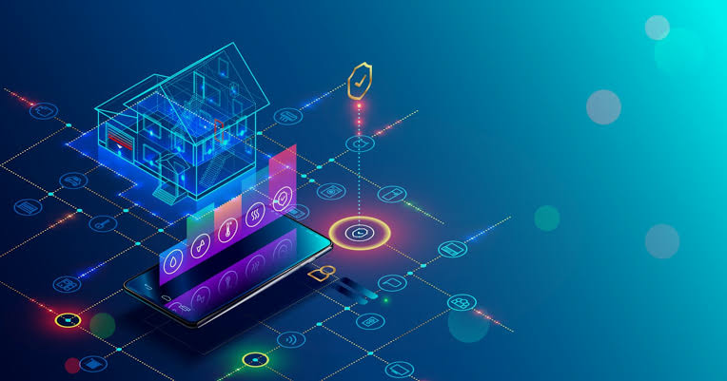
INTRODUCTION TO HOME AUTOMATION
In recent years, the concept of smart homes has gained significant momentum, driven by advances in Internet of Things (IoT) technologies, wireless communication, and affordable microcontrollers. Home automation, often involves the automatic control of household devices and systems such as lighting, fans, appliances, and security systems, thereby enhancing convenience, energy efficiency, and safety for users. The modern lifestyle demands intelligent systems that can respond to user inputs remotely, execute predefined schedules, or react based on environmental conditions. Traditional manual control of home appliances can lead to energy wastage and inefficiency, especially when users forget to turn off devices or are not physically present to operate them.
This project aims to develop a low-cost, IoT-based home automation system using the ESP32 microcontroller, relay modules, and wireless communication (Wi-Fi) to allow users to control and monitor appliances via a smartphone app or web interface. The system can also be extended to include automation features such as motion detection, scheduling, and voice assistant integration.

Slide 6
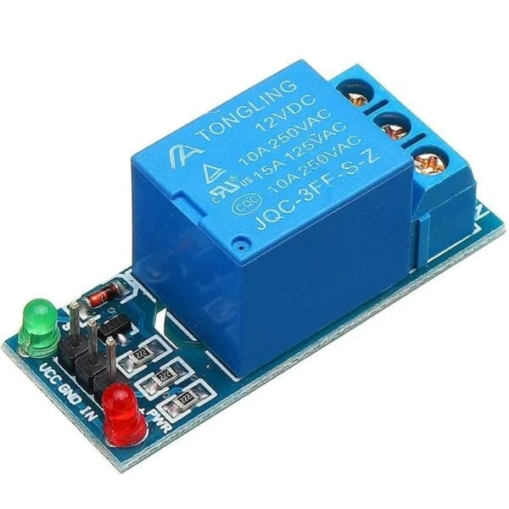
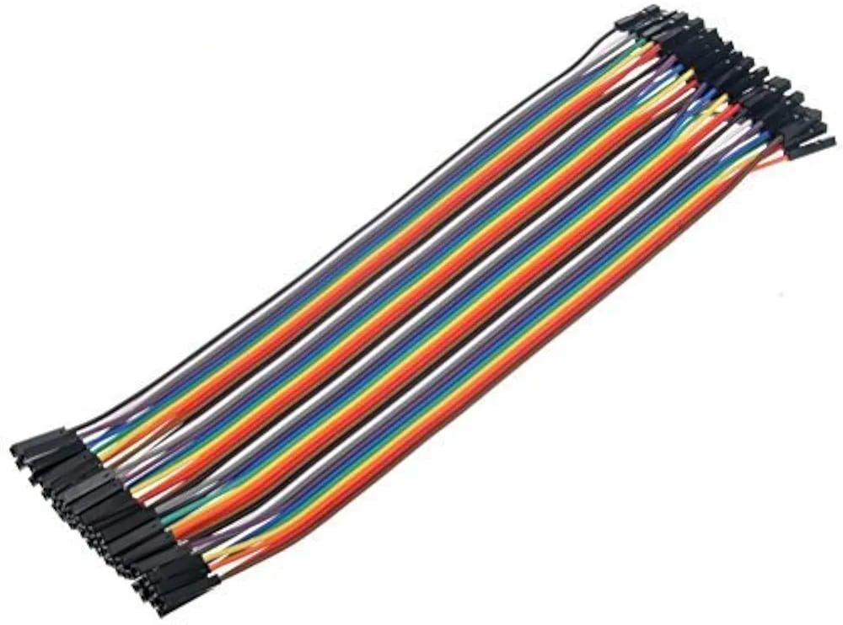
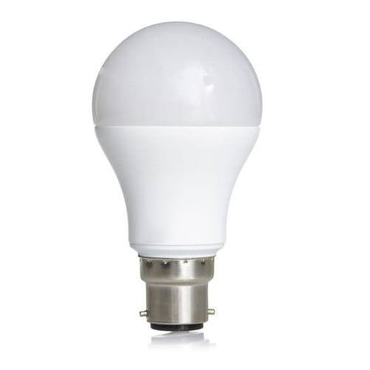
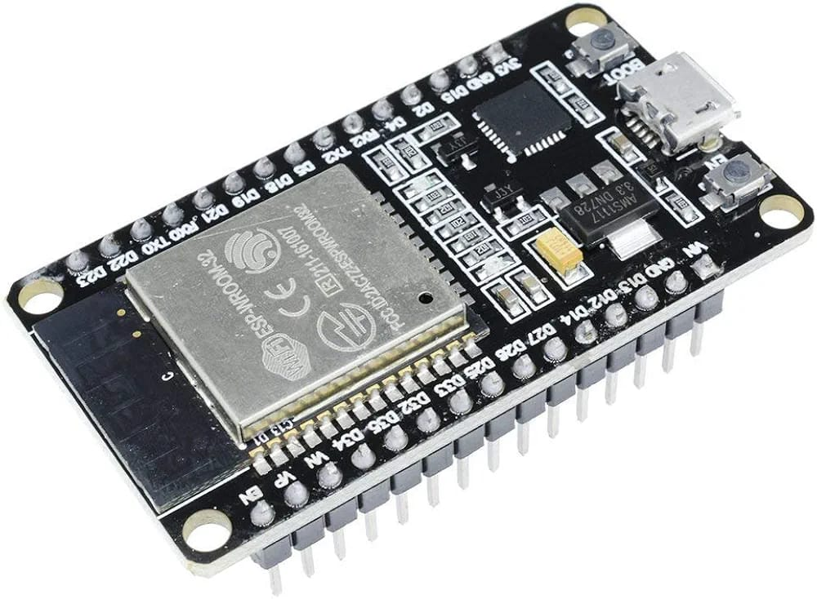
EQUIPMENTS AND SPECIFICATIONS
Connector Type: Female (socket) Dupont-style
Contact Spacing: 2.54 mm (0.1 inch) — standard pitch for breadboards and header pins
Wire Gauge: Typically 28 AWG (can vary between 26–30 AWG)
Conductor: Tinned copper or copper-clad aluminum (CCA)
Insulation: PVC (Polyvinyl Chloride) or silicone for flexibility
Current Rating: ~1A maximum (suitable for logic-level connections, not power delivery)
Voltage Rating: Up to 300V (depends on insulation, but practically used at 3.3V–12V logic)
Power Consumption: 12 Watts
Voltage: 100–240V AC
Luminous Flux: 1000–1200 lumens
Startup Time: Instant (<1 second)
Color Temperature: - Warm White: ~2700K–3000K
- Cool White: ~5000K–6500K
Beam Angle: ~180° – 270°
Lifespan: ~15,000 – 25,000 hours
CRI (Color Rendering Index): >80 (good color accuracy)
Wi-Fi: 802.11 b/g/n
Bluetooth:v4.2
CPU: Dual-core Xtensa® 32-bit LX6 microprocessor
Clock Speed: Up to 240 MHz (configurable)
SRAM: 520 KB
ROM: 448 KB
Operating Voltage: 3.0V – 3.3V
Temperature Range: –40°C to +85°C
Current Consumption:
Active Mode: ~160 mA (Wi-Fi TX)
Modem-Sleep: ~3–20 mA
Light-Sleep: ~0.8 mA
Deep-Sleep: ~10 µA
Power-off: ~2.5 µA
1-Channel
Rated Voltage: 12V DC
Trigger Voltage: Typically 3.3V or 5V
Relay Type: SPDT or SPST
AC: 250V AC @ 10A
DC: 30V DC @ 10A
LED Indicator: Shows relay ON/OFF state
VCC: Power supply (usually 5V logic section)
GND: Ground
IN: Control signal from microcontroller (1 pin per relay)

Slide 7
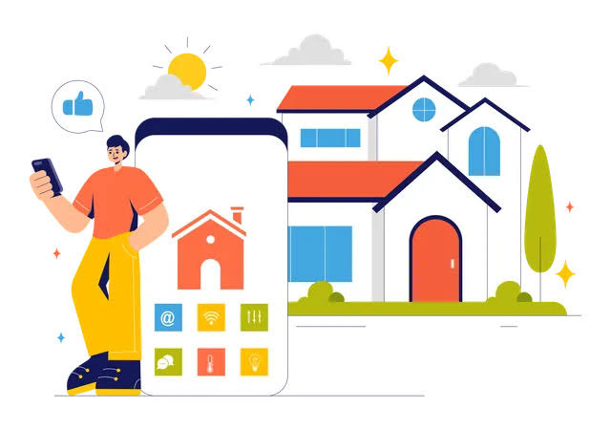

IMPLEMENTATION
The implementation of the Home Automation System is carried out in several stages, including hardware setup, software development, connectivity, and integration. The system is designed using the ESP32 microcontroller, relay modules, and a web or mobile interface, enabling remote control of household appliances via Wi-Fi.

Slide 8
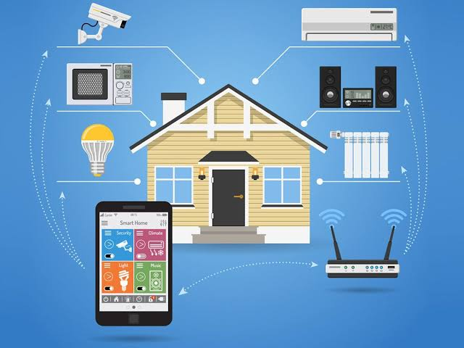
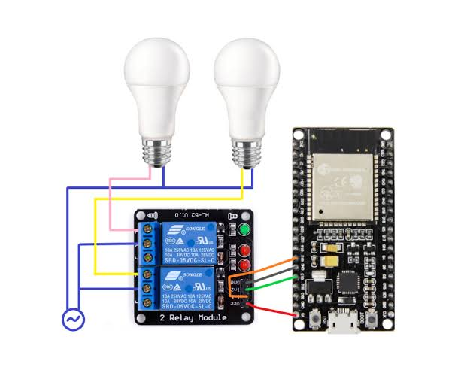
PICTORIAL REPRESENTATION
Implementation
Execution

