Slide 1

DESIGN THINKING AND INNOVATION
Presented by:
CH PUJITHA - 23KD1A0222
A MAHARSHI - 23KD1A0203
M KALI -23KD1A0263
D TEJA KRISHNA-23KD1A0229

Slide 2
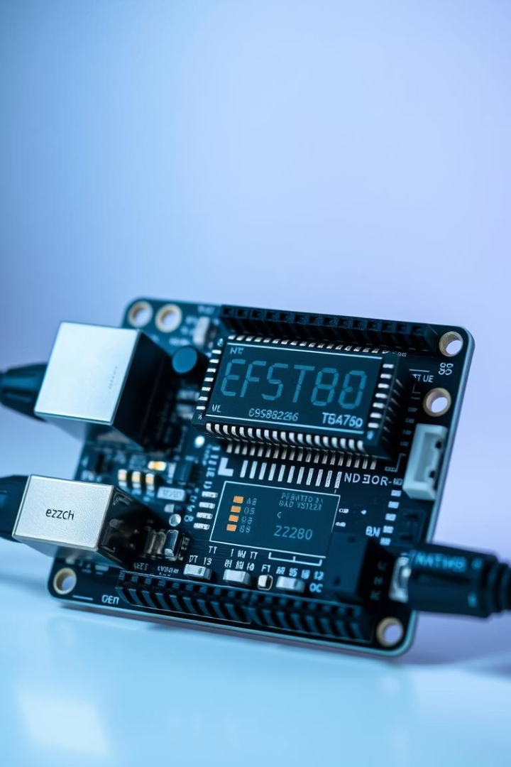

IOT BASED BATTERY MONITORING SYSTEM USING ESP8266 ARDUINO
Under the Guidance of:
Mr.B.Ram Vara prasad (Ph.D)
Assistant Professor
Department of EEE
LIET

Slide 3
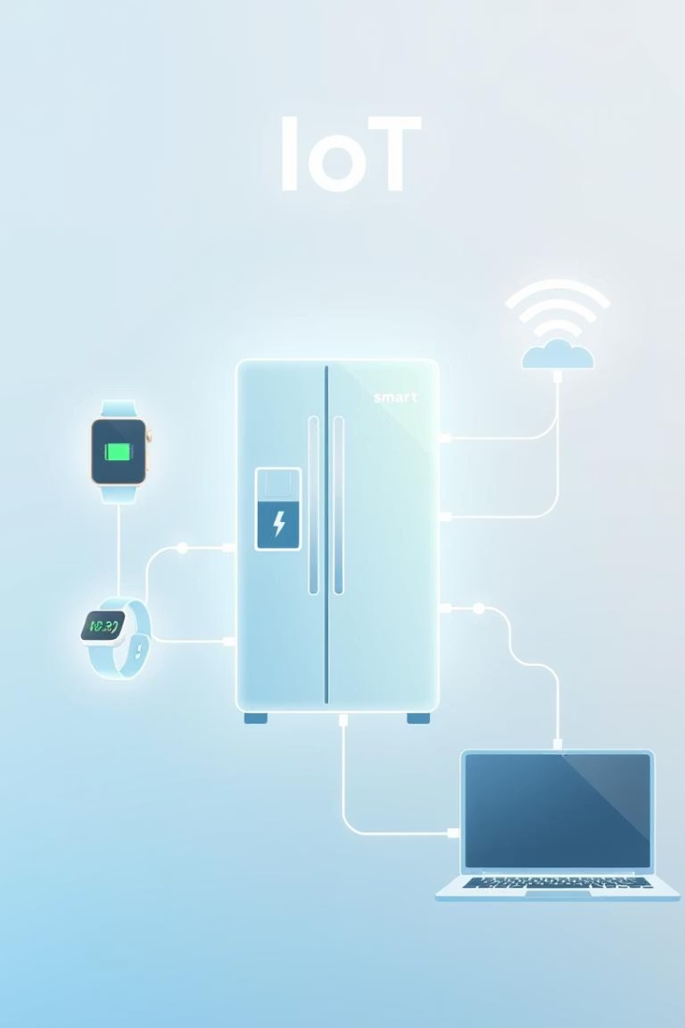
Contents Overview
Introduction & Problem
Exploring IoT fundamentals and challenges in battery health monitoring.
Design Thinking
Empathy, Define, and Ideate phases to frame the solution.
Solution Development
Storyboarding, prototyping, and system demonstration steps.
Conclusion & Contact
Insights, future enhancements, and ways to connect.

Slide 4
Introduction to IoT & Battery Monitoring
The Internet of Things (IoT) enables interconnected devices to monitor and manage data efficiently. Battery systems are critical in providing backup power for many applications.
The ESP8266 microcontroller is widely used due to its low cost and integrated Wi-Fi capability, making it ideal for implementing wireless battery monitoring solutions.
IoT-based battery monitoring systems track vital parameters such as voltage and state of health, sending real-time updates to users for timely interventions.

Slide 5

Problem Statement
Manual Checks Are Unreliable
Unexpected Downtime
Periodic physical monitoring can miss critical battery conditions leading to unnoticed damage.
Battery failures often cause sudden power loss, adversely impacting operations.
Need for Automation
A remote, automated system is required for continuous, accurate monitoring to reduce human error.

Slide 6
Empathy: Understanding the User
Applying the 5 WHY’s method reveals that the lack of continuous monitoring stems from dependence on manual checks, which are time-consuming and prone to error.
Technician persona responsible for large battery arrays.
Needs timely remote access to battery health data.
Requires actionable alerts to enable prompt maintenance.
Battery failures disrupt critical operations, impacting both safety and costs.

Slide 7

Define: Point of View Statement
POV Statement: Battery maintenance technicians need a real-time monitoring system because manual checking is inefficient and can miss critical battery failures, causing costly downtime.
This insight focuses the design process on creating a solution that increases reliability, reduces manual effort, and supports proactive maintenance.

Slide 8
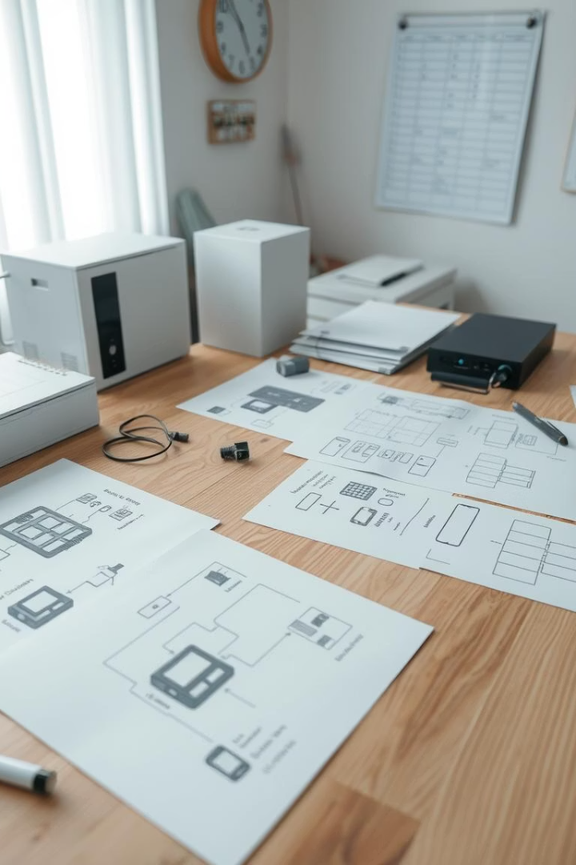
Ideate: Solution Brainstorming
1
Sensor Integration
Use voltage and current sensors to collect live battery data.
2
Wireless Communication
Leverage ESP8266 module for Wi-Fi enabled data transmission.
3
User Interface
Develop mobile and PC dashboards to display status visually.
4
Alert Systems
Trigger notifications for abnormal battery conditions automatically.

Slide 9
Storyboarding the Battery Monitoring Flow
Battery connected with voltage and current sensor modules.
This flow ensures continuous monitoring, timely updates, and proactive maintenance to avoid battery failures.
ESP8266 reads sensor data and sends it to a cloud server.
Each step is essential for creating a reliable, user-friendly IoT-based battery monitoring system.
User accesses battery status via mobile or web applications.
System sends alerts if voltage drops below predefined thresholds.

Slide 10
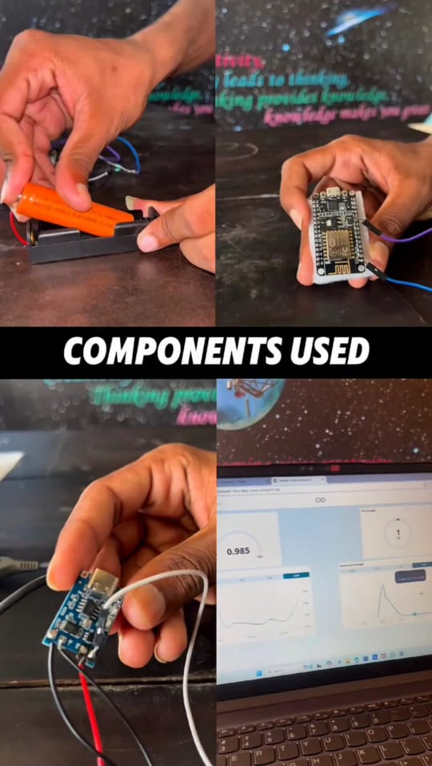

Slide 11
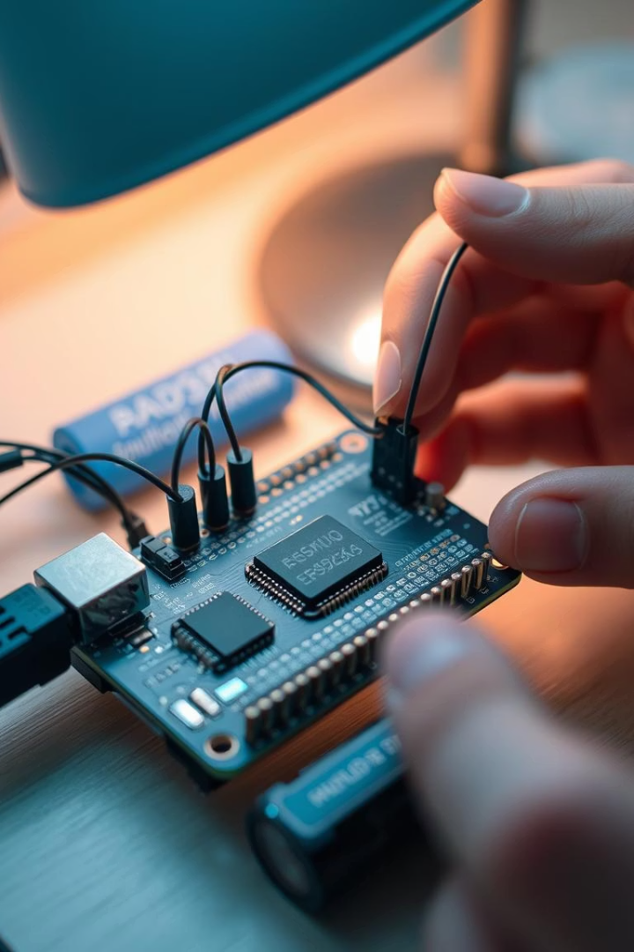




Prototype Components & Working
ESP8266 Wi-Fi Module
Arduino Board
Sensors
Processes sensor data and controls communication flow.
Voltage Sensor
Facilitates wireless data communication to cloud servers.
Current Sensor
Cloud Server
Stores and displays battery data; platforms like ThingSpeak or Blynk.
Sensor data is collected and processed by the Arduino, transmitted via ESP8266, enabling users to monitor battery health remotely in real-time.

Slide 12
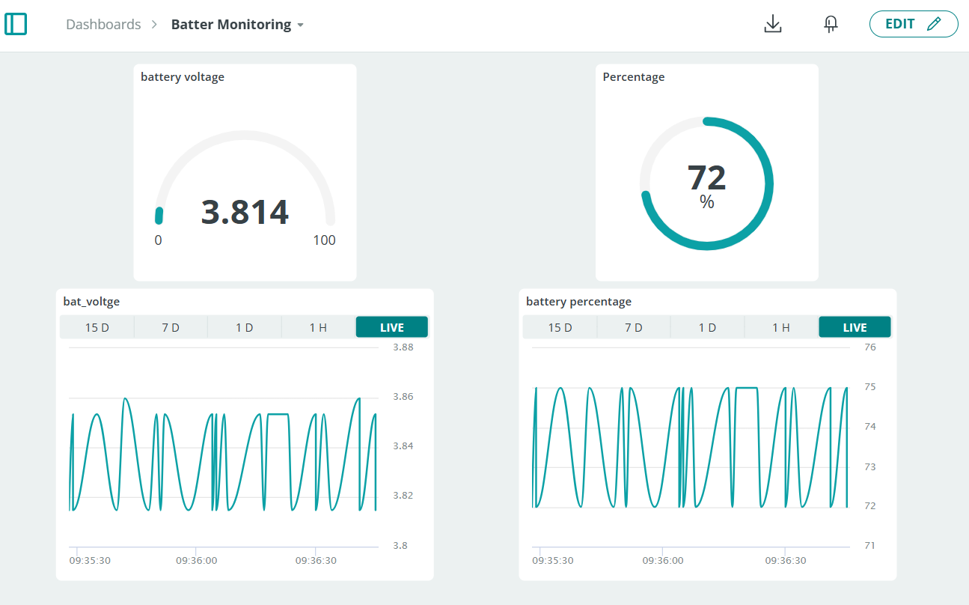

Slide 13

Conclusion and Future Directions
Reliable Battery Management
Future Enhancements
Temperature monitoring to safeguard against overheating.
IoT-based monitoring enhances system uptime and reduces manual maintenance efforts.
AI-based predictive analytics for early failure detection.
Push notifications for immediate user alerts.
Contact Us
Reach out for collaboration or queries: [Your Email IDs]

Slide 14
THANK YOU

