Slide 1

DESIGN THINKING AND INNOVATION
PRESENTED BY :
B.S.K.Samanvitha(23KD1A0214) B.Likitha(23KD1A0206) G.Sai(23KD1A0243)
CH.Mohan sampath Reddy(23KD1A0226) CH.chaitanya(23KD1A0228)

Slide 2
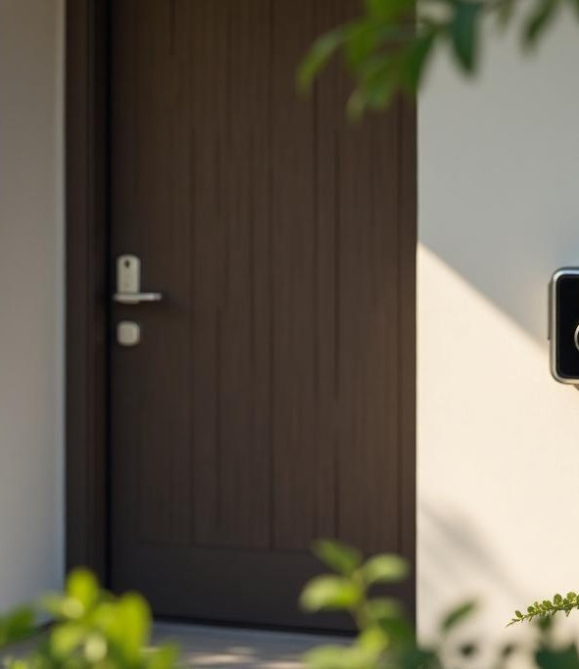
SMART DOOR BELL WITH VISTOR NOTIFICATION
UNDER THE GUIDENCE OF:
Mr.Ram Vara Prasad ,(Ph.D) Assistant professor, Department of EEE, LIET(A).

Slide 3

CONTENTS
INTRODUCTION TO DESIGN THINKING PROBLEM STATEMENT
EMPATHY DEFINE IDEATE PROTOTYPE CONCLUSION

Slide 4

WHAT IS MEANT BY DESIGN THINKING AND INNOVATION ?
Design Thinking is a user-centric, iterative problem-solving approach that emphasizes empathy, creativity, and experimentation.
It involves understanding user needs, redefining problems, and developing innovative solutions through prototyping and testing.

Slide 5











Design Thinking Process
Define
This slide is 1DD% editable. Adj”ustitas per your.requirementsand catches your viewers consideration.
Add Text Here
This.slide is 100% editable. Ad)ust it as per yourrequirements and catches your viewers consideration.
Test
This slide is % editable. Adjust it as per yourrequirements and catches your viewers consideration.
a
Empathies
This slide is 100% editable. Adj”ustit as per yourrequirements and catches your viewers consideration.
Ideas
This slide is 100% editable. Adjust it as per yourrequirements and câtclies your viewers consideration.
Prototype
This slide is 100% editable. Ad)”ustit as per yourrequirements and catches your v/éwers consideration.

Slide 6
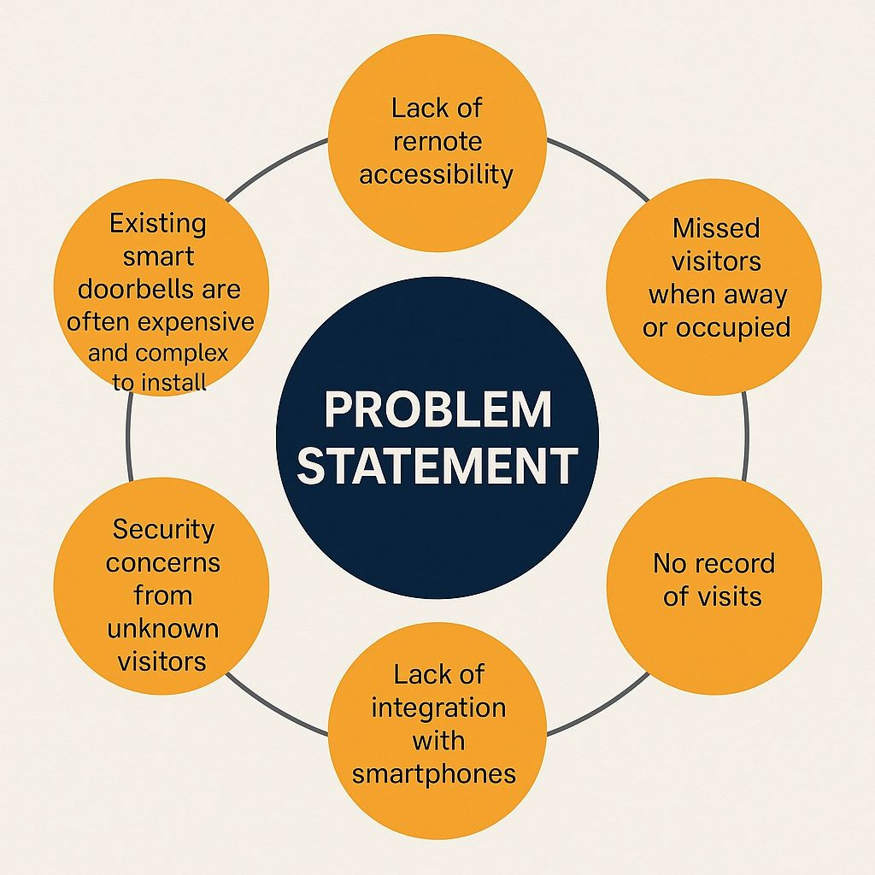
. Traditional doorbells do not offer remote
PROBLEM STATEMENT
access, making it impossible for users to know who is at the door when they are not at home.
.If the homeowner is away, busy, or unable to
hear the bell, visitors may go unnoticed, leading to missed deliveries or important guests.
. Conventional doorbells do not provide any
means to identify visitors before opening the door, posing potential safety risks.

Slide 7
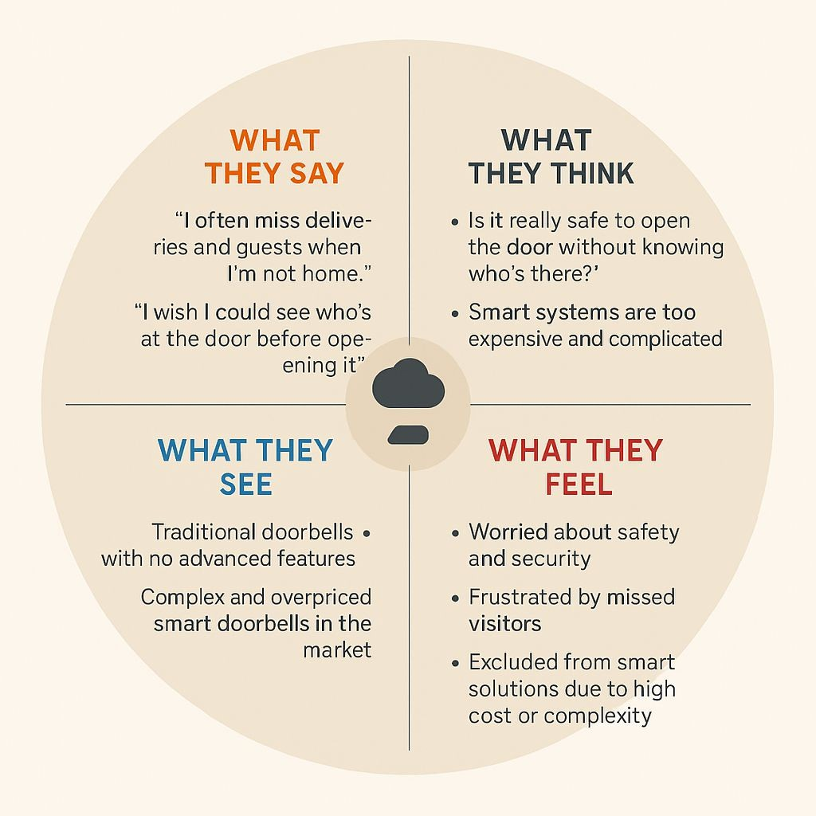
. Users are not instantly notified
when someone rings the doorbell, limiting timely responses or actions.
. In areas with safety issues, not
knowing who is at the door increases vulnerability to theft or unwanted entry.
. Most standard systems do not support
voice or video communication between the visitor and the homeowner.

Slide 8
EMPATHY
. 5 WHY’s
. EMPATHY MAP
. EXPERIENCE MAP
. PAIN POINTS
. NEEDS & EXPECTATIONS

Slide 9

1.Why do users miss visitors at their doorstep?
5 WHY’S
Why are users unable to attend visitors quickly?
Why does this cause a problem for users?
Why do users feel unsafe or inconvenienced?
Why do users need a smarter solution?

Slide 10
EXPERIENCE MAP
1st: Visitor at door (presses doorbell)
2nd: Notification sent instantly to owner's phone
3rd: Owner checks live video feed using Blynk app (ESP32 CAM) 4th: Owner decides to unlock or not
5th: If allowed, solenoid lock opens remotely 6th: Visitor enters safely or waits outside
7th: Buzzer sounds for special alerts (if any issue) 8th: Owner feels secure, even if away from home

Slide 11
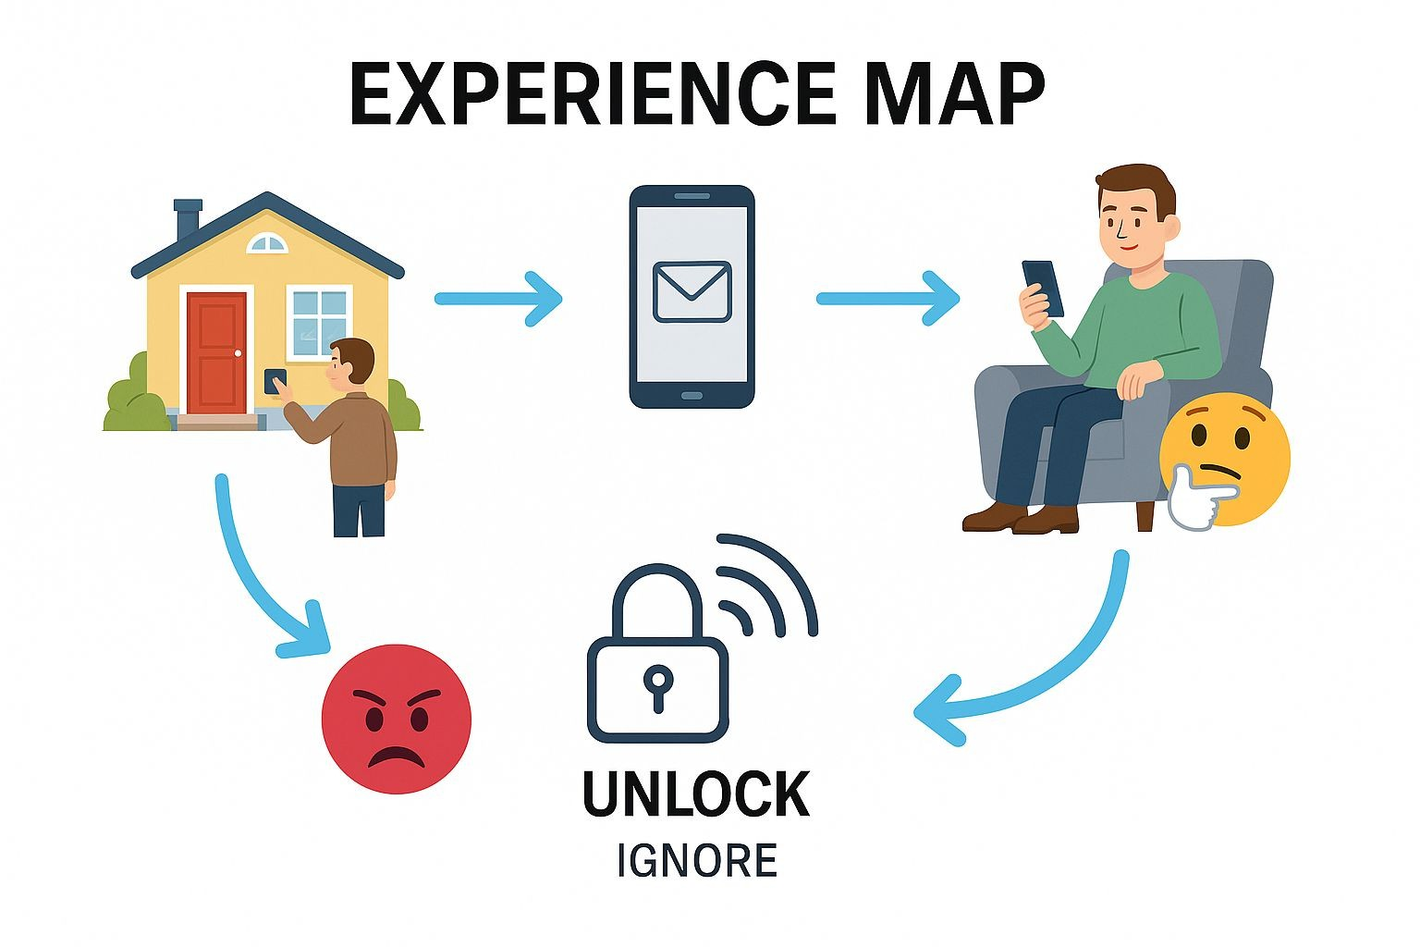

Slide 12
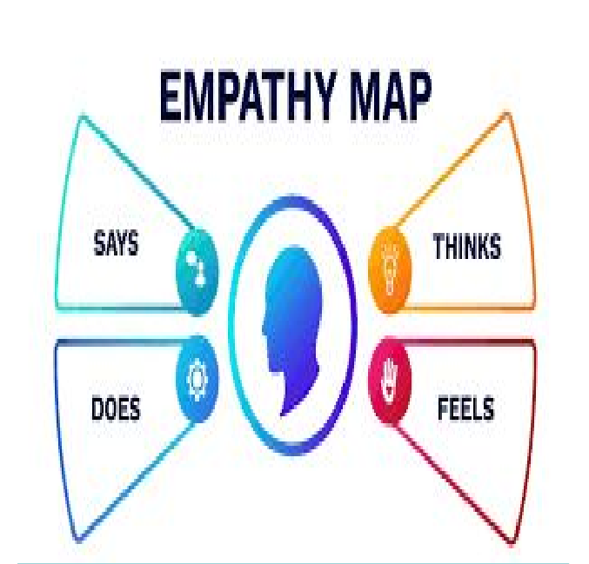
EMPATHY MAP
THINKS
"Is it safe to open the door for this visitor?"
"What if I am not at home and someone important comes?"
"I need an easy way to monitor visitors remotely."
SAYS
"I wish I could see who is at my door without going there."
"I want to avoid opening the door unnecessarily."
"It would be great if I could control the door remotely."

Slide 13
DOES
Rushes to check the door physically.
Sometimes ignores the doorbell when busy or unsure.
Asks neighbors to keep an eye on their house when away.
FEELS
Worried about safety and theft.
Frustrated when missing important visitors.
Relieved when seeing a familiar person before opening the door.

Slide 14
PAIN POINTS
Unable to identify visitors without opening the door.
Risk of allowing strangers unknowingly.
Missing important deliveries or guests when not at home.
No real-time notifications or monitoring options in traditional doorbells.
Feeling unsafe and anxious, especially when alone.
No remote control to unlock the door securely.
Difficulty managing visitors during travel or office hours.
Lack of affordable and easy-to-use smart door security solutions.

Slide 15
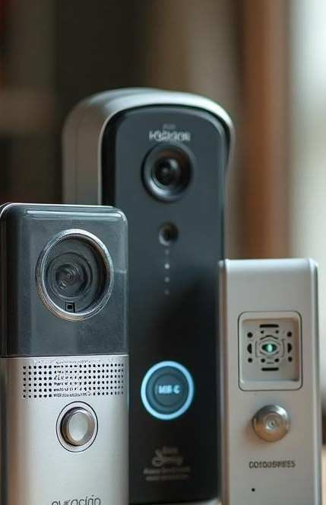
Needs
Need a safe way to verify who is at the door before opening.
Need real-time alerts when someone rings the bell.
Need an easy-to-use system that anyone can operate.
Need a remote door control option (lock/unlock).
Need clear visitor images for better decision-making.
Need an affordable and reliable smart security system.

Slide 16
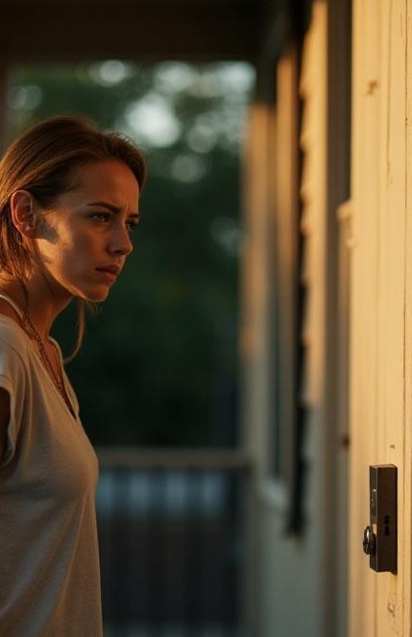
Expectations
Expect to monitor visitors from anywhere using a mobile app.
Expect fast and accurate notifications without delay.
.
Expect the system to be secure and tamper-proof.
Expect the device to be easy to install and user-friendly.
Expect integration with Wi-Fi for seamless operation.
Expect minimal maintenance after installation.

Slide 17
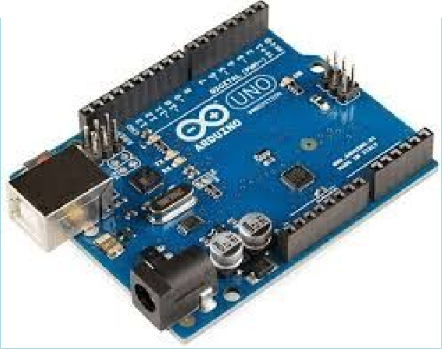
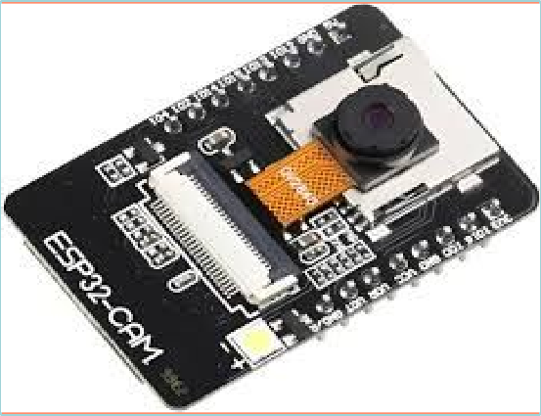
COMPONENTS
Arduino Uno
Acts as the main controller to manage inputs (push button) and outputs (solenoid lock, buzzer).
ESP32-CAM with Wi-Fi Module
Captures live images/video of visitors and sends them to the mobile app through Wi-Fi.

Slide 18
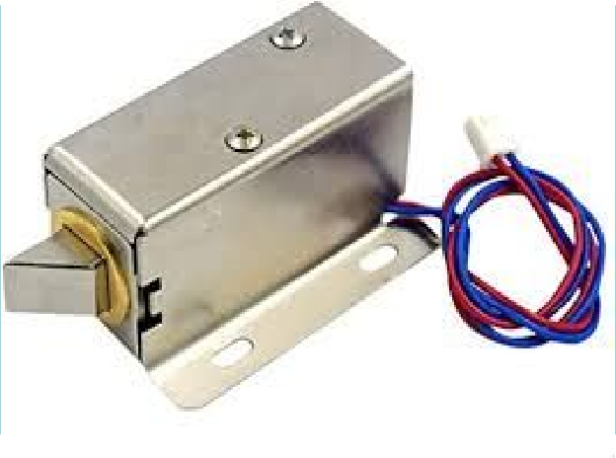
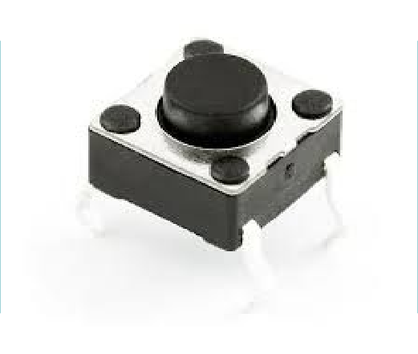
Solenoid Lock
Provides an electronic locking system that can be remotely controlled for door access.
Push Button
Used by visitors to ring the smart doorbell, triggering notifications.

Slide 19
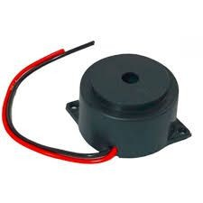
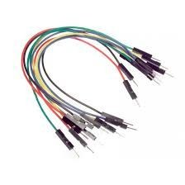

Jumper Wires
Connect all the electronic components easily and reliably.
Buzzer
Produces an audible alert whenever the doorbell button is pressed.
Blynk App
Mobile app interface for users to receive alerts, view visitors, and control the door remotely.

Slide 20
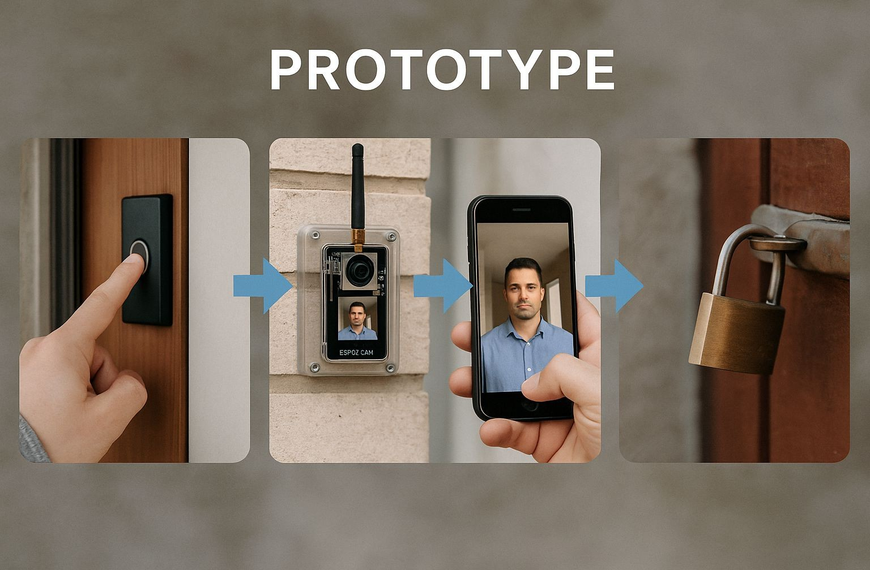

Slide 21

CONCLUSION
Our Smart Doorbell project redefines home security by combining real-time visitor monitoring, remote access, and instant notifications through an affordable and easy-to-use system.
Using Arduino Uno, ESP32-CAM, solenoid lock,
and the Blynk app, we provide a smart, safe, and convenient way to manage visitors from anywhere. This solution overcomes the limitations of traditional doorbells and offers users greater control, confidence, and peace of mind.

Slide 22


