Slide 1
DESIGN THINKING AND INNOVATION
PRESENTED BY:
ADAPA DIVYASRI 23KD1A0201
ANUMANTHU RAHUL 23KD1A0204
ALLURI HARSHINI 23KD1A0202
BANDA VEERENDRA HANSHITH 24KD5A0203
CHANDAKA SIDDU 23KD1A0223

Slide 2
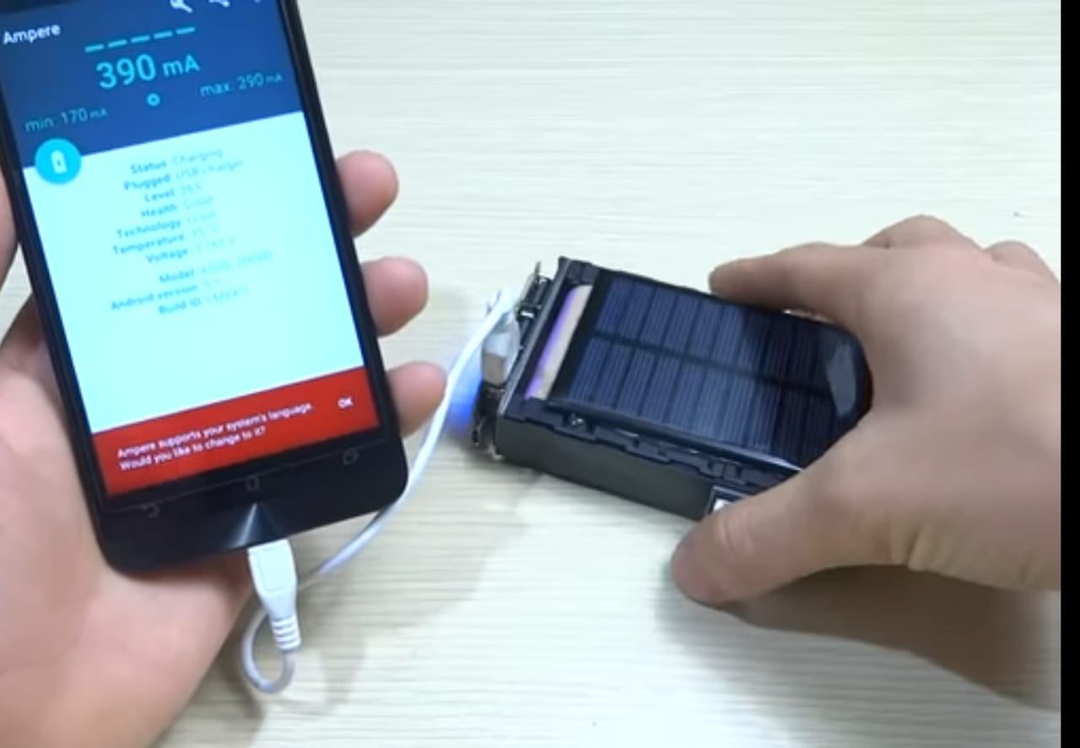
Harness the sun:
solar power bank
UNDER THE GUIDENCE OF: Mr.B.Ram Vara Prasad,(Ph.D)
Assistant professor,
Department of EEE,
LIET (A).

Slide 3
CONTENTS
INTRODUCTION TO DESIGN THINKING
PROBLEM STATEMENT
EMPATHY
DEFINE
IDEATE
PROTOTYPE
CONCLUSION

Slide 4
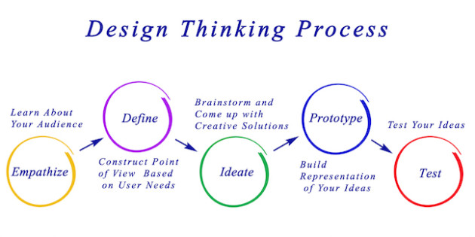

Design thinking and innovation:Design Thinking and Innovation is a creative process that focuses on understanding people’s needs, generating new ideas, and building useful solutions. It helps in creating new products, services, or ways of doing things that solve real problems and improve lives.

Slide 5



"People can't charge their phones when there's no electricity, especially while traveling or during power cuts."
"Normal power banks run out of charge and need electricity to recharge, which is not always available."
"People want an affordable and eco-friendly way to charge their devices without depending on electricity."

Slide 6


USER INTERVIEW QUESTIONS
USER RESPONSES
PERSONS
OBSERVATION (SHADOWING)

Slide 7

USER INTERVIEW QUESTIONS
What charging challenges have you faced when you're away from power outlets?
Have you ever considered using a solar power bank for mobile charging?
How often do you find yourself needing to charge your phone while away from a wall outlet?

Slide 8

USER RESPONCES
Yes, I often face charging issues during travel or long outdoor events.
Yes, I’ve considered using a solar power bank, especially for emergencies.
I usually need to charge my phone away from outlets 2–3 times a month.
Sometimes I run out of battery when I’m away from home or during long commutes.
I’ve thought about solar chargers—they’re useful but a bit slow to charge fully.
Mostly when I travel or attend full-day programs, about once or twice a month.
Yes, especially when traveling or in areas with no nearby charging points.
I’ve considered solar power banks as a good backup option during outdoor activities.
Occasionally, especially on busy days or during long trips.

Slide 9

PERSONS
Persona 1: Outdoor Enthusiast - Maya
• Age: 28
• Needs: Portable, reliable power for hiking and camping trips. Prefers eco-friendly devices.
• Pain Points: Solar-only chargers often don’t work well in cloudy conditions.
Persona 3: Rural Resident - Asha
• Age: 45
• Needs: Power backup during frequent power outages at home.
• Pain Points: Limited availability of electricity; difficulty charging devices.
.
Persona 2: Urban Commuter - Rahul
• Age: 35
• Needs: Fast, convenient charging for smartphone and earbuds during daily commute.
• Pain Points: Power banks run out quickly; limited access to charging outlets.

Slide 10


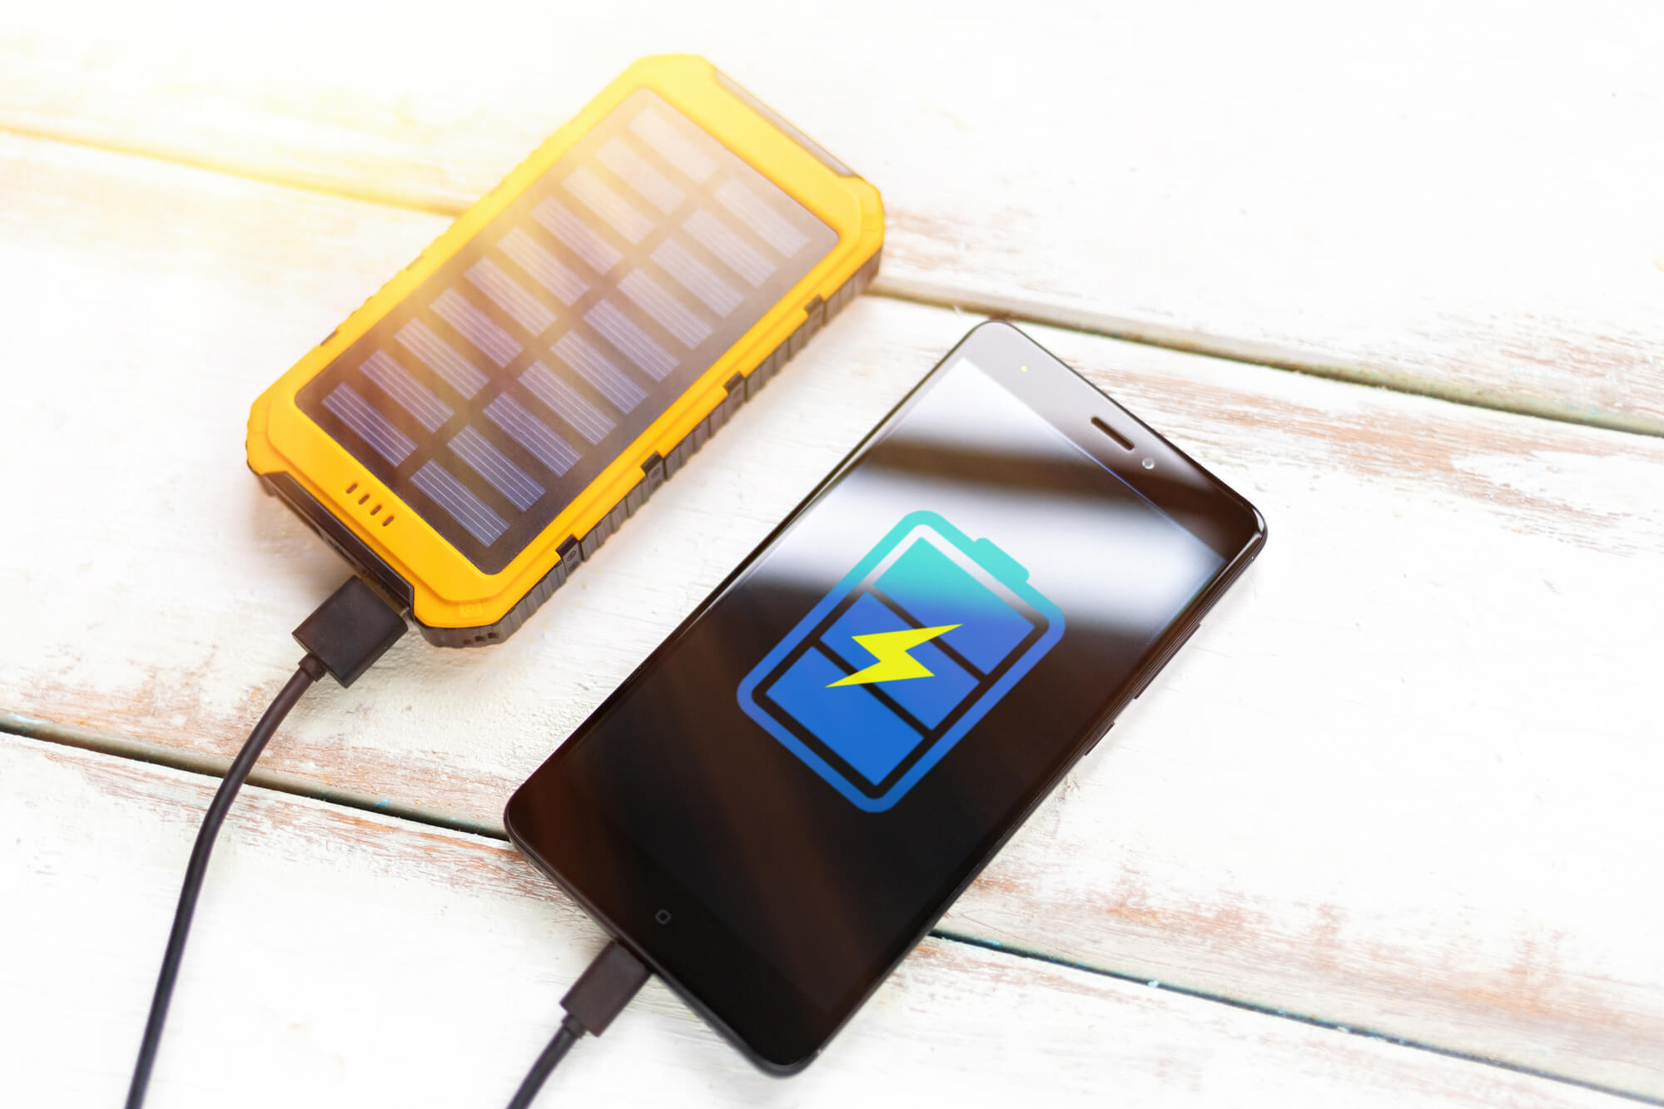
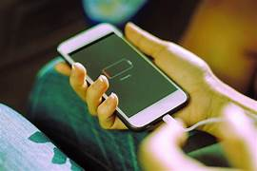
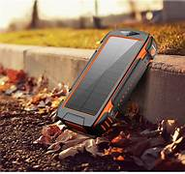
OBSERVING(SHADOWING)

Slide 11
IDEATE
IDEAFLOW
DOT VOTING
STORYBOARD GRID

Slide 12
IDEA FLOW
1. Power Banks
Use a high-capacity (10,000–30,000 mAh) power bank to charge your phone multiple times.
2. Public Transport or Shops with Solar
In some areas, buses, kiosks, or shops may allow charging for a small fee.
3. Invest in a Solar Power Kit
A small home solar setup with a battery can power essentials like phones and lights.
4. Hand-Crank or Pedal Chargers
Use manual chargers like hand-cranks or pedal-powered generators. These generate electricity without needing sunlight or fuel.

Slide 13
DOT VOTING
IDEAS
Power Banks
Public Transport with Solar
Invest in a Solar Power Kit
Pedal Charges
VOTING REPRESENTATIVES:
A.DIVYASRI 23KD1A0201(@)
A.RAHUL 23KD1A0204(#)
A. HARSHINI 23KD1A0202(&)
B.HANSHITH 24KD5A0203($)
CH.SIDDU 23KD1A0223(*)
VOTING
@@@@@
####
&&&&&
$$$
******
@@@@
#
&
$$$$
**
@
###
&&
$$$
***
@@
###
&&&&&
$$
*

Slide 14
STORYBOARD GRID
Amit was on a road trip through the remote hills of Himachal Pradesh. The scenery was breathtaking, but there was no network and no place to charge his phone. By noon, his phone battery was almost dead, and he needed GPS to navigate the winding roads ahead.
Thankfully, he had brought along a solar power bank. He placed it on the dashboard, letting it charge under the strong mountain sun. Within a few hours, it had stored enough power to recharge his phone.
With the phone back on and GPS working, Amit continued his journey without getting lost. That small solar power bank turned out to be a lifesaver, proving how helpful solar energy can be—even in the middle of nowhere.

Slide 15
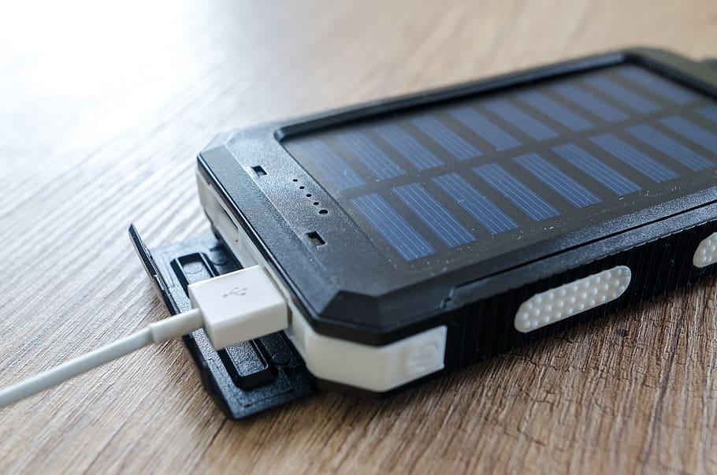
DEFINE
Using a solar power bank :
How might we able to help the smartphone users to charge their mobile while away from power outlets
How might we able to reduce stress on power grid
How might we able to increase the usage of solar power than traditional power

Slide 16
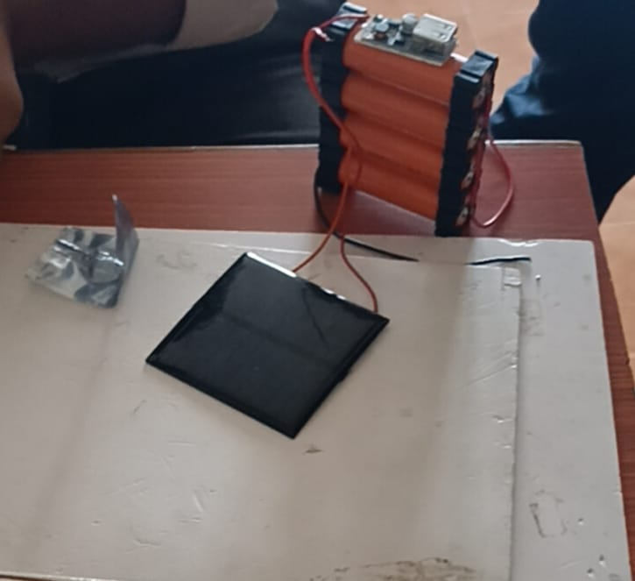
PROTOTYPE
USB POWER MODULE
LI -ION BATTERIES
BATTERY HOLDERS
SOLAR PANEL

Slide 17
CONCLUSION
In conclusion, the solar power bank represents a practical and sustainable solution for mobile device charging, especially in situations where access to traditional power sources is limited or unreliable. By harnessing renewable solar energy, it offers users an eco-friendly and portable option for staying connected while reducing dependence on electricity grids.
Throughout this project, we explored the design, functionality, and user needs surrounding solar power banks. Key insights include the importance of balancing solar panel efficiency with portability, enhancing charging speed, and increasing user awareness about realistic performance expectations.
As mobile usage continues to rise globally, particularly in outdoor and off-grid environments, solar power banks have the potential to become a more integral part of everyday life. Future development should focus on smarter energy management, rugged and user-centric design, and educational efforts to promote responsible usage.

Slide 18
