Slide 1

Design Thinking and Innovation
Presented by:
G. Hyma _23KD1A0234
M. Kavya Sri_23KD1A0261
Ch. Praveen _23KD1A0227
k. Rohith _24KD5A0208

Slide 2

Smart Water Leakage Detector using IoT
UNDER THE GUIDENCE OF:
Mr. B. Ram Vara Prasad,[Ph.D]
Assistant Professor,
Dept. of EEE, LIET(A)

Slide 3

Contents
Introduction to Design Thinking
Problem Statement
Empathy
Define
Ideate
Storyboarding
Prototype
Prototype Explanation
Conclusion

Slide 4
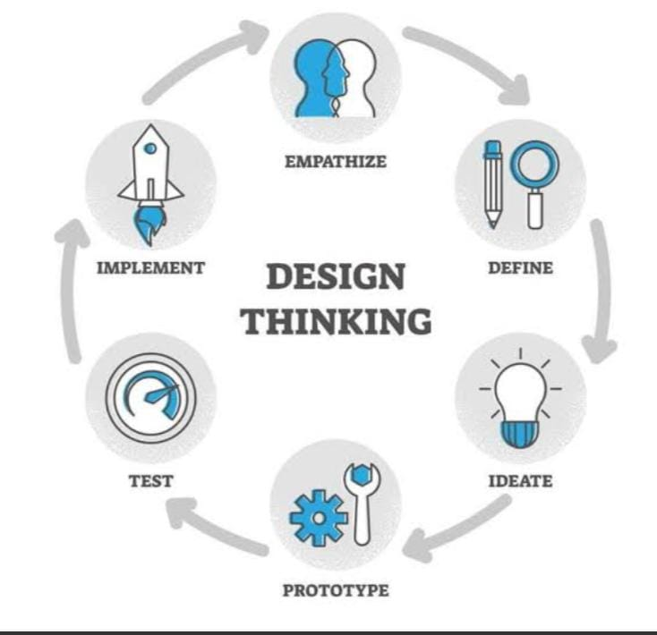
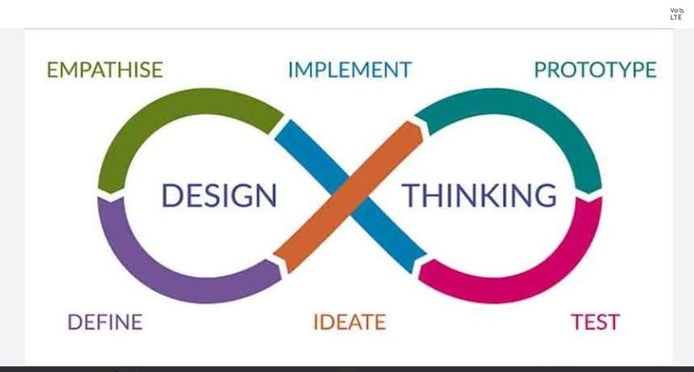

Slide 5

Introduction to Design Thinking
Human-centered
Focus on real user needs
Iterative process
Empathy, experimentation, collaboration
Proven success
Used by IDEO, Google, Apple
Academic roots
Stanford d.school leads research

Slide 6

Problem Statement: Water Leakage
Water loss
20-30% of treated water wasted (AWWA)
Damage
Property damage, mold, costly repairs
Current solutions
Mostly reactive and localized fixes
Economic impact
$13B spent yearly on damage restoration (US)

Slide 7

Empathy: Understanding User Needs
Goals
Research
Early leak detection
Interviews with homeowners, plumbers
Remote monitoring via app
Key pain: undetected leaks, high costs
Reduce repair expenses
70% unaware of hidden leaks

Slide 8




Define: Smart Water Leakage Detector
Sensors
Alerts
Integrations
Moisture, flow, pressure, sound detection
Notifications via app, SMS, email
Works with Nest, SmartThings systems

Slide 9
🗣️ INTERVIEW QUESTIONS ❓
1
What inspired the smart water leakage detector idea?
2
How did you identify key user needs and pain points?
3
What insights arose from the empathy research?
4
How were core features and functionality chosen?
5
What challenges came up during prototyping and testing?
6
How does the IoT connectivity and alert system operate?
7
What are the next steps to refine the detector?

Slide 10
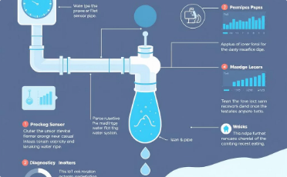
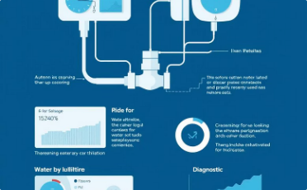
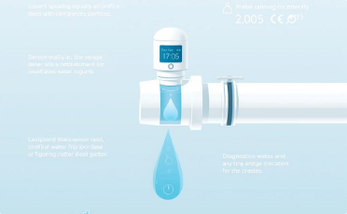
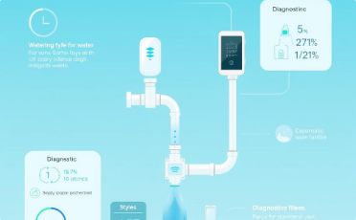
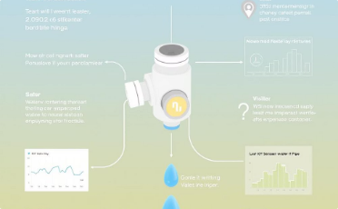
Key Insights on Water Leakage Detection
Investigating root causes of water leakage using IoT smart detection.
Undetected leaks cause property damage, mold, and high utility bills.
Understanding user frustrations is vital for effective solutions.
IoT sensors offer early alerts for faster response and less damage.
Prototyping enables validation and feedback for design improvement.

Slide 11




Ideate & Storyboarding
Brainstorm sensors
Moisture, pressure, sound technologies
Alert mechanisms
Push notifications, SMS, email
Storyboard
Pressure drop triggers alert, user checks app

Slide 12

1.Why did water damage occur?
2.Why do we need a water leakage detection system?
3.Why should buildings invest in this technology?
4.Why is water conservation important today?
5.Why is real-time detection important?

Slide 13
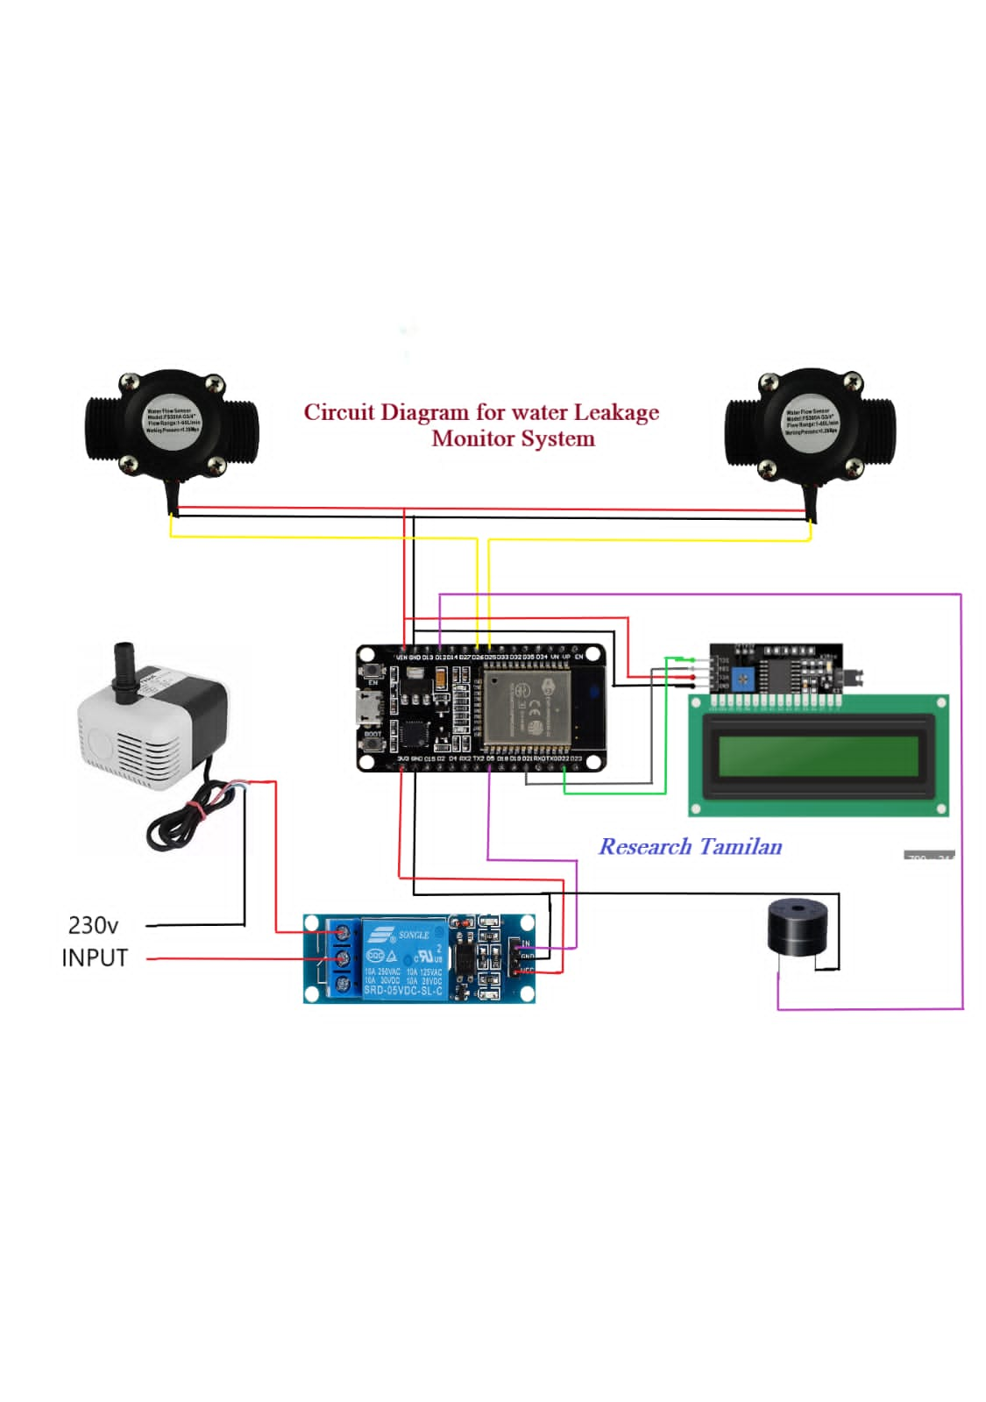
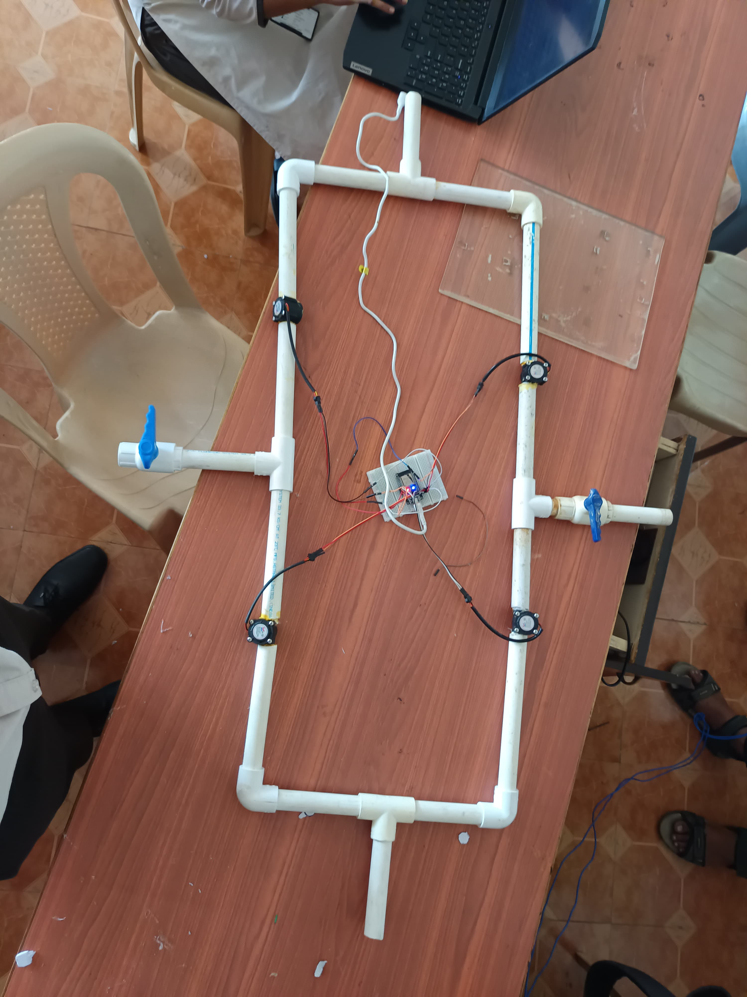
Circuit diagram
Prototype

Slide 14
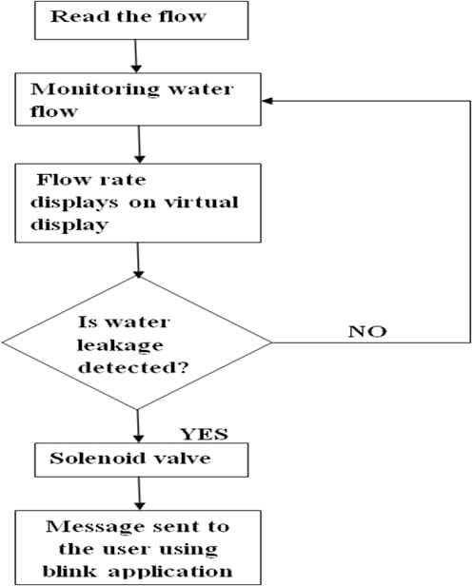
Prototype & Explanation
Hardware
Software
Key benefits
esp 32
c ++ code
Real-time data
Water flow sensors
AWS IoT platform
ML pattern recognition
Mobile app
Cost-effective

Slide 15
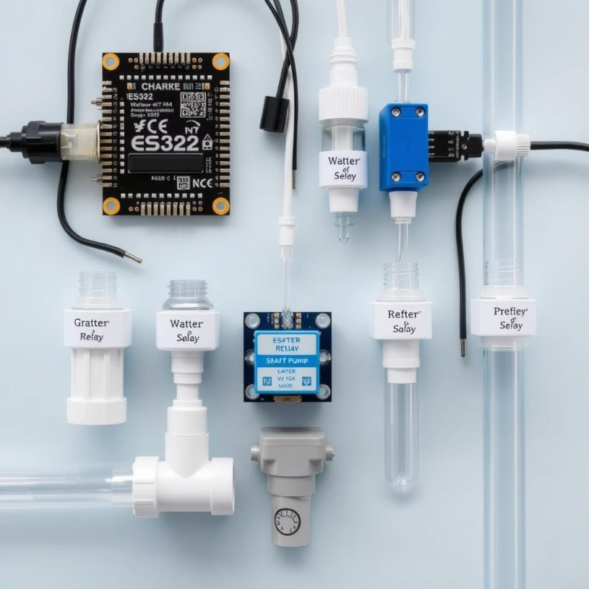
This system uses an ESP32 microcontroller as the brain, which connects to water flow sensors that monitor water usage in real-time.
A relay module controls the water pump, turning it on/off based on programmed conditions.
Water pipes connect the components in a physical flow system.
The ESP32 provides wireless connectivity .

Slide 16
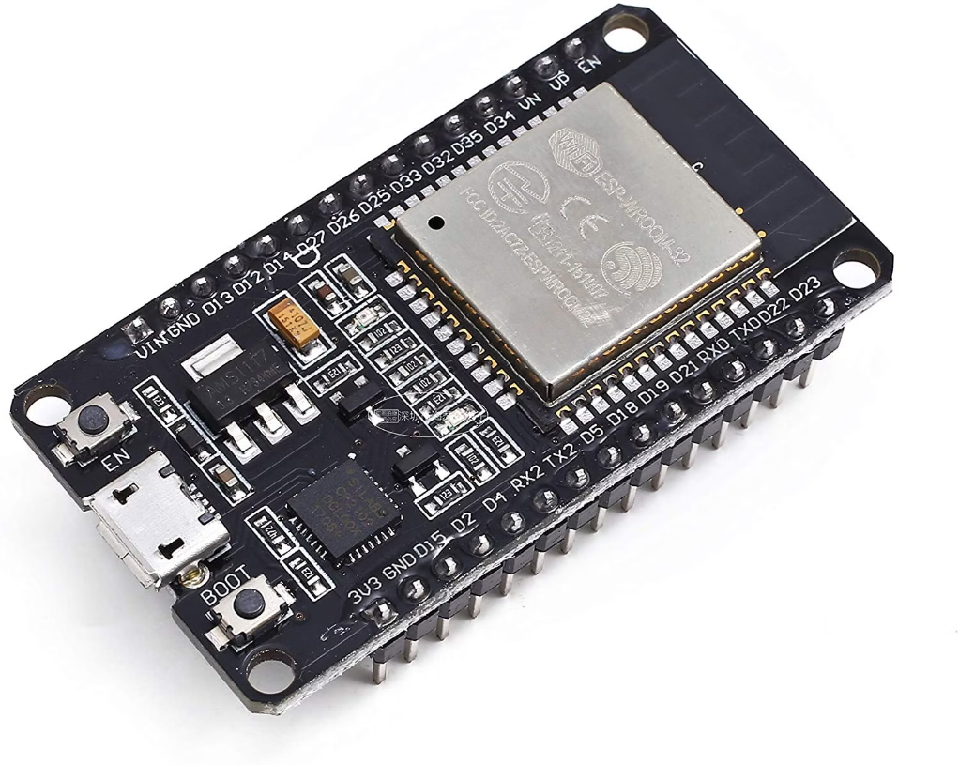
ESP32 is a low-cost System on Chip (SoC) Microcontroller from Espressif Systems, the developers of the famous ESP8266 SoC.
It is a successor to ESP8266 SoC and comes in both single-core and dual-core variations of the Tensilica’s 32-bit Xtensa LX6 Microprocessor with integrated Wi-Fi and Bluetooth.

Slide 17
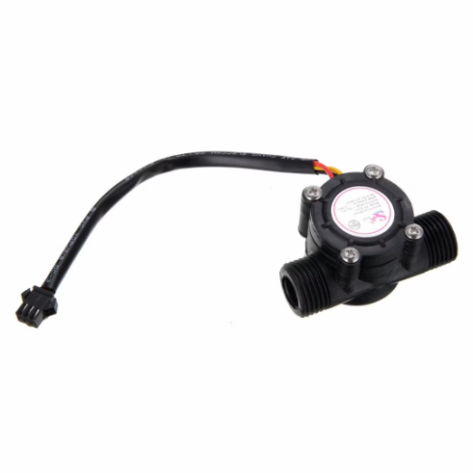
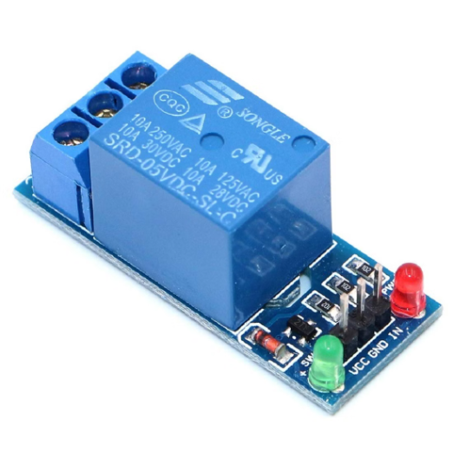
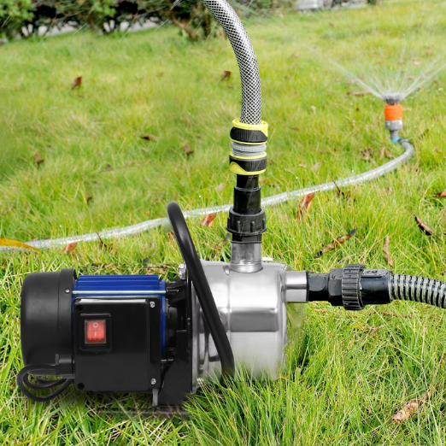
Relay module
Watering pump
Water flow sensor

Slide 18

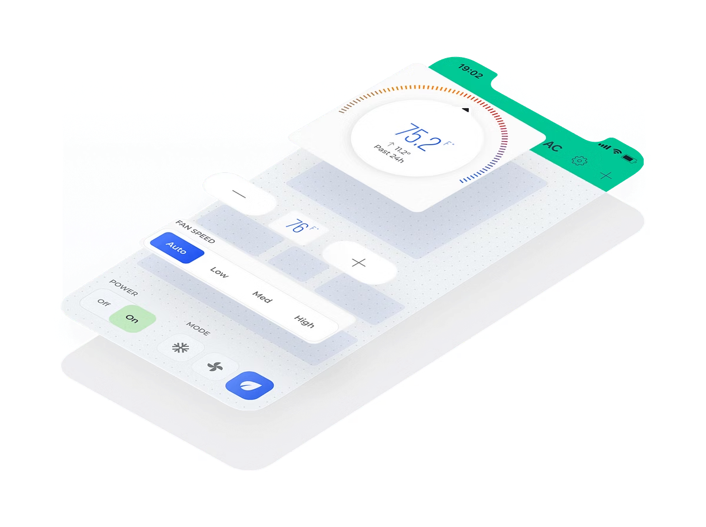

Slide 19
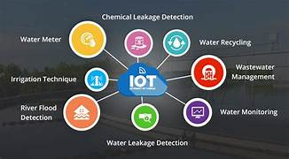
Project Applications :
Used in residential ,commericial and industrial buildings
Prevents water leakage and reduces damage to infrastructure
Remote monitoring using IOT alerts

Slide 20

Conclusion
Real-time monitoring
Damage prevention
Detects leaks early, prevents losses
Saves property and reduces bills
Future scope
Auto shut-off valves
Smart home integration

Slide 21


