Slide 1

DESIGN THINKING
AND
INNOVATION:
Presented by:
G.Tarun sai (23KD1A0237)
G.Vaikunta vasu (23KD1A0242)
B.Bhanu Prakash (23KD1A0207)
B.Varshitha (23KD1A0208)

Slide 2
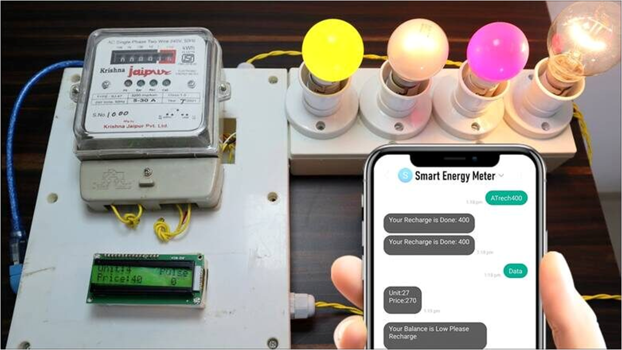
Smart Energy
Meter
__________________________
UNDER THE GUIDENCE OF:
Mr.B.Rama vara prasad,
(ph.Assistatant professor,
Department of EEE,LIET)

Slide 3
What is Design Thinking
Design Thinking is a user-focused problem-solving method that helps create innovative and practical solutions.
5 Stages of Design Thinking:
1. Empathize – Understand the user's needs
2. Define – Identify the real problem
3. Ideate – Brainstorm creative solutions
4. Prototype – Build a simple model
5. Test – Try the solution and improve it

Slide 4
> Introduction to Design Thinking
> Problem Statement
> Empathy
> Definition of Smart Meter
> Components Used
> History of Energy Meter
> Circuit Diagram
> Advantages of Smart Meter
> Graph and conclusion
SMART ENERGY METER
Contents :

Slide 5
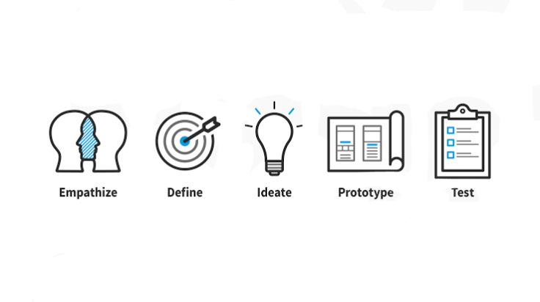
Design thinking and Innovation

Slide 6
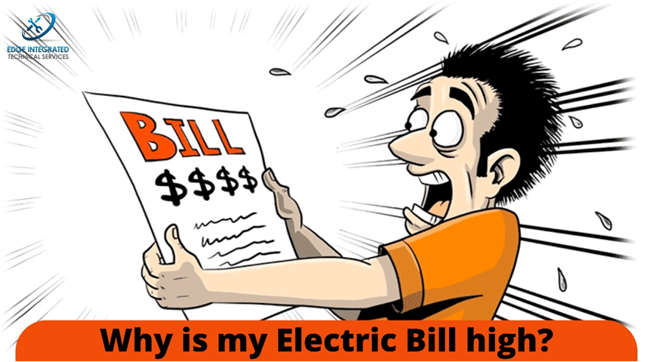
Problem statement
In our daily lifeTraditional meters don’t show real time usage, so users can’t easily track or manage their energy consumption.
Manual readings can be inconvenient, inaccurate,
or delayed
Traditional meters don’t show whether energy-saving actions are effective.
Limited Transparency and Engagement Users feel disconnected from how and when they use energy.

Slide 7
Empathy
1.Understanding Users
Before designing the meter or its interface, empathize with different user groups:
Homeowners may want clear insights into energy usage to reduce bills.
Tenants might care about transparency and control, especially in shared housing.
3.Empathy-Inspired Design Decisions
Empathy can lead to meaningful innovations,
such as, A mobile app that translates data
into simple visuals and tips.
Voice assistant integration for elderly users.
Color-coded displays (green/yellow/red) to
show current usage levels.
2. Key Insights from Empathy
Through empathy-driven research, you might discover:
People are anxious about high bills but don’t understand
energy patterns.
Many find current meters hard to read or inaccessible (e.g., in dark basements).
Some users want alerts when usage spikes unexpectedly.

Slide 8
DEFINE
Define
Problem Statement:
People need an easy and accurate way to monitor their electricity usage in real-time so they can reduce bills and save energy
Problem Statement:
People need an easy and accurate way to monitor their electricity usage in real-time so they can reduce bills and save energy

Slide 9
IDEATE
->Use sensors to measure current and voltage.
->Show real-time power data on an LCD.
->Add ESP32 to process and send data (IoT).
->Give alerts if usage crosses a set limit.
->Design it to be low-cost and user-friendly

Slide 10
Proposed solution
We propose a Smart Energy Meter system that can measure real-time voltage, current, and power consumption using sensors. The system uses an ESP32 microcontroller to read the sensor data and display the output on an LCD screen.
This solution will:
->Help users monitor energy usage in real-time.
->Alert users when power usage exceeds a set limit.
->Be low-cost, compact, and easy to install.
->Be useful for homes, small shops etc..

Slide 11
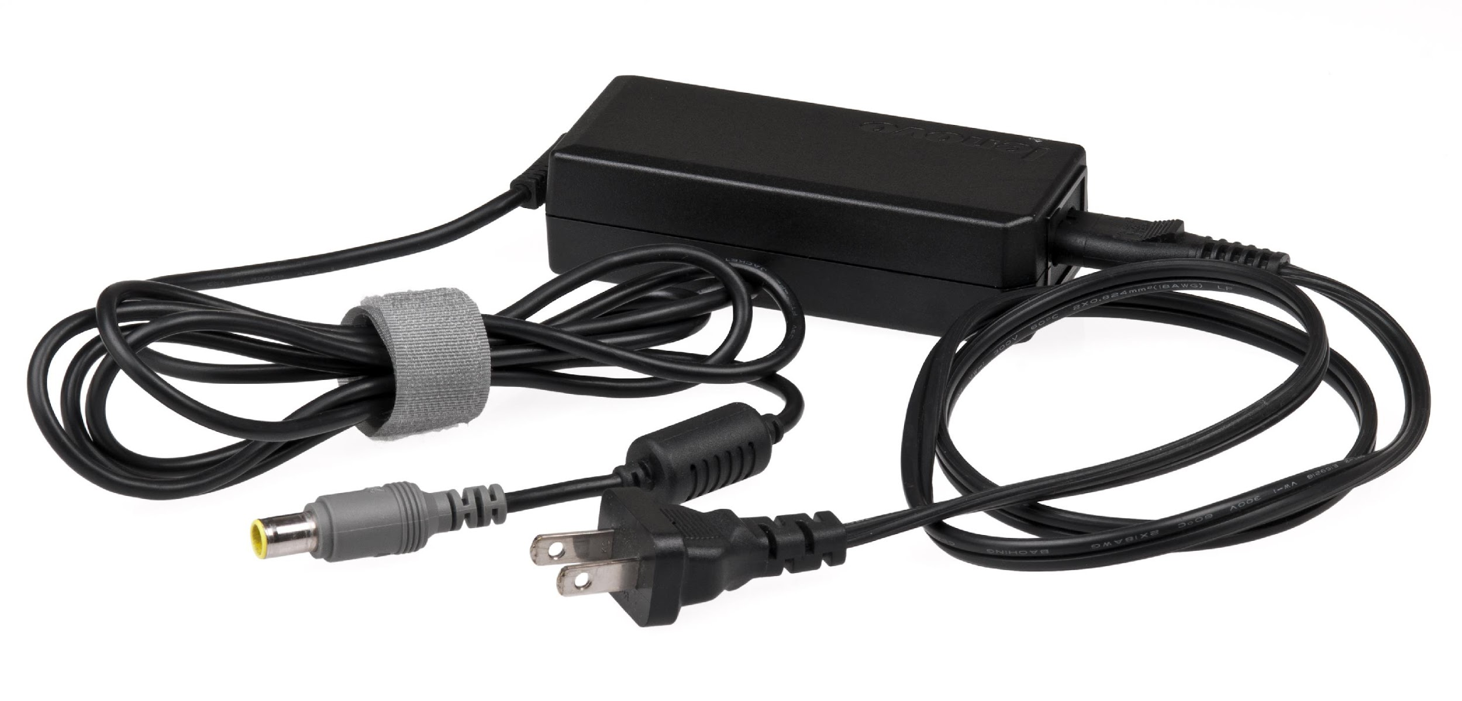
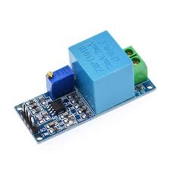
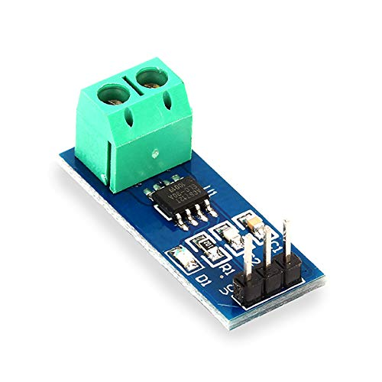
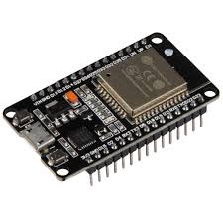
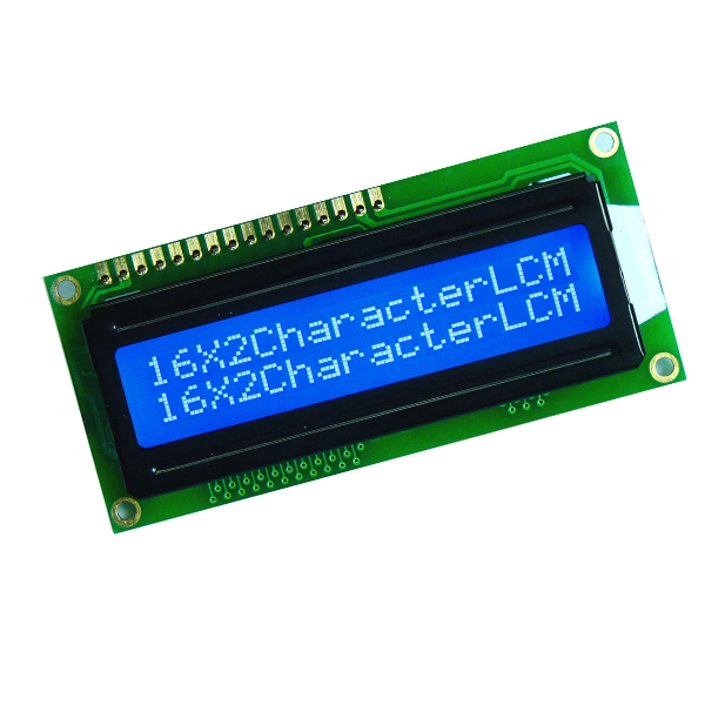
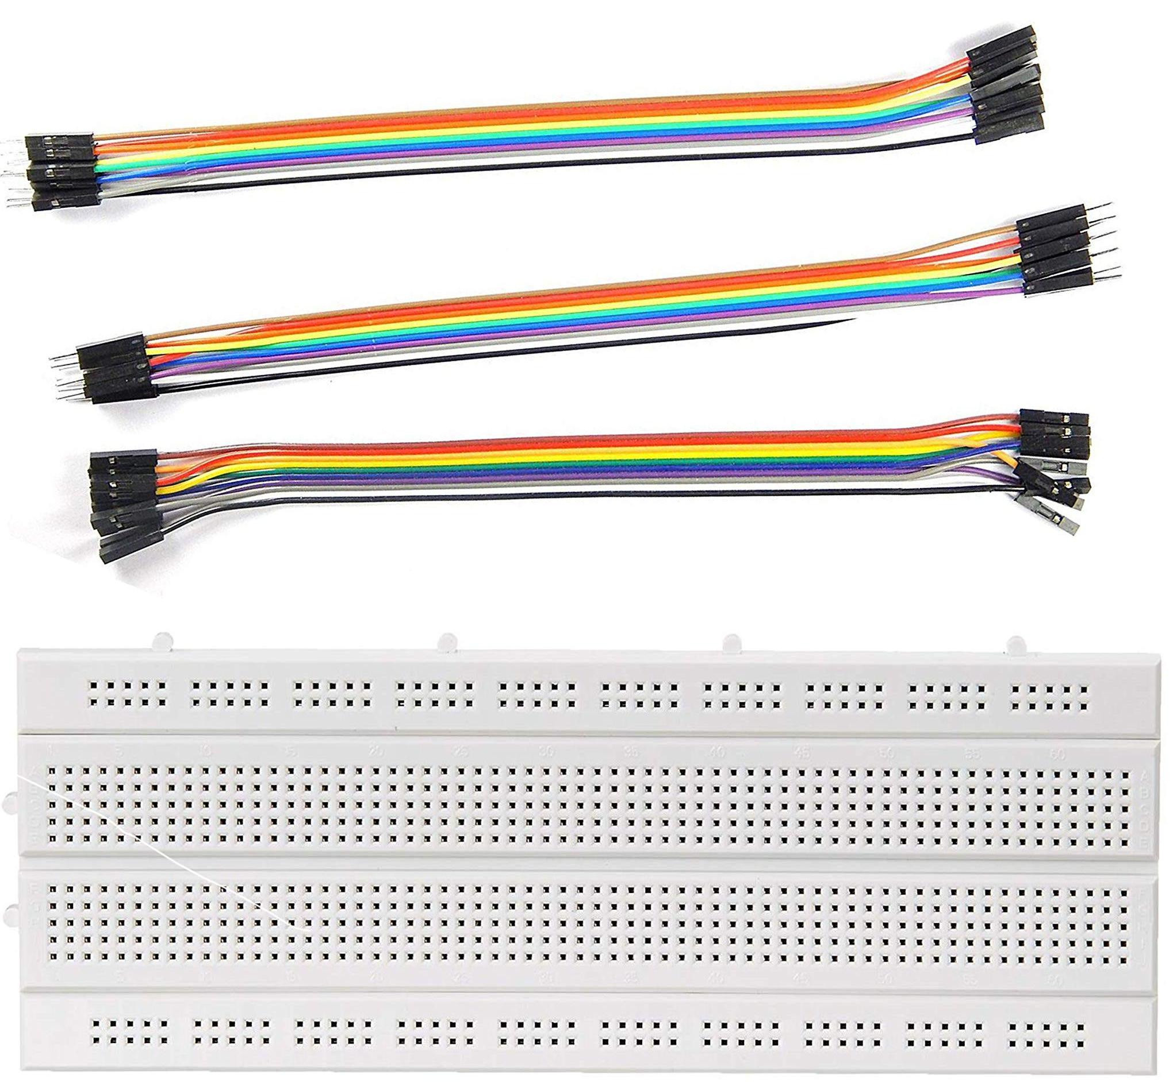
Components Used :
power supply (5v) adapter
voltage sensor (ZMPT101B)
current sensor (ACS712)
Node MCU(ESP 32)
LCD Display
wires and bread board

Slide 12
DESCRIPTION :
ESP-32
->A Wi-Fi-enabled microcontroller that reads sensor data, calculates power, and controls the display.
ACS712(Current Sensor)
->Measures the amount of current flowing through the load.
ZMPT101B(Voltage Sensor)
->Measures the AC voltage from the power source.
16X2 LED Display
->Displays voltage, current, and power readings in real-time.
Breadboard and Jumper Wires
->Used to make temporary connections between all components.
Power Adapter(5V)
->Supplies power to the ESP32 and sensors

Slide 13
Working Principle
The system uses two sensors:
->ACS712 to measure current
->ZMPT101B to measure voltage
Both sensors send signals to the ESP32 microcontroller
->ESP32 calculates power using:
Power = Voltage × Current
->The result is shown on an LCD screen in real-time
->Helps users track electricity usage and avoid over-consumption

Slide 14
KEY BENEFITS
LIMITATIONS
->Monitors power usage in real-time
->Helps reduce electricity bills
->Compact and low-cost design
->Easy to set up and use
->Can be upgraded with Wi-Fi for IoT features
->Accuracy depends on sensor calibration
->Requires careful handling of AC voltage (for safety)
->Limited features without IoT/mobile app integration
->Not suitable for high industrial loads

Slide 15
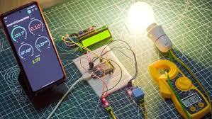
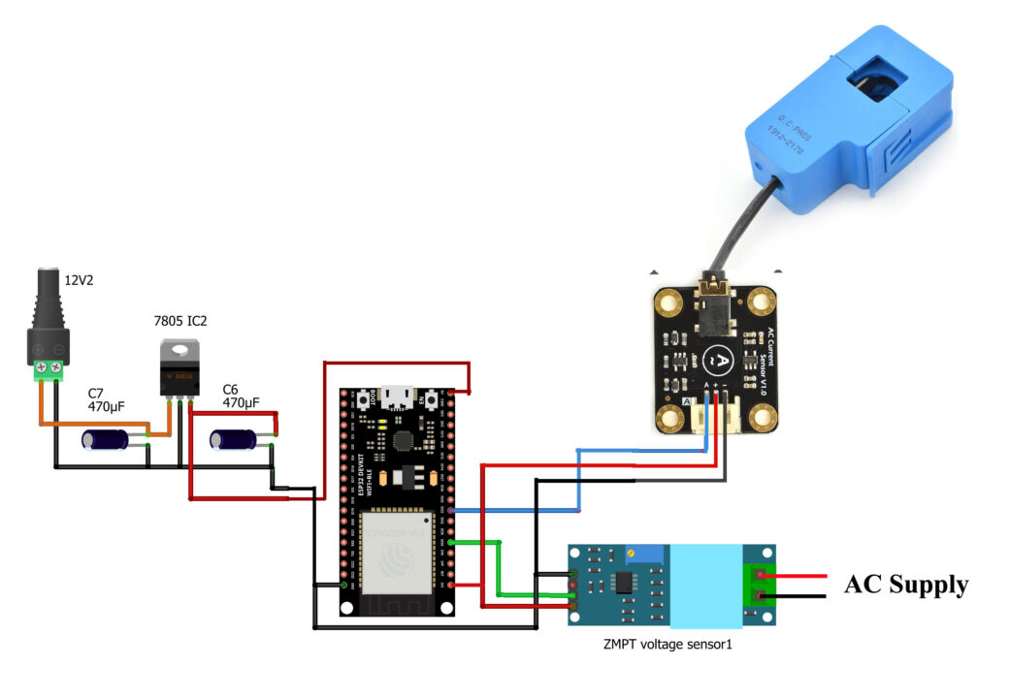
Prototype
Circuit diagram

Slide 16
Survey Questions
1. Do you currently monitor your electricity usage daily?
Yes / No
2. Have you ever received an unexpectedly high electricity bill?
Yes / No
3. Would you find it useful to see real-time power consumption?
Very useful / Somewhat useful / Not useful
4. Are you aware of how much power each of your appliances consumes?
Yes / No / Not Sure
5. Would a device that shows live energy usage help you reduce your electricity bill?
Yes / Maybe / No
Less than ₹500 / ₹500–₹1000 / More than ₹1000
7. Would you prefer the device to send data to your mobile phone?
Yes / No / Doesn’t matter
8. Would you be interested in receiving alerts when power usage is too high?
Yes / Maybe / No
9. Do you think a smart energy meter is useful for your home or shop?
Yes / No
10. Any suggestions or features you'd like in such a device?
6. How much would you be willing to spend on a smart energy monitoring device?
Less than ₹500 / ₹500–₹1000 / More than ₹1000
7. Would you prefer the device to send data to your mobile phone?
Yes / No / Doesn’t matter
8. Would you be interested in receiving alerts when power usage is too high?
Yes / Maybe / No
9. Do you think a smart energy meter is useful for your home or shop?
Yes / No
10. Any suggestions or features you'd like in such a device?

Slide 17
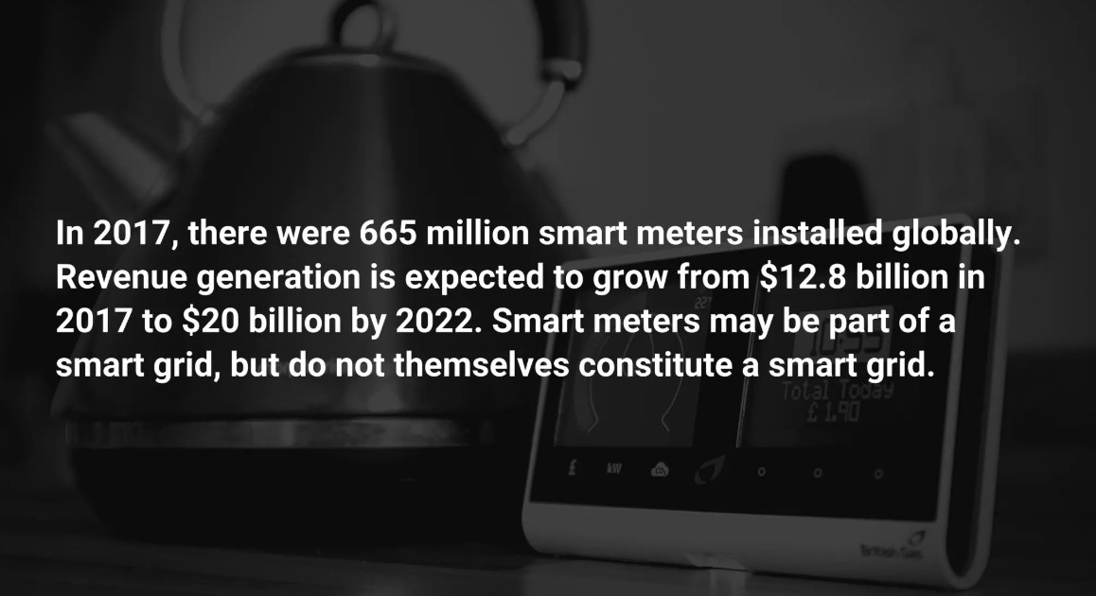

Slide 18
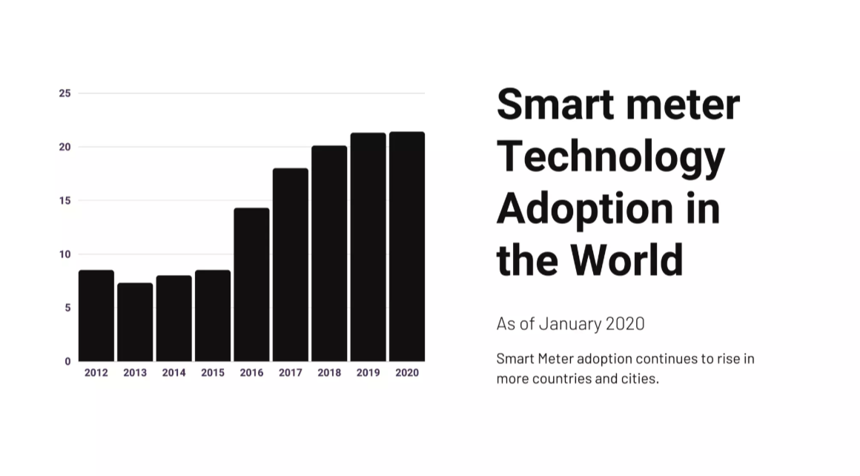

Slide 19
Conclusion:
The Smart Energy Meter is a simple, cost-effective solution for monitoring electricity usage in real-time. By using sensors and a microcontroller, it helps users become more aware of their energy consumption and encourages better power management.
This project not only supports energy saving at the individual level but also contributes to a smarter and more efficient future. With further upgrades, such as mobile app integration, the system can become even more powerful and user-friendly.
"This project is a step toward digital energy management for every home."

Slide 20



Slide 21


