Slide 1

DESIGN THINKING &INNOVATION
PRESENTED BY:
G.HYMA - 23KD1A0234
M.KAVYASRI-23KD1A0261
CH.PRAVEEN-23KD1A0227
D.ROHITH - 24KD5A0208

Slide 2
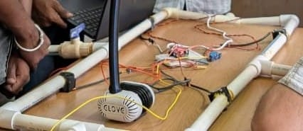
SMART WATER LEAKAGE DETECTOR SYSTEM USING IOT
UNDER THE GUIDENCE OF
Mr. B. Ram Vara Prasad,(P.h.D)
Assistant professor,
Department of EEE,
LIET (A).

Slide 3

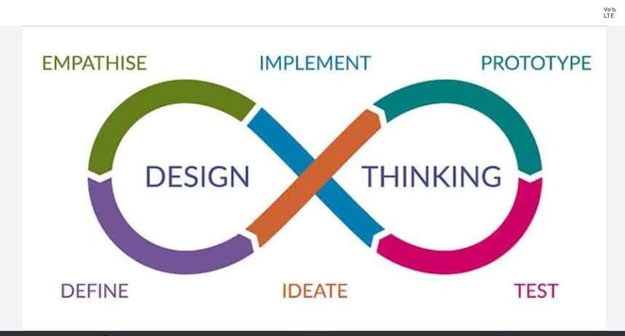
Steps:

Slide 4
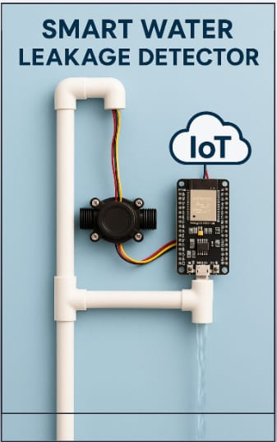
Contents:
INTRODUCTION TO DESIGN THINKING
PROBLEM STATEMENT
EMPATHY
DEFINE
IDEATE

Slide 5

PROBLEM STATEMENT : Water leakage in pipelines leads to wastage, increased costs, and potential damage. Traditional detection methods are inefficient and slow. This project proposes an IoT-based smart water leakage detection system that monitors pipelines in real-time, detects leaks quickly, and sends immediate alerts, helping to reduce water loss and repair costs.

Slide 6
EMPATHY
WHY IS WATER BEING WASTED?
WHY AREN’T LEAKS DETECTED EARLY?
WHY IS THERE NO MONITORING SYSTEM?
WHY IS THERE NO AFFORDABLE SOLUTIONS ?
WHY AREN’T SIMPLER SOLUTIONS IMPLEMENTED?

Slide 7
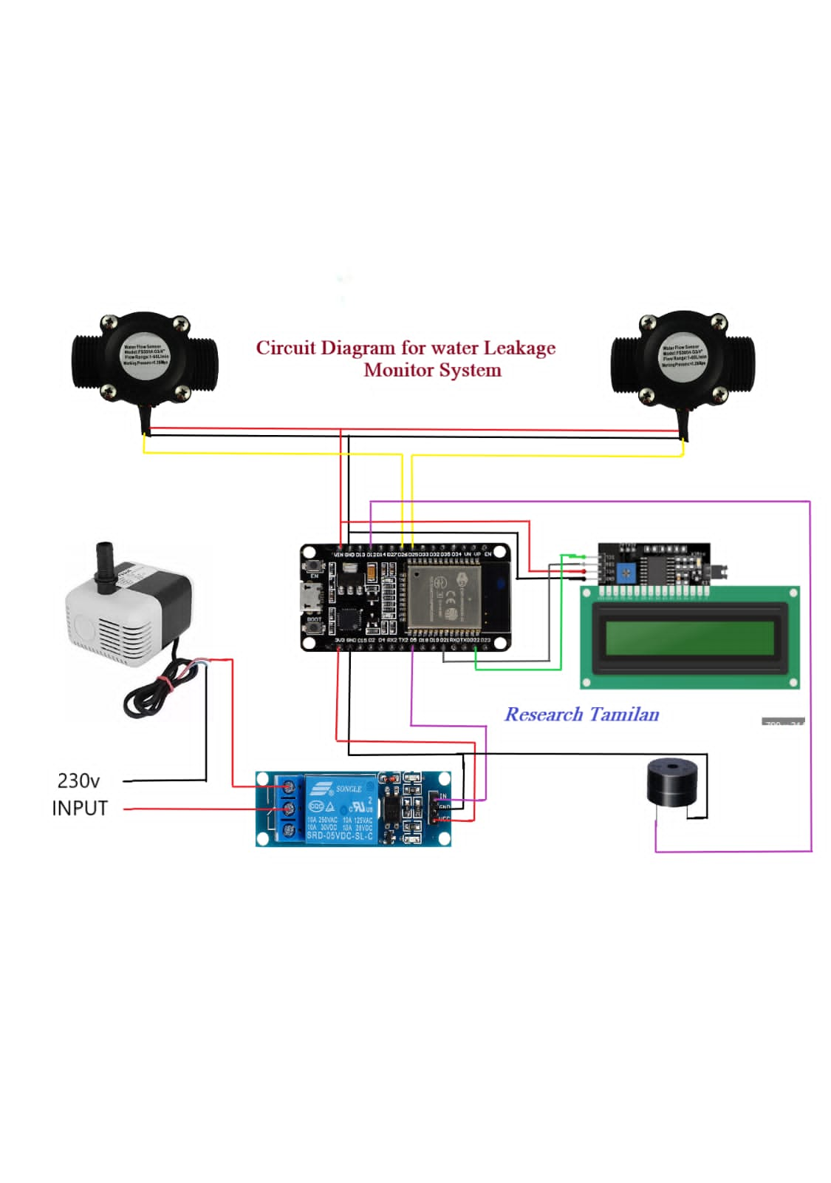
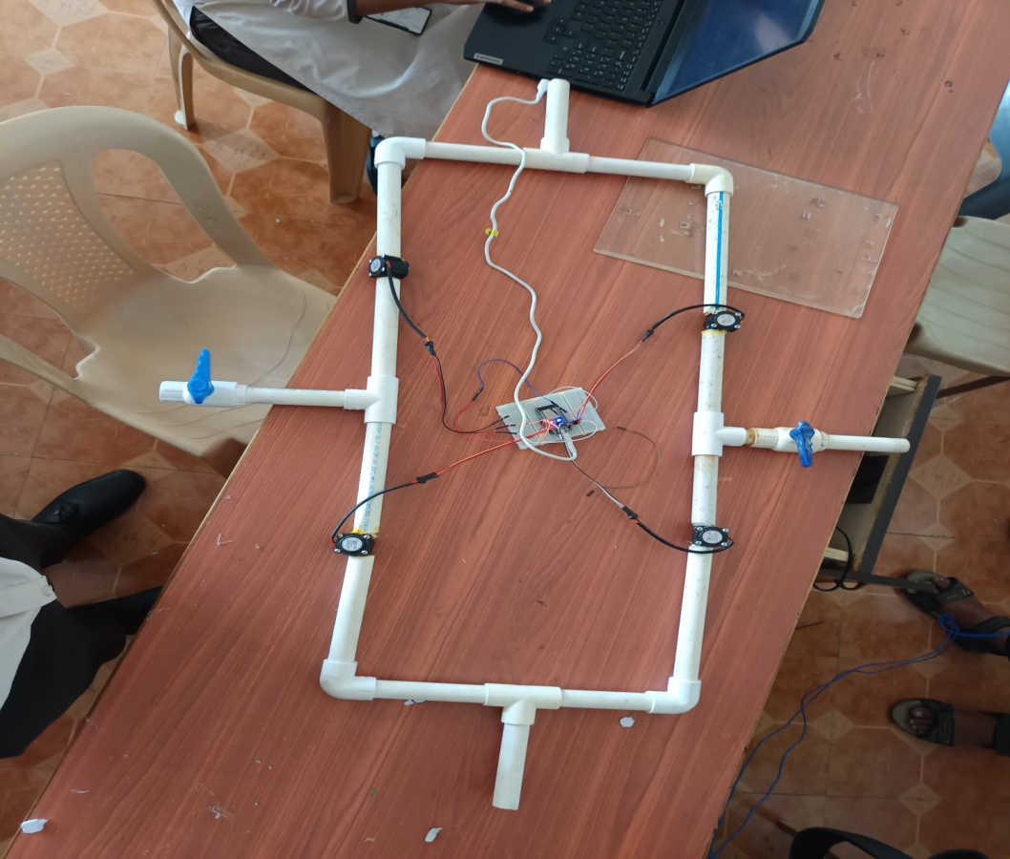
Fig:1: circuit diagram
Fig:2: hardware

Slide 8
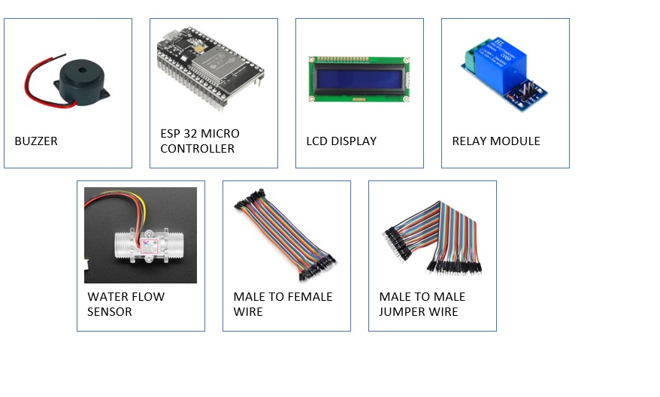
Components:

Slide 9
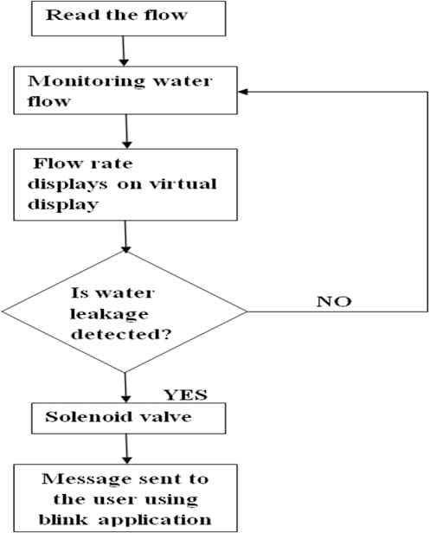
TECHNOLOGY USED:
Cloud computing
Microcontrollers
Mobile app/web interface
IOT users

Slide 10
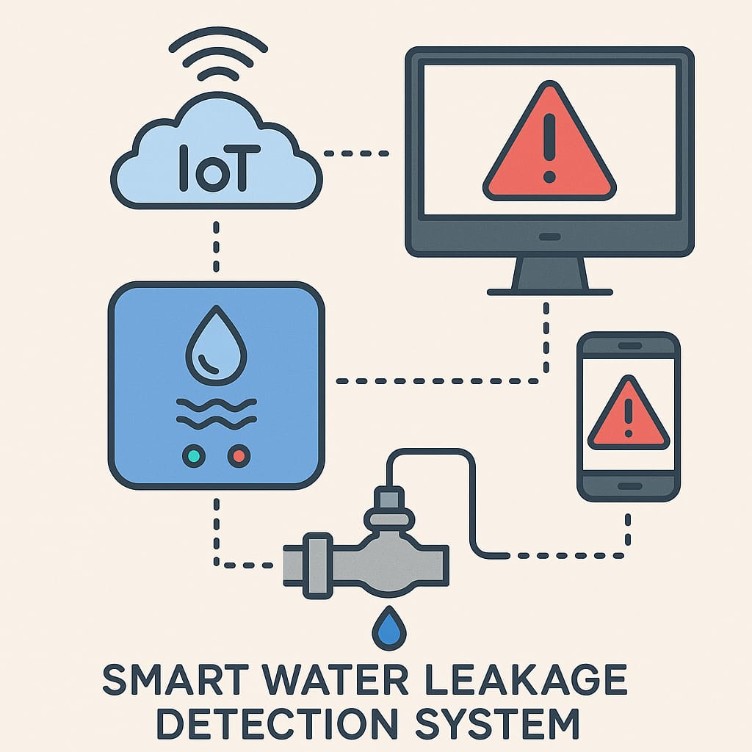
Project Applications:
Used in residential ,commericial and industrial buildings
Prevents water leakage and reduces damage to infrastructure
Remote monitoring using IOT alerts

Slide 11
Conclusion:
A smart water leakage detection system using IoT can reduce wastage, prevent damage, and save money. Future enhancements can include auto shutoff valves and AI-based predictive maintenance.

Slide 12


