Slide 1
Design thinking and innovation
Presented by
Ch Hemalatha (23KD1A0224)
G poornima (23KD1A0235)
Ch prasad(23KD1A0221)
B venu (23KD1A0209)

Slide 2
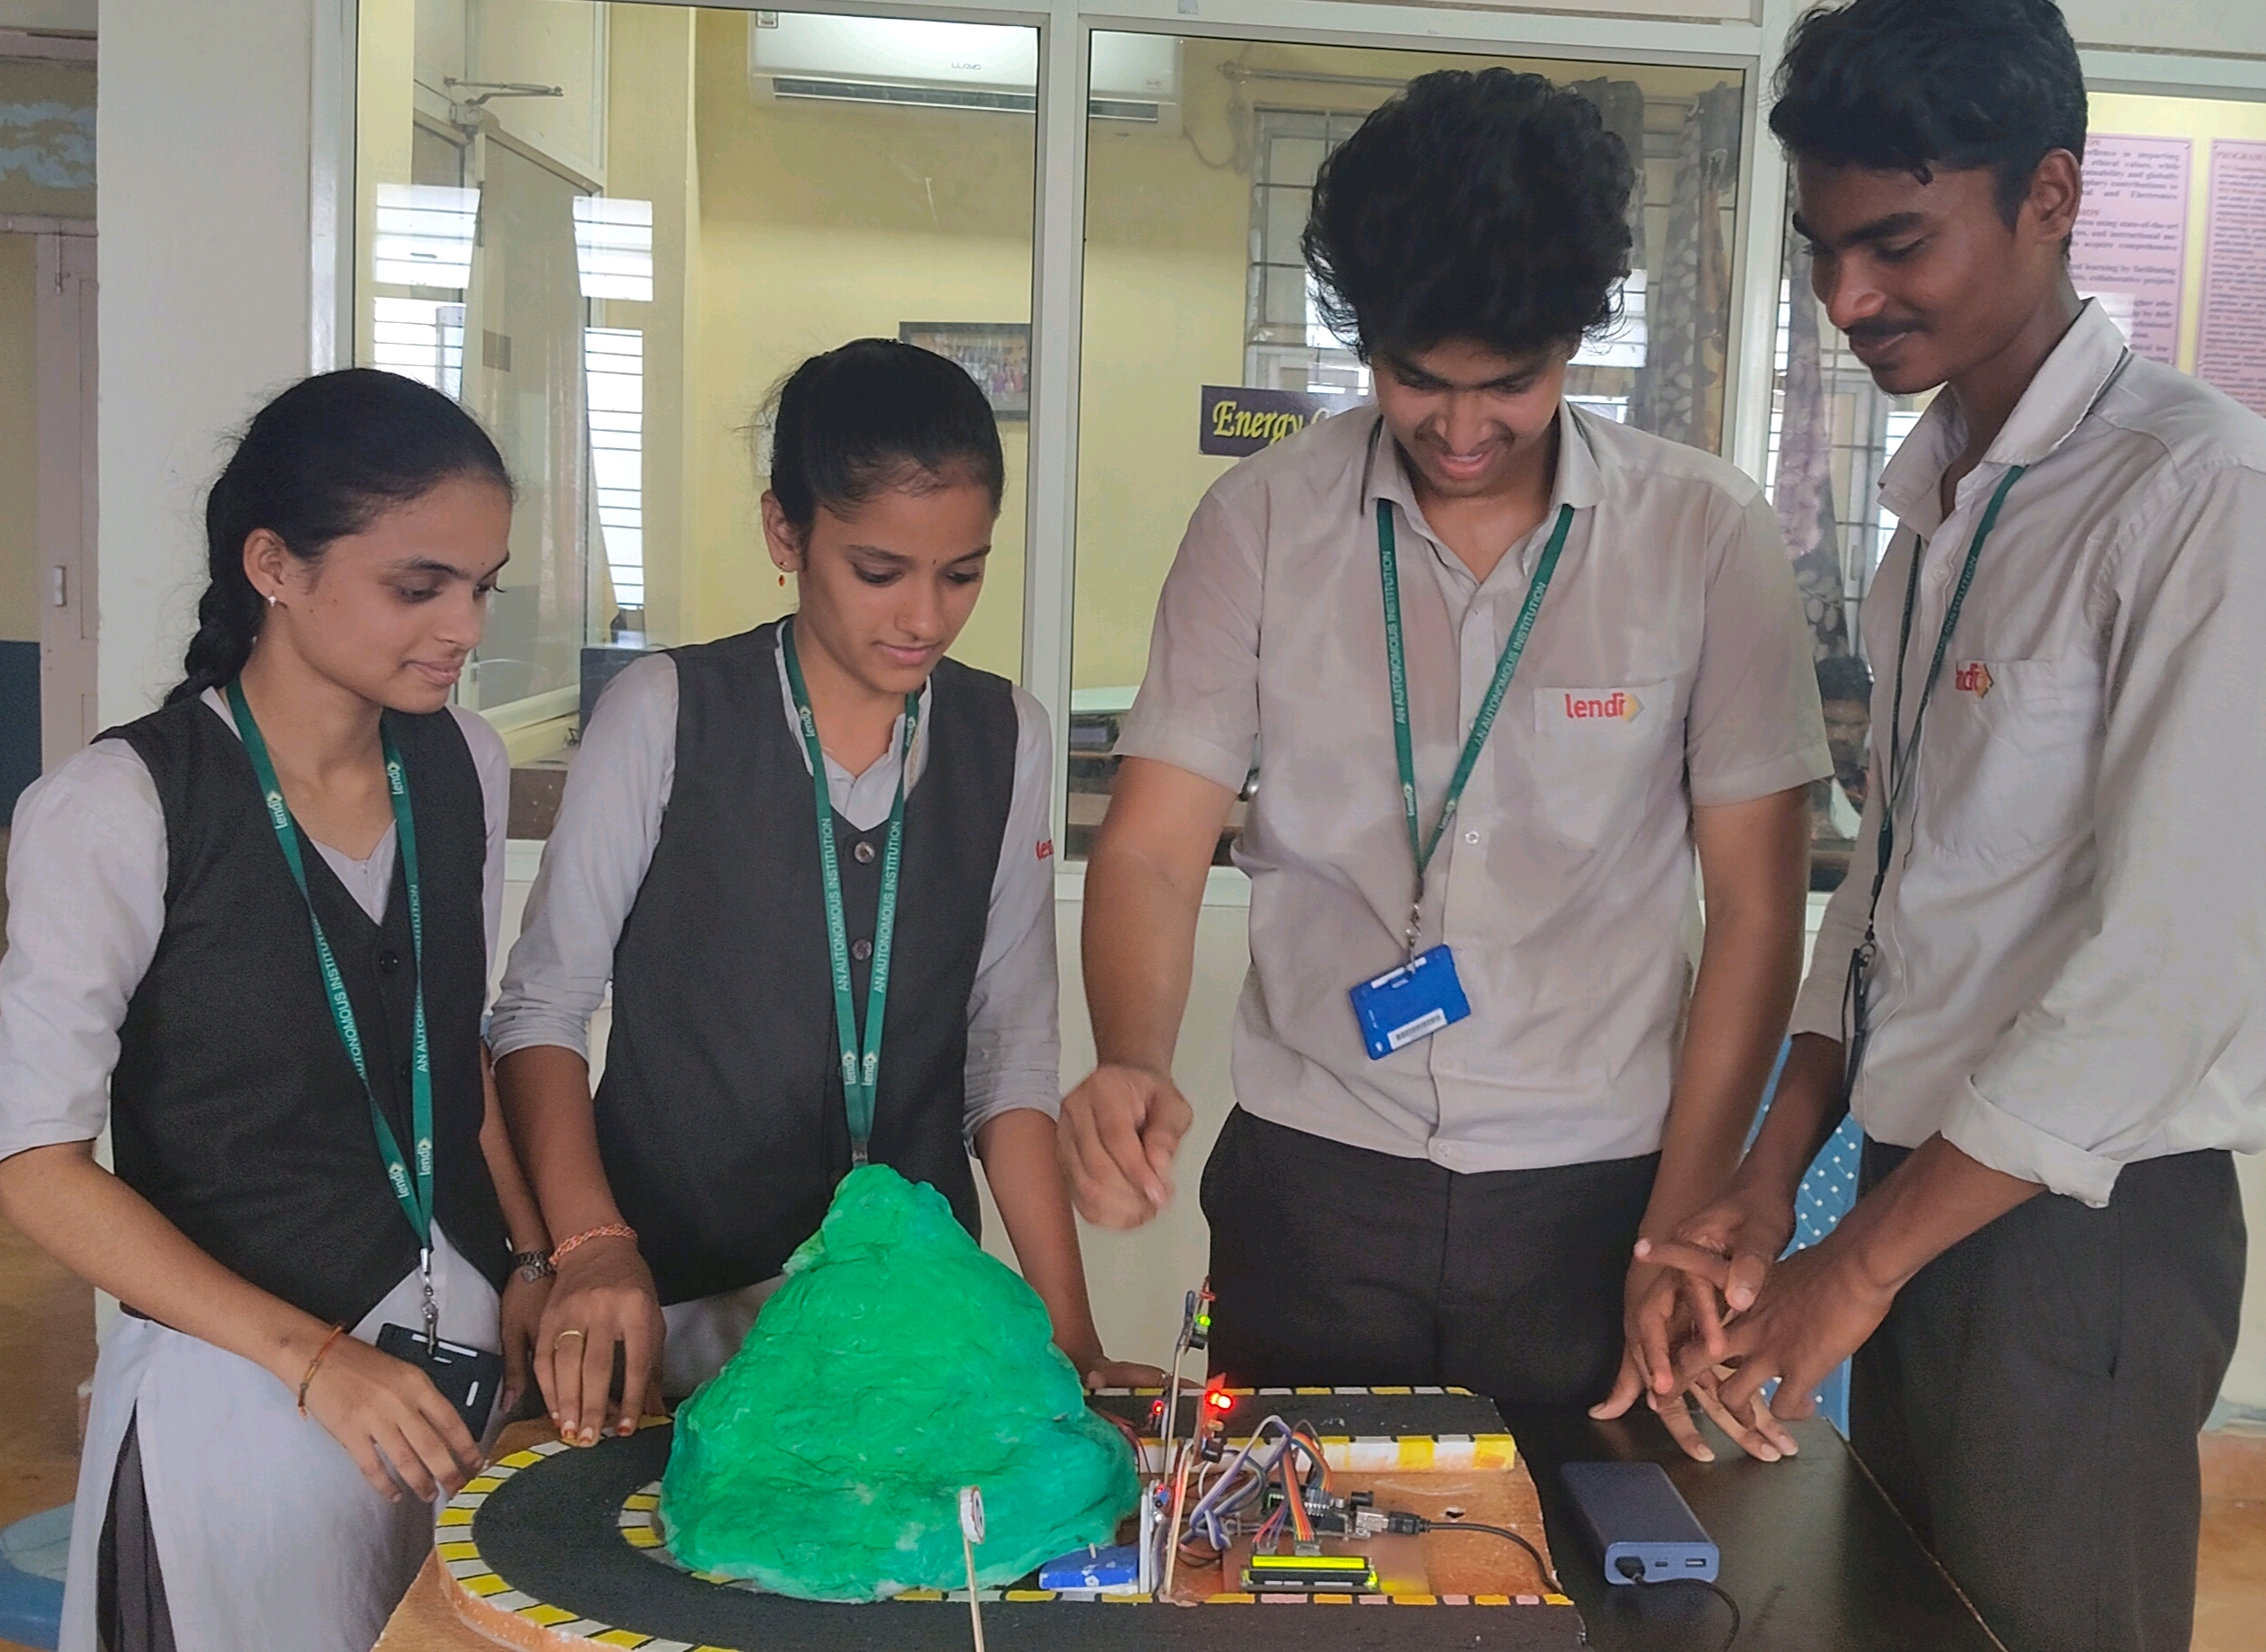
Road accident prevention in hilly areas
Under the guidance of
Mr.b Ram Vara Prasad, (ph.D)
Assistant professor, Department of EEE, LITE(A)

Slide 3

Contents
What is meant by design thinking
Problem statement
Empathy
Define
Ideate
Surey
Prototype
ApplicationS
Innovation strategies
Conclusion

Slide 4
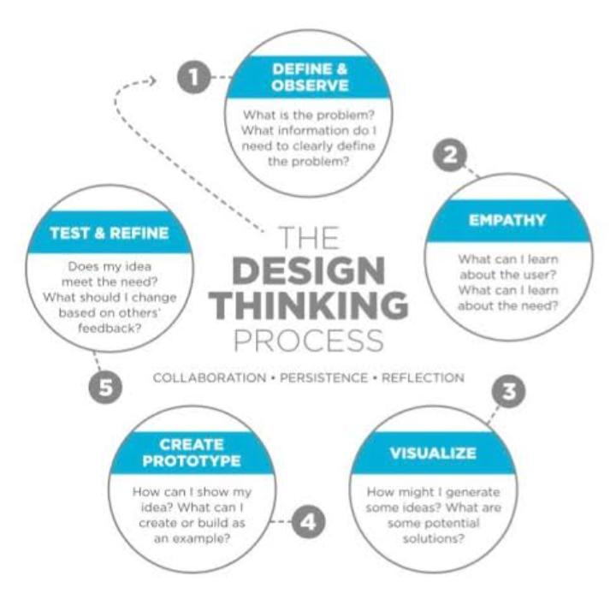

What is meant by design thinking?

Slide 5
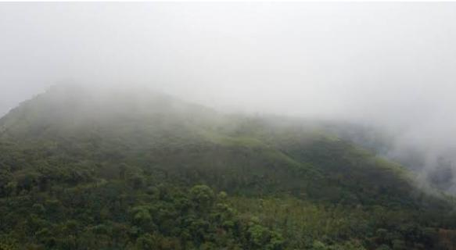
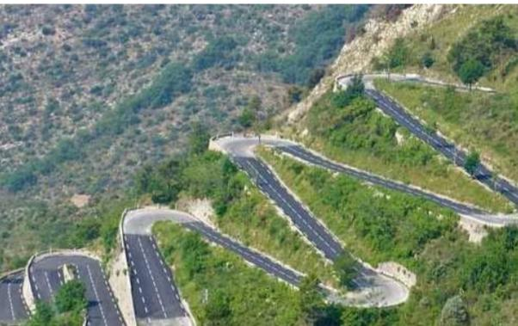
Problem statement
Road Design Challenges
Weather and Visibility Issues
Natural Hazards
Human Factors
Infrastructure problem
Emergency Response Challenges

Slide 6

Empathy
Drive with care
Slow down on curves
Use headlights in fog
Give space to others
Avoid overtaking on bends
Check brakes regularity
Stay alert,avoid distractions
Respect road signs
Use horn gently at turns

Slide 7
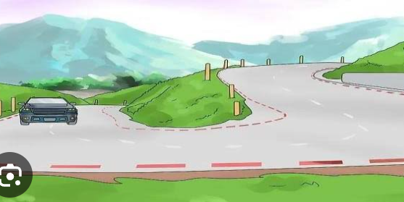
Definition
Proper Road Design and Maintenance
Adequate Signage and Road Markings
Speed Control Measures
Driver Training and Awareness
Vehicle Fitness and Load Regulation

Slide 8

Ideate
Smart Curve Alert System
Speed Monitoring and Warning Unit
Automatic Brake Assist Model
Landslide Detection and Alert System
Driver Drowsiness Detection Unit
Real-Time Road Condition Display

Slide 9
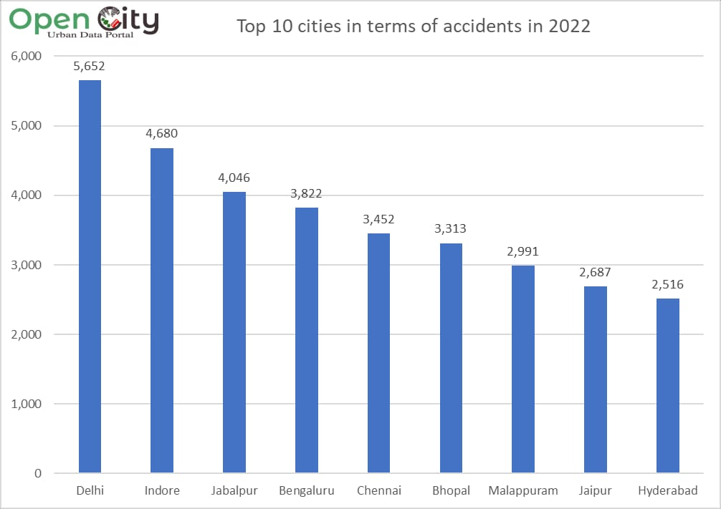
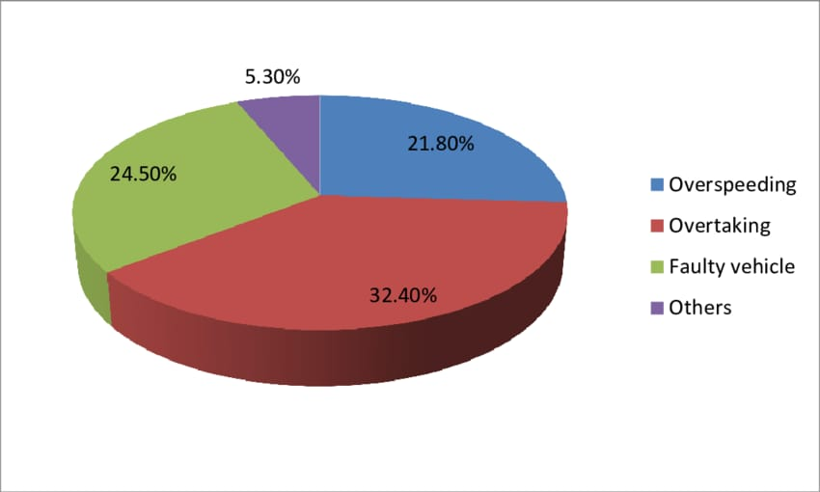
Case study

Slide 10

Survey questions ?
1. How often do you drive in hilly areas? 2. Have you ever had an accident in a hilly area? 3. What do you think causes most accidents in hilly areas? 4. Do you think road safety measures are adequate in hilly areas? 5. What would make you feel safer driving in hilly areas?

Slide 11



Responses
Co
.
.
1. HOW OFTEN DO YOU DRIVE IN HILLY AREAS?
A..Occasionally, mostly during trips.
2. HAVE YOU EVER HAD AN ACCIDENT IN A HILLY AREA?
A .No, I haven't.
3. WHAT DO YOU THINK CAUSES MOST ACCIDENTS IN HILLY AREAS?
A .Sharp turns, speeding, and poor visibility.
4. DO YOU THINK ROAD SAFETY MEASURES ARE ADEQUATE IN HILLY AREAS?
A..No, they're often insufficient.
1. HOW OFTEN DO YOU DRIVE IN HILLY AREAS?
Rarely, only when absolutely necessary.
2. HAVE YOU EVER HAD AN ACCIDENT IN A HILLY AREA?
A .Yes, a minor skid once during rain.
3. WHAT DO YOU THINK CAUSES MOST ACCIDENTS IN HILLY AREAS?
A .Overconfidence and lack of experience.
4.WHAT WOULD MAKE YOU FEEL SAFER DRIVING IN HILLY AREAS?
A..Wider roads and more frequent patrolling.
1. HOW OFTEN DO YOU DRIVE IN HILLY AREAS?
A..Frequently, as I live near a hilly region.
2. HAVE YOU EVER HAD AN ACCIDENT IN A HILLY AREA?
A..No, but I've had a few close calls.
3. WHAT DO YOU THINK CAUSES MOST ACCIDENTS IN HILLY AREAS?
A .Brake failure and reckless overtaking.
4. DO YOU THINK ROAD SAFETY MEASURES ARE ADEQUATE IN HILLY AREAS?
A..Some areas are fine, others are very risky.

Slide 12
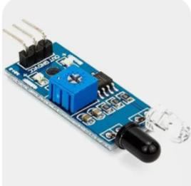

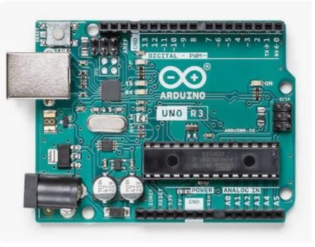
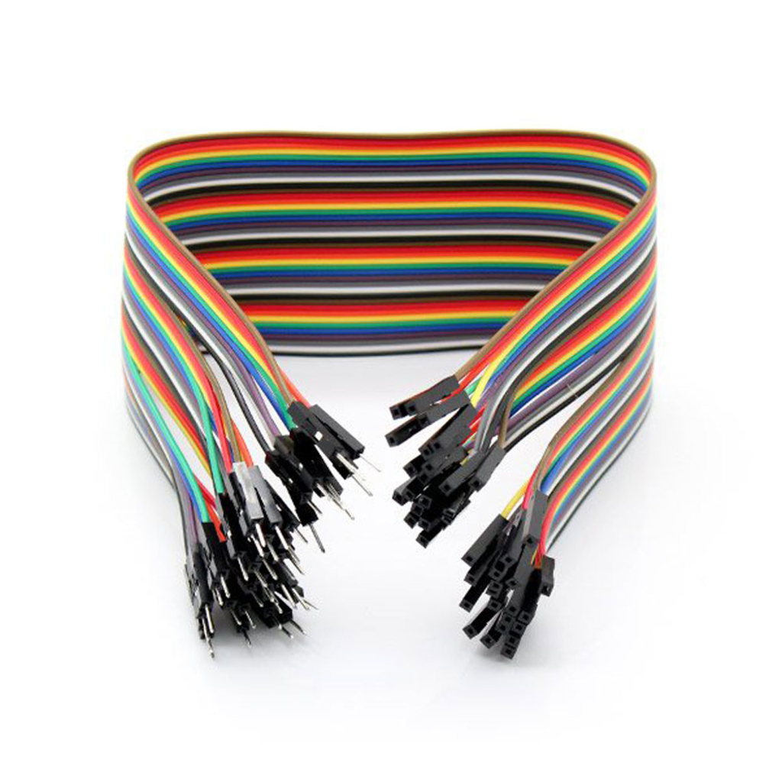
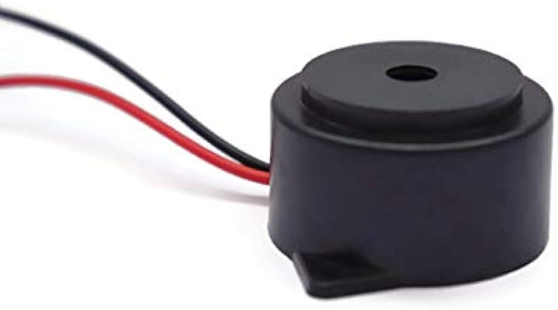
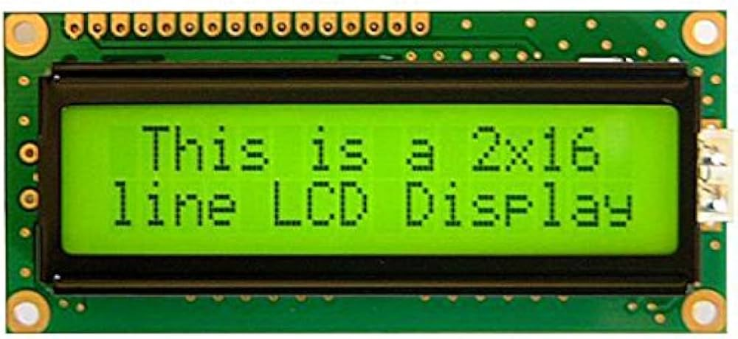
Components
IR sensors
USB cable
Arduino UNO
LCD display
Jumper wires
Buzzer

Slide 13
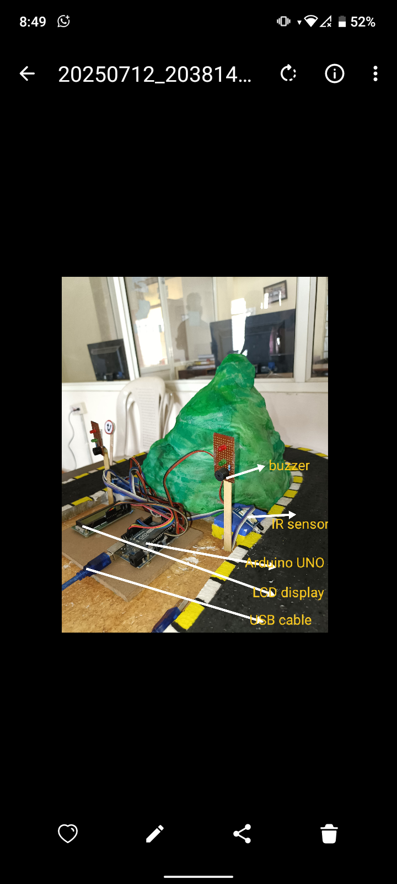
Working principle
STPES
VEHICLE DETECTION
SHOWS INFORMATIVE INDICATORS
PREVENTS ACCIDENTS

Slide 14
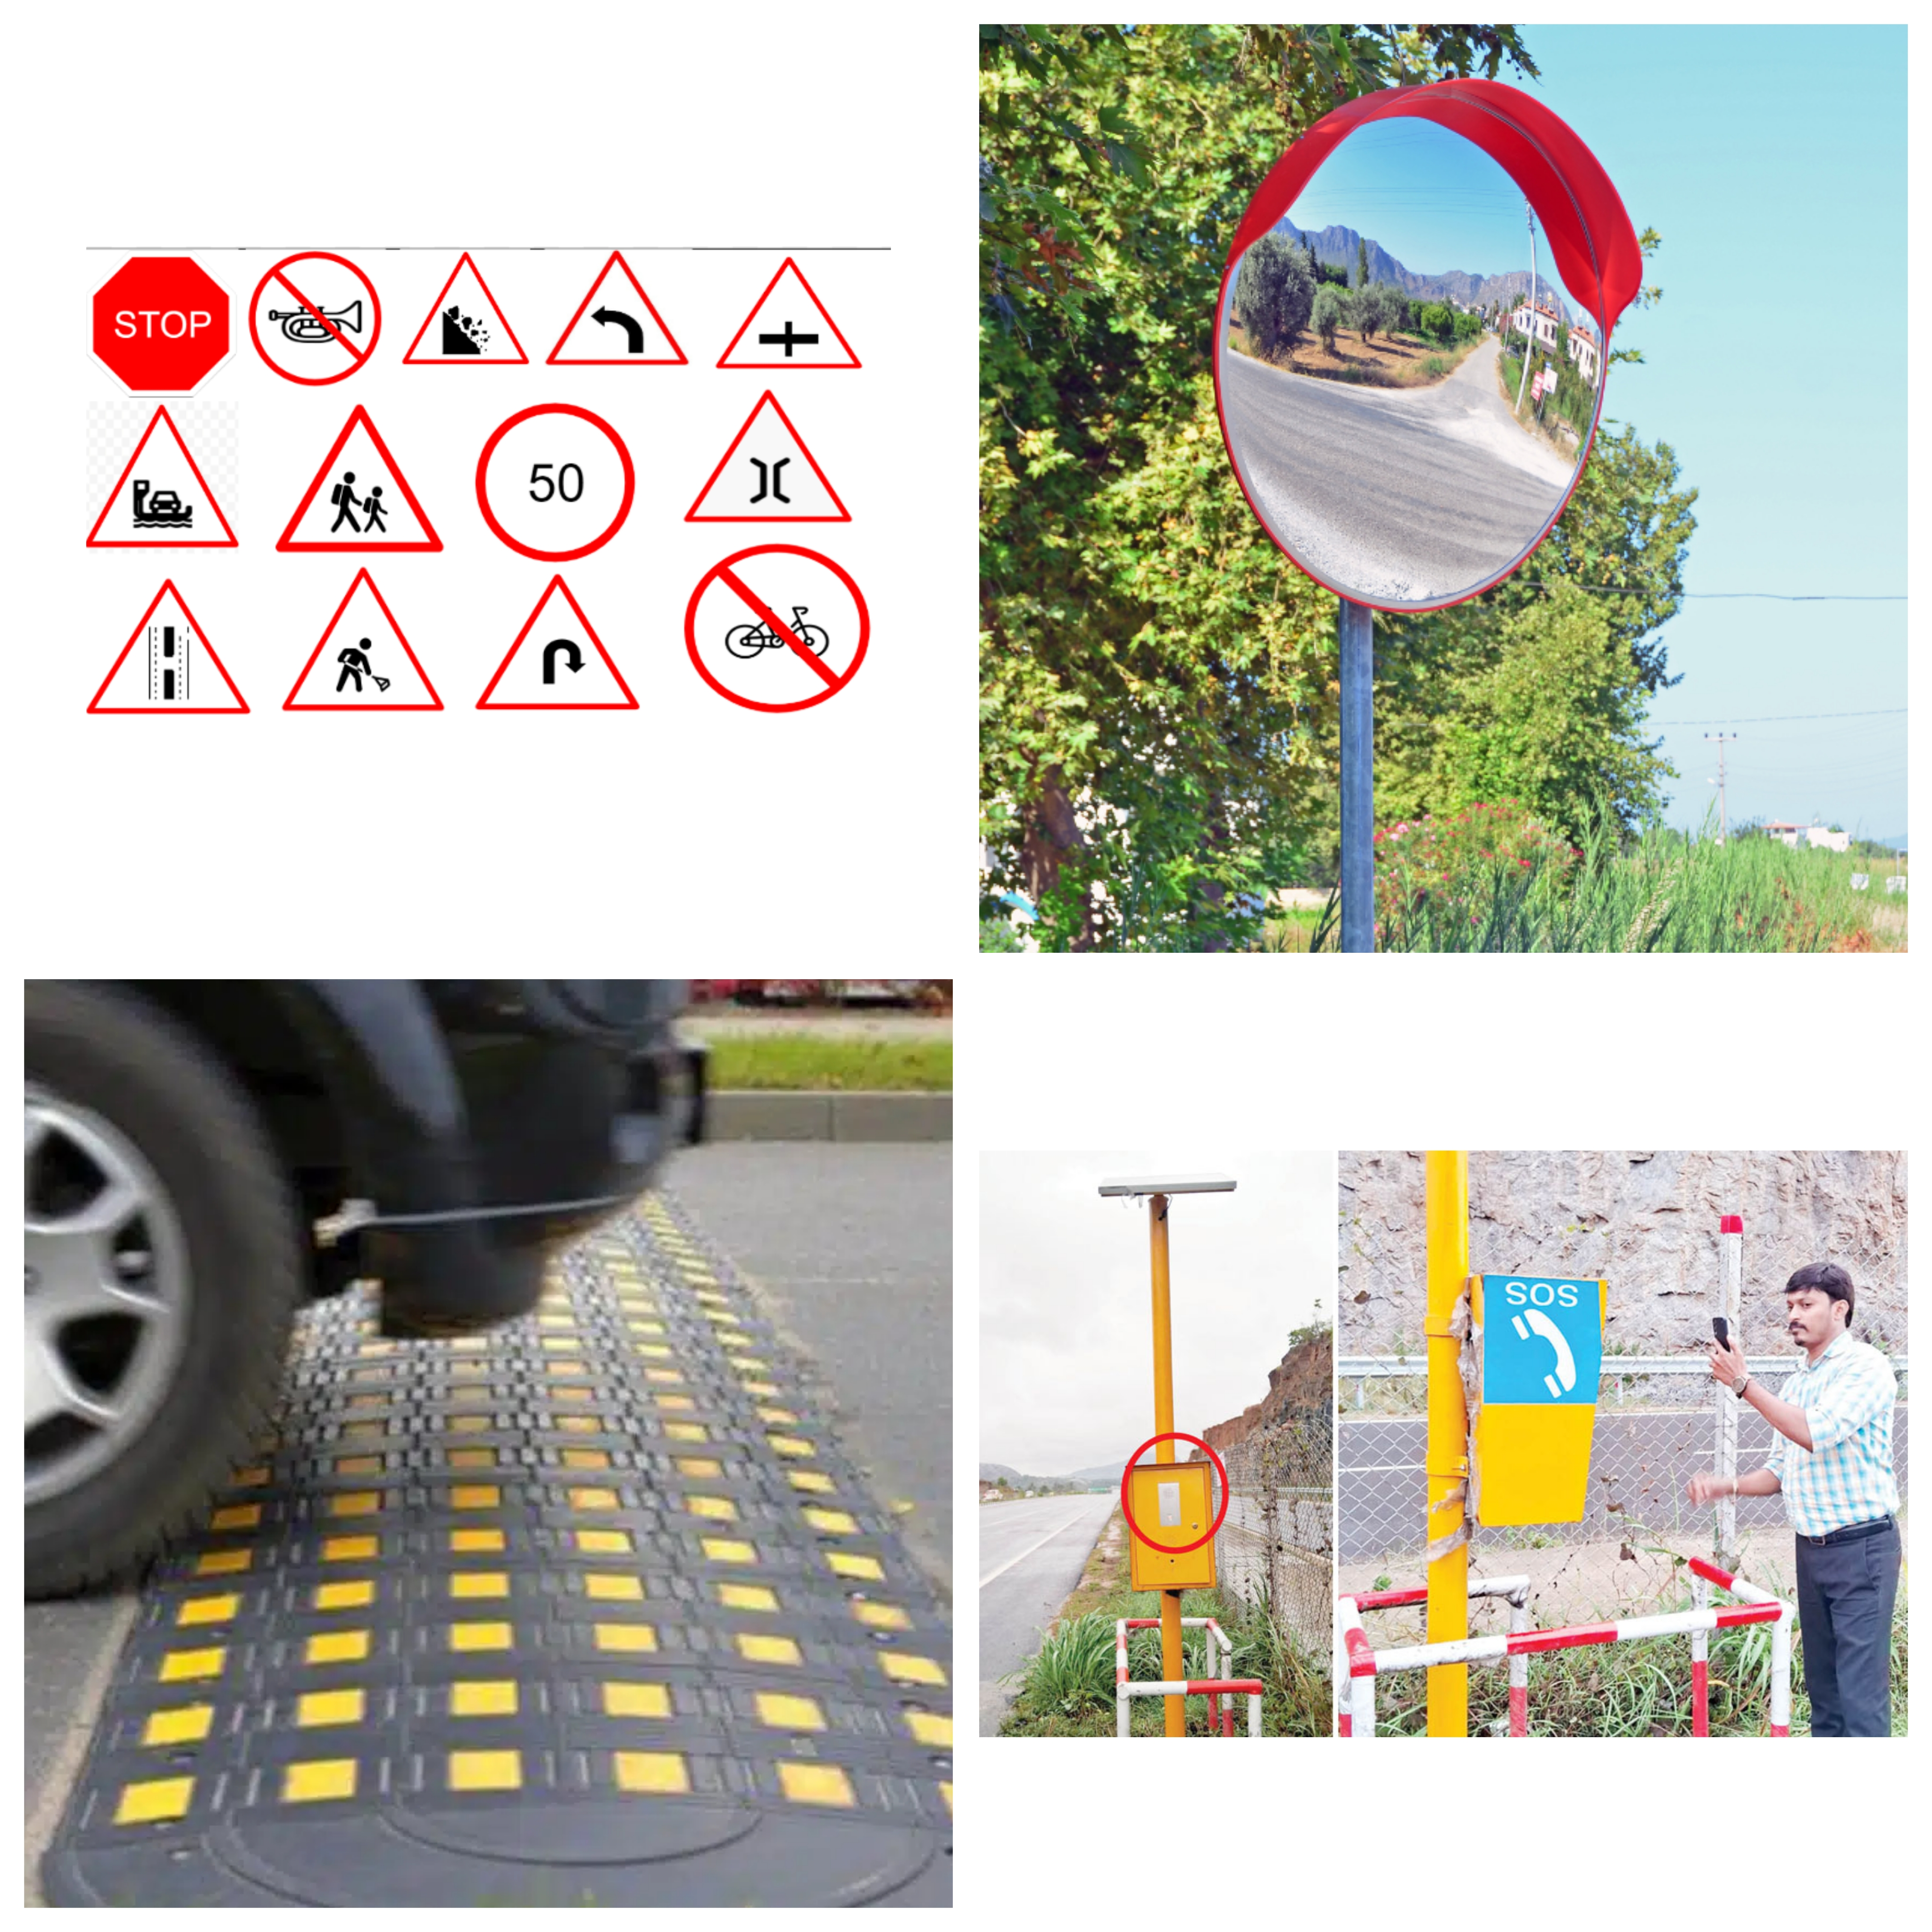
applications
Warning Signboards
Speed control measures
Proper road lighting
Guardrails and barriers
Mirror placement at blind turns
Regular road maintenance
Weather monitoring system
Driver awareness campaign
Emergency call boxes
Enforcement of whole fitness checks

Slide 15
Innovation strategies
Add a mobile app to send alerts to drivers' phones
Use fog and weather sensors to detect poor visibility
Power the system with solar panels for remote areas
Use camera sensors to detect speeding vehicles (future AI upgrade)
Add GPS & GSM modules for location-based alerts and emergency SMS
Store data online for tracking accident-prone spots
Make waterproof covers to protect sensors from rain and dust
Use voice warnings to alert drivers clearly (e.g., “Slow Down”)
Work with government programs to install system in real hilly roads.

Slide 16
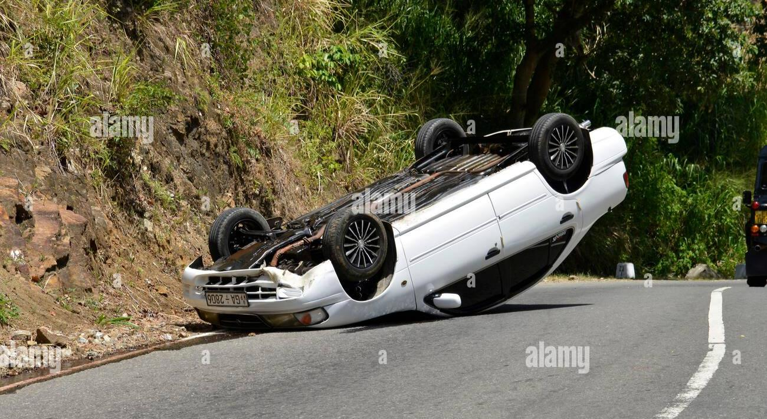
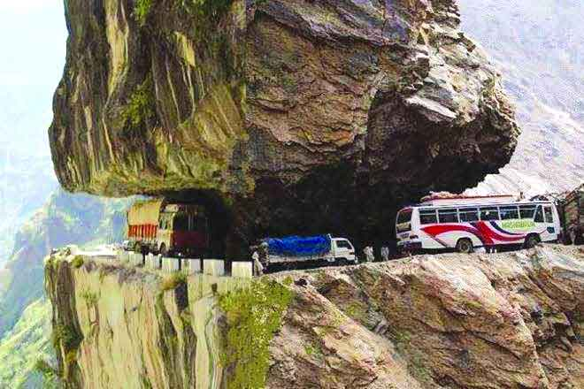
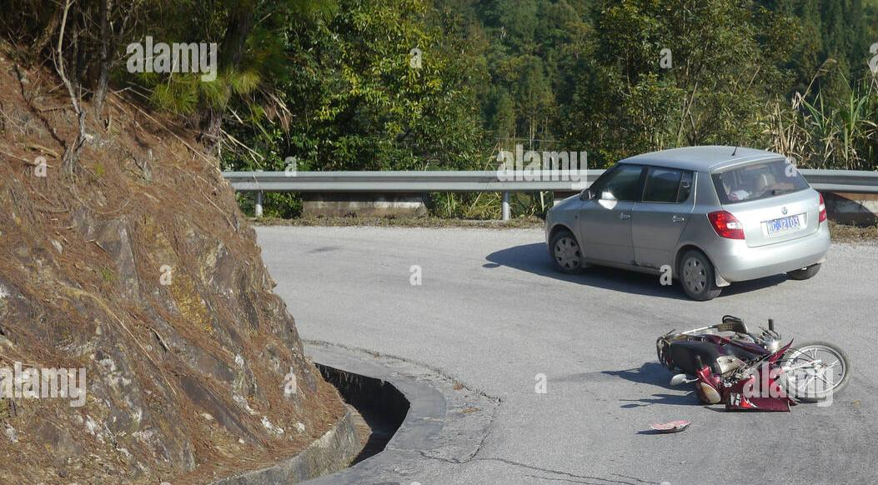
Real time scenario

Slide 17
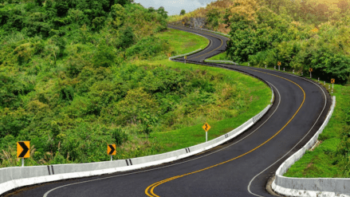
Conclusion
The Road Accident Prevention System for hilly areas is a simple yet powerful innovation that aims to save lives by providing timely alerts at dangerous curves and slopes. By using low-cost components like IR sensors, an LCD display, buzzers, and signal lights, the system helps drivers make safer decisions in risky conditions. Through design thinking, the prototype was tested, improved, and made easy to install, even in remote regions. With further support, it can be upgraded using solar power, mobile alerts, and advanced sensors. This project shows how basic electronics and user understanding can create smart solutions that make roads safer for everyone.

Slide 18


