Slide 1

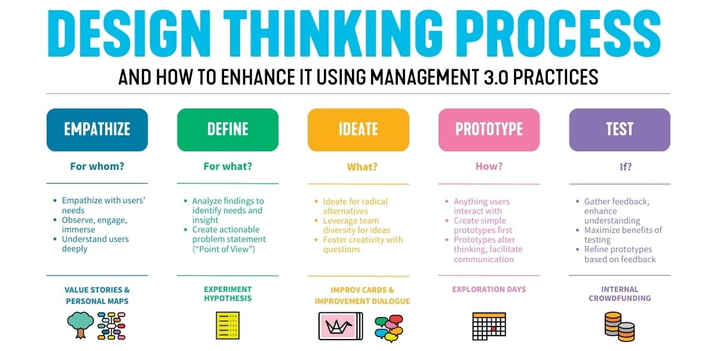
DESIGN THINKING AND INNOVATION
Presented By
CH .Sohitha Sai 23KD1A0219
L . Venkata Lakshmi 23KD1A0260
B . Ramu 23KD1A0212
I . Vamsi 23KD1A0245

Slide 2
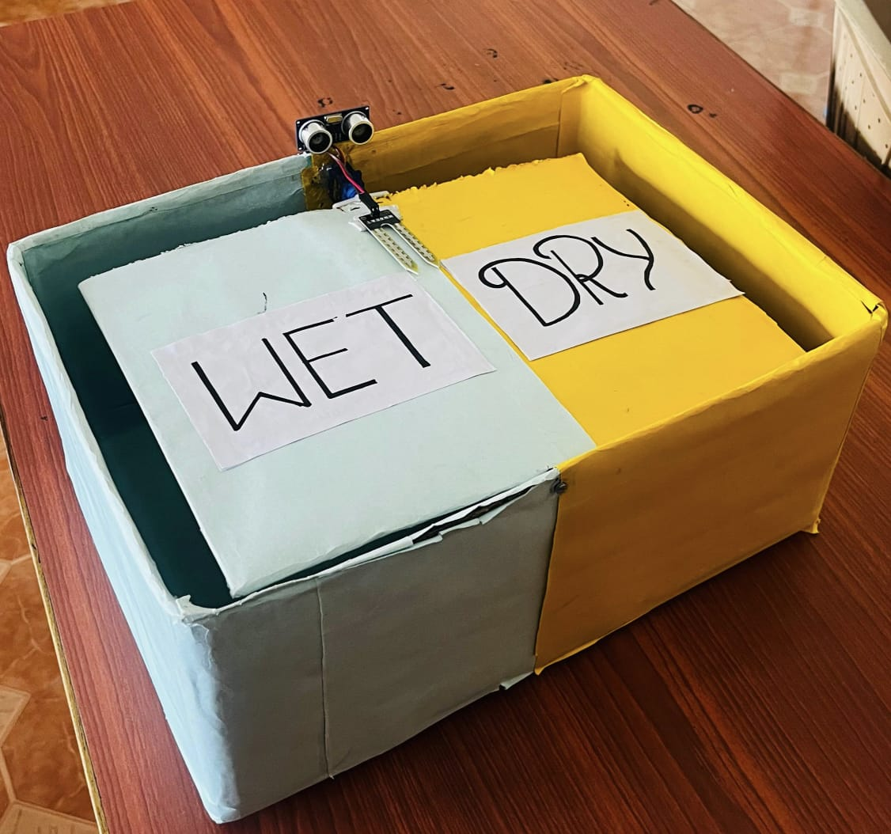
WET AND DRY WASTE SEGREGATION
UNDER THE GUIDENCE OF
Mr.B.RAM VARA PRASAD,(Ph.D)
Assistant professor,
Department of EEE, LIET(A).

Slide 3

INTRODUCTION TO DESIGN THINKING
PROBLEM STATEMENT
EMPATHY
CONTENTS
DEFINE
IDEATE
PROTOTYPE EXPLANATION
TEST
CONCLUSION

Slide 4
Design thinking and innovation are interconnected processes focused on creating value by understanding user needs and exploring creative solutions.

Slide 5
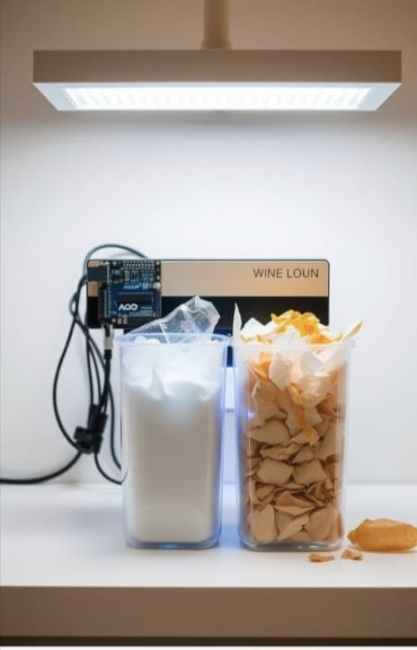
Problem Statement
✅ Poor Segregation
🕒 Time-Consuming
🧤 Unhygienic
💸 High Cost
🌍 Eco Solution
Problem statement is a clear, concise description of the issue that needs to be addressed by a project. It identifies the gap between the current state and the desired state, explaining why the problem is important and what impact solving it will have.

Slide 6
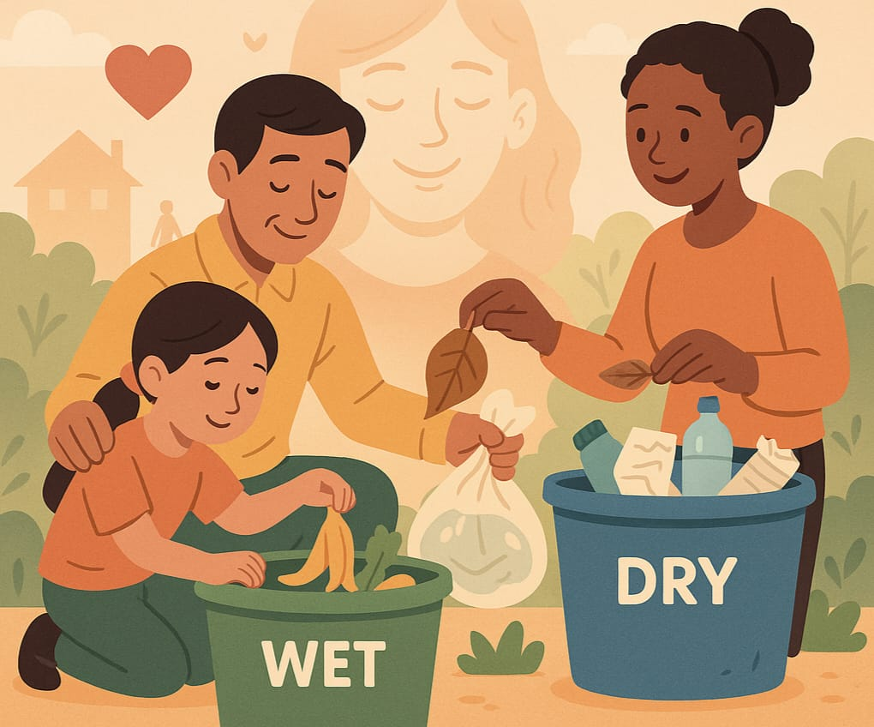
EMPATHY
5 WHY’S
PERSONA’S
INTERVIEW QUESTIONS

Slide 7

5 WHY’s 🔍
Problem: People often mix wet and dry waste, making segregation ineffective.
❓ Why 1: People don’t separate waste at the source (home/office).
❓ Why 2: They’re unaware or find it inconvenient.
❓ Why 3: No easy tools or proper awareness.
❓ Why 4: Lack of local campaigns or smart solutions.
❓ Why 5: No integration into daily habits or incentives.

Slide 8


⧉ PERSONAS 🧑‍🤝‍🧑
👩‍🍳 Lakshmi – Homemaker (40 yrs) 🔸 Pain Points: Confused about waste categories, lacks multiple bins 🔸 Needs: Clear labels, easy visuals, pickup reminders 🔸 Goal: Wants to keep surroundings clean 🧼
🎓 Raj – College Student (21 yrs) 🔸 Pain Points: Doesn’t care much, no motivation 🔸 Needs: Gamification 🎮, incentives 💰, fun approach 🔸 Goal: Wants simplicity & engagement

Slide 9


Ramesh - Sanitation Worker(35 yrs)
😣 Pain Points: Faces mixed garbage which is unhygienic and harder to manage 🧹.
🧼 Needs: Pre-sorted waste,user cooperation and less exposure to health risks ⚠️🦠.
🙏 Goals: Wants safer and cleaner waste collection 🚛 for better health and dignity.
🏢 Municipal Official – Mr. Rao (45 yrs)
🧾 In charge of waste management operations in a ward
❌ Pain Points: Poor citizen participation, limited monitoring tools
✅ Needs: Data tracking, community feedback, better tech for waste tracking
🎯 Goal: Wants to improve waste segregation rates across the city

Slide 10
🗣️ INTERVIEW QUESTIONS ❓
👩‍🍳 To Homemakers:
How do you dispose of your household waste daily? 🗑️
Do you separate it? Why/why not?
What makes it hard or easy for you?
What would help you do it better? ✅
🎓 To Students:
Do you know about wet/dry waste? 📚
Do you segregate it?
What would make it fun or rewarding? 🎯
Would you use an app for this?

Slide 11
👷‍♂️ To Sanitation Workers
🗑️ What problems do you face during collection?
🤢 How often is the waste mixed?
🙏 How can people help you?
💡 Have you seen any good solutions?
🛠️ Do you get tools or safety gear?
🏢 To Municipal Officers
📊 What is the main challenge in waste management?
📉 Is segregation improving or not?
🙋‍♂️ What do you expect from the public?
⚙️ What technology are you using now?
🚀 What support do you need to improve things?

Slide 12
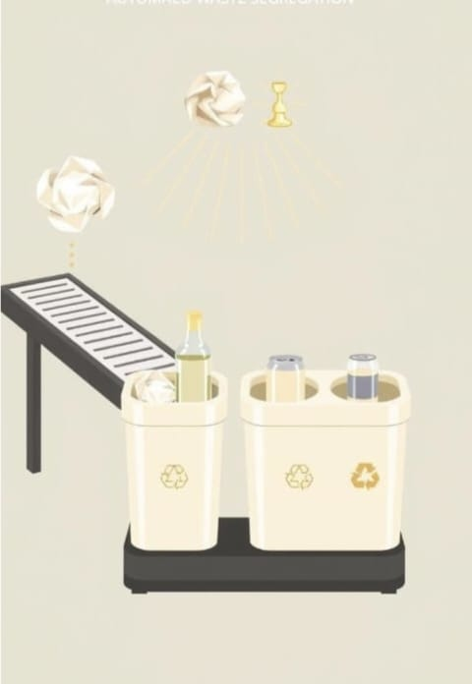
🎯 DEFINE
Despite the growing emphasis on sustainability, waste segregation at the source remains a major challenge due to:
✅ Lack of awareness and consistency in households
🕒 Time-consuming and inconvenient manual segregation
🧤 Health risks to sanitation workers
💸 High cost of existing smart segregation systems

Slide 13
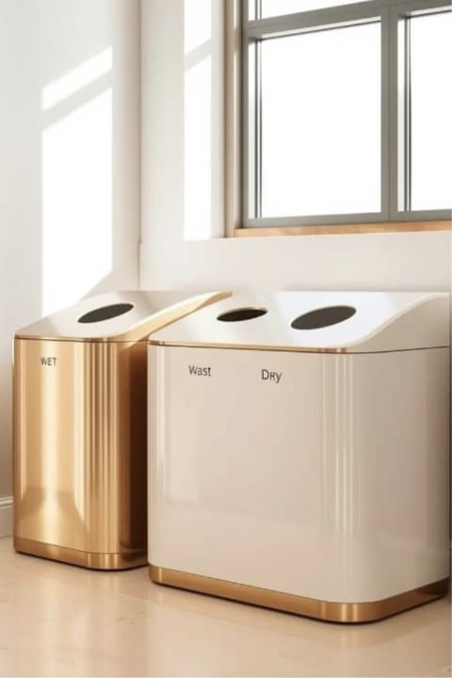
💡 IDEATE
🔍 Sensor-Based Detection – Use moisture or optical sensors to automatically identify wet vs. dry waste.
⚙️ Rotating Bin System – A smart bin that rotates compartments based on detected waste type.
📱 Mobile App Integration – App alerts and tracking to guide users and promote segregation habits.
🧩 Modular Design – Compact, detachable bin units suitable for households and small communities.

Slide 14
🛠️ PROTOTYPE – Building the Automated Waste Segregation Model
In the prototype stage, we designed and built a working model of our automated wet and dry waste segregation system using sensors and microcontroller logic. This prototype helps us test how well our concept functions in a real-world setting and gives us insights for future improvement.
🧪 Working Principle:
Waste is placed into the input tray
Sensor detects moisture level
Based on detection:
Wet waste → Bin A
Dry waste → Bin B
System notifies with LED/Buzzer
Real-time segregation with minimal user involvement

Slide 15
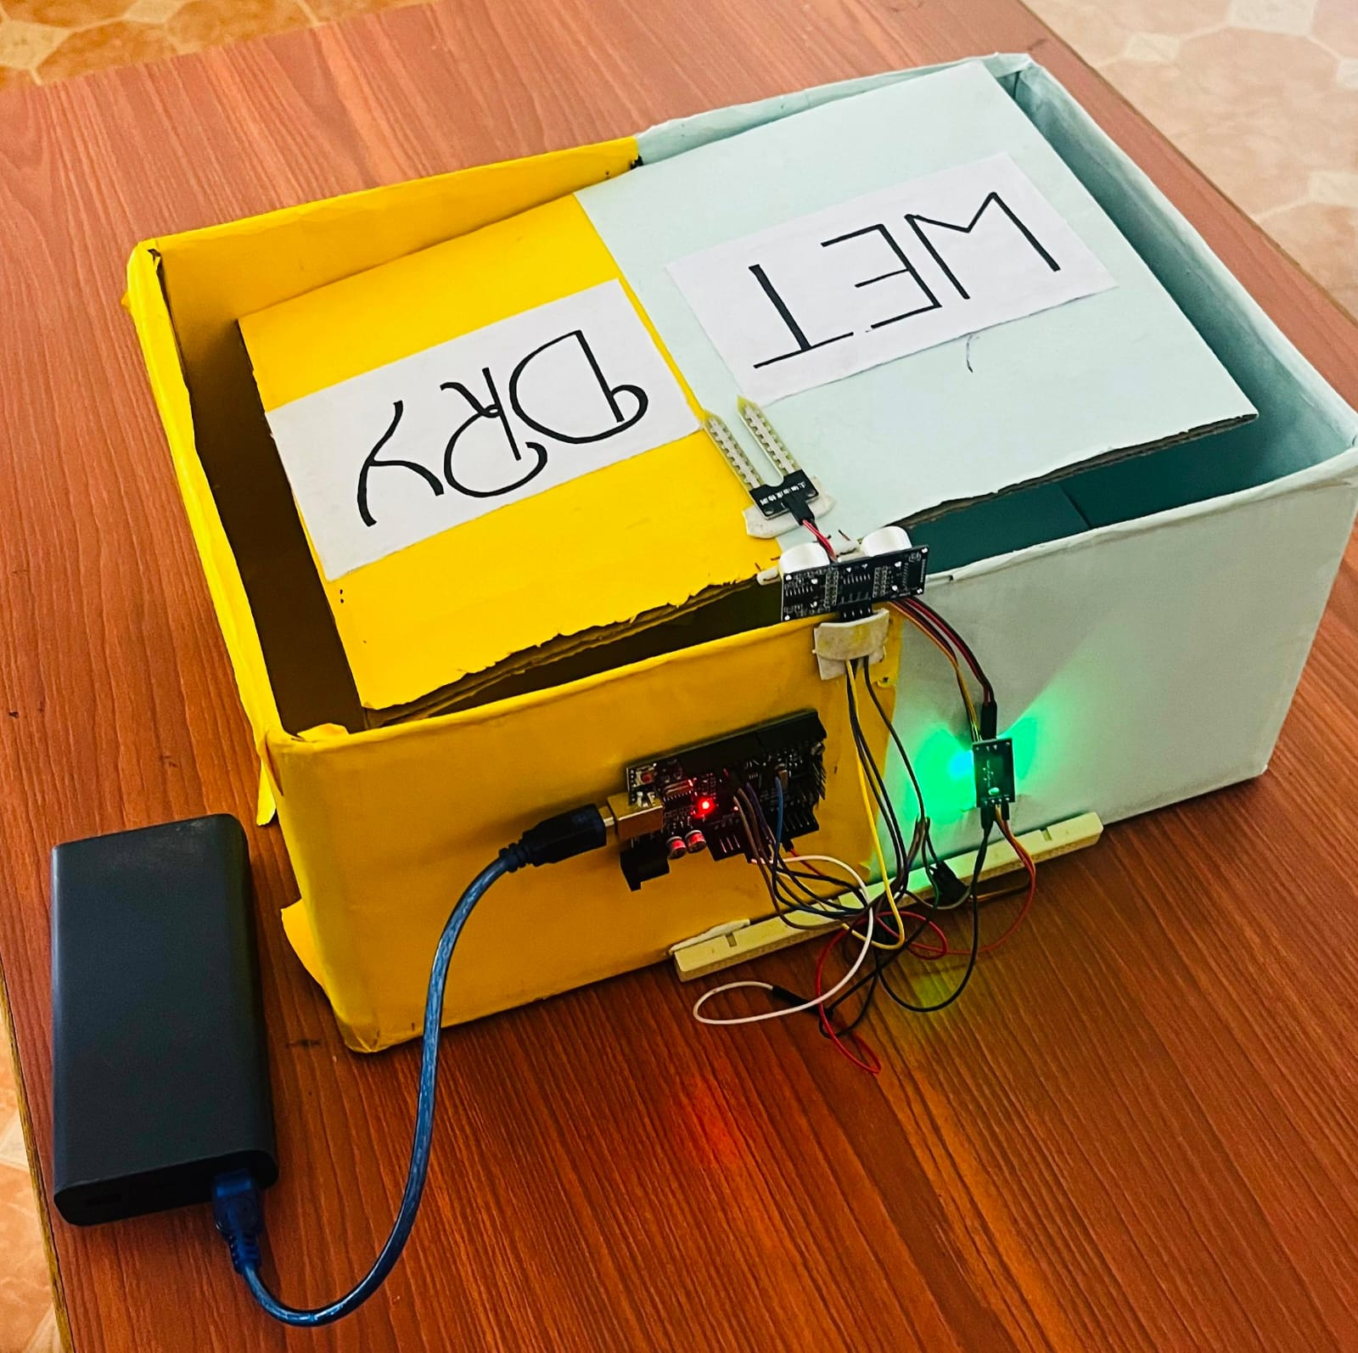
SOIL MOISTURE SENSOR
ULTRASONIC SENSOR
ARDUINO
JUMPER WIRES

Slide 16
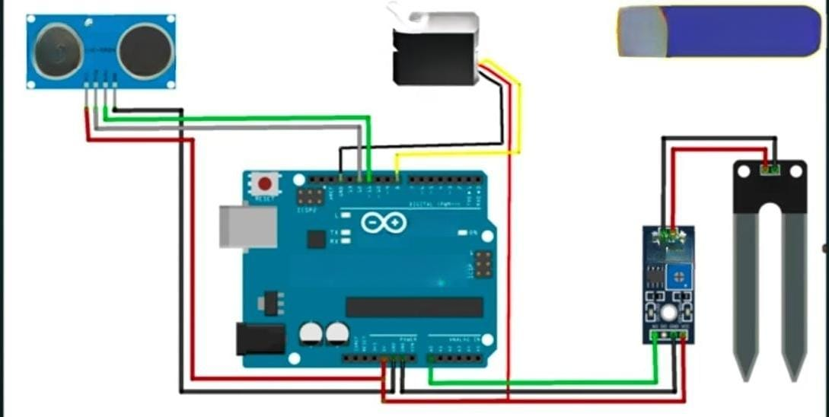
PROTO TYPE
CIRCUIT DIAGRAM

Slide 17
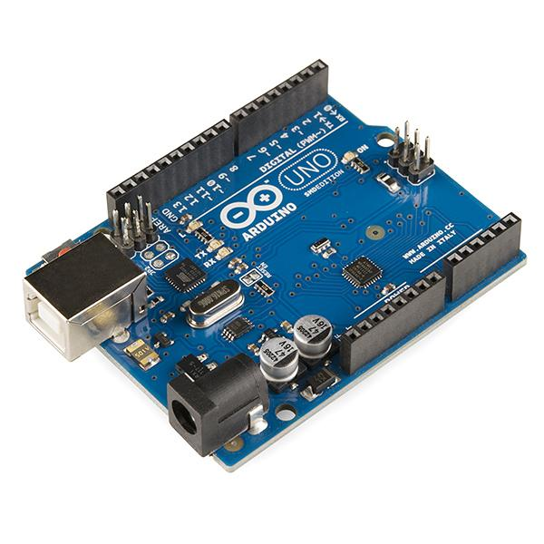
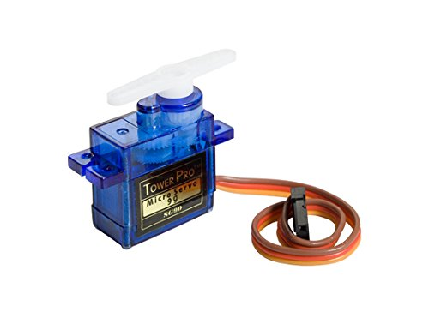
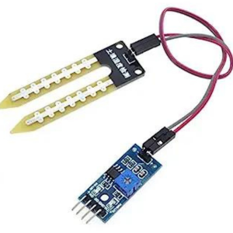
🔩 Key Components in the Prototype
Arduino Uno SMD
Acts as the system’s central controller.
Receives input from sensors and controls the servo based on logic.
Servo 9g Motor
Physically shifts the flap to direct waste into the correct bin.
Quick and precise motion based on Arduino’s signal.
Soil Moisture Sensor
Measures how wet the waste is.
Sends moisture data to Arduino to determine waste type

Slide 18
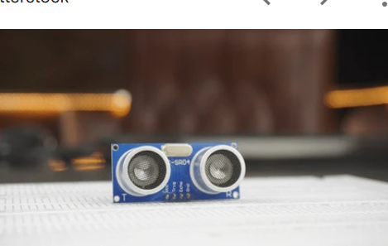
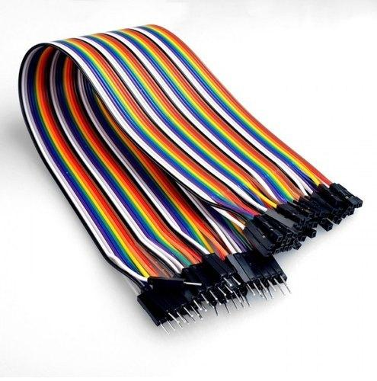
Ultrasonic Sensor 📏
Senses when waste is placed within range
Ensures system activates only when waste is detected.
USB Cable 🔌
Used for programming the Arduino and providing power during testing.
F-F and M-F Jumper Wires 🔗
Connect components to the Arduino.
Ensures smooth communication between sensors, motor, and microcontroller.

Slide 19
✅ Conclusion
🌿 Smart Waste Segregation System – Highlights:
♻️ Eco-friendly & efficient waste management solution
🤖 Arduino Uno + sensors detect moisture to sort waste
🙌 Reduces human effort & error with automation
🧼 Promotes clean & sustainable habits
🏫 Scalable for homes, schools, offices & public spaces
🌍 Contributes to a greener future with smart tech

Slide 20


