Slide 1

DESIGN THINKLING
AND INNOVATION
PRESENTED BY:
23KD1A0253 - K.RAMYA
23KD1A0255 - D.KOTI
23KD1A0213 - B.CHAITANYA
24KD5A0201 - A.VYKUNTA RAO

Slide 2


Train accident prevention
Train Accident Prevention
UNDER THE GUIDENCE OF:
Mr.B.Ram vara prasad,
(ph.Assistatant professor,
Department of EEE,LIET)
UNDER THE GUIDENCE OF:
Mr.B.Rama vara prasad,
(phd.Assistatant professor,
Department of EEE,LIET)

Slide 3
CONTENTS
Contents:
INTRODUCTION TO DESIGN THINKING
PROBLEM STATEMENT
EMPATHY
DEFINE
IDEATE
STORY BOARDING
PROTOTYPE EXPLAINING STORY
CONCLUSION
INTRODUCTION TO DESIGN THINKING
PROBLEM STATEMENT
EMPATHY
DEFINE
IDEATE
STORY BOARDING
PROTOTYPE EXPLAINING STORY
CONCLUSION

Slide 4

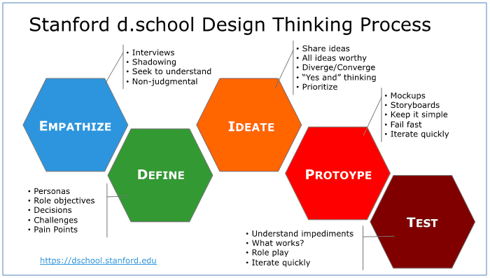
What is meant by design thinking and innovation ?
Design thinking is a human-centered, problem-solving approach to innovation that focuses on understanding user needs, exploring creative solutions, and iteratively testing and refining them.

Slide 5

PROBLEM STATEMENT
Train accidents happen due to mistakes and obstacles on tracks. A smart system is needed to quickly detect problems and prevent accidents in time.

Slide 6

EMPATHY
Problem Impact:
Train accidents, often caused by human error or track issues, lead to serious injuries, loss of lives, and major disruptions.
Emotional and Social Effect:
Victims and their families face emotional and financial hardship, while public confidence in railway safety decreases.
Urgent Need:
Implementing a real-time accident prevention system can greatly reduce risks by detecting threats early and enabling timely action.
Responsibility of Innovation:
Engineers and developers have a key role in creating technologies that not only solve technical issues but also save lives and support public well-being.

Slide 7

DEFINE
Train Accident Prevention is the implementation of safety measures, technologies, and operational procedures aimed at reducing or eliminating the risk of collisions, derailments, and other accidents involving trains. It involves systems like automatic train protection, regular maintenance, driver training, and public awareness to ensure safe and efficient railway operations.

Slide 8

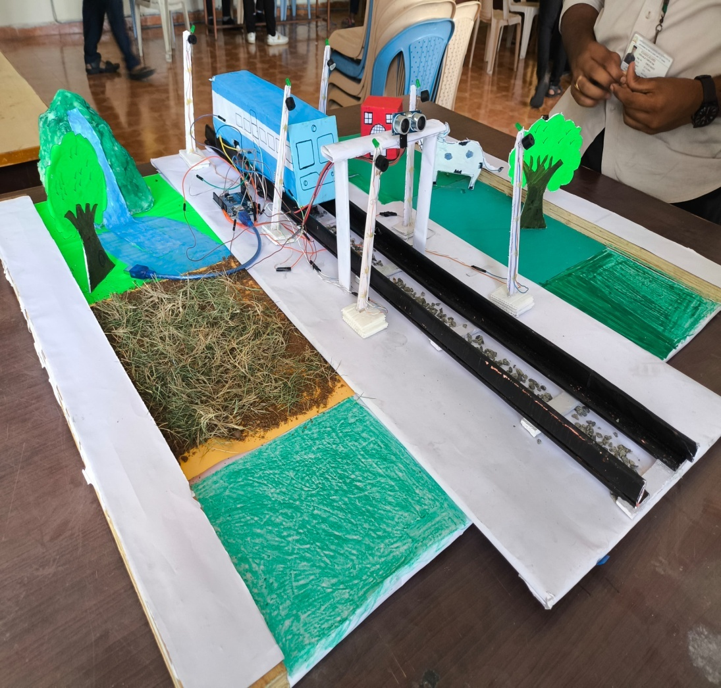
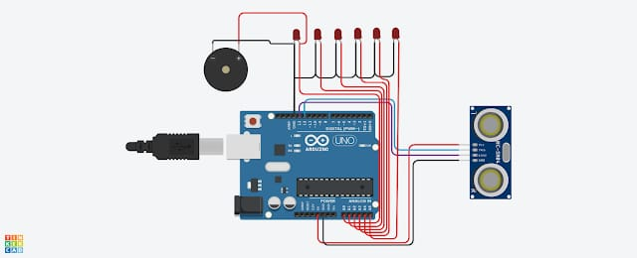
PROTOTYPE
CIRCUIT DIAGRAM

Slide 9
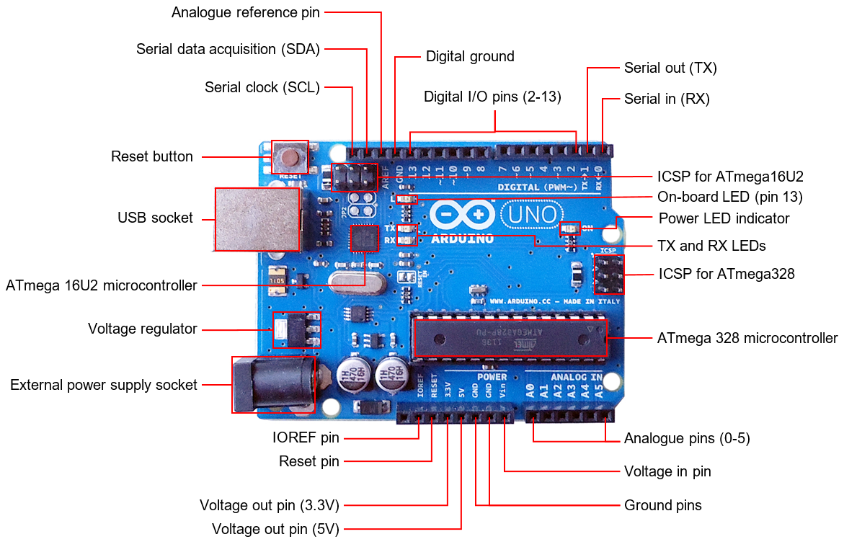

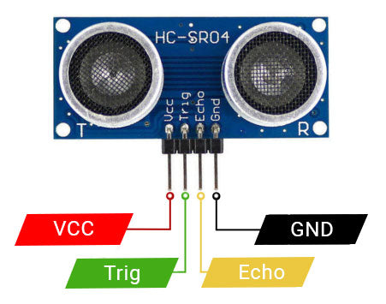
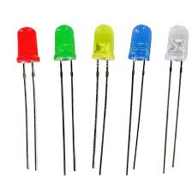
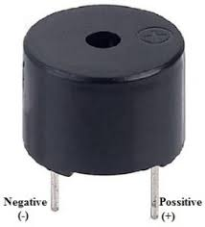
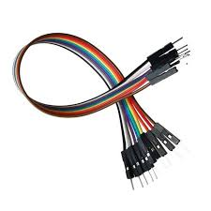
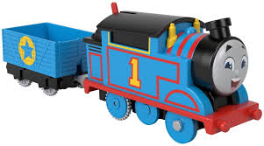
COMPONENTS

Slide 10
Working of prototype :
Sensors UsedUltrasonic/IR Sensors: Detect obstacles (like vehicles or people) on the track.Vibration or Crack Sensors: Monitor track conditions and detect track damage.GPS Module: Tracks the exact location of the train and other trains.RF or GSM Module: Used for communication between train and control station or between trains.
MicrocontrollerTypically an Arduino or Raspberry Pi is used.It collects data from sensors and makes decisions (e.g., stop the train if an obstacle is detected).
Working Process1. Obstacle Detection:Sensors placed in front of the train continuously scan the track.If an object is detected within a critical distance, the microcontroller sends a signal to slow or stop the train.2. Track Condition Monitoring:Crack sensors or vibration sensors placed along the track detect damage.If a crack is found, the system sends a warning to the control room and approaching trains.3. Train-to-Train Communication:RF modules or GSM send location updates.If two trains are on a collision path, the system alerts both trains and initiates braking.4. Control System Response:If danger is detected, the system may activate:Buzzer or alarmEmergency brakeWarning signal to the driver
Output DevicesBuzzer or Alarm: To alert the driver or control station.Display (LCD/LED): To show status or warnings.Motor Driver Circuit: To control the train’s movement in a model/prototype setup.

Slide 11
CONCLUSION
The train accident prevention prototype provides an effective and low-cost solution to enhance railway safety. By using sensors, microcontrollers, and communication systems, it can detect obstacles, monitor track conditions, and prevent collisions through timely alerts and automatic control. This system plays a crucial role in reducing human errors and improving overall train operation safety.

Slide 12

Presented by
team-4

