Slide 1
JIRA- A Project Management Tool

Slide 2
Why do we need a test management tool?
Deploy quality software, faster
Manage data related to different types of testing
Assess appropriate test coverage for requirements
Track relevant quality metrics and identify bottlenecks in the process
Get visibility into the entire project release progress
Increase collaboration between different stakeholders/teams

Slide 3
INTRODUCTION
Developed by Australian Company Atlassian.
Used for bug tracking, issue tracking & project management.
HOW TO USE JIRA?
Open Jira software and navigate to the Jira Home icon
Select Create project option
Choose a template from the library
Set up the columns as per your need from Board settings
Create an issue
Invite your Team members and start working

Slide 4
BENEFITS
Collaboration capabilities
Create customizable work-flows
Configurable to your business processes
Support for agile methodologies
Features such as notifications, comments & assignments helps to get everyone engaged in QA process
Easy to build custom workflows that suites the specific needs of teams doing annual testing
Teams can utilise and easily configurable inhouse tool they are already accustomed to using
Helps software teams track & manage their issues and projects in an Agile Manner.

Slide 5
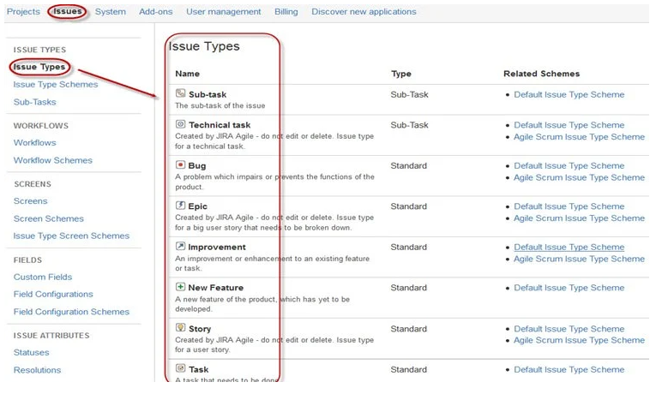
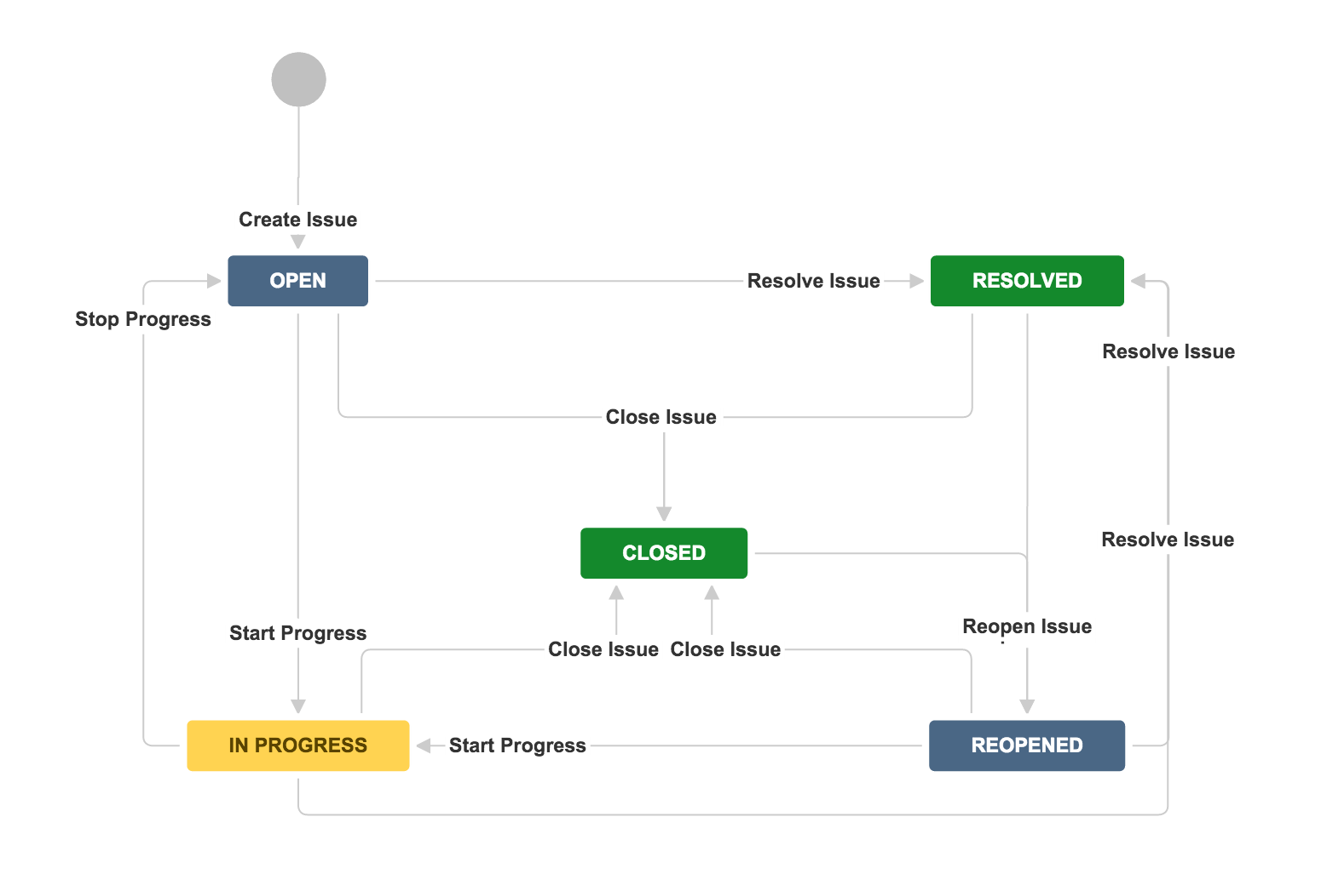
JIRA ISSUES
Track bug or issue that underlies the project
Issue type
Displays all type of items that can be created &
tracked via JIRA testing tool.
Workflow
Set of statuses and transitions that an issue goes
through during its life cycle.
Main stages
Open Issue
Resolved Issue
InProgress Issue
ReOpened Issue
Close Issue

