Slide 1
Application Layer Protocols: HTTP, HTTPS
Dr. K. Rajesh

Slide 2
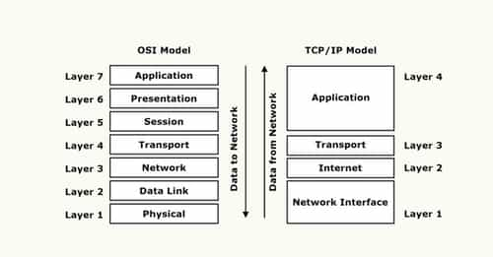
The Open Systems Interconnection (OSI) model describes seven layers that computer systems use to communicate over a network. It was the first standard model for network communications, adopted by all major computer and telecommunication companies in the early 1980s.
TCP/IP stands for Transmission Control Protocol/Internet Protocol and is a suite of communication protocols used to interconnect network devices on the internet. TCP/IP is also used as a communications protocol in a private computer network (an intranet or extranet).
Notes:
The Open Systems Interconnection (OSI) model describes seven layers that computer systems use to communicate over a network. It was the first standard model for network communications, adopted by all major computer and telecommunication companies in the early 1980s. TCP/IP stands for Transmission Control Protocol/Internet Protocol and is a suite of communication protocols used to interconnect network devices on the internet. TCP/IP is also used as a communications protocol in a private computer network (an intranet or extranet).

Slide 3
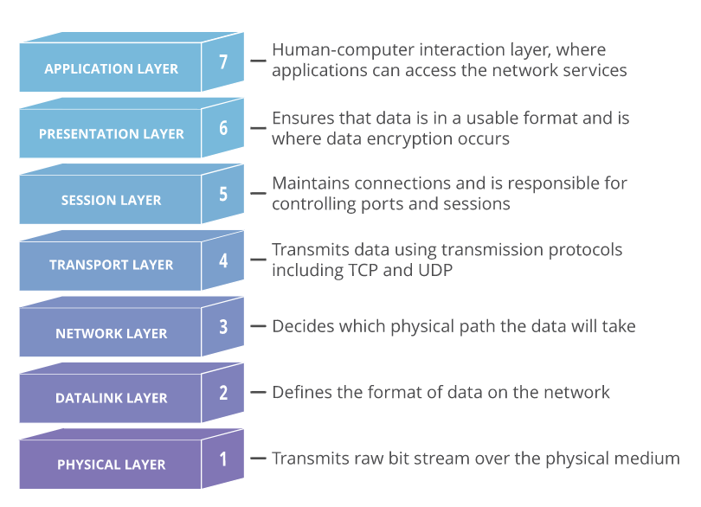

Slide 4
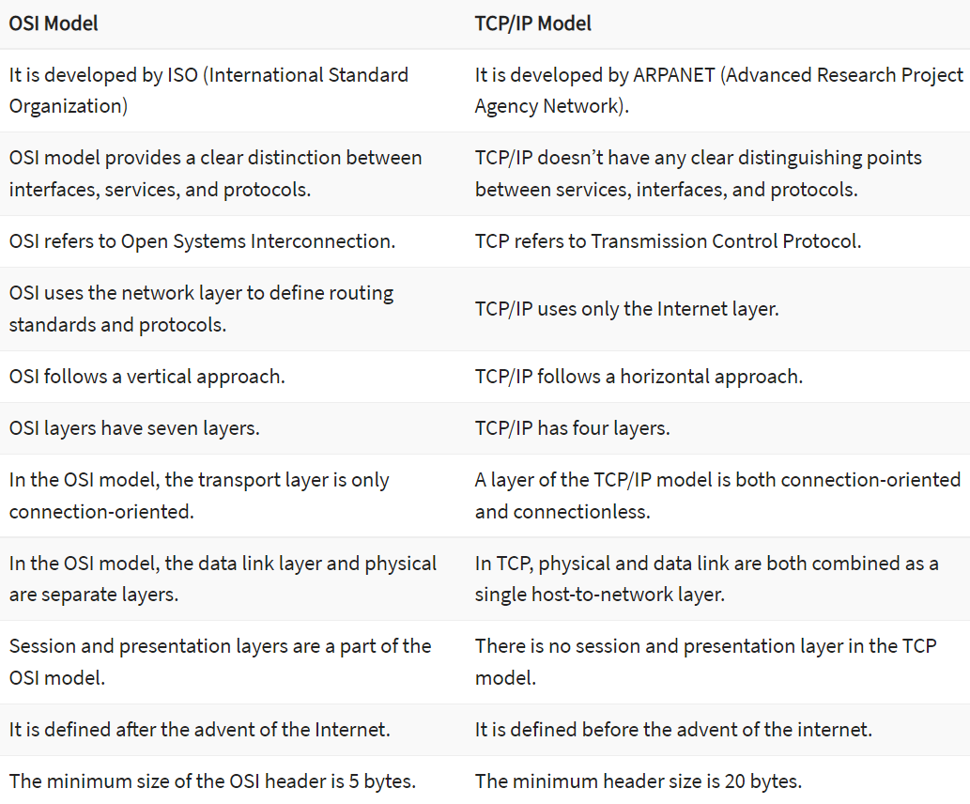
Key Difference Between TCP/IP and OSI Model

Slide 5
What is the Application Layer?
The application layer is the topmost layer of the OSI and TCP/IP models.
The application layer in the TCP/IP model is created by combining the top three layers: the application layer, the presentation layer, and the session layer.
An application layer is an abstraction layer that specifies the shared communications protocols and interface methods that host in network use.
It is the layer closest to the end user, implying that both the application layer and the end user can interact with the software application directly.

Slide 6
Application layer
Application layer protocols define how application processes (clients and servers), running on different end systems, pass messages to each other. In particular, an application layer is an abstract layer that handles the sharing protocol of the TCP/IP and OSI model.
The purpose of application layer protocols is that users can send data, access data, and use networks. The application layer also makes communication easier and sometimes allows users to use software programs.

Slide 7
Application Layer Protocols
The application layer protocols used to make communication between sender and receiver faster, more efficient, reliable, and secure. These protocols will be discussed further below.
SMTP
TELNET
FTP
MIME
POP
HTTP
DNS

Slide 8
Simple Mail Transfer Protocol(SMTP)
One of the most popular application layer protocols for network services is electronic mail (e-mail). The TCP/IP protocol that supports electronic mail on the Internet is called Simple Mail Transfer Protocol (SMTP).
SMTP transfers messages from senders' mail servers to the recipients' mail servers using TCP connections. In SMTP, users are based on e-mail addresses. SMTP provides services for mail exchange between users on the same or different computers.
Following the client/server model:
SMTP has two sides: a client-side, which executes on a sender's mail server, and a server-side, which executes on the recipient's mail server.
Both the client and server sides of SMTP run on every mail server.
When a mail server sends mail (to other mail servers), it acts as an SMTP client.
When a mail server receives mail (from other mail servers), it acts as an SMTP server.

Slide 9
Terminal Network(TELNET)
TELNET is an application layer protocol in which a client-server application allows a user to log onto a remote machine and lets the user access any application program on a remote computer. TELNET uses the NVT (Network Virtual Terminal) system to encode characters on the local system.
On the server (remote) machine, NVT decodes the characters to a form acceptable to the remote machine.
TELNET is a protocol that provides a general, bi-directional, eight-bit byte-oriented communications facility. Many application protocols are built upon the TELNET protocol. Telnet services are used on PORT 23.

Slide 10
File Transfer Protocol(FTP)
FTP is the standard mechanism provided by TCP/IP for copying a file from one host to another. FTP differs from other client-server applications because it establishes 2 connections between hosts. Two connections are Data Connection and Control Connection.
Data Connection uses PORT 20, and control connection uses PORT 21. FTP is built on a client-server architecture and uses separate control and data connections between the client and the server. One connection is used for data transfer, the other for control information (commands and responses). The FTP is data reliably and efficiently.

Slide 11
Multipurpose Internet Mail Extensions (MIME)
The Multipurpose Internet Mail Extensions (MIME) is an extension of SMTP that allows the transfer of multimedia messages. If binary data is included in a message, MIME headers are used to inform the receiving mail agent that is as follows:
Content-Transfer-Encoding: The header alerts the receiving user agent that the message body has been ASCII encoded and the type of encoding used.
Content-Type: The header informs the receiving mail agent about the type of data in the message.

Slide 12
Post Office Protocol(POP)
POP(Post Office Protocol) is also called the POP3 protocol. This is a protocol used by a mail server in conjunction with SMTP to receive and holds mail for hosts.
POP3 mail server receives e-mails and filters them into the appropriate user folders.
When a user connects to the mail server to retrieve his mail, the messages are downloaded from the mail server to the user's hard disk.

Slide 13
Domain Name System(DNS)
In Domain Name System(DNS), TCP/IP protocol uses the IP address that uniquely identifies a host's connection to the Internet to identify an entity.
DNS is a hierarchical system based on a distributed database that uses a hierarchy of Name Servers to resolve Internet host names into the corresponding IP addresses required for packet routing by issuing a DNS query to a name server.
DNS in the Internet: DNS is a protocol that can be used on different platforms.

Slide 14
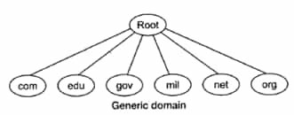
Domain name space is divided into three categories.
Generic Domain: The generic domain defines registered hosts according to their generic behavior. Each node in the tree defines a domain which is an index to the domain name space database.
Country Domain: The country domain section follows the same format as the generic domain but uses 2 characters of country abbreviations (e.g., the US for the United States) instead of 3 characters.
Inverse Domain: The inverse domain maps an address to a name.

Slide 15
HTTP (Hypertext Transfer Protocol)
HTTP is an client-server protocol that allows clients to request web pages from web servers. It is an application level protocol widely used on the Internet.
Clients are usually web browsers. When a user wants to access a web page, a browser sends an HTTP Request message to the web server. The server responds with the requested web page. By default, web servers use the TCP port 80.

Slide 16
Clients and web servers use request-response method to communicate with each other, with clients sending the HTTP Requests and servers responding with the HTTP Responses.
Clients usually send their requests using GET or POST methods, for example GET /homepage.html. Web servers responds with a status message (200 if the request was successful) and sends the requested resource.

Slide 17
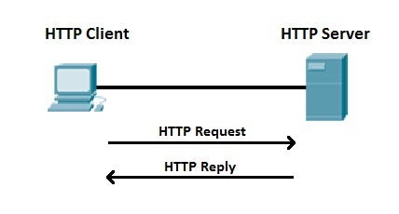
The client wants to access http://google.com and points his browser to the URL http://google.com (this is an example of an HTTP Request message). The web server hosting http://google.com receives the request and responds with the content of the web page (the HTTP response message).
Web servers usually use a well-known TCP port 80. If the port is not specified in a URL, browsers will use this port when sending HTTP request. For example, you will get the same result when requesting http://google.com and http://google.com:80.
The version of HTTP most commonly used today is HTTP/1.1. A newer version, HTTP/3 (released in 2022), is available and supported by most browser.
Notes:
It is now used by over 25% of websites and is supported by many web browsers (over 75% of users). HTTP/3 uses QUIC instead of TCP for the underlying transport protocol. Like HTTP/2, it does not obsolesce previous major versions of the protocol.

Slide 18
HTTPS (Hypertext Transfer Protocol Secure)
Hypertext Transfer Protocol Secure is a secure version of HTTP. This protocol enables secure communication between a client (e.g. web browser) and a server (e.g. web server) by using encryption.
HTTPS uses Transport Layer Security (TLS) protocol or its predecessor Secure Sockets Layer (SSL) for encryption.
HTTPS is commonly used to create a secure channel over some insecure network, e.g. Internet.
A lot of traffic on the Internet is unencryped and susceptible to sniffing attacks. HTTPS encrypts sensitive information, which makes a connection secure.

Slide 19

HTTPS (Hypertext Transfer Protocol Secure)
HTTPS URLs begin with https instead of http. In web browser, you can immediately recognize that a web site is using HTTPS because a lock appears to the right of the address bar:
HTTPS uses a well-known TCP port 443. If the port is not specified in a URL, browsers will use this port when sending HTTPS request. For example, you will get the same result when requesting https://gmail.com and https://gmail.com:443.

Slide 20
Security
The HTTP protocol is not secure protocol as it does not contain SSL (Secure Sockets Layer), which means that the data can be stolen when the data is transmitted from the client to the server.
Whereas, the HTTPS protocol contains the SSL certificate that converts the data into an encrypted form, so no data can be stolen in this case as outsiders do not understand the encrypted text.

Slide 21
Port numbers
The HTTP transmits the data over port number 80, whereas the HTTPS transmits the data over 443 port number. Under the documentation issued by Tim Berners-Lee, he stated that "if the port number is not specified, then it will be considered as HTTP".
When RFC 1340 was announced, then the IETF (Internet Engineering Task Force) provided port number 80 to the HTTP. When the new RFC was released in the year 1994, the HTTPS is assigned with a port number 443.

Slide 22
LAYERS: The HTTP protocol works on the application layer while the HTTPS protocol works on the transport layer. As we know that the responsibility of the transport layer is to move the data from the client to the server, and data security is a major concern. HTTPS operates in the transport layer, so it is wrapped with a security layer.
SSL Certificates: When we want our websites to have an HTTPS protocol, then we need to install the signed SSL certificate. The SSL certificates can be available for both free and paid service. The service can be chosen based on business needs.
The HTTP does not contain any SSL certificates, so it does not decrypt the data, and the data is sent in the form of plain text.

Slide 23
SEO Advantages: The SEO advantages are provided to those websites that use HTTPS as GOOGLE gives the preferences to those websites that use HTTPS rather than the websites that use HTTP.
Online Transactions: If we are running an online business, then it becomes necessary to have HTTPS. If we do not use the HTTPS in an online business, then the customers would not purchase as they are scared that their data can be stolen by the outsiders.

Slide 24
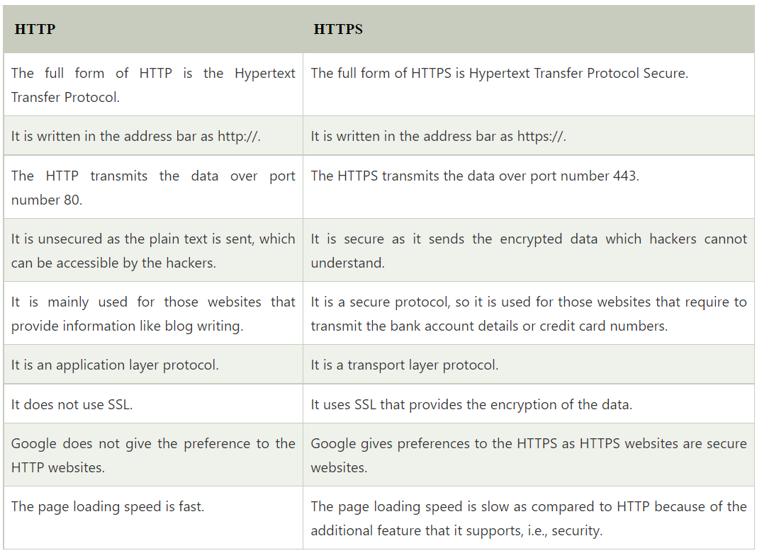

Slide 25
What is a port?
A port is a virtual point where network connections start and end. Ports are software-based and managed by a computer's operating system. Each port is associated with a specific process or service. Ports allow computers to easily differentiate between different kinds of traffic: emails go to a different port than webpages, for instance, even though both reach a computer over the same Internet connection.
A port number is a 16-bit integer ranging from 0 to 65535. A port number uniquely identifies this application to the protocol underlying this TCP/IP host (TCP, UDP, or IP).
What is a port number?
Ports are standardized across all network-connected devices, with each port assigned a number. Most ports are reserved for certain protocols — for example, all Hypertext Transfer Protocol (HTTP) messages go to port 80. While IP addresses enable messages to go to and from specific devices, port numbers allow targeting of specific services or applications within those devices.

Slide 26
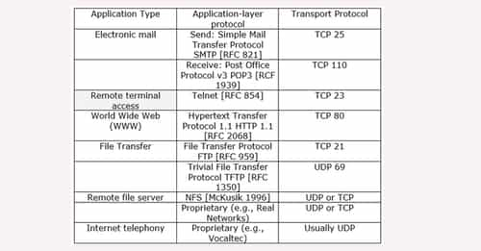

Slide 27
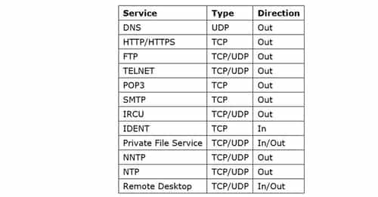

Slide 28
Thank you

