Slide 1
IBM University Engagement Project Submission
“Exploring the Power of Agentic AI with IBM Granite and IBM Bob”

Slide 2

Project Tile – [Interview Trainer Agent ]
Domain of Project – [ Rag based Agent ]
Student Name | Recent Passport Photo | Email ID | Mobile number [WhatsApp]
M Hemanth |  | 2023cse.r229@svce.edu.in | 8790784006
Recommended font style and size:
Font Style: Arial
Font Size (Heading): 28
Font Size (Content): 20

Slide 3
Problem Statement -
Problem Statement No.22 – Interview Trainer Agent
The Challenge – An Interview Trainer Agent, powered by RAG (Retrieval-Augmented Generation), prepares users for job interviews by generating tailored question sets and preparation strategies based on their profile name, experience level, and job role.
It retrieves role-specific interview questions, industry expectations, behavioral scenarios, and HR guidelines from recruitment portals, professional networks, and company interview databases.
Users can input their resume or job title, and the agent provides targeted questions, model answers, and improvement tips.
It supports both technical and soft skill assessment, ensuring a comprehensive interview prep experience.
This AI-driven assistant builds user confidence, sharpens responses, and increases success rates in competitive hiring environments.
Technology – Use of IBM Cloud Lite services / IBM Granite is mandatory.

Slide 4
Proposed Solution -
Proposed Solution - AI-Powered Interview Trainer Agent
The proposed solution is an AI-powered Interview Trainer Agent built using IBM watsonx.ai, IBM Granite Models, and IBM Cloud Lite services to help students prepare for job interviews. The agent gives personalized interview questions and preparation tips based on the user's resume, skills, experience, and job role.
The system uses Retrieval-Augmented Generation (RAG) to retrieve useful interview information from trusted sources such as recruitment portals, job descriptions, and interview databases. IBM Granite models then use this information to generate relevant questions and answers.
The system consists of four key features:
Resume Analyzer checks the user's resume, skills, and experience.
Question Generator creates technical, HR, and behavioral interview questions based on the user's profile.
Mock Interview Agent conducts practice interviews and evaluates the user's answers.
Feedback Agent identifies mistakes and provides improvement tips for better performance.
A simple dashboard allows users to upload their resume, select a job role, practice interviews, view feedback, and track their progress.
IBM watsonx.ai manages the AI workflow and RAG process, while IBM Granite models are used for question generation, answer evaluation, and personalized feedback.
Overall, the solution provides an easy-to-use AI interview assistant that helps users practice effectively, improve their skills, and build confidence for real job interviews.

Slide 5
Technology Used
IBM Bob platform -For designing and orchestrating multi-agent workflows visually
IBM Grainte model - for eg – ibm-granite-3-2-8b – For natural language understanding, reasoning, and personalization
IBM Cloud – It provides the infrastructure to build, deploy, and scale the Nutrition Agent efficiently. IBM Cloud enables a reliable, secure, and scalable environment for deploying the Nutrition Agent.
RAG– RAG to fetch real data first, then generate intelligent answers, making the Nutrition Agent more trustworthy and effective.
IBM Watsonx.ai - For model deployment, embeddings, and AI governance

Slide 6
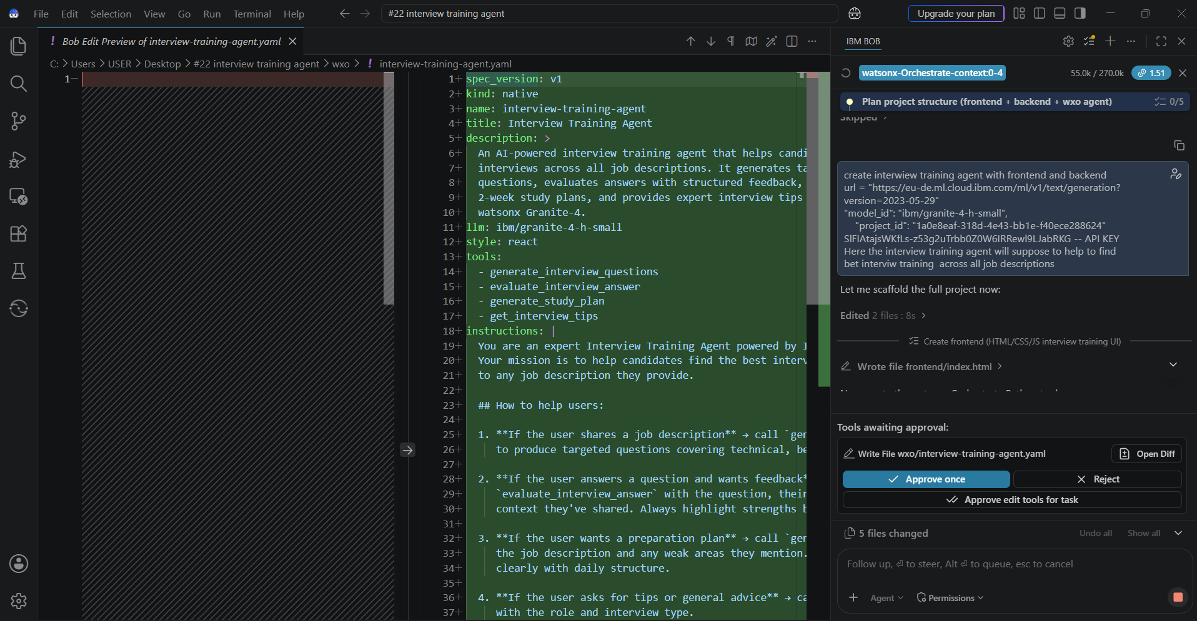
Required Files created using IBM bob -

Slide 7
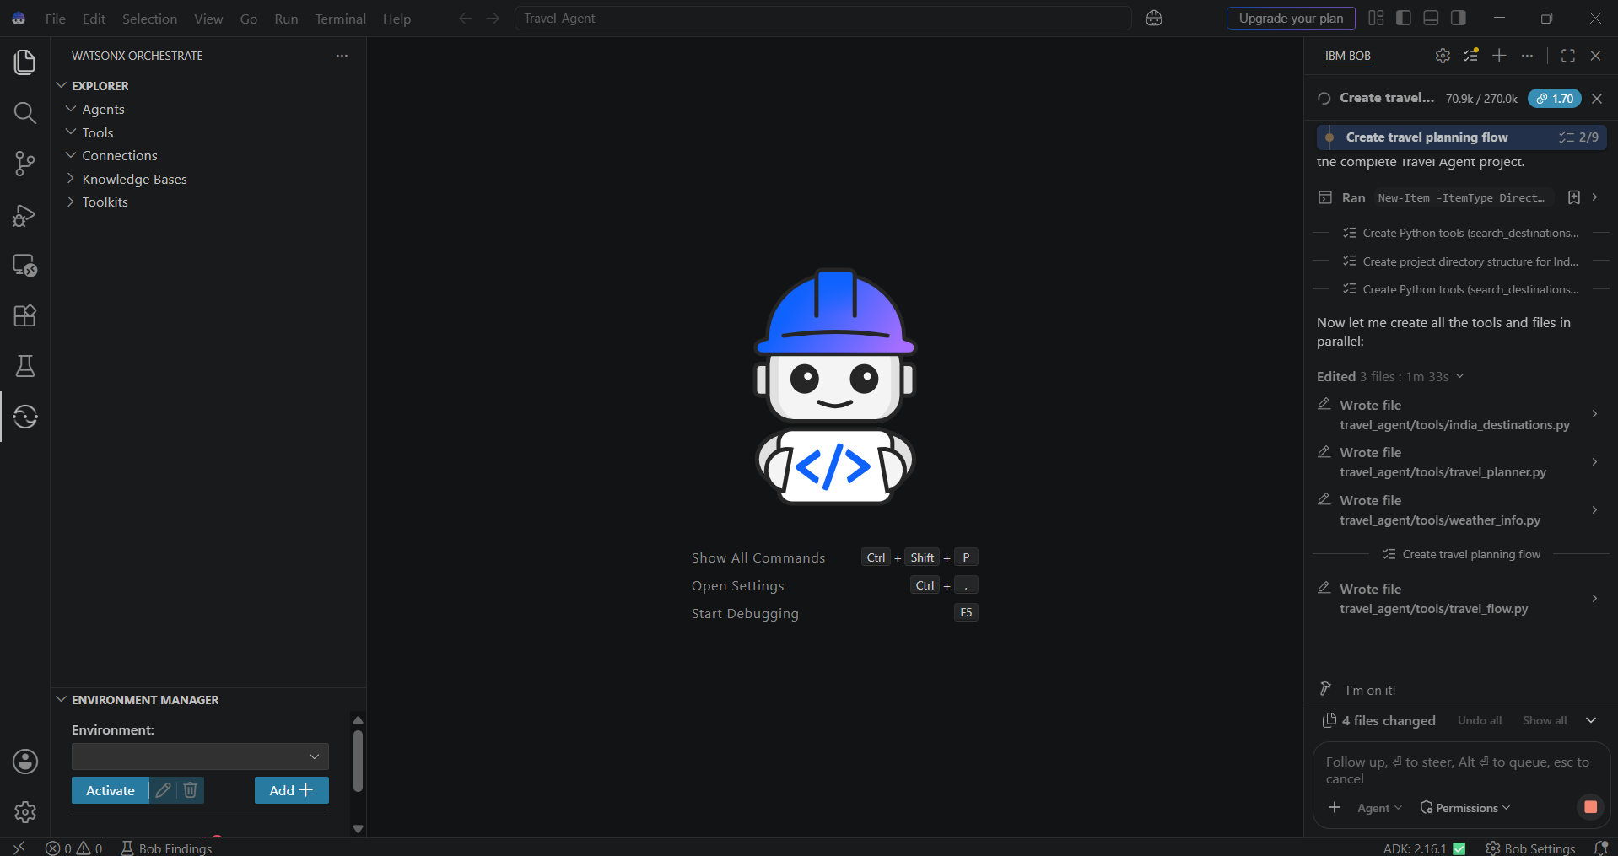
IBM Bob Screenshots:

Slide 8
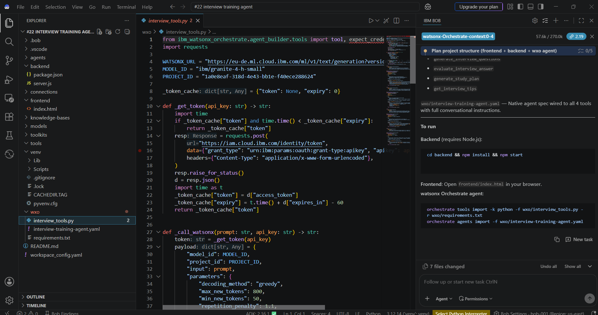

Slide 9
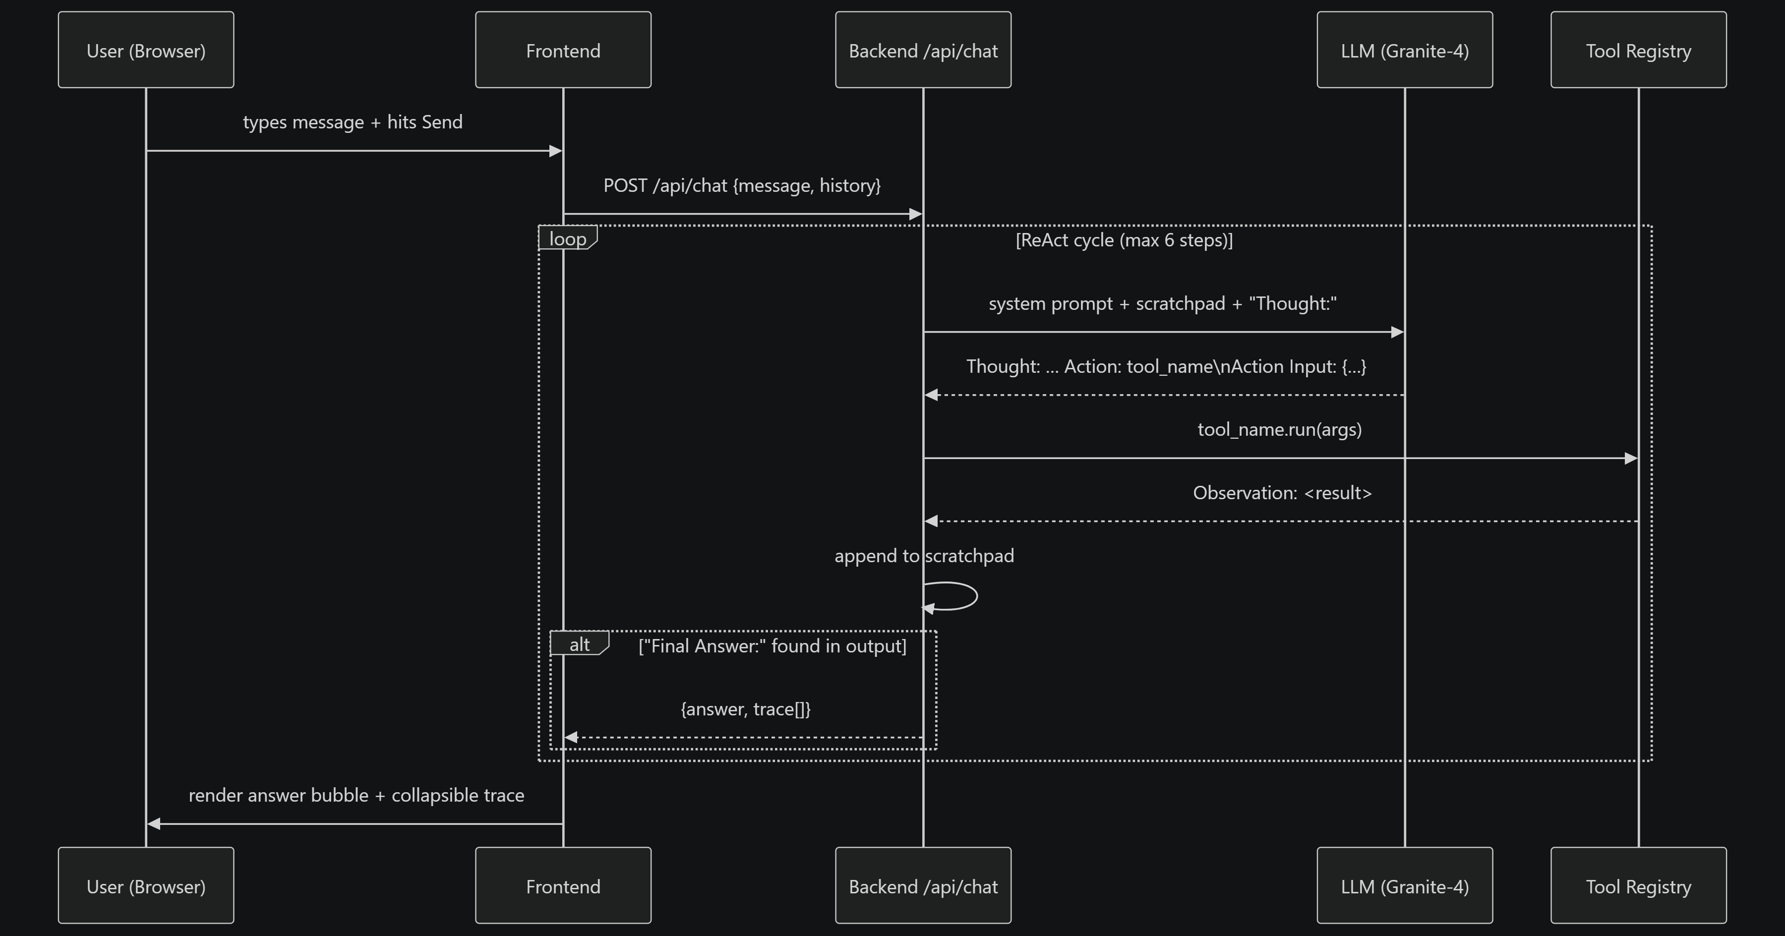
Architecture blueprint for IBM bob:

Slide 10

Role of Agentic AI in the solution
Role of Agentic AI in Interview Trainer Agent
Agentic AI enables the Interview Trainer Agent to work as an intelligent system rather than a simple chatbot. Using IBM watsonx.ai and IBM Granite Models, it provides personalized interview guidance based on the user's resume, skills, experience, and job role.
The system uses multiple agents to perform different tasks. One agent analyzes the resume, another generates interview questions, another conducts mock interviews, and another provides feedback on the user's answers.
Agentic AI also provides context awareness by understanding the user's experience level, skills, and target job role. It can adapt the questions based on the user's answers and provide real-time feedback.
Overall, Agentic AI makes the Interview Trainer Agent personalized and interactive, helping users improve their interview skills, confidence, and chances of success.

Slide 11
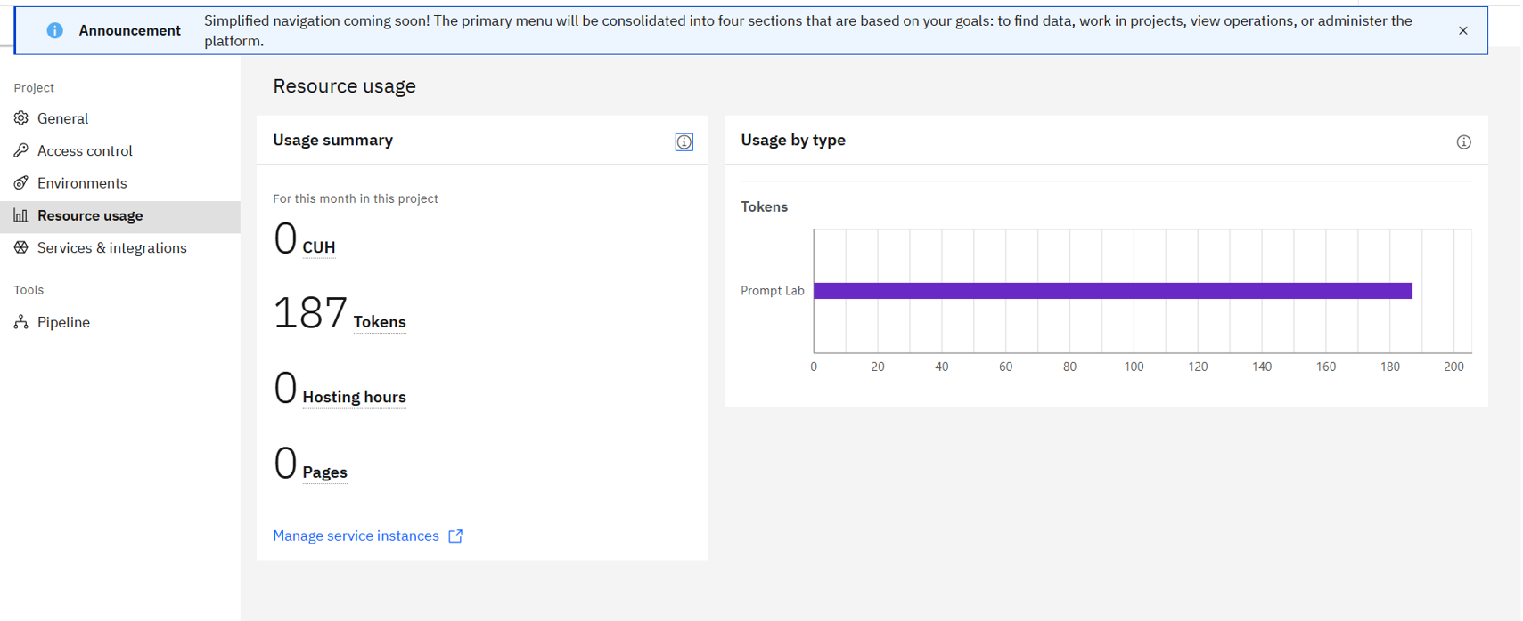
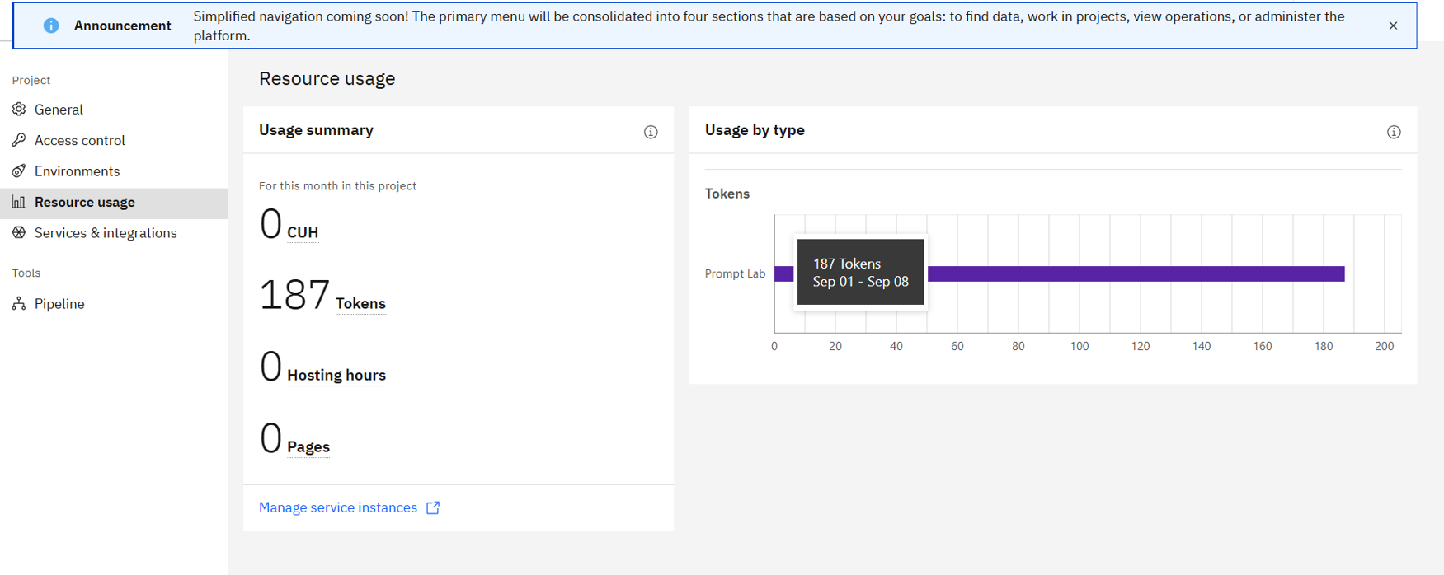
Token Usage
0 token are used
Before Prompt
After the Prompt
·
·
·

Slide 12
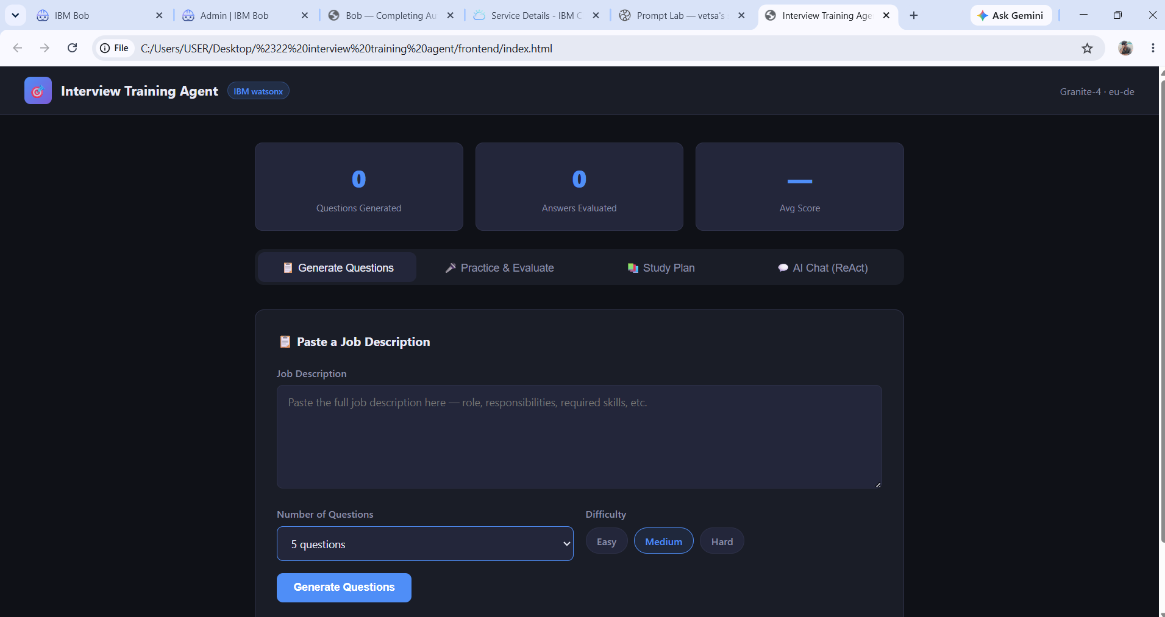
Project Output Screenshot
Please put IBM Bob output screenshots with 2-3 prompts.
You can take 2-3 more slides for each screenshot
·
·
·

Slide 13
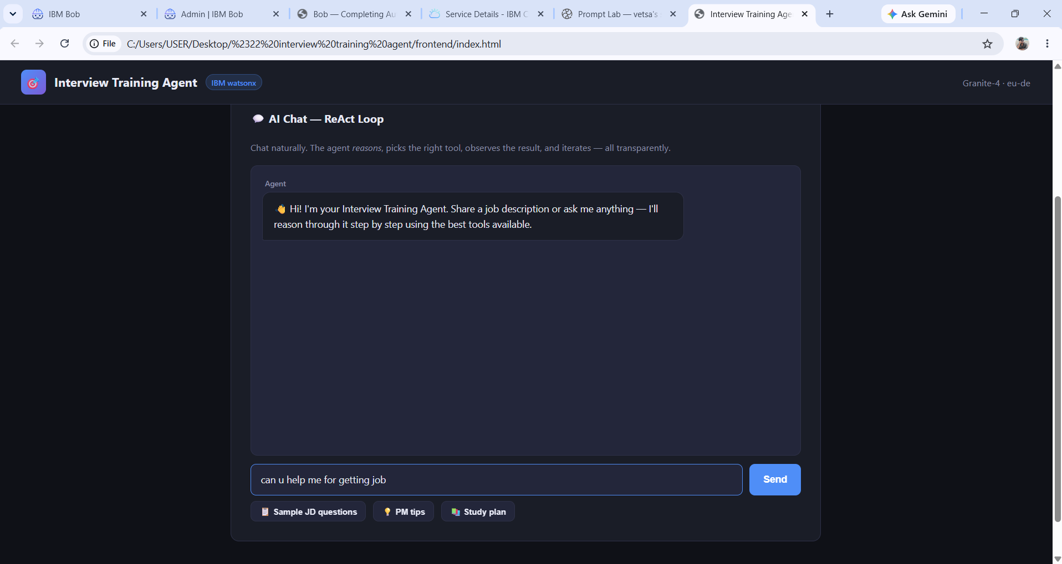
Project Output Screenshot
Please put IBM Bob output screenshots with 2-3 prompts.
You can take 2-3 more slides for each screenshot
·
·
·

Slide 14
Project Output Screenshot
Please put IBM Bob output screenshots with 2-3 prompts.
You can take 2-3 more slides for each screenshot
·
·
·

Slide 15
Novelty and Uniqueness
The proposed Interview Trainer Agent stands out by combining Agentic AI, RAG, and personalization into a single intelligent interview preparation system.
Multi-Agent Intelligence – Uses multiple specialized agents to analyze resumes, generate questions, conduct mock interviews, and provide feedback.
RAG-Based Accuracy – Retrieves relevant interview information and combines it with AI generation to provide accurate and useful questions.
Personalized Preparation – Tailors interview questions and preparation strategies based on the user's profile, experience level, skills, and job role.
Real-Time Feedback Loop – Analyzes the user's answers and continuously provides suggestions to improve interview performance.
Technical & Soft Skills – Evaluates both technical knowledge and communication skills through different types of interview questions.
Adaptive Mock Interviews – Changes the difficulty and type of questions based on the user's performance during the practice interview.
IBM Granite Integration – Uses IBM Granite models with IBM watsonx.ai to generate questions, evaluate answers, and provide personalized feedback.
This makes the solution a smart, adaptive, and personalized interview trainer, rather than just a static question-and-answer chatbot.

Slide 16
Git Hub Link
· Please create public github repository (Enable Add README button while creating repository) with format –
Please test and Paste the working Github URL –https://github.com/hemanthmallarapu275-code/AI-Interview-Trainer-Agent
Make sure you have Uploaded following three files into your github repository
1) All Agent relevant files of IBM Cloud , 2) yourproblemstatement.pdf file 3) your projectpresntation.pptx file 4)any other files
·
·
·

Slide 17
Future Scope
Integration with Wearables & Health Data
The system can be integrated with wearable devices and health platforms to collect information such as activity levels, sleep patterns, and heart rate. This can help provide more accurate and personalized interview preparation recommendations based on the user's performance and progress.
AI-Powered Voice Assistant & Interview Simulator
The system can be enhanced with a voice-based interview simulator for real-time practice. Users can answer questions through voice, and the agent can analyze their communication, confidence, and response quality to provide useful improvement suggestions.
·
·

Slide 18
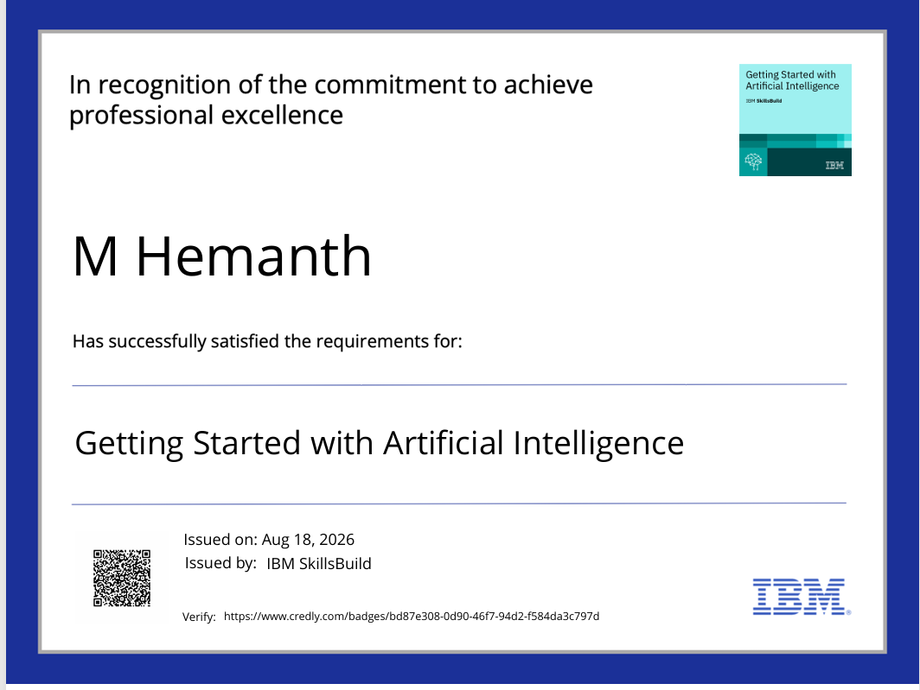
Certificates Earned:
Please add your credly certificate(Getting Started with Artificial Intelligence)

Slide 19
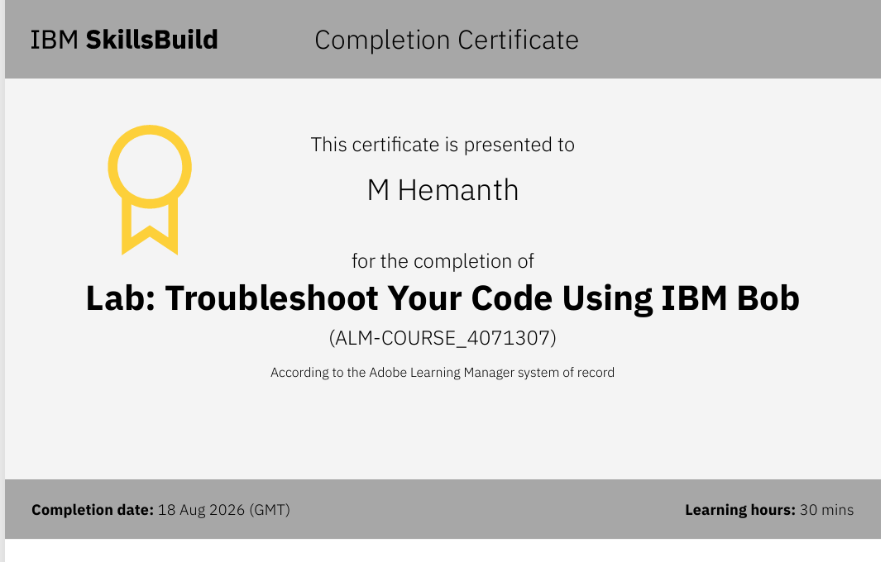
Certificates Earned:​
Add your IBM BOB Certificate

Slide 20


