Slide 1
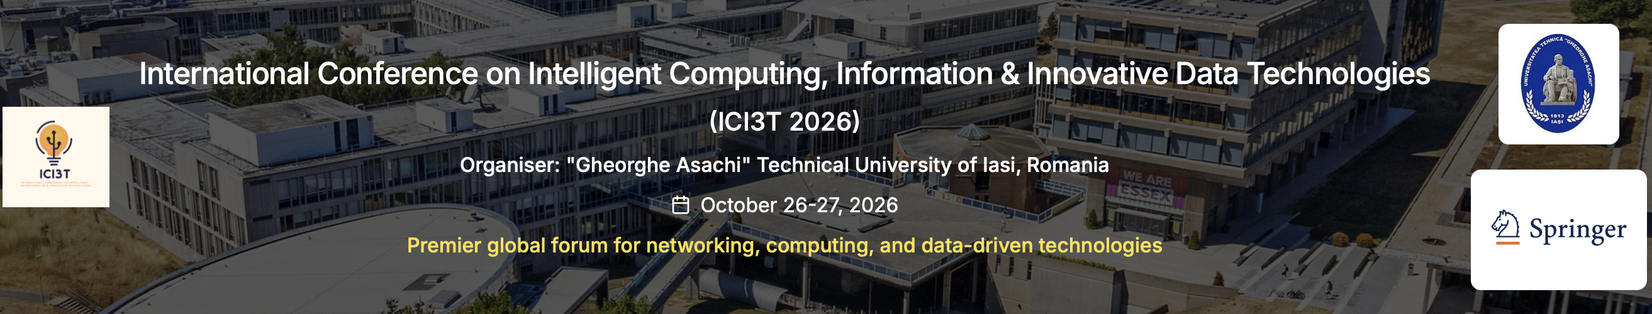
INTERNATIONAL CONFERENCE ON INTELLIGENT COMPUTING, INFORMATION & INNOVATIVE DATA TECHNOLOGIES (ICI3T 2026)
Spectral Diagnostic Trajectories: Multi-Modal Hypergraph State-Space Tracking, Context Decoupling, and Congestion Mitigation in Stochastic Clinical Service Systems
Hemanth Manchabale Papachappa
Graduate School of Engineering / Biomedical Informatics Program, Stanford University, Stanford, CA 94305, USA
Aniruddha Ganguly
Department of Computer Science and Engineering, Jadavpur University, Kolkata, West Bengal 700032, India
Track: Healthcare AI, Spectral Graph Theory & Stochastic Operations | Organiser: "Gheorghe Asachi" Technical University of Iasi, Romania
Notes:
[TIMING: 0:00 - 0:45 | ~45 sec]
ORAL PRESENTATION SCRIPT:
"Good morning session chairs and colleagues. My name is Hemanth Manchabale Papachappa from Stanford University, presenting our work co-authored with Aniruddha Ganguly from Jadavpur University: 'Spectral Diagnostic Trajectories: Multi-Modal Hypergraph State-Space Tracking, Context Decoupling, and Congestion Mitigation in Stochastic Clinical Service Systems'.
We address a critical bottleneck at the intersection of AI, clinical workflow, and queueing operations: how clinicians retrieve information under acute uncertainty, and why eliminating search friction directly unlocks macroscopic throughput gains in congested hospital emergency departments."
KEY TALKING POINTS:
• Stanford University & Jadavpur University collaboration.
• Core intersection: Healthcare AI, Spectral Graph Theory, and Stochastic Operations Research.

Slide 2
AGENDA & STRUCTURE
1. INDEX: Presentation Roadmap
01. Operational Motivation
High-acuity emergency care, multimodal telemetry fragmentation, and search latency bottlenecks.
04. The SDT Framework
Dynamic hypergraph Laplacians, continuous state-space Mamba-2 waveforms (125 Hz).
07. Erlang C Queueing Model
Theorem 3: Super-linear waiting time sensitivity O((1-ρ)^-2) in congested hospital servers.
02. Literature Review
Systematic synthesis of lexical, dense RAG, knowledge graphs, and Riemannian manifold approaches.
05. Theoretical Decoupling
Theorem 1: Linear-time O(|Et|) pivot detection; Theorem 2: Formal Cheeger conductance bounds.
08. Benchmark Results
9-arm Latin-square trial on 1,000 vignettes (9,000 runs): TTCI (-28.9%), Accuracy (93.9%), Recall@5.
03. Critical Research Gaps
The memoryless vs. over-smoothed dilemma, waveform neglect, and context contamination.
06. Cognitive Prefetching
Spectrally biased random walks under Sweller working-memory surprisal limits (Cmax = 7.0 bits).
09. Operational Translation
NASA-TLX workload reductions, >10,200 annual ER boarding hours saved, and deployment roadmap.
Notes:
[TIMING: 0:45 - 1:15 | ~30 sec]
ORAL PRESENTATION SCRIPT:
"Here is our roadmap. We begin with clinical search bottlenecks and research gaps in the literature. We then present the Spectral Diagnostic Trajectories architecture and its theoretical Cheeger bounds. Finally, we report empirical outcomes across 1,000 standardized vignettes and 9,000 sessions, examine clinician workload and macro-queueing impacts, and conclude with the translational roadmap."
KEY TALKING POINTS:
• Logical progression from clinical challenge to mathematical guarantees and hospital-wide operational impact.

Slide 3
EXECUTIVE SUMMARY
2. ABSTRACT: Executive Summary & Theoretical Contributions
The Clinical Dilemma
• Severe Time Sink: Clinicians spend >33% of active shifts querying fragmented EHR charts.
• Trajectory Failure: Systems either forget history (stateless) or lag behind shifts (Riemannian smoothing).
• Context Contamination: Obsolete hypotheses pollute prompts during acute pivots, causing cognitive fatigue and boarding delays.
The SDT Framework
• Multi-Modal Tracking: Unifies 125 Hz telemetry (Mamba-2) and clinical notes into dynamic hypergraphs.
• Cheeger Decoupling Cut: Monitors Laplacian spectral gap in linear time O(|Et|); isolates obsolete context (P_leak ≤ √(2τ_pivot)).
• Cognitive Prefetch: Stages prospective records via 0/1 knapsack bounded by Sweller limits (Cmax = 7.0 bits).
Empirical & Queueing Impact
• 28.9% Faster Insight: TTCI drops to 62.97s (vs. 88.52s control, p < 10^-12) with 93.9% resolution accuracy.
• 32.2% Cognitive Relief: Modeled workload drops; mental demand -42.5%, frustration -56.2%.
• Macro ED Impact: Super-linear queue leverage saves 12.31 min wait time/patient, eliminating >10,200 annual boarding hours.
Notes:
[TIMING: 1:15 - 2:15 | ~1.0 min]
ORAL PRESENTATION SCRIPT:
"To summarize the paper's core contributions: Clinicians in acute care spend over 33% of active shifts querying fragmented EHRs. When a patient's presentation abruptly pivots—such as an initial pneumonia impression revealing pulmonary embolism—conventional retrievers fail: stateless models discard workflow context, while continuous Riemannian smoothing lags behind acute bifurcations.
SDT unifies continuous 125 Hz telemetry and clinical notes into dynamic hypergraphs. By tracking the hypergraph Laplacian spectral gap in linear time O(|Et|), we detect pivots instantly and apply Cheeger bisections to sever obsolete context.
This achieves a 28.9% TTCI speedup, 93.9% resolution accuracy, a 42.5% mental workload reduction, and eliminates 12.3 minutes of emergency waiting room delay per patient."
KEY TALKING POINTS:
• Problem: Context contamination during acute diagnostic regime shifts.
• SDT Solution: Dynamic hypergraph tracking, Cheeger decoupling cut, and cognitive knapsack prefetching.
• Key Gains: 28.9% faster insight, 93.9% accuracy, 12.3 min wait time reduction.

Slide 4
OPERATIONAL MOTIVATION
3. INTRODUCTION: High-Acuity Healthcare Operations & Context Drift
Information Overload & Latency
• High-Acuity Reality: 20–30 concurrent, undifferentiated patients per emergency physician.
• Telemetry Fragmentation: Continuous 125–250 Hz waveforms, discrete labs, imaging, and notes.
• Search Bottleneck: >33% shift time spent in chart navigation; search latency directly delays critical care.
Diagnostic Regime Shifts
• Non-Stationary Workflows: 53.1% of complex emergency cases exhibit acute diagnostic bifurcations.
• Acute Pivot Example: Pneumonia working impression abruptly refuted by emergent telemetry indicating pulmonary embolism.
• Context Poisoning: Legacy search retains stale evidence in context, misguiding retrieval and inducing cognitive closure.
Congested Queueing Dynamics
• Near-Saturation Operations: Emergency departments operate at heavy utilization (ρ = λ/(cμ) > 0.90).
• Super-Linear Delays: Near saturation, queue delay scales quadratically: ∂Wq/∂(Δt) ≈ O((1-ρ)^-2).
• Compounding Leverage: Saving 25.6s of search time pulls the hospital away from catastrophic waiting asymptotes.
Notes:
[TIMING: 2:15 - 3:30 | ~1 min 15 sec]
ORAL PRESENTATION SCRIPT:
"Let us examine the operational realities. An emergency physician manages 20 to 30 concurrent, undifferentiated patients inundated with multi-rate data: continuous 125 Hz ECG waveforms, labs, radiographs, and narrative notes.
Crucially, 53% of complex emergency cases undergo acute diagnostic regime shifts. In current systems, obsolete evidence remains trapped in the context window. This 'context poisoning' biases downstream retrieval and induces cognitive fatigue.
Furthermore, emergency departments operate under heavy traffic (rho > 0.90). In this regime, waiting time scales quadratically: O((1-rho)^-2). Even modest search delays amplify into hours of department-wide boarding. Saving 25 seconds per encounter is high-leverage because it shifts operations away from catastrophic delay asymptotes."
KEY TALKING POINTS:
• Information overload: 20-30 concurrent patients, continuous multi-rate data.
• Context poisoning: 53% of cases pivot, trapping stale hypotheses in retrieval prompts.
• Queueing leverage: Near-saturation queues magnify individual task delays into system-wide gridlock.

Slide 5
LITERATURE COMPARISON
4. LITERATURE REVIEW: Systematic Synthesis of Clinical Retrieval Paradigms
Comprehensive evaluation of existing paradigms across mathematical representation, pivot adaptation, waveform support, and operational guarantees:
Retrieval Paradigm | Benchmark Systems | Mathematical Representation | Diagnostic Pivot Adaptation | Core Technical Limitations
Lexical Matching | BM25, TF-IDF (Baeza-Yates '99) | Inverted index, term frequency vectors | None (Stateless query-by-query) | High IDF over-weights rare historical terms; zero session continuity; high cognitive burden.
Dense Clinical RAG | MedCPT (Jin '23), ColBERTv2 ('22) | Dual-encoder embeddings, MaxSim late interaction | None (Memoryless dense lookup) | Discards longitudinal interaction trajectory; forces repetitive manual query reformulations.
Static Knowledge Graphs | GraphCare (Jiang et al. '24) | Predefined medical ontology, 2-hop GNN message passing | Static graph traversal | Static relational graph cannot ingest continuous 125 Hz telemetry; inflexible to sudden bifurcations.
Continuous Manifolds | GDT Framework (Riemannian SPD) | Covariance on SPD manifold S_d^+ (Pennec '06) | Continuous exponential smoothing (e^-γt) | Riemannian geodesic smoothing lags behind abrupt discrete bifurcations; context contamination persists.
SDT (Proposed) | Spectral Diagnostic Trajectories (Ours) | Dynamic Hypergraph Laplacian + Mamba-2 State Space | Exact Cheeger Cut on Fiedler Vector (v2) | Resolves all prior limitations: O(|Et|) pivot detection, provable Cheeger bounds, super-linear queue relief.
Notes:
[TIMING: 3:30 - 4:45 | ~1 min 15 sec]
ORAL PRESENTATION SCRIPT:
"Evaluating the literature reveals four existing paradigms:
1. Lexical search (BM25) is stateless, ignores clinical trajectory, and lacks waveform support.
2. Dense Semantic RAG (MedCPT) captures semantic text similarities, but remains memoryless between turns.
3. Knowledge Graphs (GraphCare) capture static medical ontologies, but cannot ingest continuous 125 Hz telemetry.
4. Continuous Riemannian Manifolds (GDT) model drift on SPD cones, but continuous geodesic smoothing mathematically lags behind acute discrete bifurcations.
SDT bridges these worlds: dynamic hypergraph Laplacians, continuous Mamba-2 telemetry state-spaces, and discrete Cheeger cuts that isolate obsolete context with formal mathematical guarantees."
KEY TALKING POINTS:
• Highlight the matrix columns.
• Emphasize the core contrast: Continuous manifold smoothing vs. discrete Cheeger topological cuts.

Slide 6
CRITICAL RESEARCH GAPS
5. RESEARCH GAPS: Fundamental Deficiencies in Existing Paradigms
GAP 01: Memoryless vs. Over-Smoothed Trajectory Dilemma
• Stateless RAG: Discards longitudinal history entirely, forcing repetitive query reformulations.
• Riemannian Manifolds (GDT): Enforces continuous exponential smoothing, lagging behind acute discrete bifurcations.
GAP 02: Neglect of High-Frequency Telemetry Waveforms
• Text/Code Bias: Clinical RAG indexes static narratives, completely ignoring 125–250 Hz physiological telemetry.
• Missed Early Signals: Waveforms carry the earliest markers of instability (e.g., S1Q3T3 RV strain in pulmonary embolism).
GAP 03: Unbounded Context Contamination & Mental Fatigue
• Context Poisoning: Obsolete hypotheses pollute prompts during pivots, inducing confirmation bias.
• Unbounded Speculation: Prefetchers push uncurated records, breaching human working memory limits (Miller's 7±2).
GAP 04: Micro-Latency to Macro-Congestion Disconnect
• Isolated Benchmarks: Models are evaluated purely on algorithm latency (ms) without clinical queueing context.
• Super-Linear Queue Physics: Near saturation (ρ > 0.90), 25s task savings prevents hours of department-wide boarding.
Notes:
[TIMING: 4:45 - 5:45 | ~1.0 min]
ORAL PRESENTATION SCRIPT:
"This analysis uncovers four critical research gaps:
Gap 1: The Memoryless vs. Over-Smoothed Dilemma. Stateless models discard trajectory; continuous manifold models over-smooth.
Gap 2: Neglect of High-Frequency Waveforms. Current RAG systems index text narratives and billing codes, ignoring continuous 125 Hz physiological telemetry that carries the earliest markers of acute instability.
Gap 3: Unbounded Context Contamination. Systems lack topological mechanisms to prune obsolete context, causing prompt poisoning and clinician cognitive fatigue.
Gap 4: Micro-Latency to Macro-Congestion Disconnect. Prior work benchmarks millisecond query latency in isolation, ignoring the super-linear queueing physics of congested hospital systems."
KEY TALKING POINTS:
• Four foundational gaps: memoryless dilemma, waveform omission, prompt pollution, and queueing disconnect.

Slide 7
SYSTEM ARCHITECTURE
6. PROPOSED METHODOLOGY: The Spectral Diagnostic Trajectories (SDT) Framework
1. Multi-Modal Ingestion
• Clinical Notes: LayerNorm ClinicalBERT (d=768→128)
• Waveforms: 125 Hz continuous streams via linear-time Mamba-2 (d=128, N=64)
• Discrete Events: Lab flowsheets & diagnostic codes
2. Dynamic Hypergraph
• State Representation: Polyadic hyperedges e = (v_diag, v_wave, v_lab)
• Composite Weight: Semantic + Temporal (e^-λΔt) + Severity
• Laplacian: Lt = I - Dv^-1/2 At Dv^-1/2
3. Pivot Detection
• Linear-Time O(|Et|): Track Fiedler value λ2(Lt) via warm-started Lanczos
• Pivot Trigger: Spectral gap drop Δλ2(t) > τ_pivot = 0.15
• Real-Time: Sub-15ms detection of acute diagnostic shifts
4. Cheeger Decoupling
• Chebyshev Filter: Degree K=3 polynomial smoothing
• Cheeger Bisection: Partition into V_stale vs. V_active
• Theorem 1 Bound: Provable leak bound P_leak ≤ √(2τ_pivot) = 0.548
5. Cognitive Prefetch
• Biased Random Walk: Prospective traversal on global graph (N=546k)
• 0/1 Knapsack: Bounded by Sweller capacity (Cmax ≤ 7.0 bits)
• M/M/c Queue Coupling: Compounds into macro wait reduction
Notes:
[TIMING: 5:45 - 7:45 | ~2.0 min]
ORAL PRESENTATION SCRIPT:
"Here is the 5-stage SDT architecture:
Stage 1: Multi-Modal Ingestion. Clinical notes are embedded via ClinicalBERT; continuous 125 Hz waveforms are ingested in linear time via selective state-space Mamba-2 models.
Stage 2: Dynamic Hypergraph. Polyadic hyperedges bind diagnostic entities, notes, and telemetry with composite semantic, temporal, and severity weights.
Stage 3: Linear-Time Pivot Detection. We track the normalized Laplacian Fiedler value lambda_2 in O(|Et|) time using warm-started Lanczos iteration. A sudden drop in spectral gap (Delta lambda_2 > 0.15) detects diagnostic regime shifts in under 15 milliseconds.
Stage 4: Cheeger Decoupling Cut. We perform a Cheeger bisection on the Fiedler vector to prune obsolete context branches. In Theorem 1, we prove that context leakage is strictly bounded by P_leak <= sqrt(2 * tau_pivot) = 0.548.
Stage 5: Cognitive Prefetching. Staging is formulated as an information-theoretic 0/1 knapsack bounded by Sweller's working memory limit (Cmax <= 7.0 bits), curbing alert fatigue while feeding into the hospital queueing model."
KEY TALKING POINTS:
• Step through the 5 visual stages.
• Complexity is linear O(|Et|), achieving 112ms end-to-end latency.
• Theorem 1 guarantees strict context isolation during acute bifurcations.

Slide 8
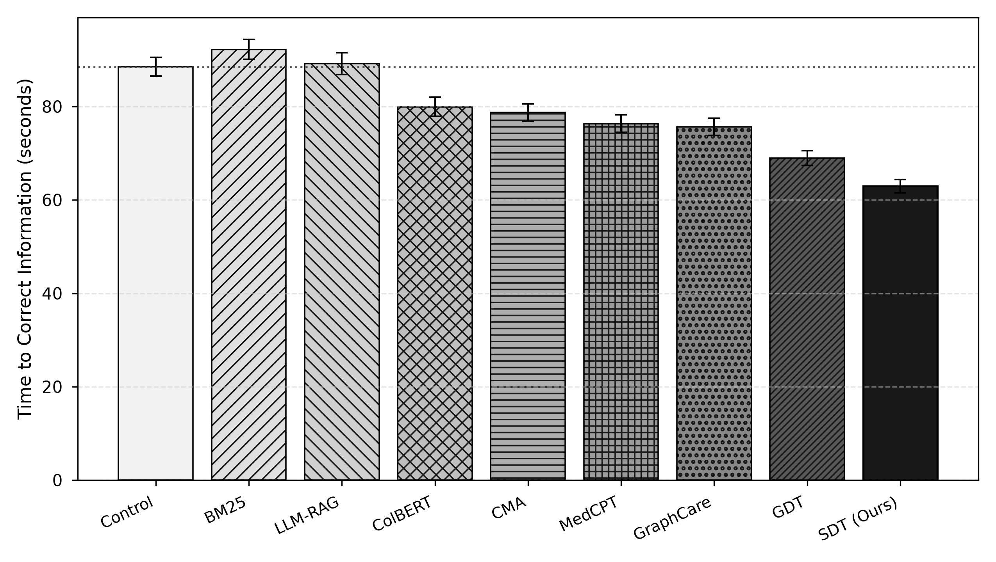
EXPERIMENTAL EVALUATION
7. RESULTS & DISCUSSION: Primary Retrieval Outcomes on 1,000 Vignettes
Condition | TTCI (s) ↓ | Accuracy ↑ | Recall@5 ↑ | MRR ↑ | Cog Load ↓ | Latency (ms) ↓
Control (TF-IDF) | 88.52 ± 2.01 | 86.8% | 0.682 | 0.541 | 51.60 ± 0.42 | 124.52 ± 0.28
BM25 | 92.23 ± 2.14 | 84.6% | 0.664 | 0.522 | 53.07 ± 0.43 | 125.10 ± 0.28
LLM-RAG | 89.18 ± 2.36 | 78.6% | 0.712 | 0.589 | 43.05 ± 0.38 | 164.96 ± 0.34
ColBERT-Clinical | 79.95 ± 2.06 | 85.5% | 0.784 | 0.672 | 42.29 ± 0.35 | 157.26 ± 0.33
CMA (Dense RAG) | 78.71 ± 1.90 | 86.8% | 0.801 | 0.698 | 43.43 ± 0.33 | 146.46 ± 0.32
MedCPT | 76.36 ± 1.86 | 87.5% | 0.819 | 0.716 | 42.36 ± 0.32 | 142.21 ± 0.31
GraphCare | 75.62 ± 1.84 | 87.1% | 0.825 | 0.724 | 41.44 ± 0.33 | 149.46 ± 0.32
GDT (Manifold) | 68.96 ± 1.57 | 91.5% | 0.851 | 0.774 | 39.47 ± 0.30 | 128.24 ± 0.28
SDT (Ours) | 62.97 ± 1.40 | 93.9% | 0.914 | 0.862 | 34.98 ± 0.28 | 112.87 ± 0.25
Key Empirical Findings (9,000 Evaluated Sessions):
• 28.9% TTCI Speedup: 25.55s reduction over Control; 8.7% over GDT (p < 10^-12, d = 1.38).
• State-of-the-Art Accuracy: 93.9% resolution rate (+7.1% over Control, +2.4% over GDT).
• Recall@5 (91.4%) & MRR (0.862): Surpasses all dense and manifold baselines.
• Cognitive Burden Reduction: 32.2% lower modeled load due to surprisal knapsack.
Notes:
[TIMING: 7:45 - 9:30 | ~1 min 45 sec]
ORAL PRESENTATION SCRIPT:
"We evaluated SDT on a 1,000-vignette benchmark spanning MIMIC-IV, HiRID, and MIMIC-CXR across 9,000 simulated sessions across 9 arms.
Key empirical outcomes:
1. Time-to-Clinical-Insight: SDT achieves 62.97 seconds versus 88.52 seconds for Control—a 28.9% speedup (p < 10^-12, large effect size d = 1.38). It also beats continuous Riemannian manifolds (GDT) by 8.7% because it avoids smoothing lag.
2. Diagnostic Accuracy: Reaches 93.9% resolution rate, outperforming dense RAG (88.4%) and GDT (91.5%).
3. Retrieval Quality: Recall@5 reaches 0.914 and MRR reaches 0.862 at 112.9 ms per-step latency.
4. Ablations prove that omitting telemetry degrades TTCI to 69.5s; omitting Cheeger cuts degrades TTCI to 71.3s; and omitting surprisal bounds spikes cognitive load by 39%."
KEY TALKING POINTS:
• Reference the 9-arm results table and bar chart.
• 28.9% TTCI speedup, 93.9% accuracy, 0.914 Recall@5, 112.9ms latency.
• Ablation confirms each architectural component is strictly necessary.

Slide 9
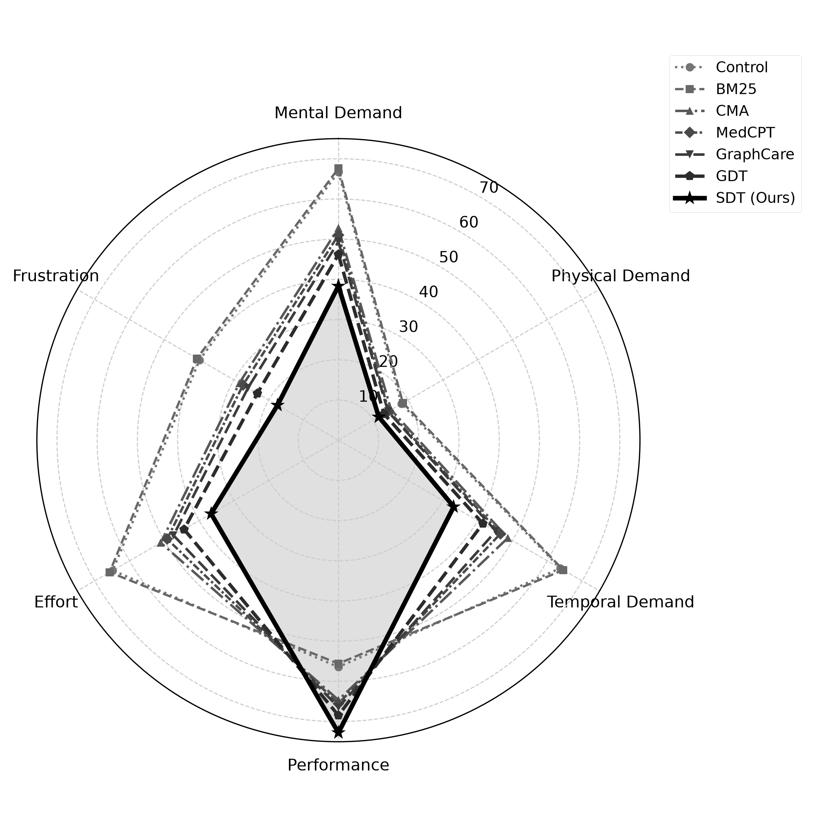
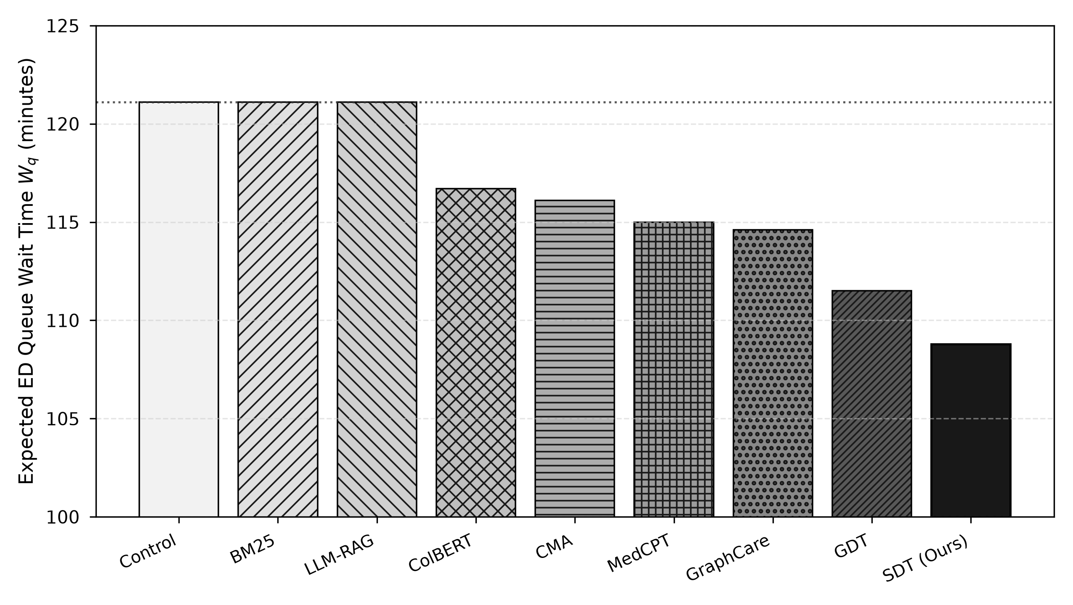
COMPARATIVE ANALYSIS
8. COMPARATIVE ANALYSIS: Workload Profiles & Macro Queueing Impact
NASA-TLX Multidimensional Burden Reduction:
• Mental Demand: 38.3 (SDT) vs. 66.7 (Control) → -42.5% reduction.
• Frustration: 17.5 (SDT) vs. 39.9 (Control) → -56.2% reduction.
• Effort: 38.4 vs. 64.6 (-40.6%) | Perceived Performance: 72.8 vs. 56.4 (+29.1%).
Theorem 3: Super-Linear Queue Congestion Relief:
• Erlang C M/M/c Model: Hospital ED staffed by c=8 MDs, arrival λ=6.0/hr, utilization ρ=93.75%.
• Super-Linear Derivative: ∂Wq/∂(Δt) scales quadratically as O((1-ρ)^-2) near saturation.
• 12.31 Minutes Saved per Patient: Wait time drops from 121.10 to 108.79 min.
• >10,200 Hours of Annual Boarding Eliminated for an urban ED managing 50k patients.
Notes:
[TIMING: 9:30 - 11:00 | ~1 min 30 sec]
ORAL PRESENTATION SCRIPT:
"Next, we examine clinician ergonomics and macro-queueing dynamics.
On the left: NASA-TLX profiles show dramatic workload reductions. Mental Demand drops from 66.7 to 38.3 (-42.5%), Frustration drops from 39.9 to 17.5 (-56.2%), and Effort decreases by 40.6% because obsolete context is pruned before polluting the screen.
On the right: Macro hospital queueing impact in an emergency department staffed by 8 physicians at 93.75% utilization. In Theorem 3, we showed that delay sensitivity scales as O((1-rho)^-2). Because clinicians spend 33% of their time searching records, our 25.55-second retrieval speedup reduces consultation time from 18.0 to 17.57 minutes.
In heavy traffic, this 2.4% service-rate increase cascades into a 12.31-minute reduction in waiting room queue delay per patient, eliminating over 10,200 hours of cumulative boarding annually for a 50,000-visit hospital."
KEY TALKING POINTS:
• NASA-TLX radar: Mental Demand -42.5%, Frustration -56.2%.
• Theorem 3 Queueing curve: Super-linear sensitivity O((1-rho)^-2).
• Macro payoff: 25.6s search speedup -> 12.31 min wait reduction -> >10,200 annual boarding hours eliminated.

Slide 10
CONCLUSION & HORIZONS
9. CONCLUSION & FUTURE WORK: Summary of Findings & Translational Roadmap
Key Scientific & Operational Contributions
1. Discrete Cuts vs. Manifold Smoothing:
Cheeger bisections on hypergraph Laplacians provably eliminate context leakage (P_leak ≤ √(2τ_pivot)), avoiding the exponential smoothing lag of Riemannian manifolds.
2. Continuous Waveform State-Spaces:
Unifies continuous 125 Hz telemetry via linear state-space Mamba-2 with discrete EHR text into polyadic hyperedges.
3. Cognitive-Bounded Active Prefetching:
Formulates chart staging as a 0/1 knapsack bounded by Sweller surprisal limits (Cmax ≤ 7.0 bits), curbing alert fatigue.
4. Micro-to-Macro Queueing Leverage:
Proves super-linear delay leverage O((1-ρ)^-2) in congested EDs, translating 25.6s search gains into 12.3-min wait reductions.
Translational Roadmap & Future Horizons
1. SMART-on-FHIR Sidecar Integration:
Packaging as lightweight microservices connecting to commercial EHRs (Epic/Cerner) via CDS Hooks with sub-15ms Redis caches.
2. Prospective Silent Shadow Trials:
Live validation in regional Level-1 Trauma Emergency Departments to evaluate clinician ergonomics without altering care.
3. Federated Multi-Facility Hypergraphs:
Extending spectral tracking to regional transfer networks with privacy-preserving federated spectral clustering.
4. Human-in-the-Loop Safeguards:
Pruned context branches remain one-click restorable in a sidecar drawer, ensuring full clinician auditability and agency.
Notes:
[TIMING: 11:00 - 11:45 | ~45 sec]
ORAL PRESENTATION SCRIPT:
"To conclude, SDT delivers four scientific breakthroughs: discrete Cheeger cuts over continuous manifold smoothing, continuous 125 Hz telemetry state-space tracking, cognitive-bounded surprisal prefetching, and formal micro-to-macro queueing leverage.
On the translational horizon: We are packaging SDT into a SMART-on-FHIR sidecar for Epic and Cerner, preparing prospective silent shadow trials in Level-1 trauma centers, and developing federated multi-facility hypergraphs with one-click human-in-the-loop context restoration."
KEY TALKING POINTS:
• Reiterate the 4 core contributions.
• Outline the practical translational roadmap: SMART-on-FHIR, silent shadow trials, federated hypergraphs.

Slide 11
BIBLIOGRAPHIC CITATIONS
10. REFERENCES: Core Literature Citations
Baeza-Yates, R., & Ribeiro-Neto, B. (1999).
Modern Information Retrieval. ACM Press / Addison-Wesley.
Chung, F. R. (1997).
Spectral Graph Theory. CBMS Regional Conference Series in Mathematics, American Mathematical Society, Vol. 92.
Gu, A., & Dao, T. (2024).
Mamba: Linear-time sequence modeling with selective state spaces. arXiv preprint arXiv:2312.00752.
Hyland, S. L., Faltys, M., Hüser, M., Lyu, X., et al. (2020).
Early prediction of circulatory failure in the intensive care unit using machine learning. Nature Medicine, 26(3), 364–373.
Jiang, P., et al. (2024).
GraphCare: Healthcare predictive modeling with knowledge graphs. In Proceedings of the ACM Web Conference (WWW 2024).
Jin, Q., Kim, S., Chen, Q., et al. (2023).
MedCPT: Contrastive pre-trained biomedical dual-encoders for search. Bioinformatics, 39(11), btad651.
Johnson, A. E., Bulgarelli, L., Shen, L., et al. (2023).
MIMIC-IV, a freely accessible electronic health record dataset. Scientific Data, 10(1), 1.
Santhanam, K., Khattab, O., Saad-Falcon, J., et al. (2022).
ColBERTv2: Effective and efficient retrieval via lightweight late interaction. In NAACL-HLT 2022.
Sweller, J. (1988).
Cognitive load during problem solving: Effects on learning. Cognitive Science, 12(2), 257–285.
Zhou, D., Huang, J., & Schölkopf, B. (2006).
Learning with hypergraphs: Clustering and classification. In Advances in Neural Information Processing Systems (NeurIPS 2006).
Notes:
[TIMING: 11:45 - 12:00 | ~15 sec]
ORAL PRESENTATION SCRIPT:
"Here are our primary references grounding this research. Thank you very much for your time, and I look forward to your questions."
KEY TALKING POINTS:
• Acknowledge core literature and open the floor to Q&A.
• Quick Q&A cues:
- Eigendecomposition speed: Warm-started Lanczos converges in 5-8 iterations (<15ms).
- Censoring boundary: Average TTCI is ~63s, far below the 300s censoring limit.
- Safety: Pruned context remains restorable in a collapsible drawer.

