Slide 1
ML based Recommender Systems

Slide 2
Overview
What does our model do:
It already has a large dataset comprising of many movies reviewed and rated by a lot of people.
It gets the movies liked by the user as input.
Using the dataset and machine learning algorithms it predicts other movies which the user may like.

Slide 3
Requirements
For the recommender model to work accurately to a decent level, a large dataset with a proper distribution of a variety of data is required.
Eg: Here we have used a dataset of around 1000 movies which has a nearly equal distribution of genres.
If such a proper dataset is not there then training our model with that will give us erroneous results.

Slide 4
Libraries and frameworks used
TensorFlow (for constructing and optimising the model)
NumPy (for intermediate data conversions)
Pandas (for file input/output)
Sys (for system command prompt based statements)

Slide 5
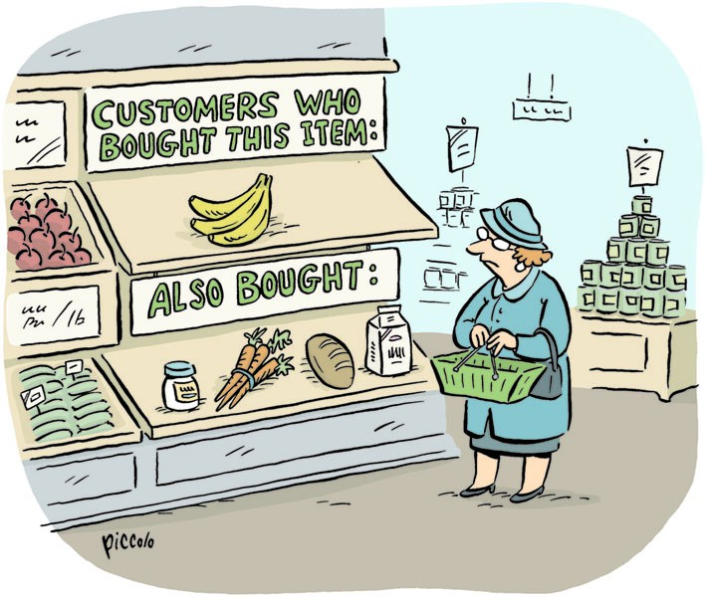
Functioning of recommender systems

Slide 6
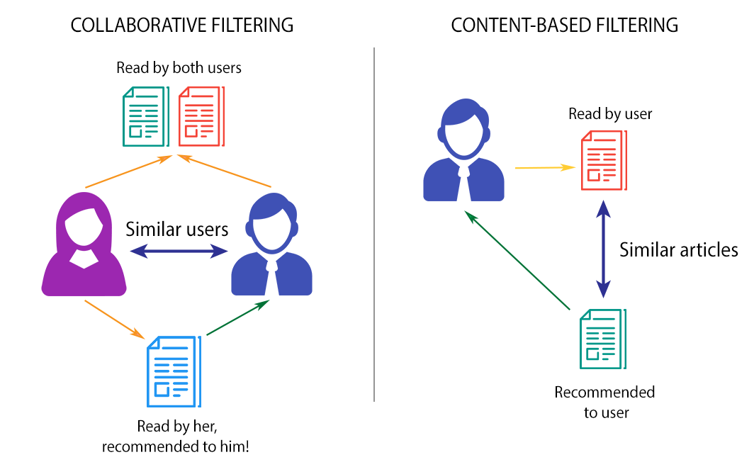
Types of filtering

Slide 7
Applications of recommender systems
They can be used in any platform wherein users need to be directed to the product of their choice in order to increase target accuracy.
Eg: They can be used in education, media streaming websites, e-commerce sites etc.

Slide 8
Possible Applications
Eg: Say in an e-learning site in which a user is frequently searching for books related to engineering physics, mathematics etc. showing him books related to other unrelated topics like biology or art will have less target accuracy.
Whereas if we show him more books related to his topic of interest it will have more target accuracy and he will buy books from that recommended list.

Slide 9
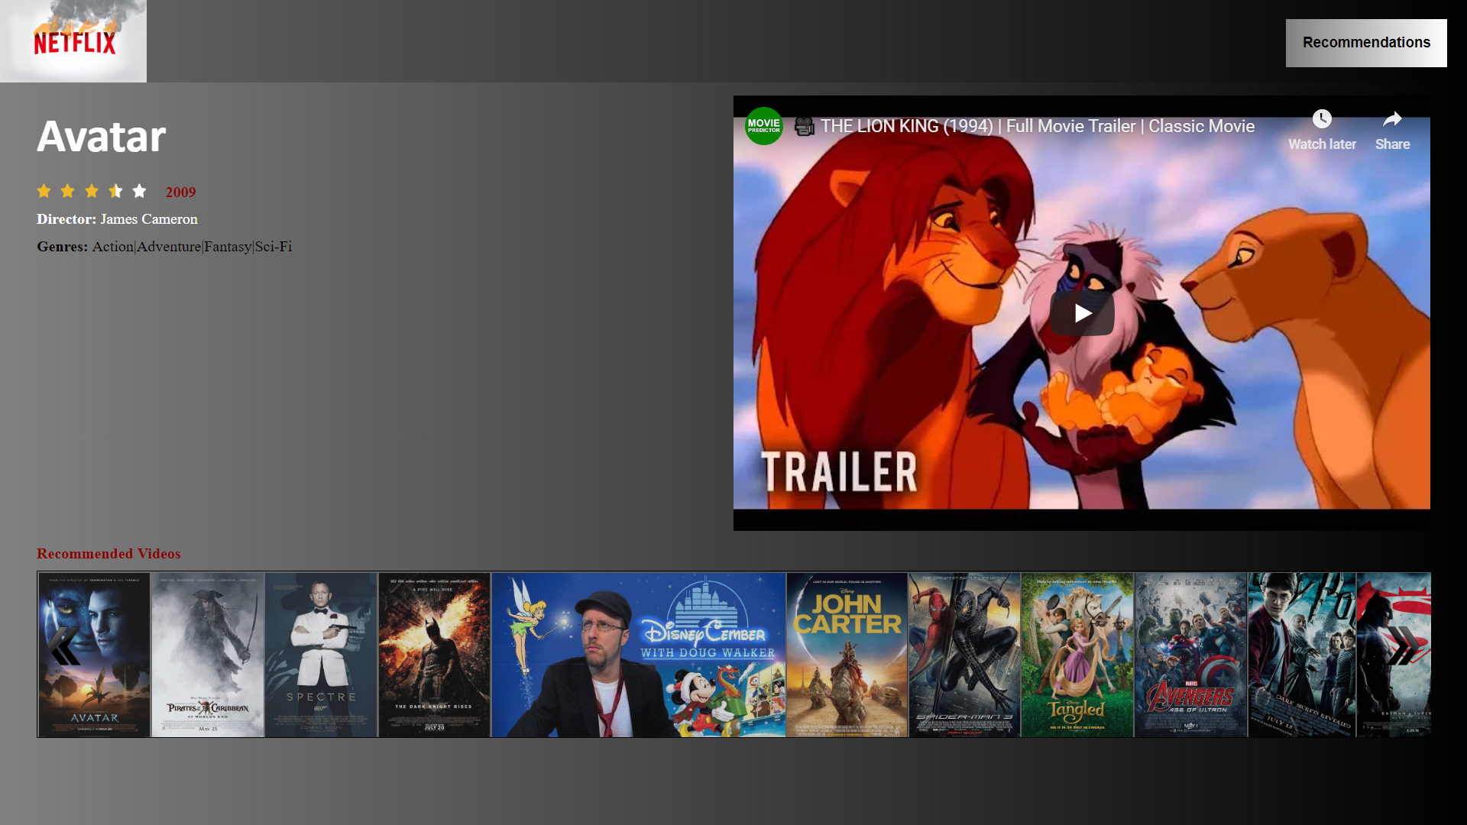
The Prototype (Selection Page)

Slide 10
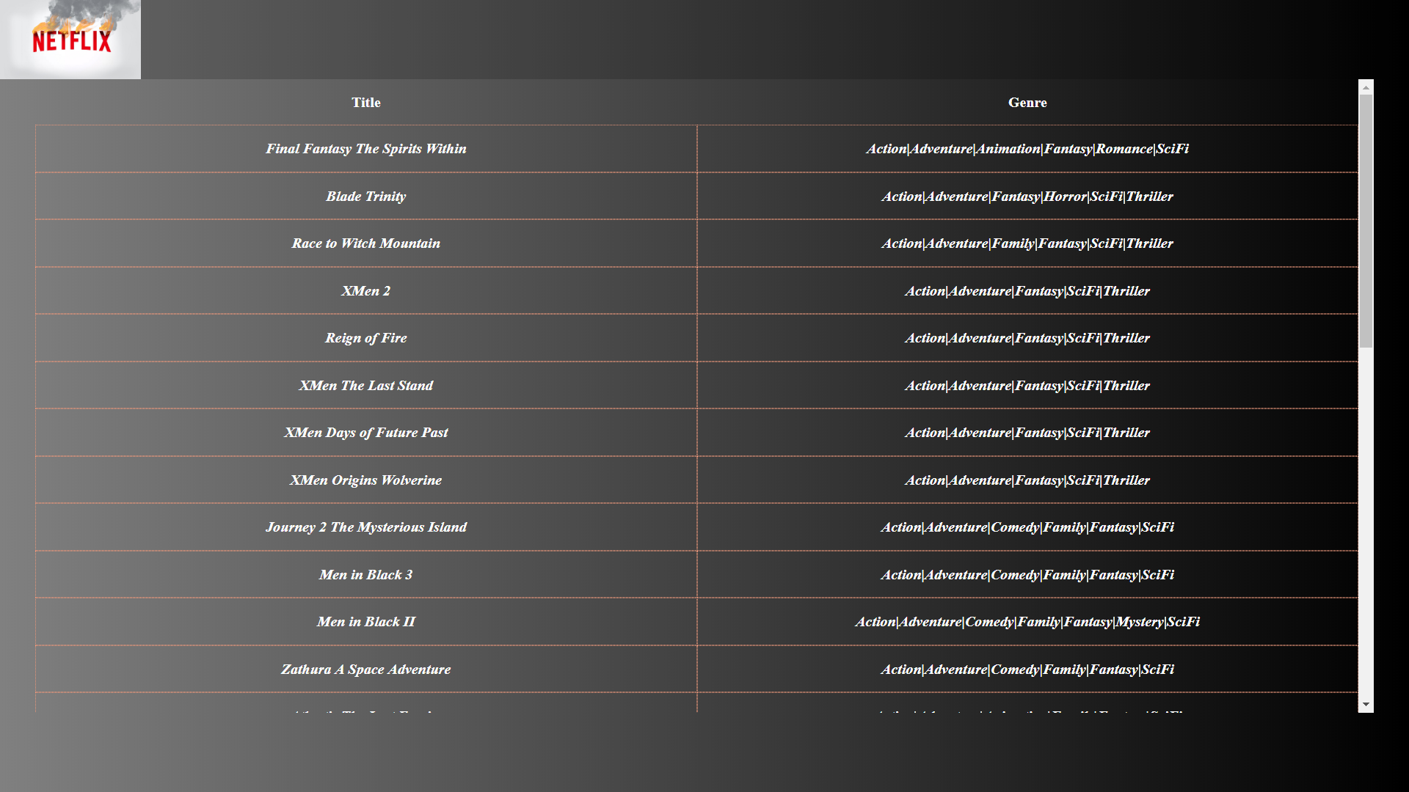
The Prototype (Predicted Results)

Slide 11
Thank You !

