Slide 1


Review-I
5G NEW RADIO PHYSICAL LAYER SIMULATION
AY 2025-26
Capstone Project – Introduction (PROJ2999)
GITAM (Deemed-to-be) University
Department of Electrical Electronics and Communication Engineering
Project Team:
C. Lakshmi Narayana
P. Hemanth
P. Hari Krishna
Project Mentor:
Dr. T. Nagarjuna
Project In-charge:
Dr. Kshitij Shakya
www.gitam.edu

Slide 2
Objective and Goals
Objective
The primary objective is to design and implement a 5G New Radio physical layer simulation.
To evaluate system performance under various channel conditions and validate the efficiency of signal processing algorithms before hardware implementation.
Goals
To build a complete end-to-end 5G physical layer simulator in MATLAB.
To analyze and visualize key performance metrics such as Bit Error Rate (BER) and throughput.

Slide 3
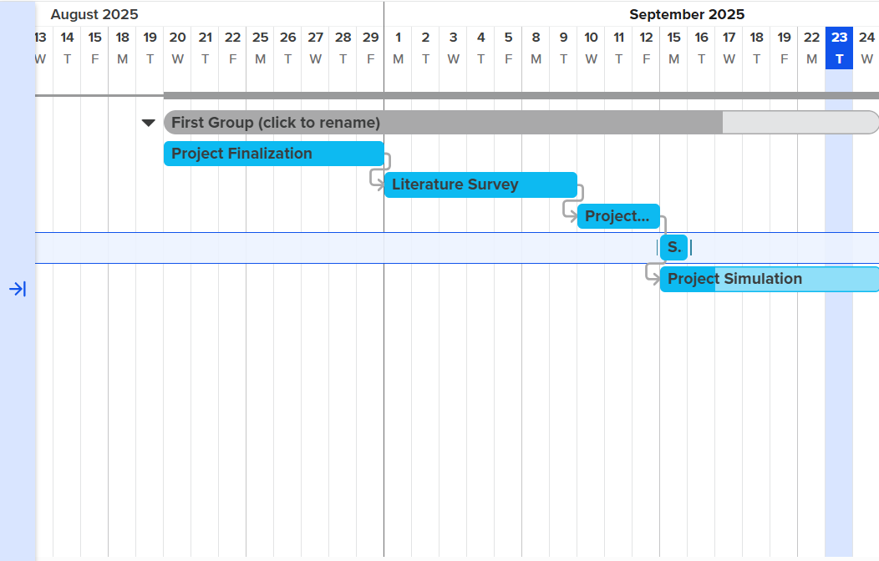
Project Plan (Clearly mention milestone for objectives under each reviews)
Gant Chart - Milestones and Activities

Slide 4
Project Plan (Clearly mention milestone for objectives under each reviews)
Gant Chart – Milestones and Achievements

Slide 5
Literature Survey
Key Publications :
Author details | Research contributions | Research Limitations
Morais, D. H. (2024). 5G NR overview and physical layer. In Key 5g/5g-advanced physical layer technologies: Enabling mobile and fixed wireless access (pp. 233-321). Cham: Springer International Publishing. | Provides a structured overview of 5G NR physical layer functions (channels, signals, scheduling, HARQ, power control) and their role in achieving high data rates and low latency. Highlights the evolution of 5G through Releases 15–19, offering insights into both current capabilities and future enhancements. | Focuses on high-level architecture and procedures without detailed technical algorithms or performance analysis. Relies mainly on 3GPP specifications, with limited discussion of real-world deployment challenges or empirical validation.
Ssimbwa, J., Yoon, S. H., Lee, Y., & Ko, Y. C. (2024). Towards 5G-advanced NR-unlicensed systems: Physical layer design and performance. Journal of Communications and Networks, 26(2), 207-214. | It provides a detailed performance analysis of specific NR-U scheduling configurations, highlighting the trade-offs of frame structure, HARQ, and RLC parameters. It presents quantitative evidence through simulation that demonstrates the direct performance impact of the chosen NR-U design configurations. | The findings are exclusively based on simulations and have not been validated in a real-world hardware or network environment. The research scope is limited to a select subset of parameters, omitting other critical factors like mobility and dynamic interference.

Slide 6
Author details | Research contributions | Research Limitations
Rossato, F. (2024). Simulation Study, Design and Implementation of 5G NR Layer-2 Protocols for Non-Terrestrial Networks. | Developed new 5G NR Layer-2 protocols (HARQ and scheduling) for NTNs, improving reliability and throughput. Enhanced the ns-3 NTN module to handle high propagation delays and reduce unnecessary retransmissions. | Tested only through simulations, not on real NTN hardware or testbeds. Other protocol stack challenges in NTNs (handover, synchronization) were not addressed.
Belesaca, J. D., Vazquez-Rodas, A., Urquiza-Aguiar, L. F., & Vega-Sánchez, J. D. (2024). An in-depth assessment of the physical layer performance in the proposed B5G framework. Ad Hoc Networks, 164, 103609. | It provides a comparative performance analysis of the 5G using ideal, practical, and novel CNN-based channel estimation techniques. It identifies the specific physical layer elements that most significantly impact system performance, guiding future B5G optimization strategies. | The conclusions are derived entirely from simulations and lack validation from real-world hardware or live network deployments. The analysis is focused exclusively on the downlink (PDSCH) and does not evaluate the performance of the uplink channel.

Slide 7
Key Publications
Key Resources – Whitepaper| Application Notes | Datasheet| Others
https://devopedia.org/5g-nr-phy
Existing Implementations – Products| Opensource| GitHub etc
GitHub : https://github.com/kir812/pyPhyNR

Slide 8
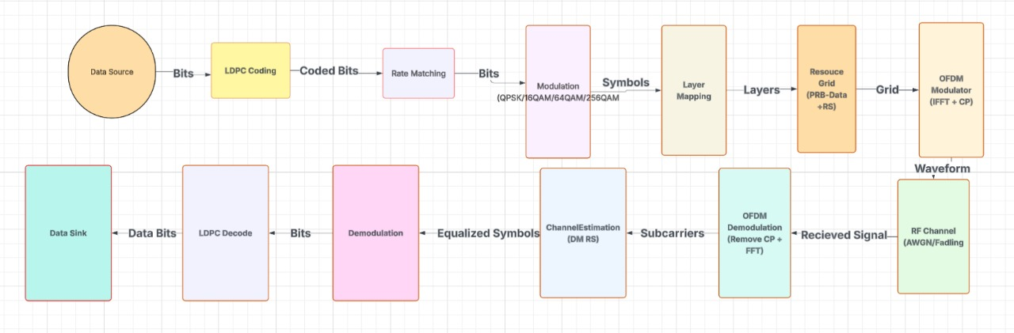
5G Architecture

Slide 9
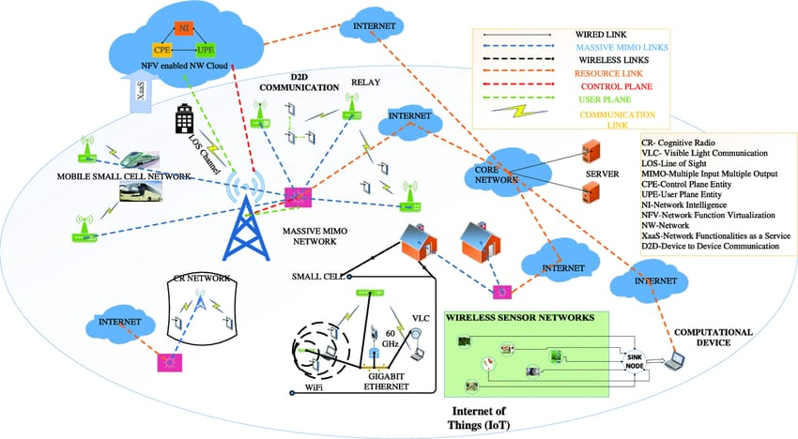
5G Architecture Applications

Slide 10
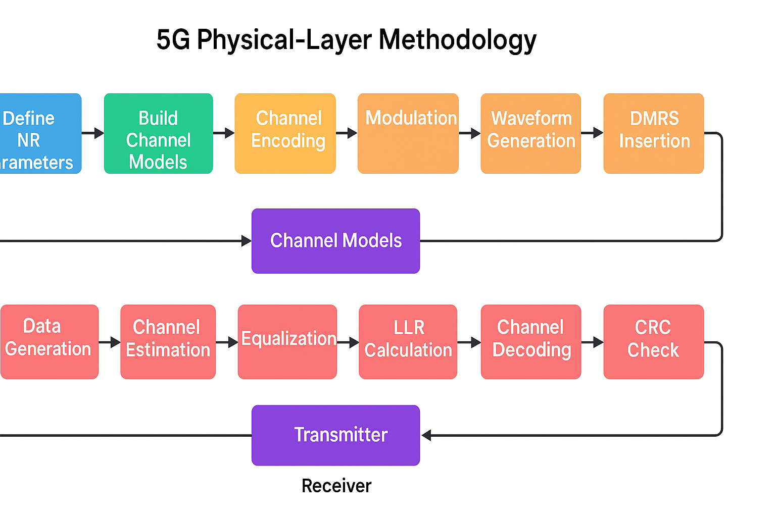

Slide 11
5G NR parameters:
1. Carrier frequency (sub-6 or mmWave)
2.Subcarrier spacing (15–240 kHz numerology)
3.Type of channel coding (LDPC)
4.OFDM parameters (FFT size, CP length, slot duration)

Slide 12
Build channel propagation models:
3GPP spatial channel model (SCM)
mmWave models with blockage

Slide 13
Implementing the transmitter chain:
Data generation(LDPC/Polar encoding)
Rate matching
Modulation (QPSK → 256QAM)
Resource grid mapping
DFT-s-OFDM or CP-OFDM
waveform generation

Slide 14
Pass through the channel:
The signal is transmitted through the selected channel models:
Time-varying multipath channel
Frequency-selective fading

Slide 15
Implementing the receiver chain
The receive processing mirrors the transmitter:
RF impairments correction
Synchronization (time/frequency offset estimation)
Demodulation
LDPC/Polar decoding
CRC check & BLER estimation

Slide 16
Evaluating system performance and Important Prerequisites / Libraries:
BLER vs SNR
Throughput
MATLAB 5G Toolbox
pyPhyNR python toolkit(downloaded from GitHub)

Slide 17
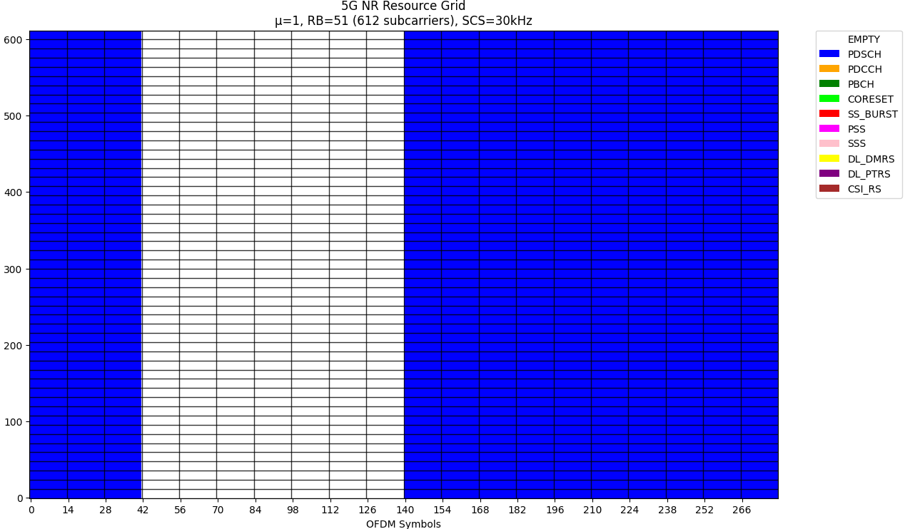
Results

Slide 18
This figure visualizes the time–frequency grid used by the 5G New Radio downlink physical layer. Each cell in the grid corresponds to one Resource Element (RE), which is one subcarrier in one OFDM symbol.
X-axis = OFDM symbols in time
Y-axis = Subcarriers (grouped as RBs) in frequency
Total RBs = 51, SCS = 30 kHz, numerology μ = 1
Each color corresponds to a specific physical channel or signal defined by 3GPP. These represent the actual transmission in those REs.
Blue — PDSCH (Physical Downlink Shared Channel)
These are the data-bearing REs.
The PDSCH carries user data or higher-layer messages (e.g., RRC, NAS, paging).
The large blue sections on the left and right are PDSCH transmissions scheduled in two time windows.
Significance:
It shows that your scheduler allocated downlink data bursts at the beginning and end of the frame, leaving the middle part unused.

Slide 19
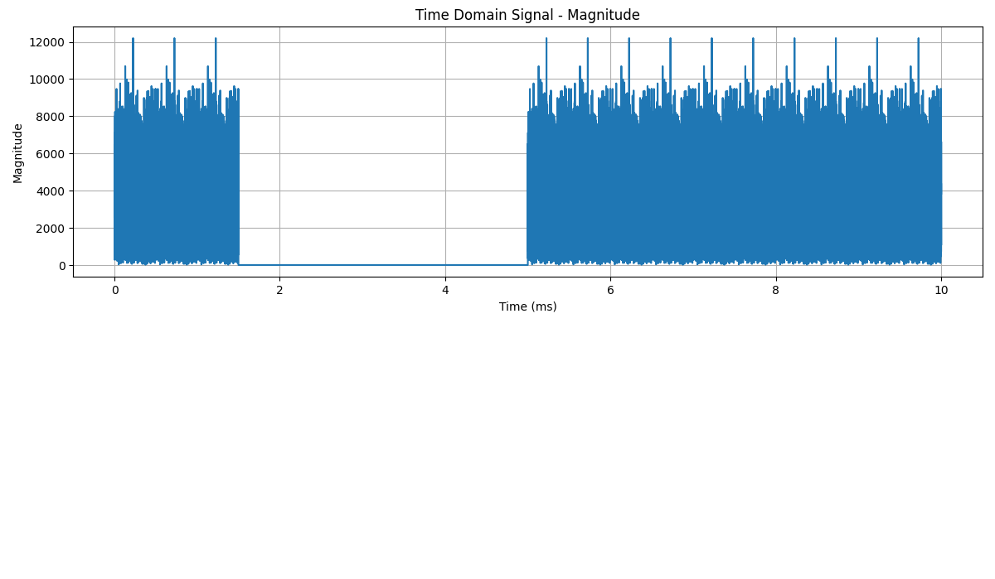
This graph shows the magnitude of the time-domain IQ samples produced after OFDM modulation. You’re essentially looking at the raw transmit waveform of your NR carrier over a 10-ms interval.
X-axis → Time (ms)
Y-axis → Signal magnitude (|I + jQ|)
Blue filled region → Samples where the transmitter is active
Flat zero region → Samples where nothing is transmitted
These chunks are the actual transmitted OFDM symbols that contain physical channels, such as:
✔ PDSCH (data)

Slide 20
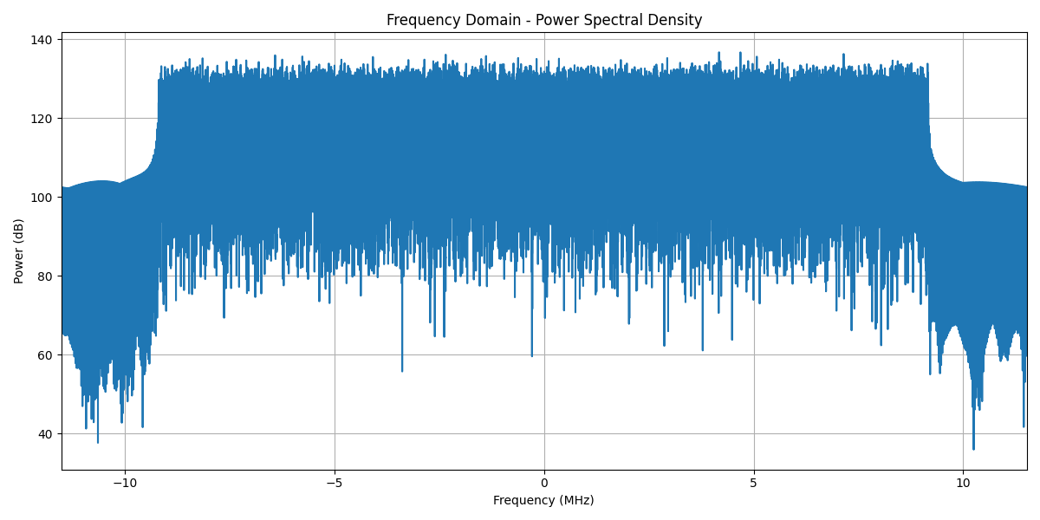

Slide 21
This plot shows the power distribution of your 5G NR waveform across frequency after OFDM modulation. It’s essentially the “spectrum” of your generated signal.
X-axis → Frequency (MHz)
Y-axis → Power (dB)
Blue region → Magnitude of the PSD across all subcarriers
Low-power dips and edges → Subcarrier structure, resource usage, and OFDM characteristics
The filled blue region is the power spectral density of your full downlink OFDM waveform. This includes:
✔ All active PDSCH RBs
✔ DMRS embedded inside them
✔ Any reference signals
✔ The effect of OFDM modulation, CP, and the sampling rate
It reflects how power is spread across the occupied NR bandwidth.
Significance:
This confirms the transmitter is occupying the correct useful bandwidth and your OFDM system is working properly.

Slide 22
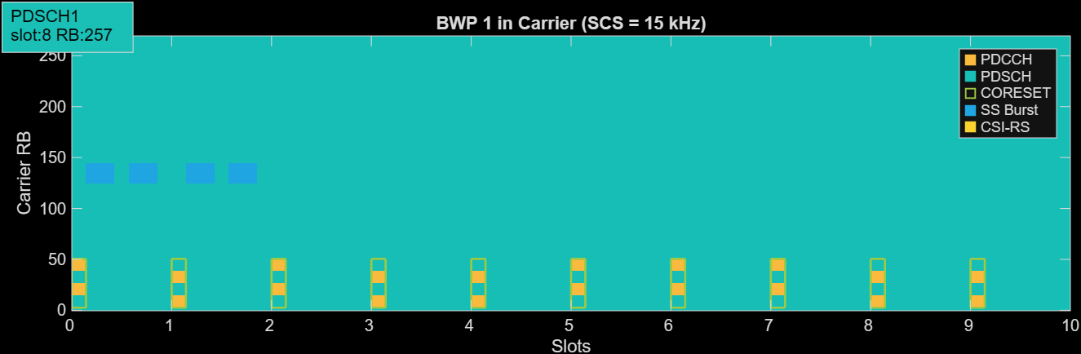

Slide 23
This figure shows how different physical channels are scheduled inside a Bandwidth Part (BWP) across multiple slots. It’s a time–frequency visualization, but at a much coarser level than the full RE grid.
X-axis: Slots (time)
Y-axis: Carrier Resource Blocks (frequency)
Colored blocks: Physical channels/signals
Empty cyan region: Unused BWP spectrum
Colored blocks mark the presence of actual NR physical channels (PDCCH, PDSCH, CORESET, SS burst, CSI-RS).
These blocks show exactly when and where these channels are active in the BWP
Most of the BWP is empty, meaning the gNB is not transmitting in those RBs.

Slide 24
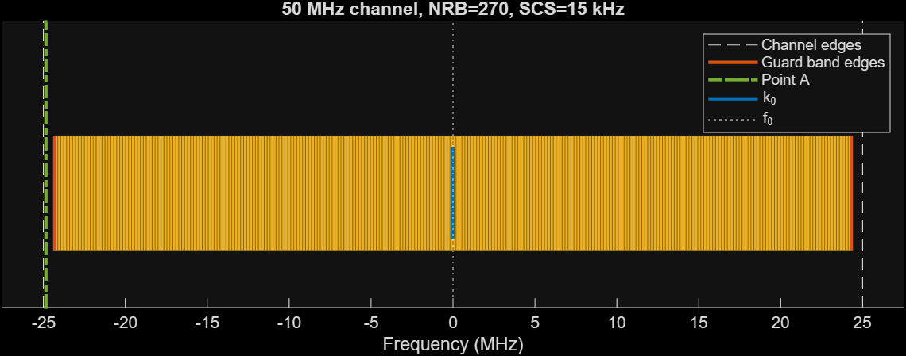

Slide 25
This plot shows the frequency-domain layout of a 5G NR carrier with:
Channel bandwidth: 50 MHz
NRB: 270
SCS: 15 kHz
This is essentially the “spectrum map” of every subcarrier inside the NR channel.
Each vertical orange line is one subcarrier.
All these subcarriers together form 270 RBs × 12 subcarriers per RB = 3240 active subcarriers.
This is the actual OFDM grid where PDCCH, PDSCH, PBCH, DMRS, CSI-RS, etc., will be placed.

Slide 26
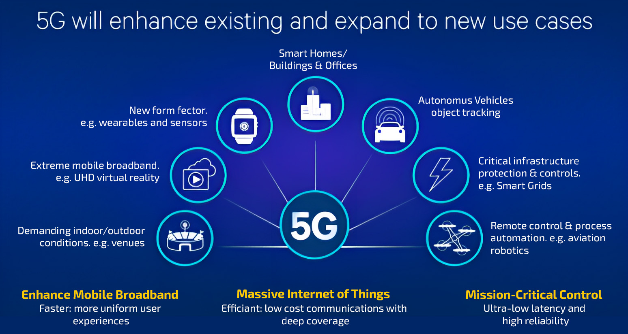

Slide 27
References:
“Technical Principles and Simulations of the 5G NR Physical Layer Standard” (by Marco Roggero & Houman Zarrinkoub) — This paper walks through the essentials of the 5G NR PHY: waveform structure, numerology, resource grid, massive-MIMO/beamforming aspects, link-level simulation.
“New Radio Physical Layer Abstraction for System‐Level Simulations of 5G Networks” (Sandra Lagen et al., 2020) — Focuses on PHY abstraction (ex: EESM-based mapping) for system-level simulation of 5G NR.
“Understanding the 5G NR Physical Layer” (J. Campos, 2017) — An earlier but foundational document that covers key PHY building blocks, useful for simulation baseline.

Slide 28
Conclusion:
In conclusion, this simulation study provided comprehensive insights into 5G NR downlink performance and efficiency. By modeling end-to-end PDSCH transmission under varied configurations, it demonstrated how resource allocation and waveform parameters affect throughput, spectral utilization, and power requirements.
The results validate that 5G NR’s physical-layer innovations (flexible CP-OFDM numerology, multi-BWP support, advanced channel coding, etc.) yield the anticipated improvements in performance and flexibility.
Importantly, the project underscores that accurate link-level simulation is a powerful tool for understanding 5G NR behavior and guiding design choices.

Slide 29
THANK YOU
Have a Great Day !

