Slide 1

Unlocking the power of Llama2 for local Multi-Document Summarization
-By Kunduru Hemanth Reddy

Slide 2

Introduction
•Text summarization is a crucial task in natural language processing.
•It helps extract the most important information from a given document or text while retaining its core significance.
•One of the solutions is using Llama2 locally without using any cloud services.

Slide 3
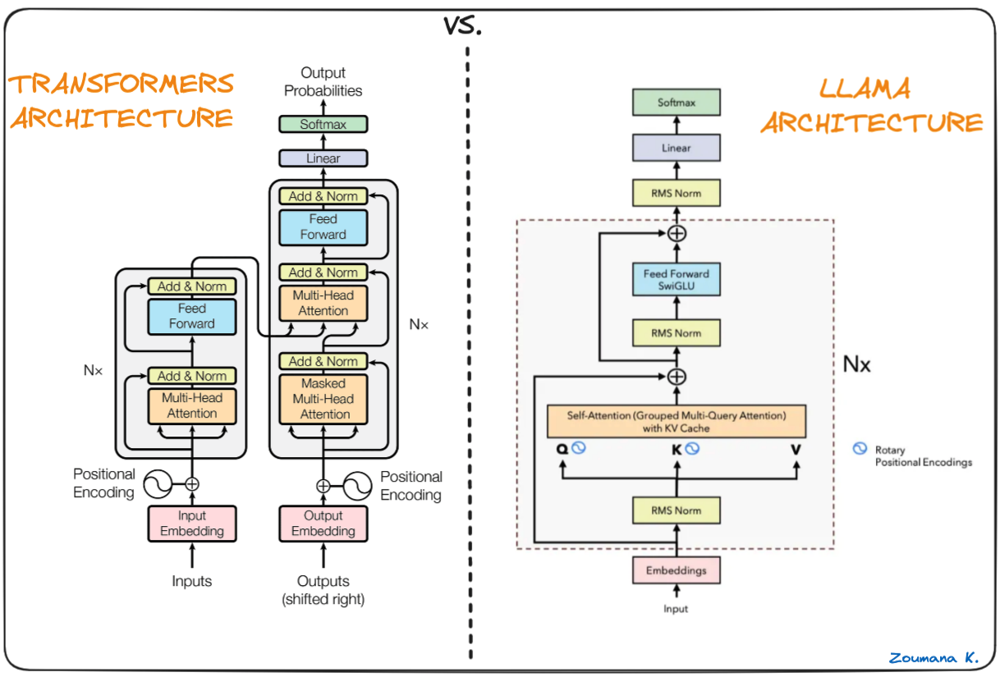

Slide 4
Llama 2
•Llama-2 is built on classic “Transformer Architecture”.
•Pre-normalization: Unlike conventional transformers that normalize the output of each sub-layer, Llama-2 utilizes pre-normalization. This means it normalizes the input of each sub-layer using RMSNorm, leading to improved training stability and robustness against initialization randomness.
•SwigGLU Activation Function: Replacing the widely used ReLU activation function, Llama-2 employs SwigGLU. This novel activation combines a scaled sigmoid with a linear unit, resulting in smoother gradients and potentially reducing vanishing gradients during training.
•Rotary Embeddings: Instead of absolute positional embeddings, Llama-2 leverages rotary embeddings. These encode positional information through rotations in a high-dimensional space, offering greater efficiency and better performance for longer sequences.

Slide 5
Question
Embedding
Input Question
Instructor Text Embedding
Text Chunk
Embeddings
BBBB
Knowledge base
📄
📄
F
A
I
S
S
Pdf.1
…
…
Answer
Pdf.2
Text Chunk
Embeddings
chunks
Ranked
Result
LLM model

Slide 6
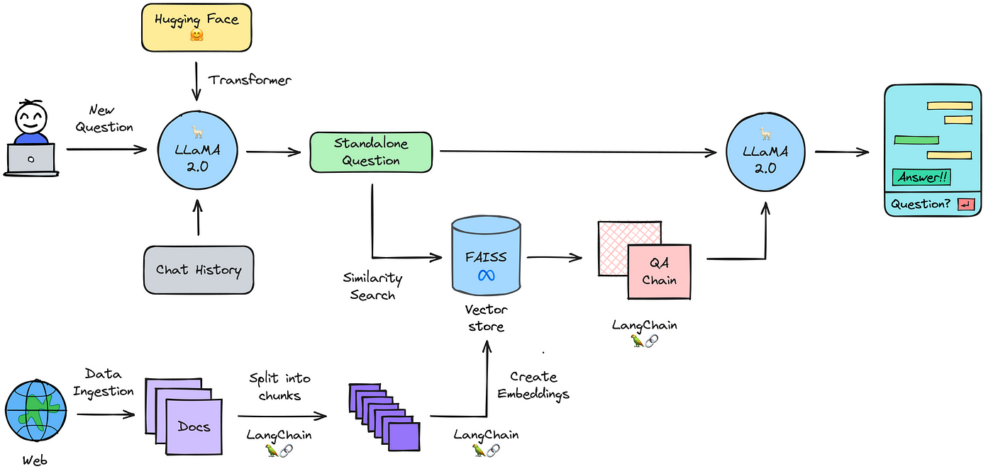

Slide 7
FEATURES
•Format Agnostic: Our system transcends limitations of traditional text summaries, handling diverse document formats like PDFs, Word documents, images, and even websites. Additionally, it can process and summarize information contained within YouTube links and Images, making it truly multimodal.
•Summarization Modes: Users can choose from various summarization styles, tailoring the output to their needs. Whether users seek a concise overview, a detailed analysis, or a creative retelling, our system adapts to deliver the desired level of information.
•Interactive Q&A: Beyond summaries, users can engage in a dynamic question-answering dialogue with the system. Simply ask questions related to the processed documents, and our system will utilize its knowledge base and advanced algorithms to provide accurate and contextually relevant answers.

Slide 8
conclusion
•By combining advanced language models, efficient infrastructure, and intuitive design, this project provides a powerful and versatile tool for navigating and understanding large documents.
•Our Llama-2 application significantly reduces human effort when dealing with lengthy documents. Built using the Streamlit framework, it effortlessly combines powerful features for summarizing documents and clearing up any confusion, all thanks to the advanced capabilities of the Llama-2 model.
•By expertly combining document summarization with question-answering abilities, our application solves the double challenge of condensing information and resolving doubts within one unified platform. Users can now grasp the essence of large documents quickly and easily, saving time and effort compared to traditional methods.

Slide 9
Thank you

