Slide 1
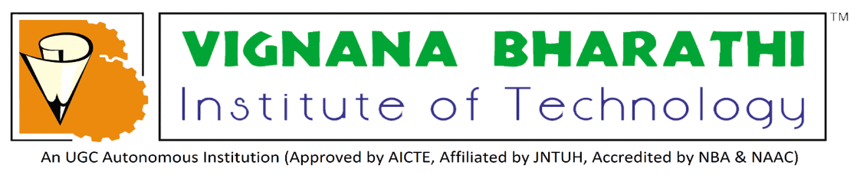
AVISHKAR
MEGHANA 22P61A66K3 CSM - D
DEEKSHITH 22P61A66L5 CSM - D

Slide 2
Build a Technology Driven Approach to Lower Construction Costs and Shorten Project Timelines

Slide 3
Problem Explanation
In today’s developing world, there is a need for excellent infrastructure with rapid progress in the fields of architecture and engineering.
The problem arises when the cost of construction is high and timelines are exceeded.
The main factors contributing to this issue include an insufficiently trained workforce, high labour costs and frequent design changes.
These challenges can lead to delays, increased expenses and lower quality outcomes in the project delivery.
To improve the development in the construction industry, we plan to design a technology based on 3D printing using AI/ML algorithms.

Slide 4
Solution
The 3D printing combined with AI/ML enhances design, assures quality and advances extended, cost-effective infrastructure construction.
AI algorithms helps to assess project specifications and autonomously create optimized 3D designs.
Integrating computer vision functionality into the 3D printing process enables live monitoring.
With the usage of AI algorithms we can evaluate project timelines and resource availability to reduce delays in optimized construction schedules.

Slide 5
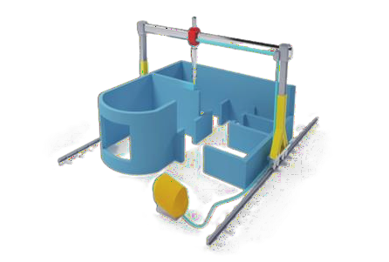
Domain chosen
AI/ML enhancements not only minimize errors but also lead to increased efficiency in project execution.
3D printing with AI improves building efficiency, minimizes errors, reduces cost and improves overall performance of the projects.
The sequential manufacturing process enables swift and efficient construction, resulting in reduced project timelines.
3D printing reduces delays, speeds up fabrication and enhances overall efficiency of construction.

Slide 6
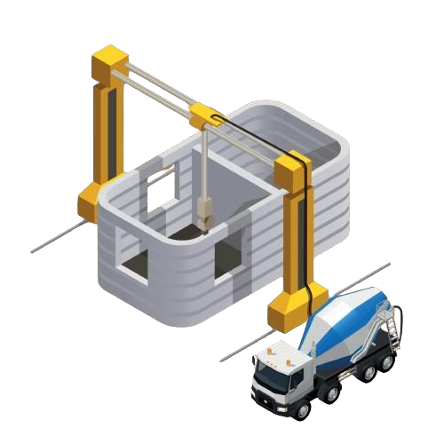
Feasibility of Solution
3D printing and AI/ML algorithms eliminate material waste to ensure accurate conclusions.
The process operates continuously without breaks for drying, with testing conducted at predetermined intervals.
This approach enables the development of intricate and distinctive architectural ideas that might be challenging to achieve through traditional methods.
Automating the design phase decreases the planning time and guarantees precision in structural layouts.

Slide 7
Comparing with Existing Solutions
EXISTING SOLUTION | PROPOSED SOLUTION
Manual processes and potential delays impact overall efficiency. Higher labor costs, extended project durations and material wastage contribute to increased overall expenses. High material wastage and prolonged construction times contribute to an increased environmental impact. Limited scope for significant advancements, incremental improvements in processes may occur. | Automation and rapid construction contribute to enhanced efficiency. While initial setup costs may be higher, the efficient nature of 3D printing reduces expenses, making it a cost-effective solution. Precise material usage makes 3D printing a more sustainable choice, minimizing environmental impact. This can be innovative shift in building, with ongoing research established to extend the scope of applications.

Slide 8
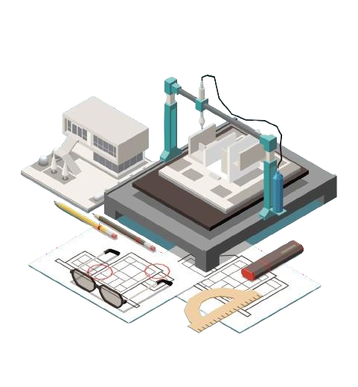
Applications
3D printing enables the creation of intricate and customized architectural designs.
AI/ML algorithms help to reduce material waste while using resources more efficiently.
AI predicts project timelines, identifies risks and optimizes construction schedules.
These algorithms, which constantly monitor environmental variables may alter system settings in real time to enhance comfort, energy efficiency and cost savings.

Slide 9
QUERIES?

Slide 10
THANK YOU

