Slide 1
SQL DATABASE PROJECT
Event Management System
A relational database for managing technical events, registrations,
attendance, and certificates
PRESENTED BY
Hemanth Sai
Lakshmi Narayana
Prasanth
1
2
3
Batch 2026

Slide 2
OVERVIEW
Project Objective
Design and implement a relational database that manages the complete lifecycle of technical events — from event creation to certificate issuance.
01
02
03
04
Manage Events
Track Registrations
Record Attendance
Issue Certificates
Store event details — type, date, venue and registration fee.
Link participants to events and monitor registration status.
Capture Present / Absent status for every registered participant.
Generate participation and winner certificates per registration.
Expected Outcome: Generate consolidated participant lists and attendance reports for event organizers.
Event Management System — SQL Database Project
2

Slide 3
SCHEMA
Database Schema Overview
Five related tables model events, participants and their journey through registration, attendance and certification.
Events
Participants
Registrations
Attendance
Certificates
PK event_id
PK participant_id
PK registration_id
PK attendance_id
PK certificate_id
event_name
event_type
event_date
venue
registration_fee
participant_name
email
phone
city
event_id (FK)
participant_id (FK)
registration_date
registration_status
registration_id (FK)
attendance_date
attendance_status
registration_id (FK)
certificate_type
issue_date
Event Management System — SQL Database Project
3

Slide 4
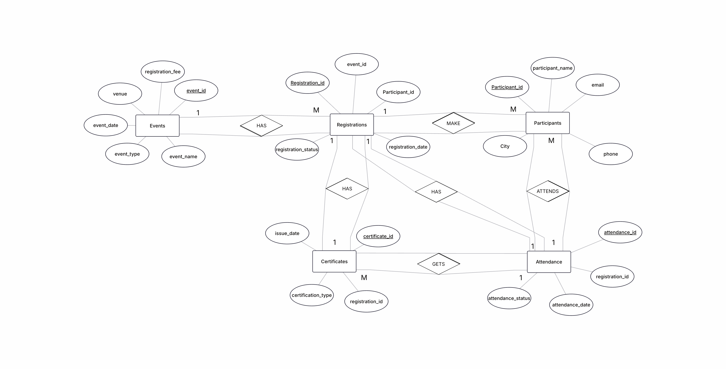
DESIGN
Entity Relationship Diagram (ER Diagram)
Event Management System — SQL Database Project
4

Slide 5
MODULE 1
Basic SQL — SELECT & WHERE
Concept
SELECT retrieves specific columns from one or more tables.
WHERE filters rows so only records matching a condition are returned.
Together they form the foundation of every SQL query used in this project — from listing events to locating participants by city.
Example Queries
Q1 — Display all events with type and venue
Q2 — Participants from a particular city
SELECT event_name, event_type, venue
FROM Events;
SELECT participant_name, email
FROM Participants
WHERE city = 'Hyderabad';
Event Management System — SQL Database Project
5

Slide 6
MODULE 2
Aggregate Functions
Concept
Aggregate functions summarize many rows into a single value: COUNT, AVG, MAX, MIN and SUM.
Paired with GROUP BY, they summarize data per event, per status, or per event type.
Used here to count registrations, average fees and tally attendance outcomes.
Example Queries
Q16 — Participants registered per event
Q17 — Average fee by event type
Q20 — Present / Absent count per event
SELECT event_id,
COUNT(participant_id) AS total_participants
FROM Registrations
GROUP BY event_id;
SELECT event_type,
AVG(registration_fee) AS avg_fee
FROM Events
GROUP BY event_type;
SELECT r.event_id, a.attendance_status,
COUNT(*) AS total
FROM Attendance a
JOIN Registrations r
ON a.registration_id = r.registration_id
GROUP BY r.event_id, a.attendance_status;
Event Management System — SQL Database Project
6

Slide 7
MODULE 3
String, Numeric & Date Functions
Concept
String functions reshape text — UPPER, LOWER, LEFT and CONCAT.
Date functions extract or reformat values — DATEDIFF, DATE_FORMAT.
Used for display formatting, name/city merges and event-timing calculations.
Example Queries
Q6 — Names in uppercase
Q9 — Concatenate name and city
Q13 — Days between registration & event
Q14 — Format event date
SELECT UPPER(participant_name)
AS participant_name
FROM Participants;
SELECT CONCAT(participant_name,
' - ', city) AS name_city
FROM Participants;
SELECT r.registration_id,
DATEDIFF(e.event_date,
r.registration_date) AS days_before
FROM Registrations r
JOIN Events e ON r.event_id = e.event_id;
SELECT event_name,
DATE_FORMAT(event_date, '%d-%M-%Y')
AS formatted_date
FROM Events;
Event Management System — SQL Database Project
7

Slide 8
MODULE 4
JOINS
Concept
JOIN combines rows from two or more tables using a related key column.
INNER JOIN returns only matching rows; LEFT JOIN also keeps unmatched rows from the left table.
Joins connect Events, Participants, Registrations, Attendance and Certificates into unified reports.
Example Queries
Q24 — Event, participant & registration date
Q27 — Events including those with no registrations
SELECT e.event_name, p.participant_name,
r.registration_date
FROM Registrations r
JOIN Participants p
ON r.participant_id = p.participant_id
JOIN Events e ON r.event_id = e.event_id;
SELECT e.event_name, r.registration_id
FROM Events e
LEFT JOIN Registrations r
ON e.event_id = r.event_id;
Event Management System — SQL Database Project
8

Slide 9
MODULE 5
Subqueries
Concept
A subquery is a query nested inside another query's WHERE, FROM or SELECT clause.
It lets one query filter or compare against a value computed by another query.
Used here to compare against averages and to exclude events already present in another table.
Example Queries
Q30 — Participants above average event fee
Q34 — Events that never received a registration
SELECT DISTINCT p.participant_name
FROM Participants p
JOIN Registrations r
ON p.participant_id = r.participant_id
JOIN Events e ON r.event_id = e.event_id
WHERE e.registration_fee >
(SELECT AVG(registration_fee) FROM Events);
SELECT event_name
FROM Events
WHERE event_id NOT IN
(SELECT event_id FROM Registrations);
Event Management System — SQL Database Project
9

Slide 10
MODULE 6
Views
Concept
A view is a saved, virtual table defined by a SELECT query — it stores no data of its own.
It simplifies repeated multi-table joins into one reusable, query-able object.
Used here to package participant/event details and event attendance summaries.
Example Queries
Q35 — Participant_Event_Details view
Retrieve records from the view
CREATE VIEW Participant_Event_Details AS
SELECT p.participant_name, e.event_name,
e.event_date, r.registration_status,
a.attendance_status
FROM Registrations r
JOIN Participants p
ON r.participant_id = p.participant_id
JOIN Events e ON r.event_id = e.event_id
LEFT JOIN Attendance a
ON r.registration_id = a.registration_id;
SELECT * FROM Participant_Event_Details;
SELECT * FROM Event_Attendance_Summary;
Event Management System — SQL Database Project
10

Slide 11
MODULE 7
Transactions
Concept
A transaction groups several SQL statements into one atomic unit of work.
SAVEPOINT marks a point inside a transaction to roll back to, without undoing everything.
COMMIT makes all changes permanent; ROLLBACK reverses them to the savepoint or transaction start.
Example Queries
Q37 — Update fee, savepoint, rollback & commit
START TRANSACTION;
UPDATE Events
SET registration_fee = registration_fee * 1.10
WHERE event_id = 101;
SAVEPOINT before_status_update;
UPDATE Registrations
SET registration_status = 'Cancelled'
WHERE registration_id = 301;
ROLLBACK TO before_status_update;
COMMIT;
Event Management System — SQL Database Project
11

Slide 12
MODULE 8
Stored Procedures
Concept
A stored procedure is a precompiled block of SQL saved in the database and reused on demand.
It accepts input parameters, so the same logic runs for any participant without rewriting SQL.
Used here to fetch a participant's registrations and their total events attended.
Example Queries
Q38 — All registrations for one participant
DELIMITER //
CREATE PROCEDURE
GetParticipantRegistrations(IN p_id INT)
BEGIN
SELECT r.registration_id, e.event_name,
e.event_date, r.registration_date,
r.registration_status
FROM Registrations r
JOIN Events e ON r.event_id = e.event_id
WHERE r.participant_id = p_id;
END //
DELIMITER ;
CALL GetParticipantRegistrations(201);
Event Management System — SQL Database Project
12

Slide 13
MODULE 9
Triggers
Concept
A trigger is SQL code that runs automatically in response to an INSERT, UPDATE or DELETE.
It keeps a history of changes without altering any application logic.
Used here to archive deleted registrations and log attendance status changes.
Example Queries
Q40 — Archive a deleted registration
Q41 — Log an attendance status change
CREATE TRIGGER trg_registration_delete
AFTER DELETE ON Registrations
FOR EACH ROW
INSERT INTO Registrations_Archive
(registration_id, event_id,
participant_id, registration_date,
registration_status)
VALUES
(OLD.registration_id, OLD.event_id,
OLD.participant_id,
OLD.registration_date,
OLD.registration_status);
CREATE TRIGGER trg_attendance_update
AFTER UPDATE ON Attendance
FOR EACH ROW
INSERT INTO Attendance_History
(registration_id, old_status,
new_status, change_date)
VALUES
(OLD.registration_id,
OLD.attendance_status,
NEW.attendance_status, NOW());
Event Management System — SQL Database Project
13

Slide 14
Thank You
Event Management System — SQL Database Project
Hemanth Sai • Lakshmi Narayana • Prasanth

