Slide 1
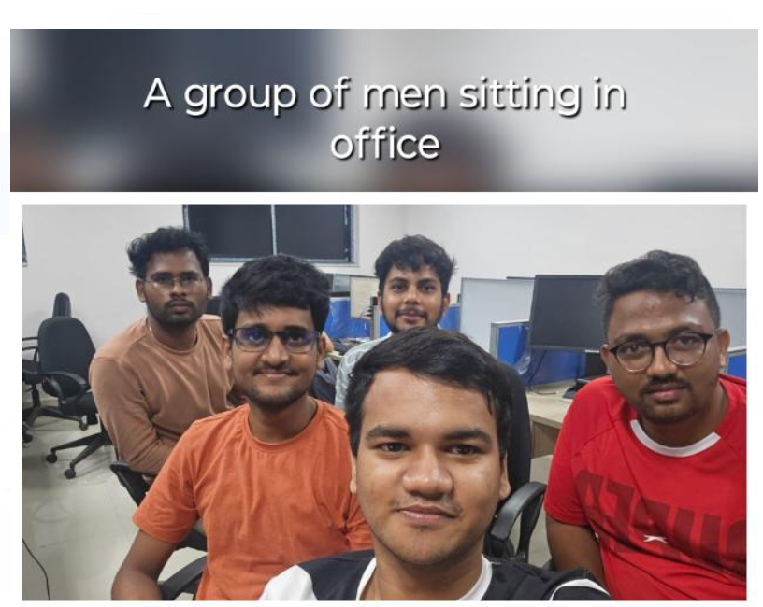
Image Captioning
Perceptron
Manideep G (244101027)
Ishan Varshney (244101022)
Priyanshu Shrivastav (244101033)
Hemanth Prakash S (244101021)
P Sai Kiran Chary (244101031)

Slide 2
Problem Statement
Objective: Generate captions for images using minimal computational
resources.
Model: Pre-trained Vision-Language models (e.g., CLIP, BLIP).
Focus: Leverage lightweight models or few-shot learning techniques.
Minimize training time and resource usage while maintaining caption quality.
Evaluation:
Compare the performance of simpler models or fine-tuning approaches.
Prioritize efficiency without significantly sacrificing caption quality.

Slide 3
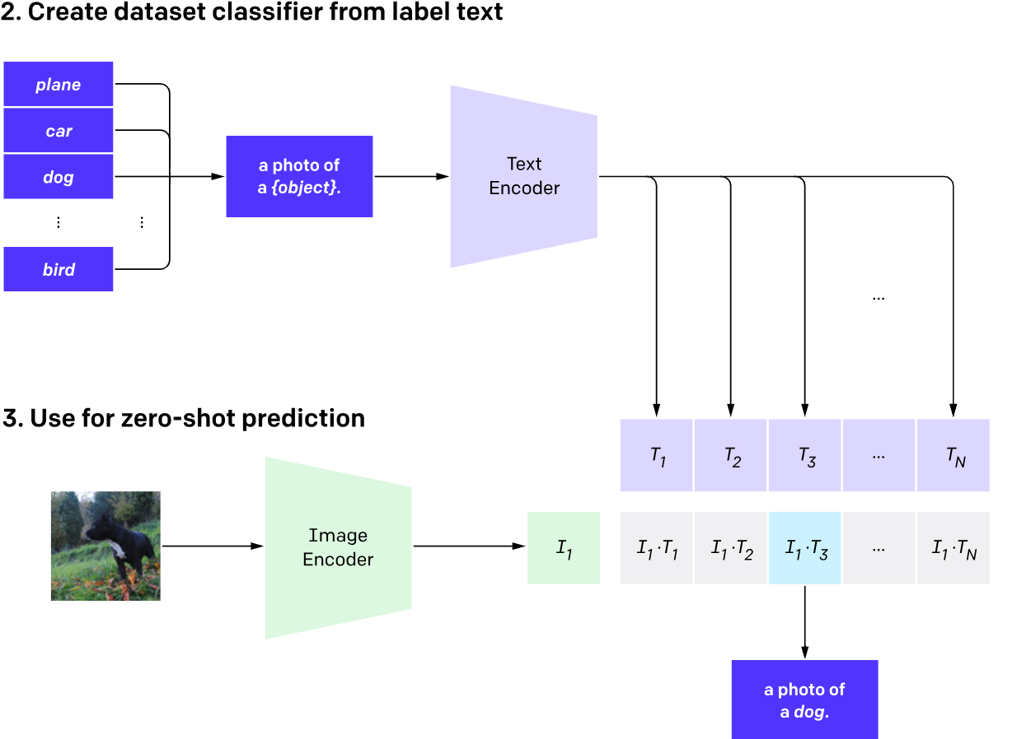
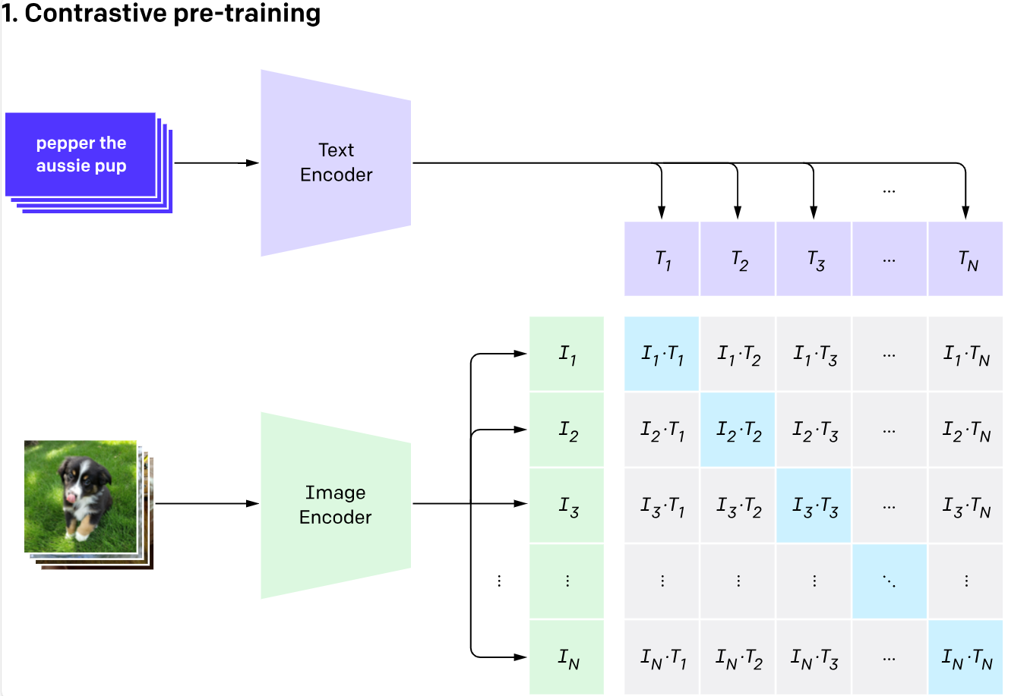
CLIP Model

Slide 4
Fine-grained Image Captioning with CLIP Reward
Introduction:
Image Captioning: Standard models often miss detailed aspects of images,
focusing on common objects due to training with text similarity objectives.
CLIP-based Approach: Uses CLIP (a multimodal encoder trained on large
image-text datasets) to calculate image-text similarity and guide more
distinctive, fine-grained captions.
Key Innovations:
CLIP Reward: Encourages the generation of descriptive captions without
relying on reference captions.
Grammar Finetuning: Improves caption grammar by finetuning the CLIP
text encoder, eliminating repetitive and ungrammatical outputs.

Slide 5
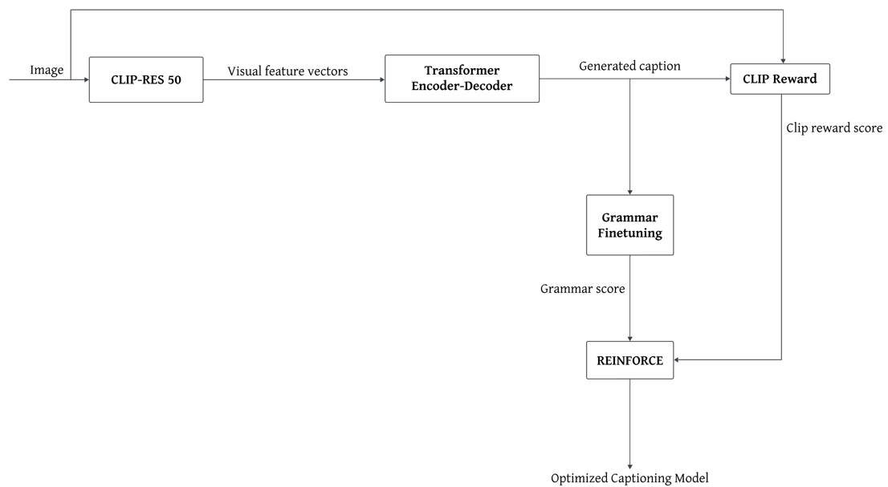
Architecture of Fine-grained Image Captioning with CLIP Reward

Slide 6
Approaches
Approach 1: Finetuning the model using new image-caption pairs
Approach 2: GAN approach
Approach 3: Integrating t5 model

Slide 7
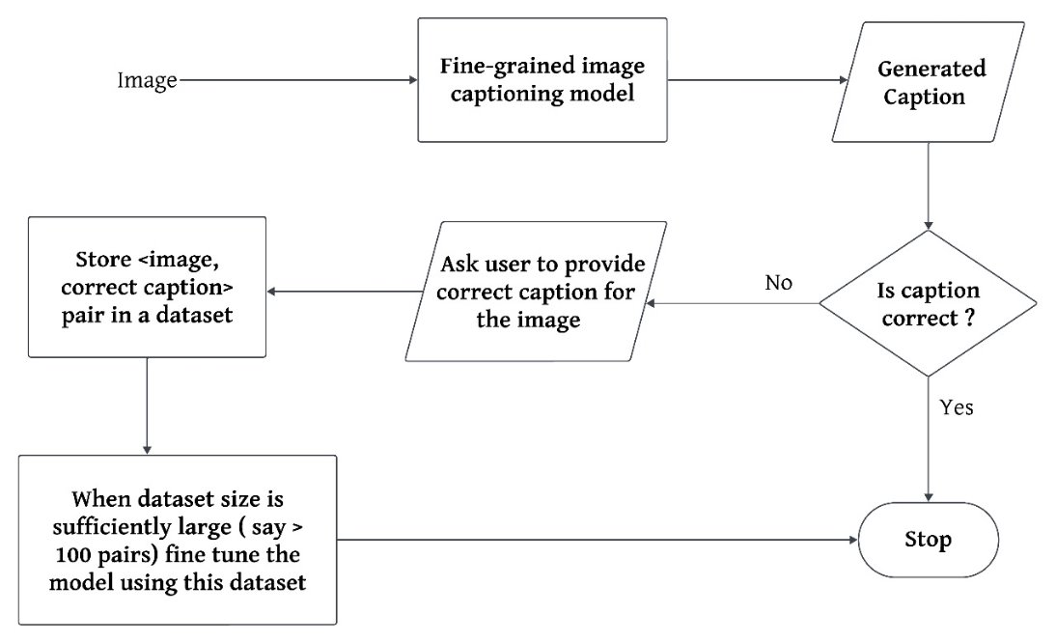
Approach 1: Finetuning the model using custom dataset

Slide 8
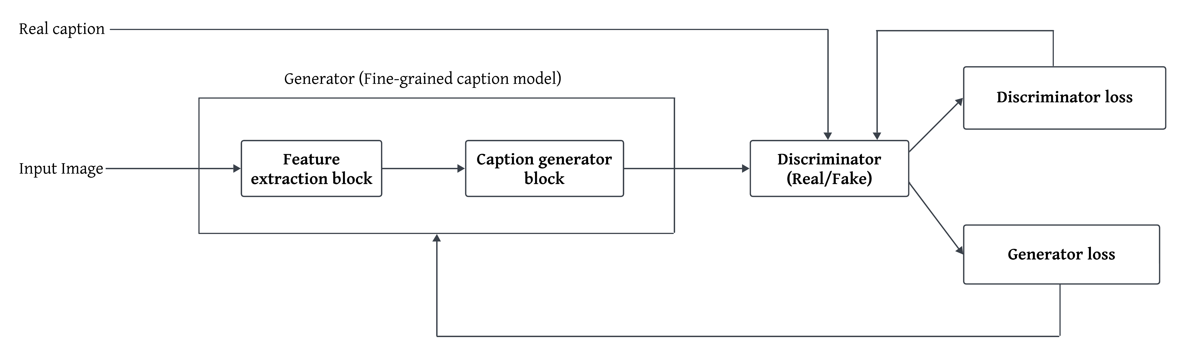
Approach 2: GAN Approach

Slide 9
Challenges to implement this approach
Training Instability- Balancing generator and discriminator updates is difficult, leading to unreliable caption quality.
High Computational Cost-Complex architectures extend training durations, delaying model development.
Marginal Performance Gains-Enhancements in semantic accuracy are limited, offering minimal benefits for the added complexity.
Maintenance and Scalability Issues-Coordinating model updates is cumbersome, hindering scalability and adaptability.

Slide 10
Approach 3: t5 model approach
What is t5 model?
Unified Text-to-Text Format: T5 converts all NLP tasks into a "text-to-text" format, making it adaptable to a wide range of language processing tasks, including summarization.
Versatile Transformer-Based Architecture: Built on the transformer architecture, T5 leverages its design for efficient language understanding and generation across tasks.
Training on Large Datasets: It is pretrained on diverse, extensive datasets, which helps it understand complex sentence structures and rephrase them concisely.
Effective Summarization: T5 excels at condensing long sentences into shorter, meaningful ones by capturing key information and context.

Slide 11
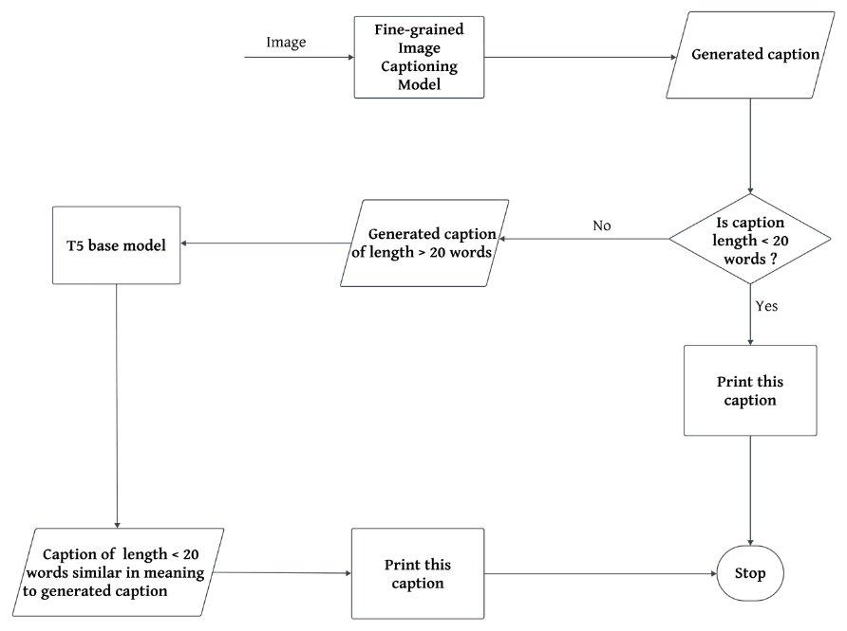
Approach 3: T5 model approach

Slide 12
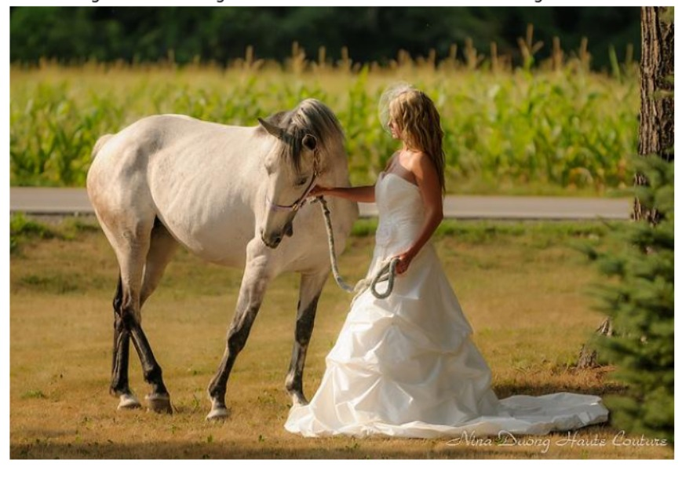
Example

Slide 13
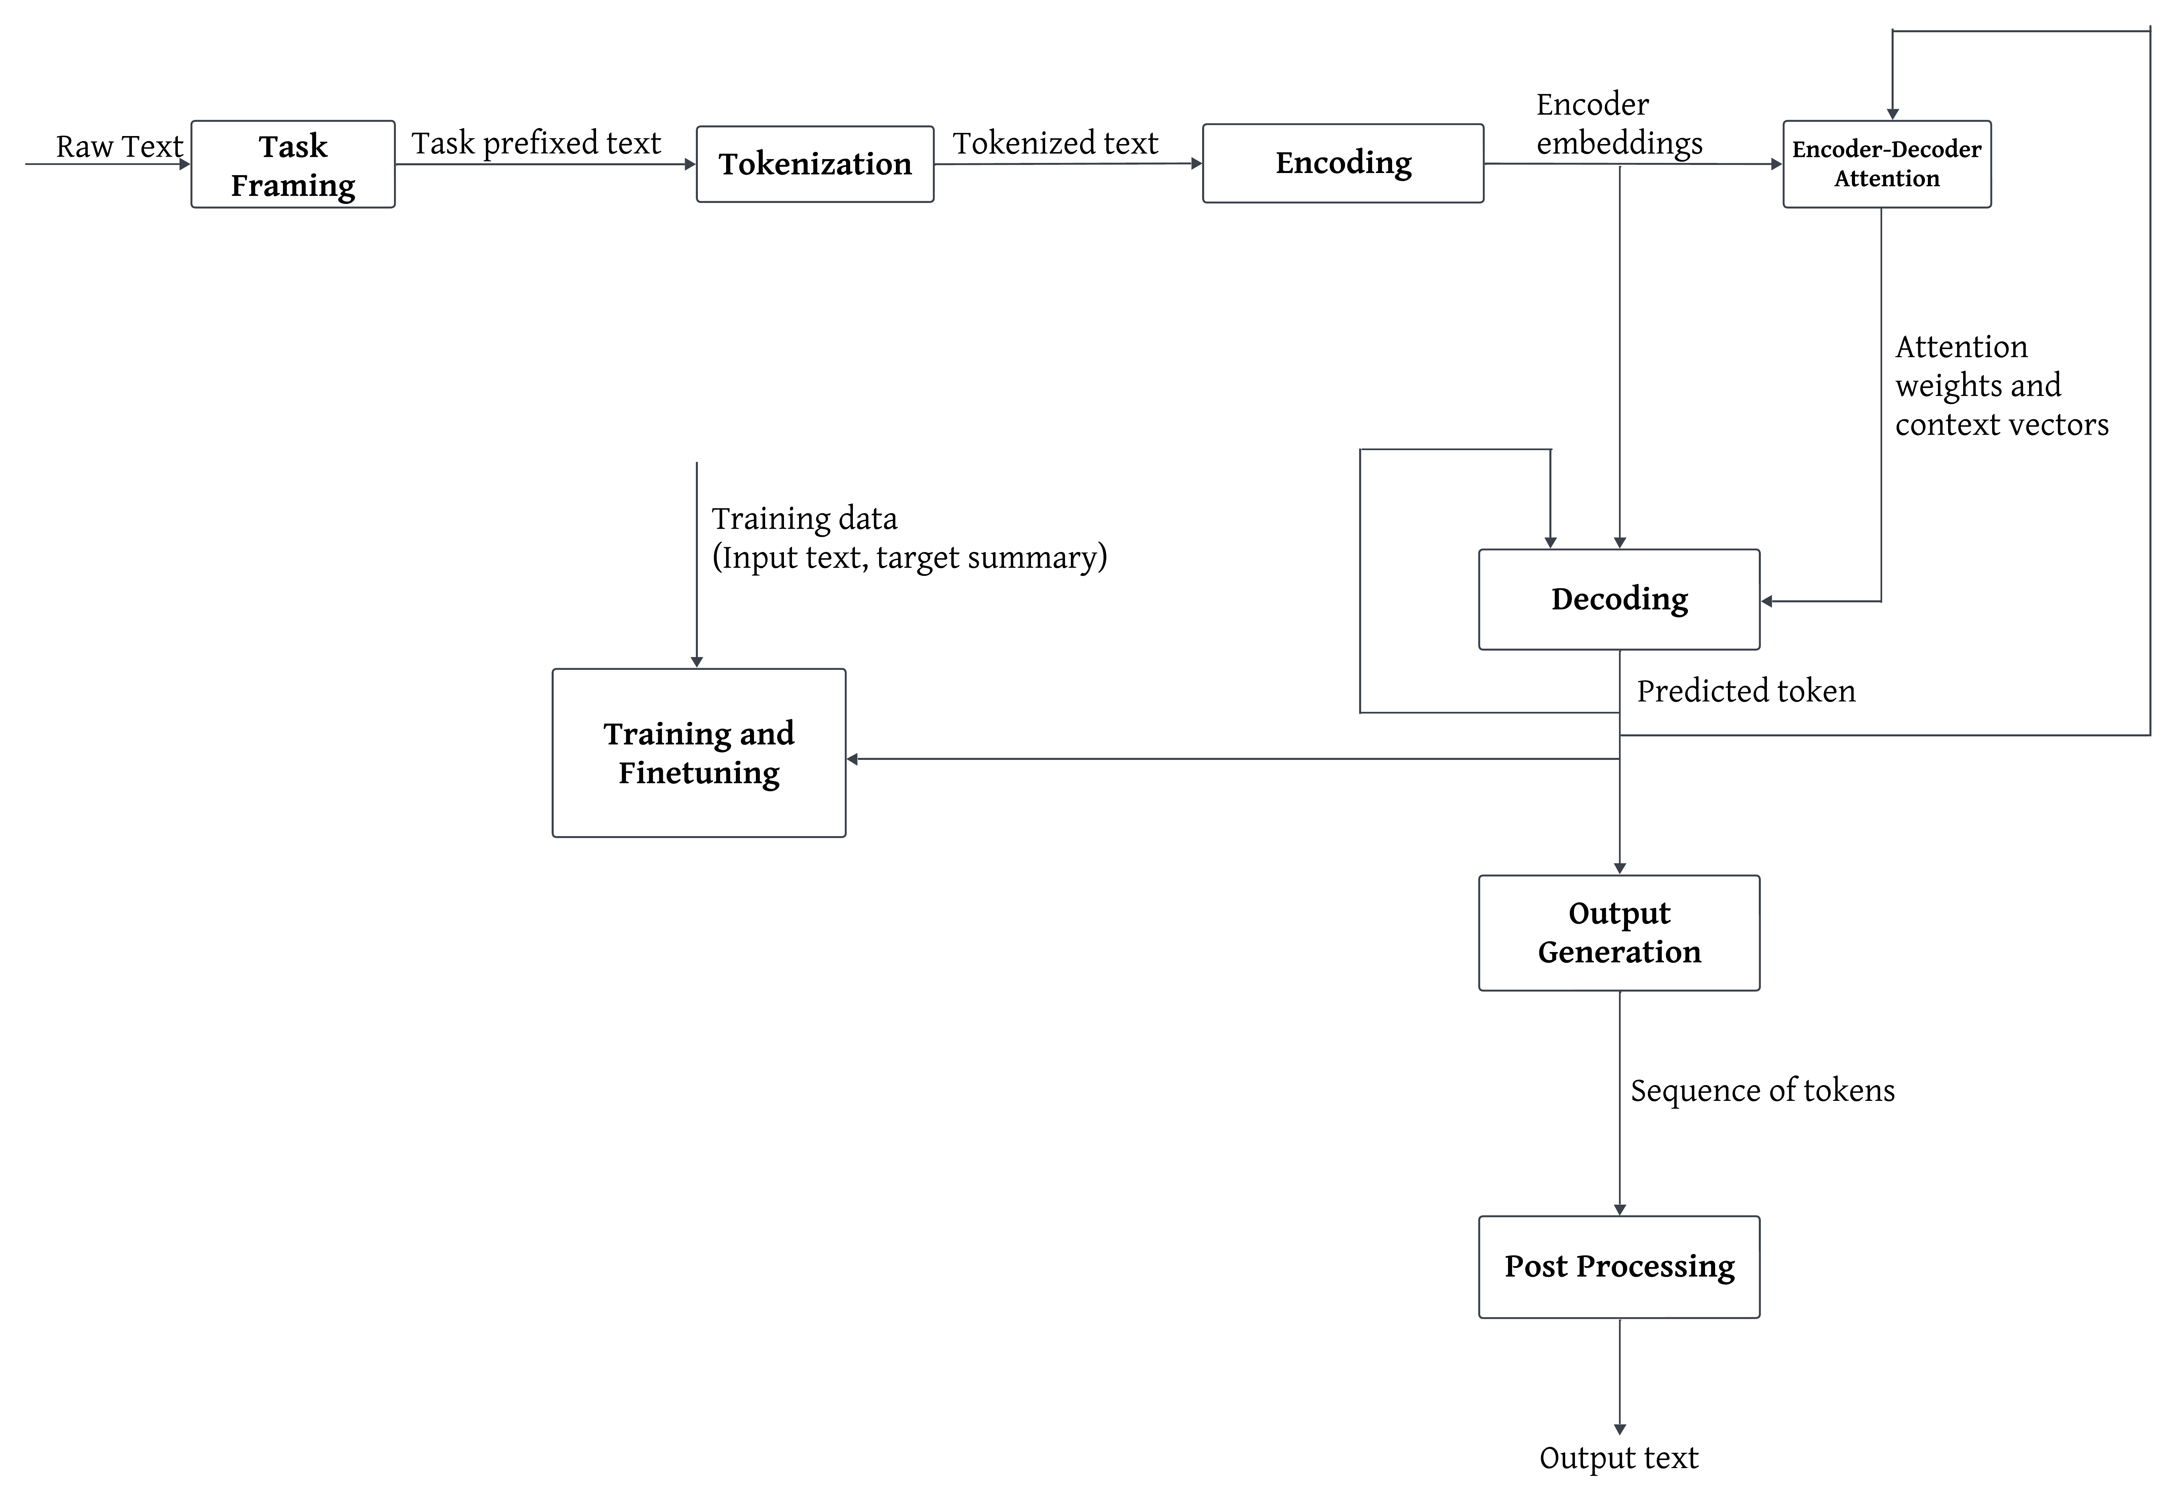
Architecture of t5 model
Approach 3

Slide 14
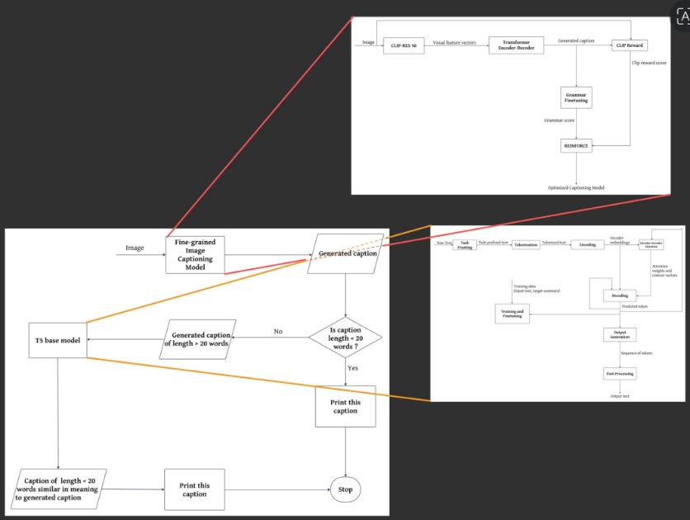
Our Proposed Solution

Slide 15
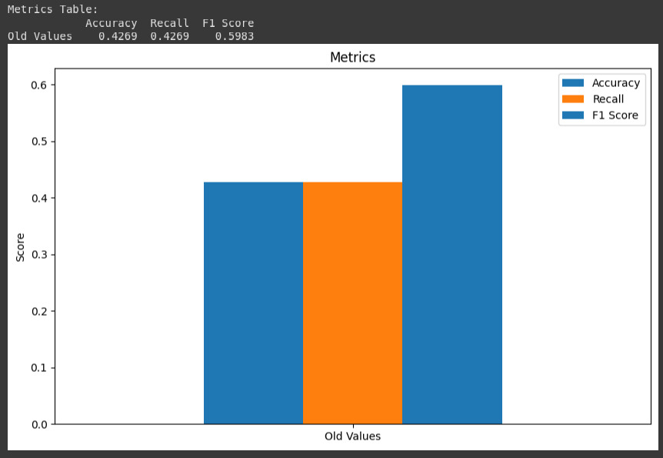
Accuracy Comparison

Slide 16
Conclusion
This project presents a T5-based approach for improving image captioning by summarizing verbose captions. Our findings show that T5 effectively produces concise, semantically accurate captions. Future work will focus on further refining summarization techniques to enhance caption quality.

Slide 17
THANK YOU
Fig. 6 shows a sample(2) image for the new model

