Slide 1
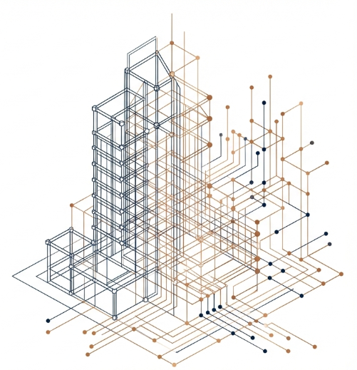

TITLE
Tag line
Company Profile
Company Profile

Slide 2
Heading
Sub tagline
Main Summary
Body with tags and bullet points
Slide 2 of 10

Slide 3
Industries We Serve
Aerospace and defence
Agribusiness
Automotive
Chemicals
Consumer products
Construction and real estate
Defence and security
Finance services
Government
High tech
Education and research
Industrial manufacturing
Life science and healthcare
Media, sports and entertainment
Mill Products
Mining
Oil, gas and energy
Professional services
Retail
Telecommunication
Travel and transportation
Utilities
Wholesale distribution
New and Emerging Industries

Slide 4














































Trusted By

Slide 5
GET IN TOUCH WITH US
Thank
You
CORPORATE OFFICE
DEVELOPMENT CENTER
#7, SJR Eternity, Phase 1
Kodigehalli Road, Hoodi
Bangalore, Karnataka, India.
Pincode-560048
1102 & 1103, 1st Floor, A - Block,
Ardente Office One, Hoodi,
Bangalore, Karnataka, India.
Pincode-560048
www.lumbinielite.com
Email:- info@lumbinielite.com

