Slide 1

SEVAK BOT
BY
Team Name : WhoCreated
SSO-Id:- HEMANT13295
Team members:-
Vaibhav Tayal – BITS Pilani
Hemant Kumar – BITS Pilani
Mohit Rathi – BITS Pilani
Abhishek Singh- BITS Pilani

Slide 2
“Ensuring the access of all citizens to government information and to essential information for human development is a must for every democratic society”
Koichiro Matsuura
Former Director-General of UNESCO

Slide 3
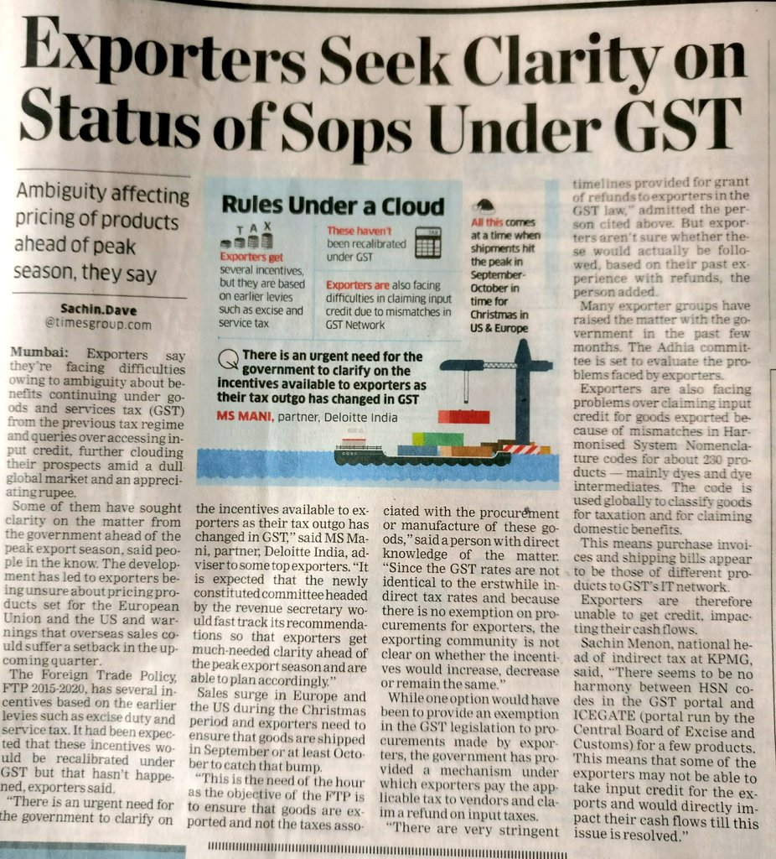


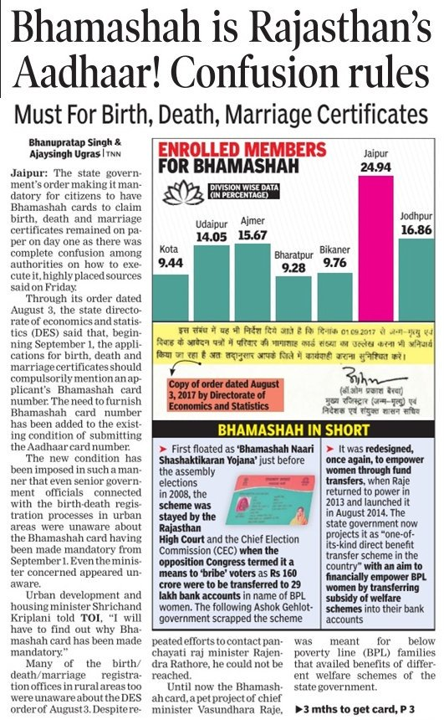
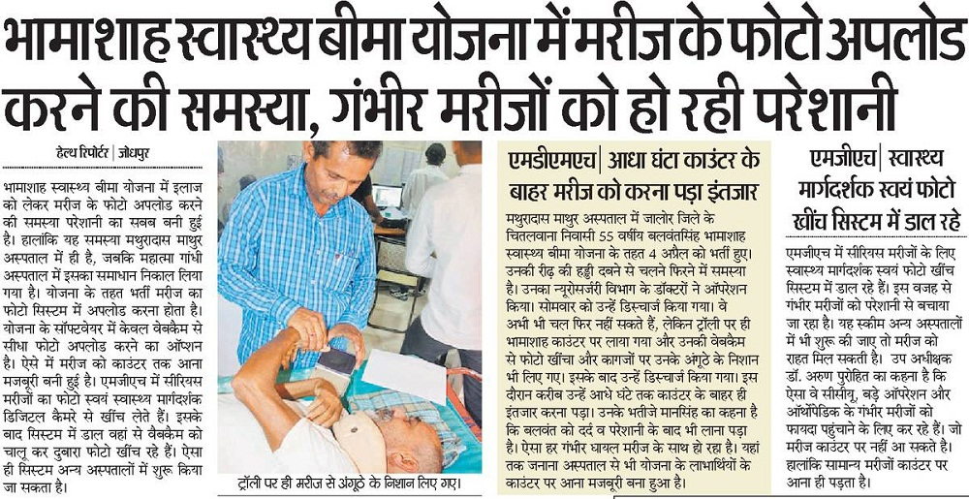
It is important to inform the masses about the changes and developments. Most live in a state of confusion and uncertainty regarding the various government schemes and programs.
The information present is very scattered and inaccessible to the uninformed and the backward.
Informing and educating people about their rights and government facilities forms the very backbone of a stable and progressive society.

Slide 4

How to make information accessible to everybody and in a personalized manner ?
How to streamline the information and present it in a systematic order to people who don’t have access to it ?

Slide 5

SEVAK BOT
Artificially intelligent and Digital Government assistant with a personalized interface between the user and government data, similar to Google Assistant.
Utility
Potential Applications
Can be installed at an election site to answer voter id specific queries or other related information.
The program can be installed in Kiosks and kiosks could be placed at a business park where a businessperson could clear his/her queries regarding GST.
Can be used in ‘Smart Cities’ to disseminate information
Provides a personalized experience to you and help you in a directed manner towards the solution to your query.
Can be customized and trained according to situation and the need.
$ Video Demonstration Link: https://youtu.be/yOnVZbvjTgc

Slide 6

Something about your ‘SEVAK’
It gives you answers and solutions suiting your needs and not just some general answers to your queries.
It is smart! We’ve incorporated Machine Learning in it so that it learns overtime. No need to be perfect in your language and sentence structure because it understands you.
It is bilingual. Some effort and you can make it multilingual.
No need for you to even write. Just ask it verbally and it’ll shoot back the answer instantly.
Internet connectivity issues? No problem! It works offline and hence can be placed in the remote areas really empowering the people living in such areas.

