Slide 1
MATCHING PRODuCTS Recommendations ON UPLOADing AN image On an e-commerce Platform USING neural network models
HEMANT KUMAR KHURANA
Nov 2025

Slide 2
Introduction
The thesis is about the application of reverse image retrieval on fashion industry data for an ecommerce website.
The aim is to test various models on the fashion industry dataset and find a model which is best suited for reverse image search for an fashion industry ecommerce website.
The objectives include
  To access the effectiveness of the pre trained models in terms of accuracy for reverse image search on an fashion industry ecommerce platform
  To build new custom made model and compare the results with pre-trained models.
  To measure the effect of pre-processing of data and of different similarity measure on results.

Slide 3
Literature Review
Application areas
  Fashion industry
  Garment industry
  Fashion forecasting
  Logistics
  Collage
  Cross border ecommerce
Other Application areas
  Webpage Recommendations
  Advertisement
  Counterfeiting
  Disease Diagnosis
  Library and Information Science
  Digital Forensics

Slide 4
Methods of Image Retrieval – Initial Methods
Text to Image
Histogram of RCB values
Perpetual Hashing
Compact Composite Descriptor
Texture Histograms

Slide 5
Methods of Image Retrieval – Manual Methods
Scale Invariant Feature Transform (SIFT)
Speeded Up Robust Features (SURF)
Oriented Fast Rotated Brief (ORB)
Local binary pattern
Principal Component Analysis
Linear Discriminant Analysis
Maximally Stable Extremal Regions

Slide 6
Methods of Image Retrieval – CNN Methods
Single Image Based Models
EfficinetNet
InceptionNet
ResNet
VGGNet
AlexNet
LeNet-5
MobileNet
GoogleNet
Region Based Models
RCNN
Fast RCNN
Faster RCNN
One Shot Detector Models
Yolo
Single Shot Detector
One Shot Learning Models
Triplet Network
Contrastive Learning Based Models

Slide 7
Methods of Image Retrieval – Advanced Methods
Multi-Objective for Adaptive Reverse Recommendation
Hybrid Recommendation (CNN plus Clustering)
Clustering Techniques (Fuzzy C-means, RGB, Texture)
Image Pre-processing (Color Histogram, Wavelet Transforms, 3D Histograms, Color Space, Local Binary Pattern, Grey Wolf Optimization)
Vector Database Management
Fine-Grained Model (Mask Recurrent Convolutional Network-Location Detection, Class, Bounding Box, Segmentation Mask)

Slide 8
Research Methodology – Data Selection, Pre-Processing and Transformation
Data
Fashion Industry Dataset is selected from Kaggle.
Data size of 572.13 MB.
44.4k images and a csv file.
Image resolution of 60*80 pixel.
Data Pre-processing
Image resizing
Image Padding
Normalization
Image rotation, zoom and crop
Transformation
Contrastive Learning

Slide 9
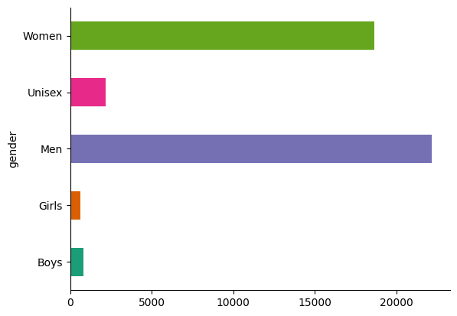
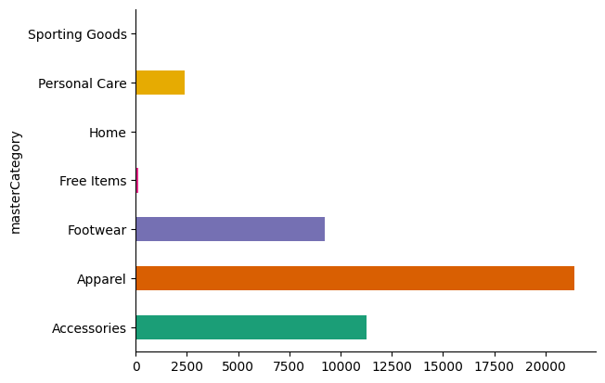
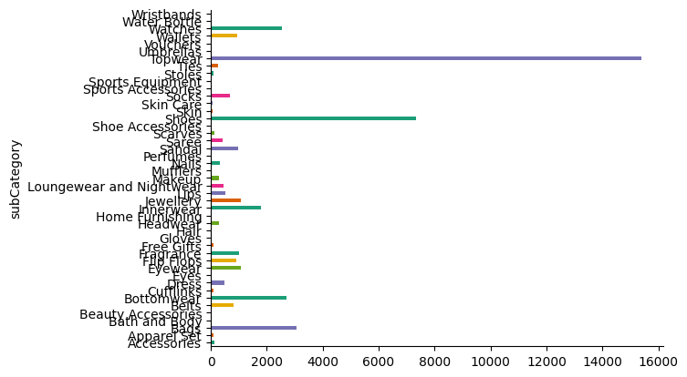
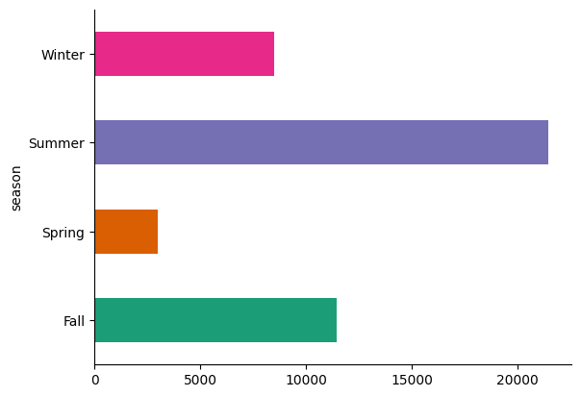
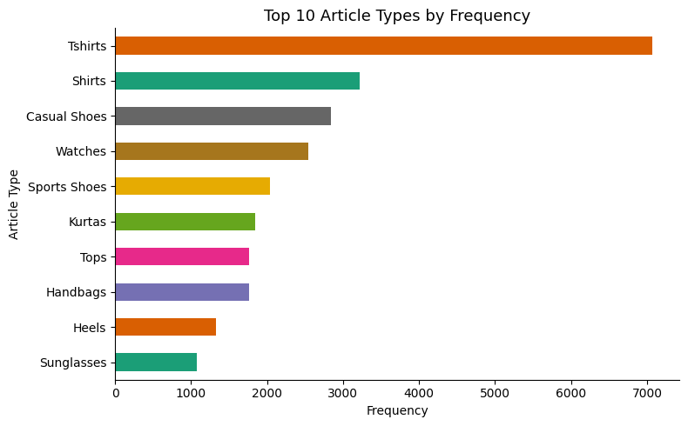
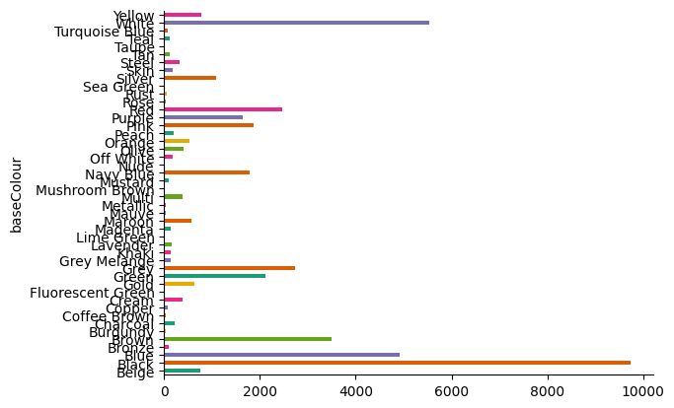
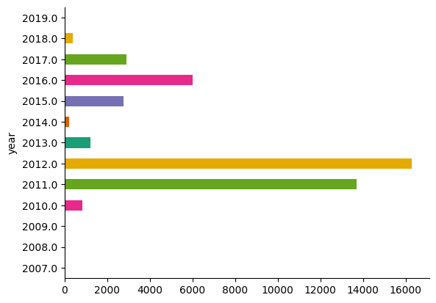
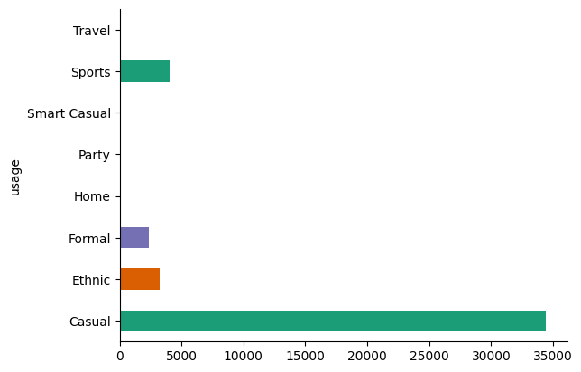
Research Methodology – Data Visualization Frequency Distribution
Gender wise
SubCategory wise
Master Category wise
Season wise
Base Colour wise
Base Usage wise
Year wise

Slide 10
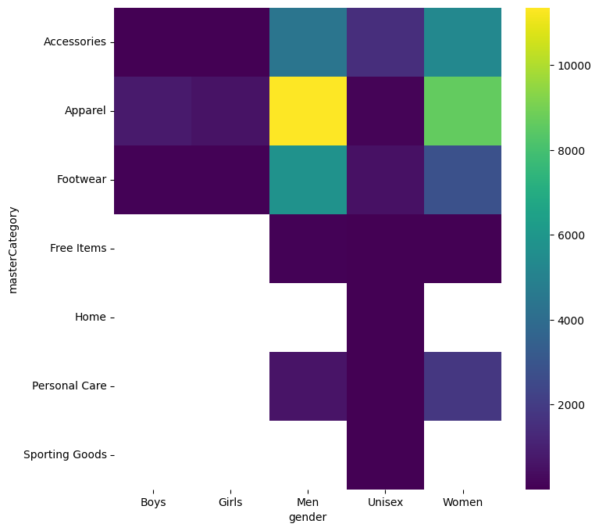
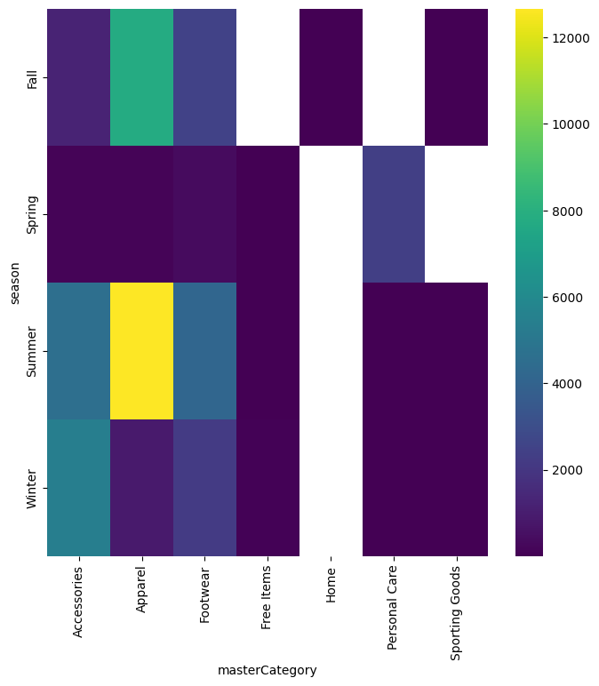
Research Methodology – Data Visualization Heat Maps

Slide 11
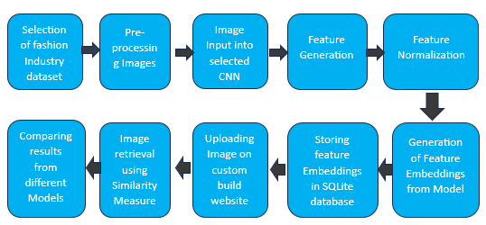
Research Process

Slide 12
Research Methodology – Models Used
Pre-trained MobileNetV2 model trained on ImageNet dataset with Euclidean distance
Pre-trained MobileNetV2 model trained on ImageNet dataset with Cosine Similarity
Pre-trained MobileNetV2 model trained on ImageNet dataset with Manhattan distance
Pre-trained ResNet50 model trained on ImageNet dataset for feature database along with MobileNetV2 model for image feature extraction with Manhattan distance
Pre-trained ResNet50 model trained on ImageNet dataset with Manhattan distance
Pre-trained ResNet50 model trained on ImageNet dataset with image padding with Manhattan distance
Fine-tuned (on articleType classification) pre-trained ResNet50 model trained on ImageNet dataset with cosine similarity
Contrastive Learning Fine-tuned pre-trained ResNet50 model trained on ImageNet dataset with Cosine Similarity
Custom Build Contrastive Learning ResNet50 model trained on fashion industry dataset with Cosine Similarity

Slide 13
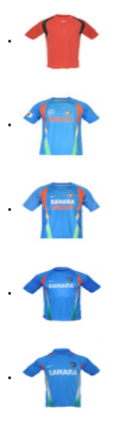
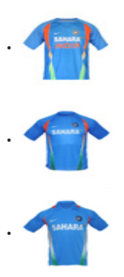
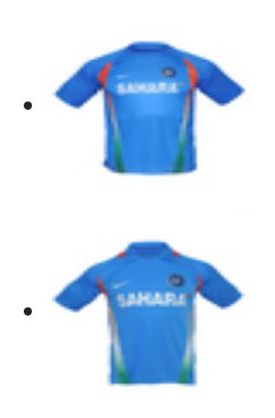
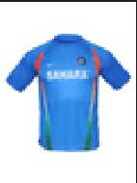
Results – 1
Pre-trained MobileNetV2 model trained on ImageNet dataset with Euclidean distance
Sample Image
Results with distance of < 18
Results with distance of < 19
Results with distance of < 20

Slide 14
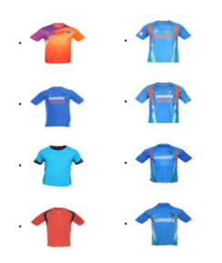
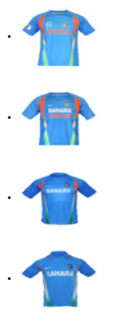
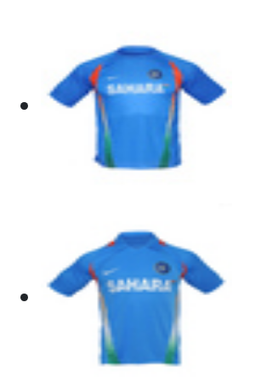
Results – 2
Pre-trained MobileNetV2 model trained on ImageNet dataset with Cosine Similarity
Sample Image
Results with Similarity of > .85
Results with Similarity of > .78
Results with Similarity of > .75

Slide 15
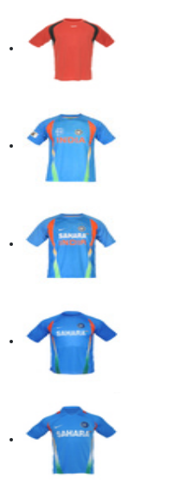
Results – 3
Pre-trained MobileNetV2 model trained on ImageNet dataset with Manhattan Distance
Sample Image
Results with Distance of <300
Results with Distance of < 350
Results with Distance of <360

Slide 16
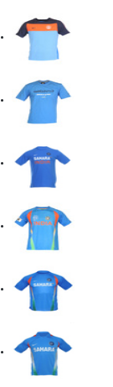
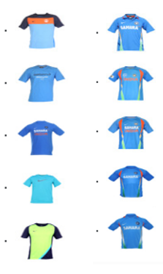
Results – 4
Pre-trained ResNet50 model trained on ImageNet dataset with Manhattan Distance
Sample Image
Results with Distance of < 625
Results with Distance of <650

Slide 17
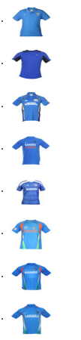
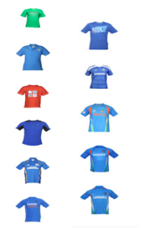
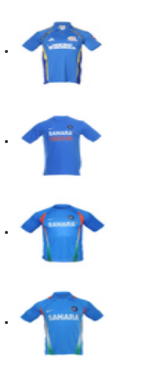
Results – 5
Pre-trained ResNet50 model trained on ImageNet dataset with Manhattan Distance and Image Padding
Sample Image
Results with Distance of < 425
Results with Distance of <434
Results with Distance of <450

Slide 18
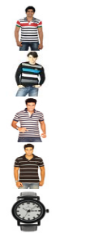
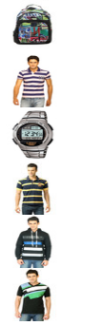
Results – 6
Finetuned Pre-trained ResNet50 model trained on ImageNet dataset on articleType Classification and with Cosine Similarity
Sample Image
Results with Similarity of > 0.95

Slide 19
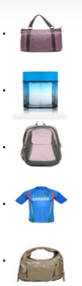
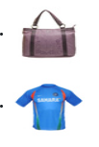
Results – 7
Finetuned Pre-trained ResNet50 model trained on ImageNet dataset on Contrastive Learning and with Cosine Similarity
Sample Image
Results with Similarity of > 0.94
Results with Similarity of > 0.95

Slide 20
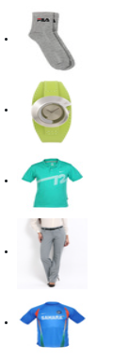
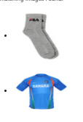
Results – 8
Custom Trained ResNet50 model trained on ImageNet dataset and with Cosine Similarity
Sample Image
Results with Similarity of > 0.997
Results with Similarity of > 0.998

Slide 21
Recall and Precision
 | Model | Recall@1 | Recall@5 | Recall@10 | mAP
0 | ResNet50 (Scratch) | 1.0 | 1.0 | 1.0 | 0.378605
1 | SimCLR ResNet50 | 1.0 | 1.0 | 1.0 | 0.459474
2 | ResNet50 Fine-tuned | 1.0 | 1.0 | 1.0 | 0.541431
3 | ResNet50 (Pretrained + Padding) | 1.0 | 1.0 | 1.0 | 0.708221

Slide 22
Embedding Separation Summary
Sr. No. | Model | Silhouette | Intra-Class | Inter-Class | Separation Ratio
0 | ResNet50 (Scratch) | -0.453485 | 0.767261 | 0.990459 | 1.290903
1 | SimCLR ResNet50 | -0.270317 | 0.709757 | 0.996486 | 1.403981
2 | ResNet50 Fine-tuned | -0.515556 | 0.054785 | 0.203822 | 3.720384
3 | ResNet50 (Pretrained + Padding) | -0.078462 | 0.168644 | 0.359602 | 2.132321

Slide 23
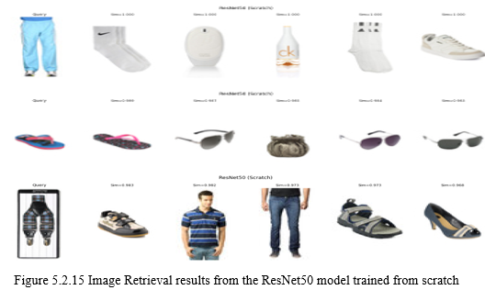
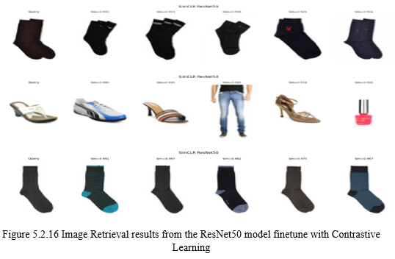
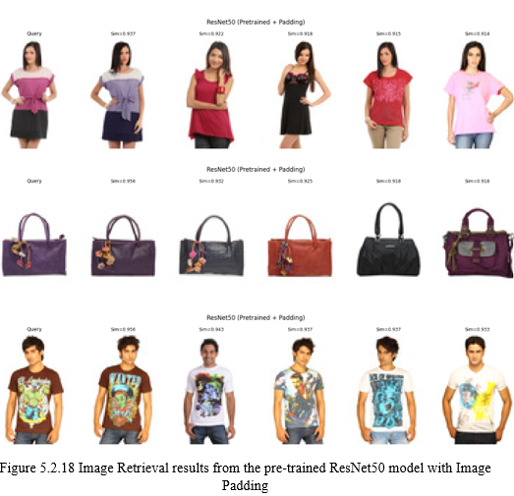
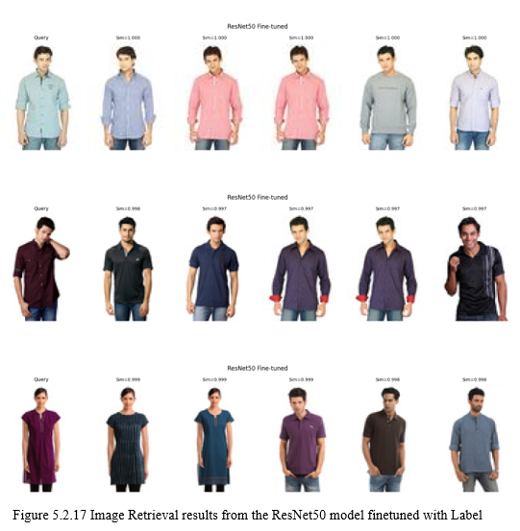
Other Retrieval Tests

Slide 24
Conclusion and Recommendations
Pre-trainedResNet50 with image padding gave best results
Second best model was Finetuned ResNet50 Model on Classification
Similarity Measure does not make material difference in results
There is a scope to find a better model by combining finetuning of Classification with Contrastive Learning
Other possible improvements are increasing batch size, epochs, image augmentation techniques, use of better quality image data and testing other models on fashion industry dataset

