Slide 1
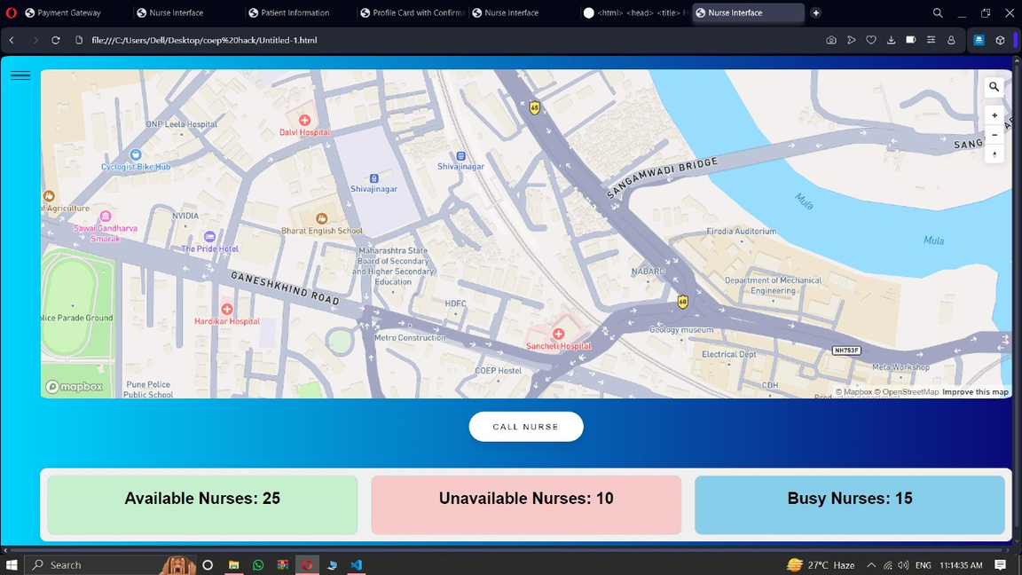
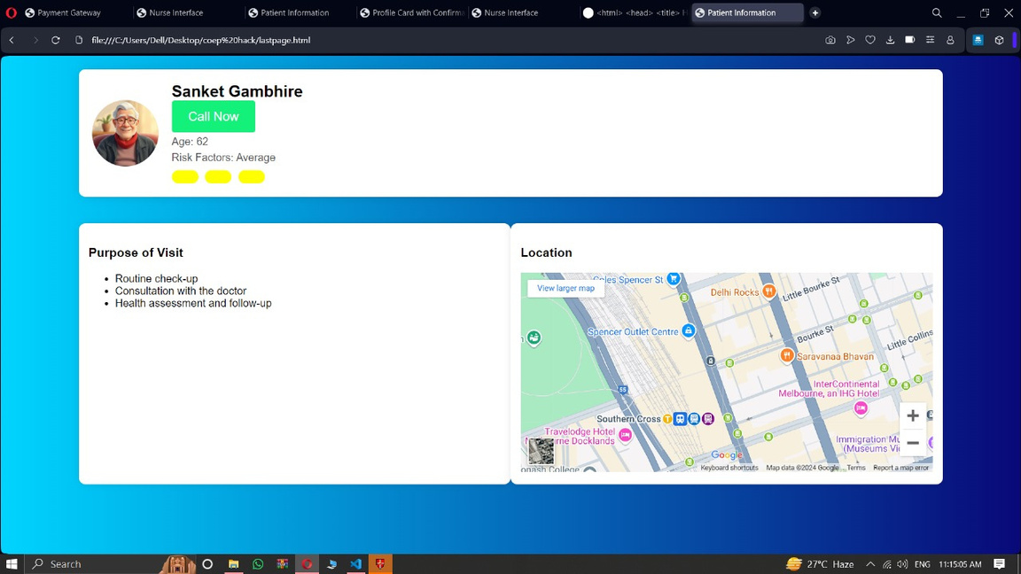
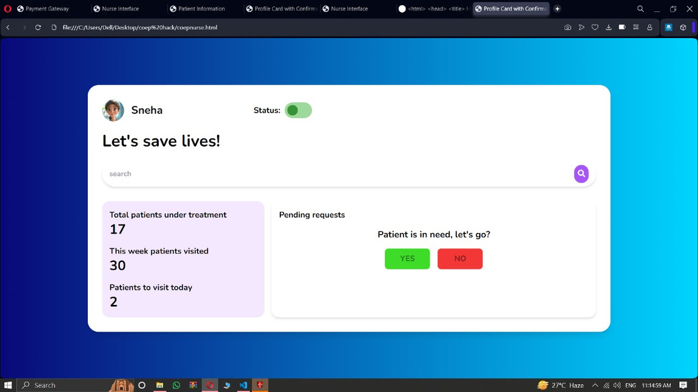
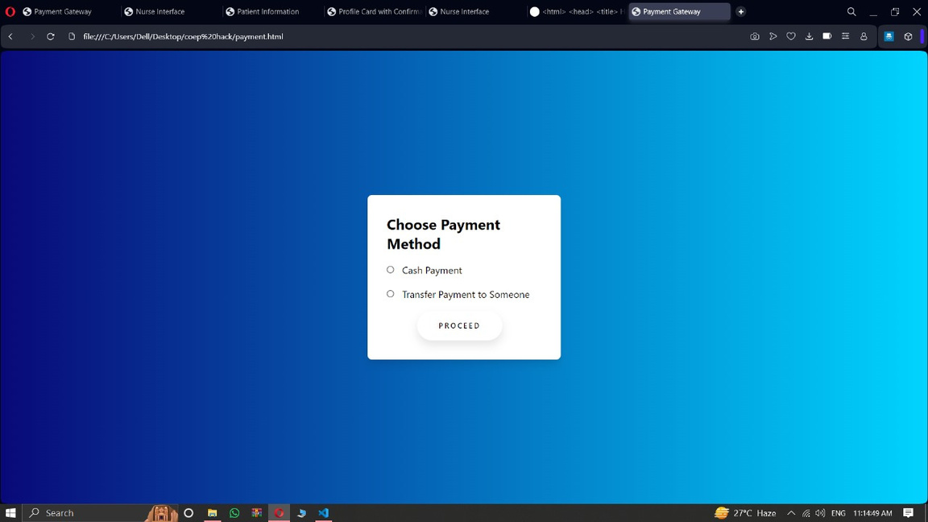

Slide 2


Union Selling point:
Real-time GPS tracking of both patients and nurses on duty, ensuring accurate and quick nurse allocation.
Automated nurse contact system that retries with the next nearest nurse if the first nurse is unavailable, minimizing delays.
Multiple payment options, allowing payments to be made by someone else, or via cash at the point of service.
Patient risk level assessment, helping prioritize critical cases and ensure the appropriate urgency in nurse assignment.

Slide 3



Viability:
Scalability: The website can serve initial markets but may need to transition to a mobile app for broader adoption.
Market Acceptance: Users may prefer mobile-first solutions, limiting adoption of a web-only version.
Feasibility:
User Experience: Websites lack the seamless background tracking and convenience of mobile apps.
Device Dependency: Requires constant browser access and internet-enabled devices with location permissions.

