Slide 1


Indian Institute of Information Technology, Allahabad
Department of Information Technology
Prediction of heart disease using Ensemble Techniques and Multi Layer Perceptron Neural Network
Under the Guidance of
Prof. O. P. Vyas
By
Hemant Kumar Lader (MIT2019007)

Slide 2

ABSTRACT
According to the World Health Organization around 17.9 million people die each year due to the cardiovascular heart disease.
Early prediction of heart disease can prevent many patient deaths and and efficient treatment could be provided at early stages.
Developing a medical diagnosis system based on machine learning for prediction of heart disease gives more accurate diagnosis results than traditional way.

Slide 3
ABSTRACT…(continued)
The predictive modeling solution for prediction of heart disease is extremely challenging.
Some attributes such as age, blood pressure, blood sugar etc. from the UCI cleveland dataset are fed into algorithms which are used to predict the risk of heart attack.
Many previous work has been done on different data mining techniques, so in this project I will be trying to optimize the result by comparing and combining them using ensemble method and multi layer perceptron

Slide 4

LITERATURE SURVEY
In [1], the age range was grouped by the K-Nearest Neighbor algorithm into class. The Risk level of each class was identified with the help of ID3 algorithm. The accuracy of prediction was measured by considering different attributes. This gave highest of 80.6% accuracy.
In [2], authors investigated the heart disease prediction using KStar, J48, SMO, Bayes Net and Multilayer Perceptron through Weka software. Using k-Fold Cross-Validation resampling procedure. The performance of these data mining techniques is measured by combining the results of predictive accuracy, ROC curve

Slide 5
LITERATURE SURVEY…(continued)
In [3], authors uses algorithms like logistic regression, support vector machine, k-nearest neighbor, Gaussian naïve Bayes, decision tree classifier and random forest classifier. And the prediction accuracy for logistic regression is found to be the highest among all with 88.29% accuracy. They uses 13 attributes of UCI cleveland dataset.
The prediction method for heart disease using Neural Network has been proposed by Chaitrali S.Dangare.etl [4]. It has mainly three layers, i.e. the input layer, hidden layer and the output layer. The input is given to the input layer and the result is obtained in the output layer.

Slide 6
Problem Statement
To develop a system for predicting heart disease from risk factors using machine learning techniques Ensemble Methods and Multi Layer Perceptron Neural Network. To predict heart disease efficiently and accurately.

Slide 7
Dataset Description
The dataset I am using for this project is “Heart Disease Data Set” from UCI Machine learning repository [5].
Inputs attributes:
Age, Sex, Chest Pain, Resting blood pressure, Serum cholesterol, Fasting blood sugar, Resting electrocardiographic results, Maximum heart rate achieved, Exercise induced angina, ST depression, Slope of the peak exercise ST segment, Number of major vessels colored by fluoroscopy and thal.
Output Attribute
Target : Normal or Heart Problem

Slide 8
Dataset Description…(continued)
Age : age in years
Sex : (1 = male; 0 = female)
Cp : chest pain type
Trestbps : resting blood pressure (in mmHg)
Chol : serum cholesterol in mg/dl
fbs(fasting blood sugar > 120 mg/dl) : (1 = true; 0 = false)
Restecg : resting electrocardiographic results
Thalach : maximum heart rate achieved
Exang : exercise induced angina (1 = yes; 0 = no)
Oldpeak : ST depression induced by exercise relative to rest
Slope : the slope of the peak exercise ST segment
Ca : number of major vessels (0-3) colored by fluoroscopy
Thal : 3 = normal; 6 = fixed defect; 7 = reversable defect
Target : 1 = Heart Problem or 0 = Normal

Slide 9
Dataset Description…(continued)
The heart disease dataset is made up of 75 raw features from which 13 features were published. These features are very vital in the diagnosis of heart diseases.
The features include fasting blood sugar test which must indicate
< 120 mg / dl for a patient with absent test result and test result of
> 120 mg / dl for a patient that has heart disease.
Also, a patient that has serum cholesterol greater than 180 mg/dl is also considered as heart disease present.

Slide 10
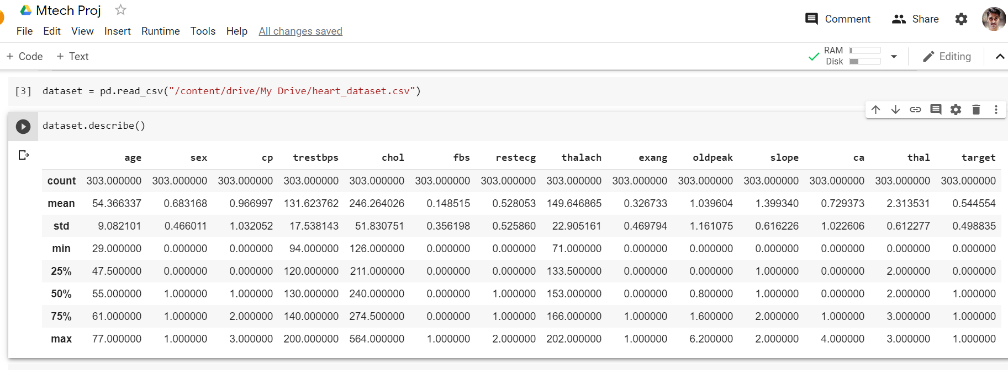
Dataset Description…(continued)
The description of used dataset, 13 feature columns and 1 target column

Slide 11
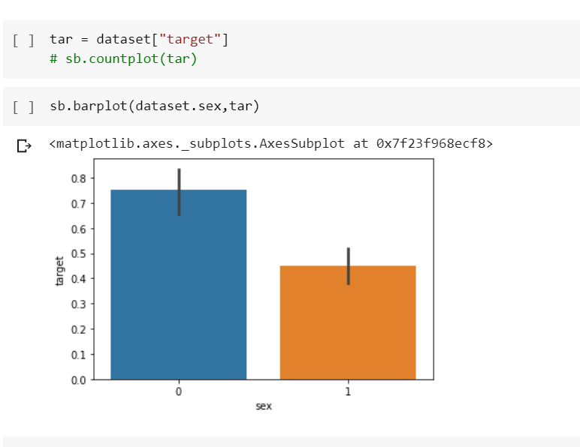
METHODOLOGY
First I analyse which attributes of dataset are strongly correlated. And how it affect the final prediction.
By analysing the dataset it is found that females are more likely to have heart problems than males
Fig. 1. Correlation of gender with Heart disease.

Slide 12
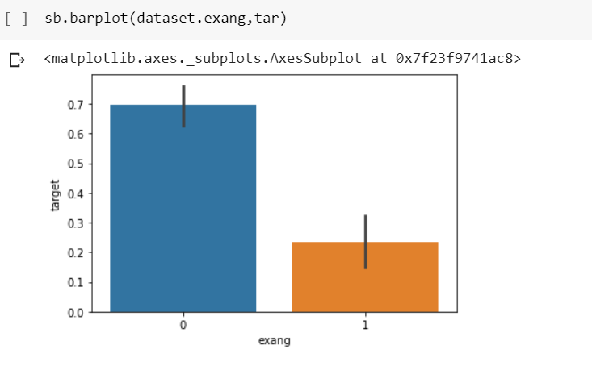
METHODOLOGY…(continued)
Likewise exang attribute is strongly correlated with the target attribute. And this is how other attributes are correlated.
exang 0.436757
cp 0.433798
oldpeak 0.430696
thalach 0.421741
ca 0.391724
slope 0.345877
thal 0.344029
sex 0.280937
age 0.225439
trestbps 0.144931
restecg 0.137230
chol 0.085239
Fig. 2. Correlation of exang with Heart disease. fbs 0.028046

Slide 13
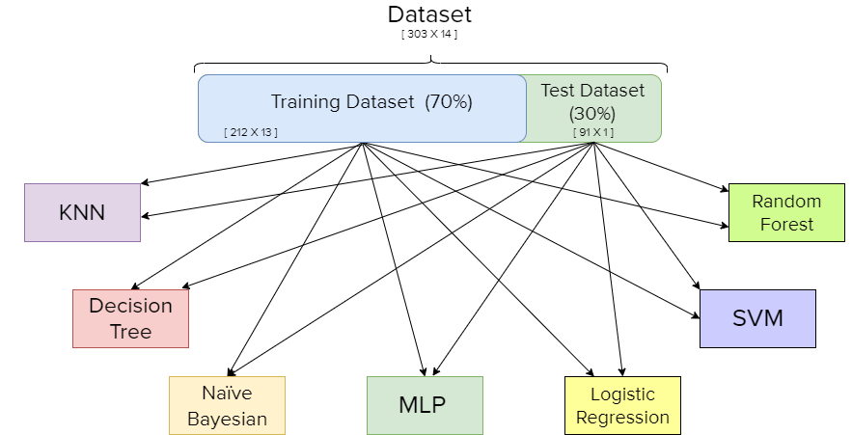
METHODOLOGY…(continued)
I splitted 70% of dataset as training data and 30% as test data.
Fig. 3. Base model /
Classifiers for proposed approach

Slide 14
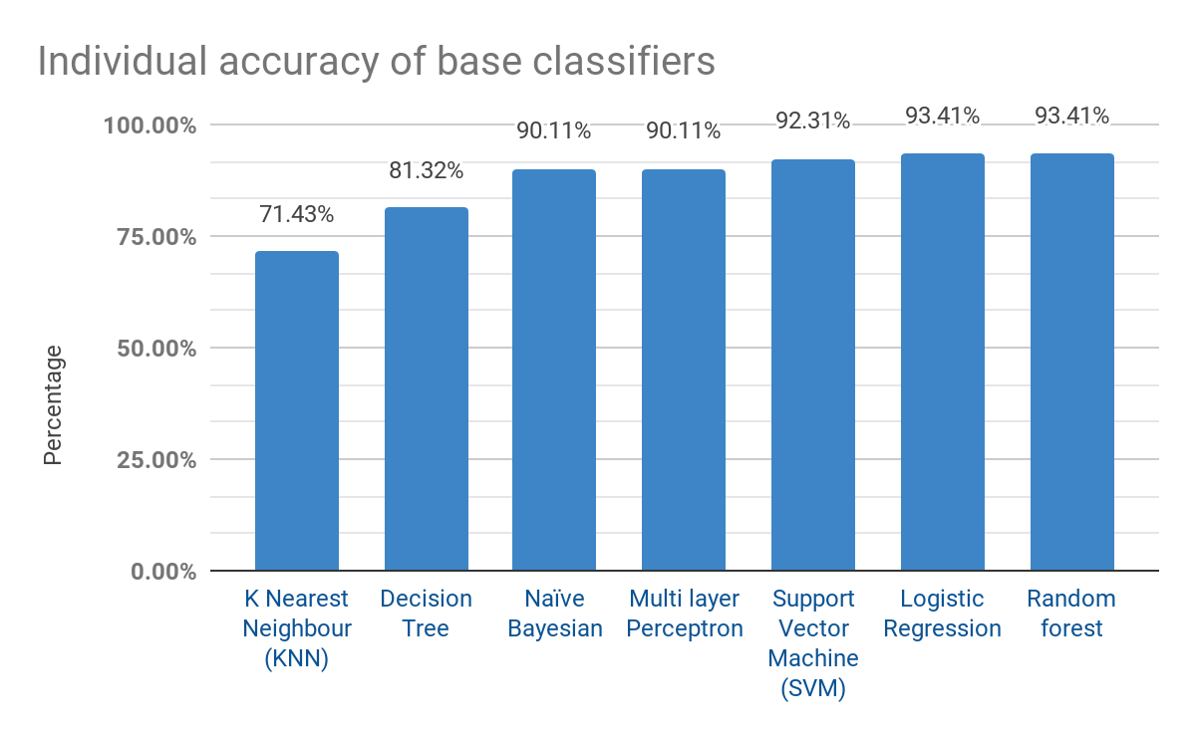
METHODOLOGY…(continued)
I calculated individual accuracy percentage of 7 classifiers. To see the performance on prediction.
Fig 4. Comparison of accuracy of chosen base classifier

Slide 15
METHODOLOGY…(continued)
To optimize the prediction accuracy I chose these techniques of classification as base models based on reviewed papers:
Logistic Regression
Naïve Bayesian
Support Vector Machine (SVM)
K Nearest Neighbour (KNN)
Decision Tree
Multi layer Perceptron
Random forest

Slide 16
METHODOLOGY…(continued)
In paper [8], S. Kamley proposed hybrid approach to predict heart disease using ensemble classification techniques like bagging and boosting.
In this project I used Stacking, Voting Classifier and Adaboost techniques of Ensemble methods and compared the overall performance of the system with individual models.

Slide 17
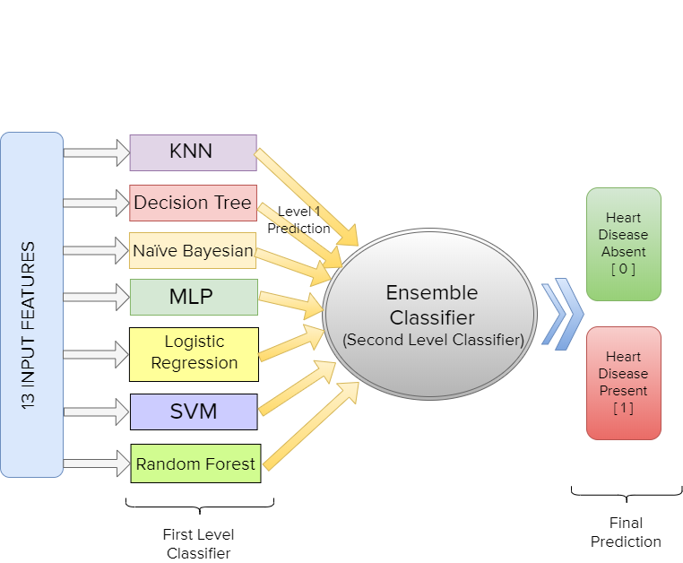
METHODOLOGY…(continued)
Proposed ensemble approach
using
Stacking
method
MLP
Test Data
Fig. 5. Proposed classification system using ensemble Stacking technique

Slide 18
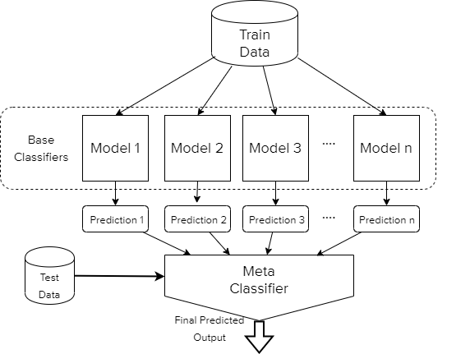
METHODOLOGY…(continued)
Stacking Ensemble Technique:
Uses a meta-learning algorithm to learn how to best combine the predictions from two or more base machine learning algorithms [9]
I used Multi-Layer Perceptron as Meta Classifier.
Fig 6. Standard stacking ensemble learning

Slide 19
METHODOLOGY…(continued)
As in [6] authors used data mining and Artificial Neural Network (ANN) techniques. Multilayer perceptron neural network along with back propagation algorithm is used to develop the system. Because MLPNN model proves the better results. Their experimental result shows that using neural networks the system predicts Heart disease with very high accuracy.
So to fill the accuracy gap from other techniques I used Multilayer perceptron neural network as meta classifier for proposed approach.

Slide 20
METHODOLOGY…(continued)
Multilayer Perceptron Neural Network (MLPNN):
Artificial neurons are used in multiple layers
Has multiple layers input layer, output layer and hidden layers
Trained by a back propagation algorithm
Input layer will contain 13 neurons
Output layer contains 2 neurons for “Disease Presence”/“Disease Absence”.
Two hidden layer with 7 and 5 neurons for base classifier. Fig 7.a.
One hidden layer with 5 neurons for meta-classifier. Fig. 7.b.

Slide 21
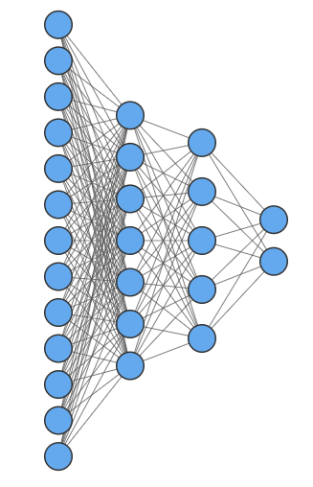
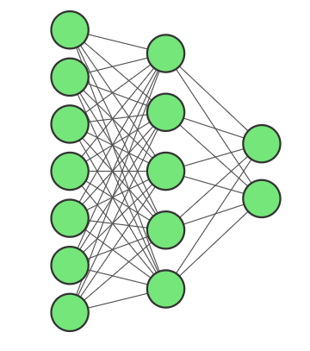
METHODOLOGY…(continued)
Multilayer Perceptron Neural Network (MLPNN):
13 risk factors
Predicted output of 7 Base Classifiers
0
0
1
1
Fig 7. a. MLP for base classifier
Fig 7. b. MLP for meta classifier

Slide 22
METHODOLOGY…(continued)
I implemented these approaches in Python programming language in Google Colab.
In addition to stacking Ensemble technique. I used Adaboost Classifier and Voting Classifier to check if it performs better than stacking approach for this system.
I trained 7 individual classifiers and created a stack classifier using multi layer perceptron as meta-classifier (final classifier).
I tried different combinations of random states for mlp and split ratios to get the optimal performance by this system.

Slide 23
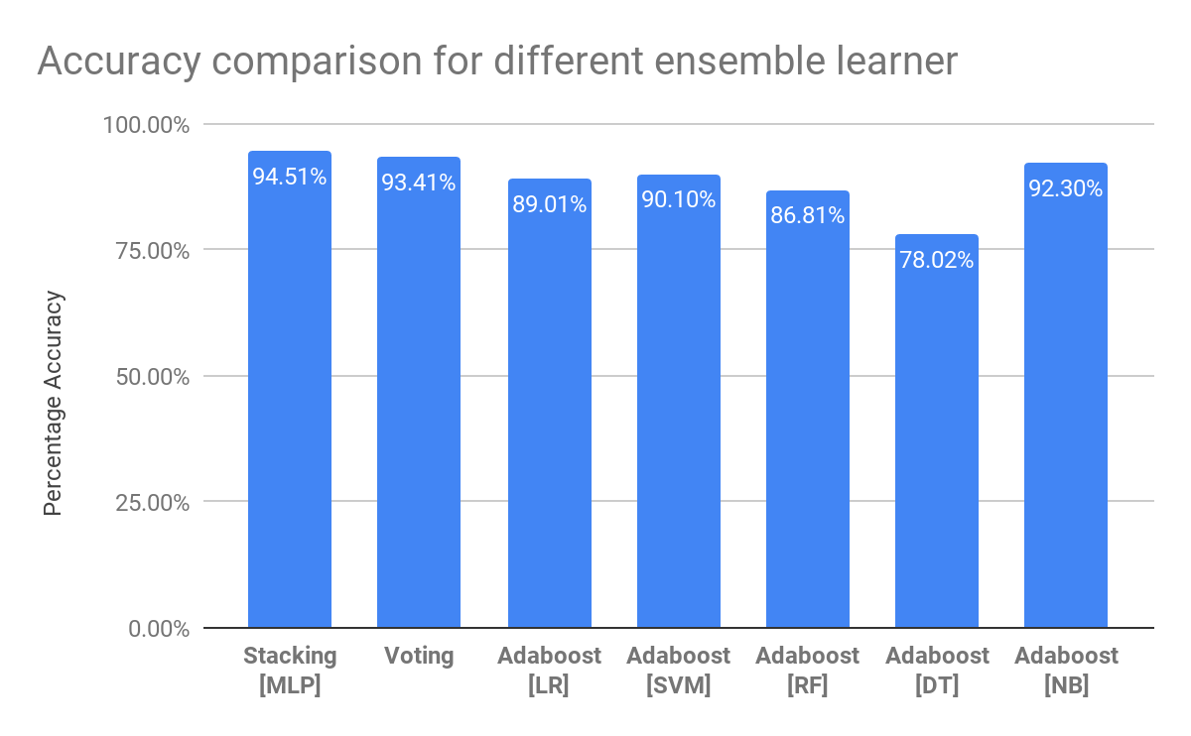
METHODOLOGY…(continued)
This is the comparison of different adaboost classifiers, voting classifier and Stacking classifier.
Stacking with MLP as final classifier gives higher accuracy among others which is 94.51 %.
Fig 8. Comparison of different ensemble approach with proposed approach Stacking with MLP as Final classifier (first bar)

Slide 24
RESULT
The proposed approach for heart disease prediction gives higher accuracy than their individual base classifiers (From Fig. 8. and Fig. 4) with the accuracy of 94.51%.
This is the confusion matrix of the predictive model.
True Positive (TP) : Disease actually present, predicted present.
False Negative (FN) : Disease actually present, predicted absent.
True Negative (TN) : Disease actually absent, predicted absent.
False Positive (FP) : Disease actually absent, predicted present.
Table. 1. Confusion Matrix
Heart Disease | Predicted Absent | PredictedPresent
Actual Absent | 40 | 3
Actual Present | 2 | 46
TP
FN
FP
TN

Slide 25
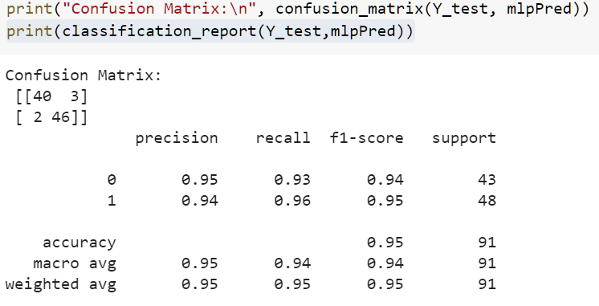
RESULT…(continued)
For disease absent
Recall : 0.93
Precision: 0.95
For disease present
Recall : 0.96
Precision: 0.94

Slide 26
Conclusion
From the result it is clear that using ensemble methods gives better performance than that of their individual learning model. Ensemble methods are meta-algorithms that combine several machine learning techniques into one predictive model in order to decrease variance, bias, or improve predictions (stacking).

Slide 27
Conclusion…(continued)
The trained model of this system can be used to combined with web-portal or mobile application, It can also be integrated with IoT applications. To alert the doctors prior to the high risk.
Accuracy for this prediction may increase beyond 94.51% by using extreme gradient boosting. It converts weak model to strong models by adjusting the weights iteratively to reduce bias and increase accuracy.

Slide 28

REFERENCES
Thomas, J., and R Theresa Princy. “Human Heart Disease Prediction System Using Data Mining Techniques.” 2016 International Conference on Circuit, Power and Computing Technologies (ICCPCT), 2016, doi:10.1109/iccpct.2016.7530265.
Sultana, Marjia, et al. “Analysis of Data Mining Techniques for Heart Disease Prediction.” 2016 3rd International Conference on Electrical Engineering and Information Communication Technology (ICEEICT), 2016, doi:10.1109/ceeict.2016.7873142.
Swain, Debabrata, et al. “An Efficient Heart Disease Prediction System Using Machine Learning.” Machine Learning and Information Processing Advances in Intelligent Systems and Computing, 2020, pp. 39–50., doi:10.1007/978-981-15-1884-3_4.
Dangare, Chaitrali & Apte, Sulabha. (2012). A Data Mining Approach for Prediction of Heart Disease Using Neural Networks. 3.
Amin, Syed Umar, et al. “Genetic Neural Network Based Data Mining in Prediction of Heart Disease Using Risk Factors.” 2013 Ieee Conference On Information And Communication Technologies, 2013, doi:10.1109/cict.2013.6558288.
D. Dua and C. Graff, “Heart Disease Data Set.” archive.ics.uci.edu/ml/datasets/Heart Disease.

Slide 29
REFERENCES…(continued)
6. Deshmukh, Rachana, et al. “Heart Disease Prediction Using Artificial Neural Network.” Ijarcce, vol. 8, no. 1, 2019, pp. 85–89., doi:10.17148/ijarcce.2019.8119.
7. Alim, Muhammad Affan, et al. “Robust Heart Disease Prediction: A Novel Approach Based on Significant Feature and Ensemble Learning Model.” 2020 3rd International Conference on Computing, Mathematics and Engineering Technologies (ICoMET), 2020, doi:10.1109/icomet48670.2020.9074135.
8. Kamley, Sachin. “Performance of Hybrid Ensemble Classification Techniques for Prevalence of Heart Disease Prediction.” VOLUME-8 ISSUE-10, AUGUST 2019, REGULAR ISSUE International Journal of Innovative Technology and Exploring Engineering, vol. 8, no. 10, Oct. 2019, pp. 1875–1882., doi:10.35940/ijitee.j9233.0881019.
9. Sikora, Riyaz, and Ola Al-Laymoun. “A Modified Stacking Ensemble Machine Learning Algorithm Using Genetic Algorithms.” Artificial Intelligence, pp. 395–405., doi:10.4018/978-1-5225-1759-7.ch016.

Slide 30
Thank you

