Slide 1

Workshop on Python Programming for beginners 26/5/2020 to 30/5/2020
In collaboration with
Dr. S. & S.S. Ghandhy College of Engineering & Technology, Surat
Information Technology Department
Presented by
Hemant N Yadav
Assistant Professor, Department of Information Technology, CSPIT.
CHARUSAT.

Slide 2
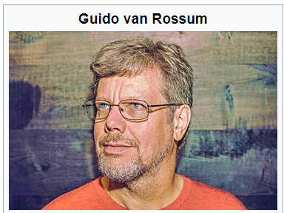
Python is Created by Guido van Rossum in 1991

Slide 3
Contents
Why python?
You tube channel
Google Trend
Employability
Cross-platform
Huge Community

Slide 4
Contents
Large Ecosystem
Easy to learn
Wide spread applicability
Web Programming [flask, Django]
GUI [PyQt]
Software Automation [Selenium Python]
Testing [pytest, unittest]
ERP [Open ERP, odoo]
Artificial Intelligence, Machine Learning and Data Science
Hardware Programming[MicroPython, Raspberry Pi]

Slide 5
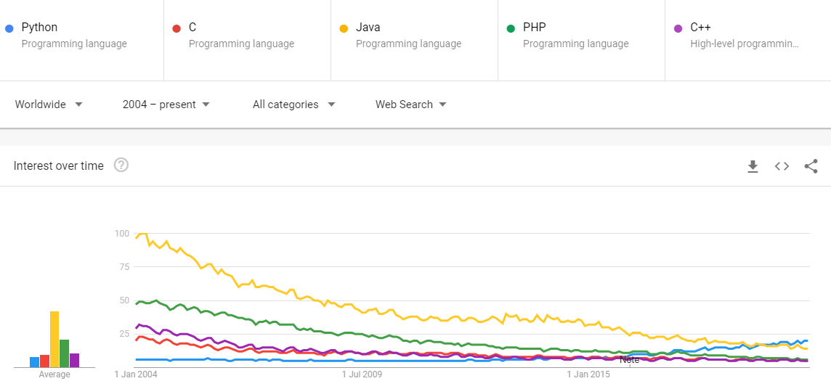
Google Trend Result
https://trends.google.com/trends/explore?date=all&q=%2Fm%2F05z1_,%2Fm%2F01t6b,%2Fm%2F07sbkfb,%2Fm%2F060kv,%2Fm%2F0jgqg

Slide 6
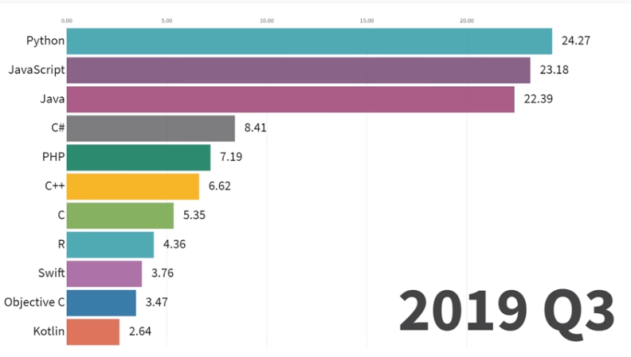
Data is beautiful - Youtube channel
https://youtu.be/2Uj1A9AguFs

Slide 7
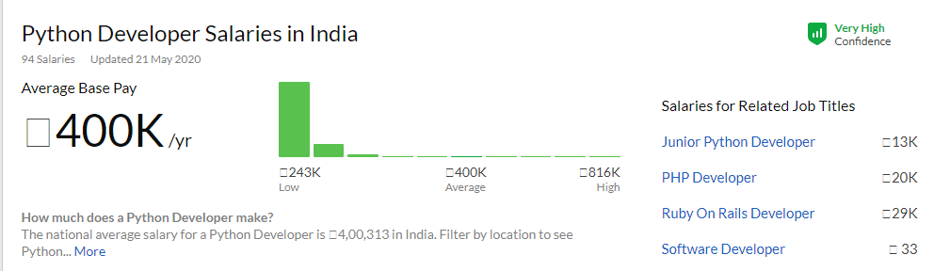
Salary - Glassdoor
https://www.glassdoor.co.in/Salaries/india-python-developer-salary-SRCH_IL.0,5_IN115_KO6,22.htm

Slide 8
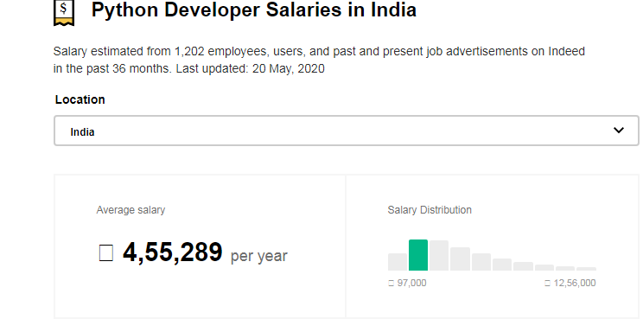
Salary - indeed
https://www.indeed.co.in/salaries/python-developer-Salaries

Slide 9
Basic Concepts of Python
Free and Open-source
High Level Language
Interpreted
Portable & Extensible
Object-oriented programming language

Slide 10
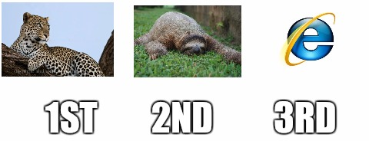
Building Programming Ecosystem
Installing Python
Python.org -> download
anaconda.com -> products -> individual
Code Editor
Pycharm
Jupyter notebook
Spider
Online - Fastest to getting started
Google Colab

Slide 11
Google Colab Features
Code
Formatted Text
Publish
Share
GPU-TPU
Integrate to git

Slide 12
Hello world

Slide 13
Thank you
Hemant N Yadav
Assistant Professor, CHARUSAT.
hemantyadav.it@charusat.ac.in
hemantnyadav@gmail.com

Slide 14
References
Quiz:
https://www.afterhoursprogramming.com/tests/python/
https://en.wikiversity.org/wiki/Python_Concepts/Why_learn_Python

