Slide 1
Introduction to Kubernetes, EKS and Istio
Hemant Seth

Slide 2
Microservices Are Great, But Only if You Solve These Challenges
When monoliths applications are broken down into microservices or a new microservices architecture is being started, first problem we see that now there are more components to manage, deploy and all of them should be able interact with each other. Some common problems are below mentioned .
Deployment
Resource Isolation & Utilization
Resiliency
Networking

Slide 3
Container Orchestration Tools
There are different container orchestration tools which makes the deployment easy. Like
Kubernetes
AWS Elastic Container Service (ECS)
Docker Swarm
So, the key of container orchestration tool is
Control Plane
Cluster of machines as one Well-defined API
Abstraction of Infrastructure

Slide 4
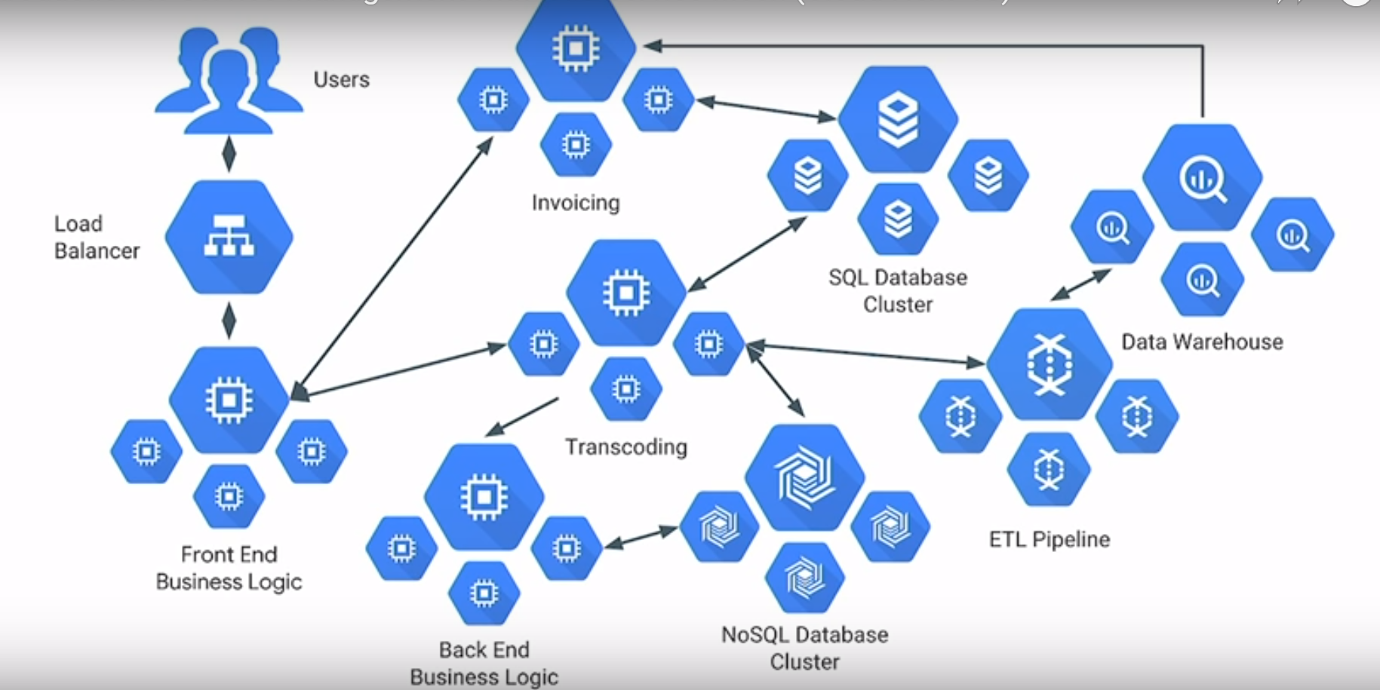
Microservices

Slide 5
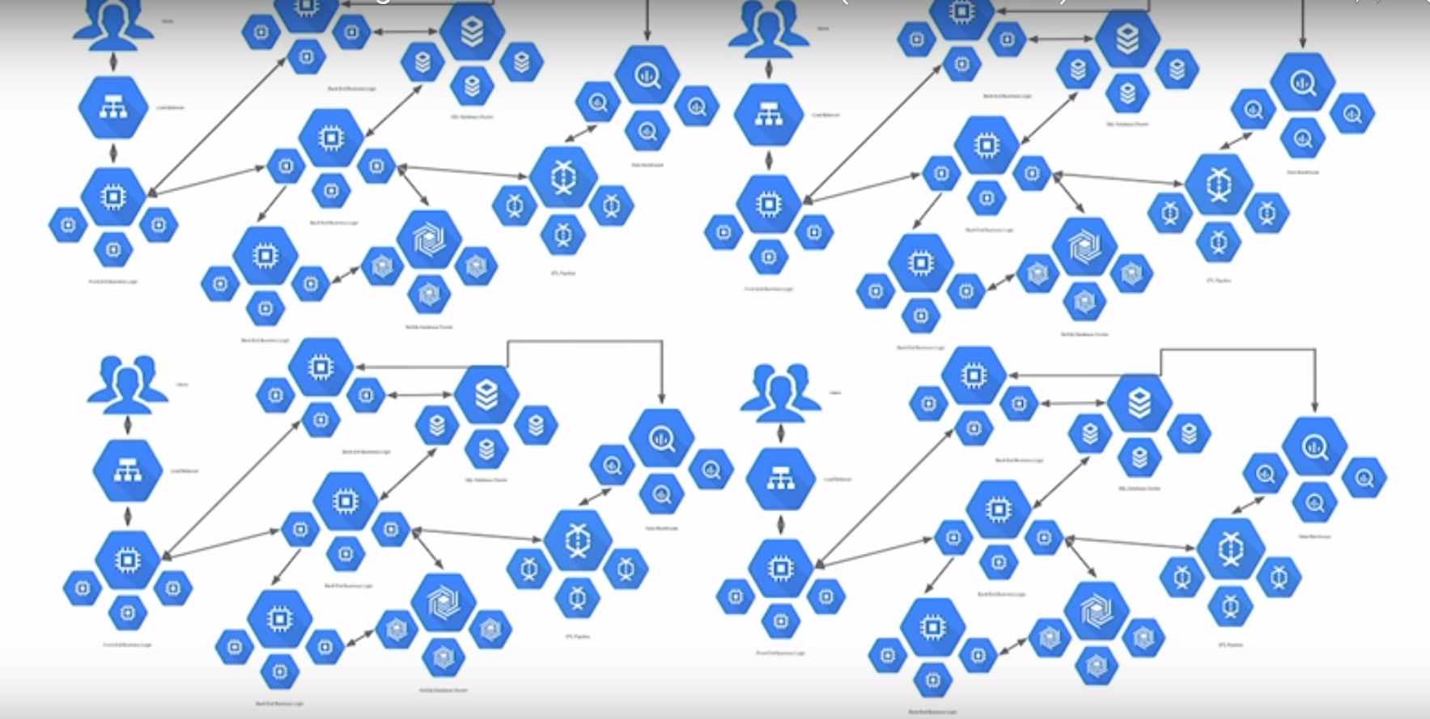
Microservices

Slide 6
Issues with Microservices
Request Routing
Load Balancing
Fault Tolerance
Observability & Insight
Monitoring & Tracing
Circuit Breaking
Authentication
Service Discovery (Interaction between microservices

Slide 7
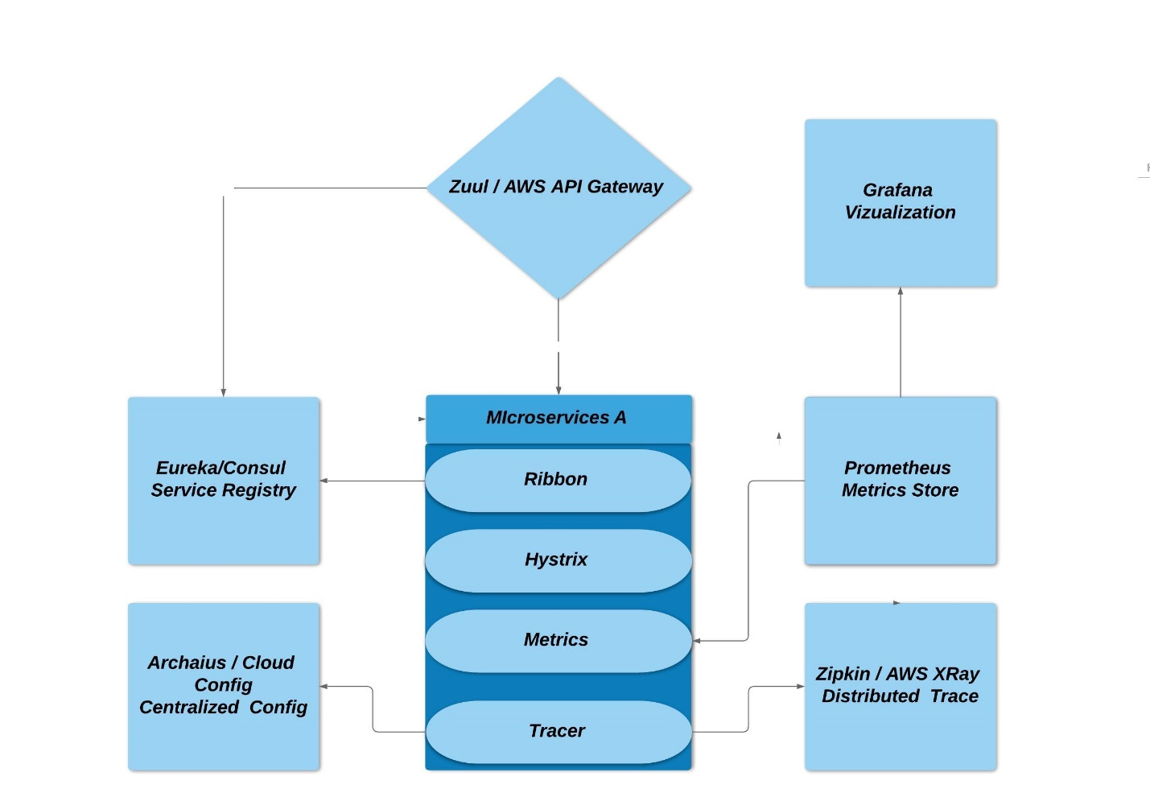
Performing these tasks has gotten easier in Java since the launch of NetflixOSS in 2011. Netflix OSS stack (Spring Cloud) provides
Eureka - Service Registry/Discovery
Ribbon - Client Side LB
Zuul – API Gateway
Hystrix - Circuit Breaker
Zipkin - Distributed Tracing
Prometheus - Monitoring
Grafana - Data Visualization

Slide 8
Issues with Architecture
Cross cutting concerns
Tightly coupled
Complex Implementation This becomes more difficult or harder with
Multiple Stack
Multiple Frameworks
Polyglot (For example, one would need to find/build libraries for Node.js to participate in service discovery and support observability)
Legacy

Slide 9
Istio (Service Mesh)
A complete framework for connecting, securing, managing and monitoring microservices.
Istio provides an easy way to create a network of deployed services with load balancing, service-to-service authentication, monitoring, and more, without requiring any changes in service code.
Istio was first announced in 2017, an open source platform with key contributions from Google, IBM, Lyft and others.
Istio is platform-independent and currently supports on-premise, Kubernetes, Mesos, and more

Slide 10
What does it do
Service to service communication
Routing rules
Retries
Circuit Breaker
Performance Monitoring
Tracing
Authentication

Slide 11
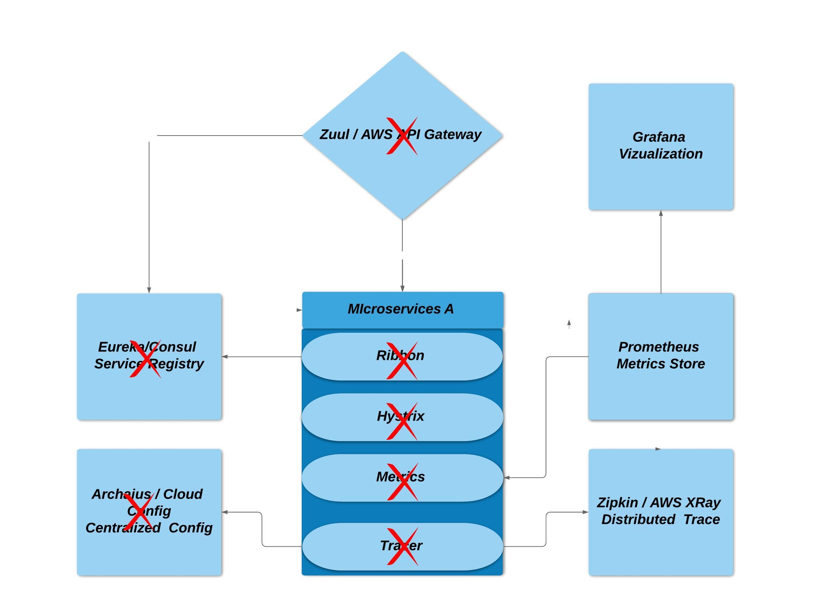

Slide 12
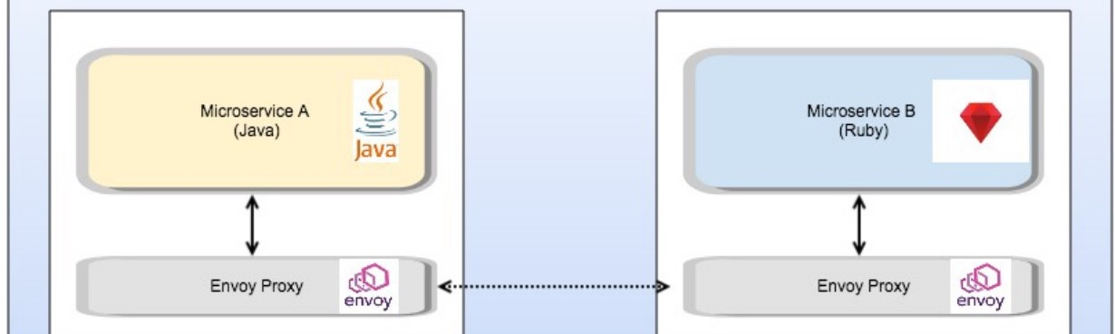
Take all of these cross-cutting concerns and move it to them in proxy/sidecar

Slide 13
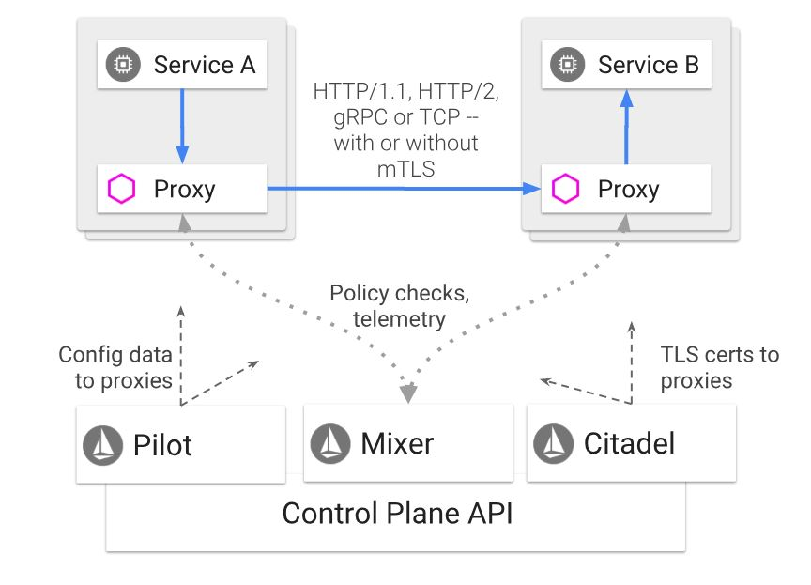
Architecture

Slide 14
Envoy - It is a high-performance proxy developed in C++ by Lyft to mediate all inbound and outbound traffic for all services in the service mesh. It is deployed as a sidecar to the relevant service in the same Kubernetes pod.
Dynamic service discovery
Load balancing
TLS termination
HTTP/2 and gRPC proxies
Circuit breakers
Health checks
Staged rollouts with %-based traffic split
Fault injection
Rich metrics
Mixer – It enforces access control and usage policies across the service mesh, and collects telemetry data from the Envoy proxy and other services. The plugin model enables Istio to interface with a variety of host environments and infrastructure backends.
Pilot – It provides service discovery for the Envoy sidecars, traffic management capabilities for intelligent routing, and resiliency. It converts high level routing rules and configurations and send it to proxies at runtime.
Citadel – It provides strong service-to-service and end-user authentication using Mutual TLS and JWT. It can be used to encrypt the traffic between the services.

Slide 15
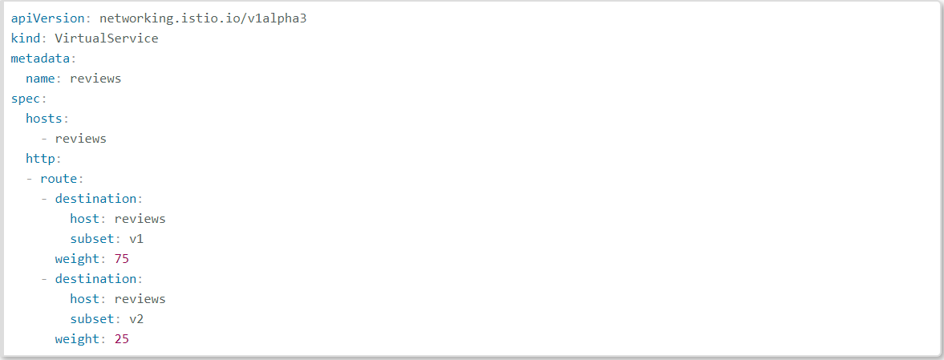
Splitting traffic between versions based on weight

Slide 16
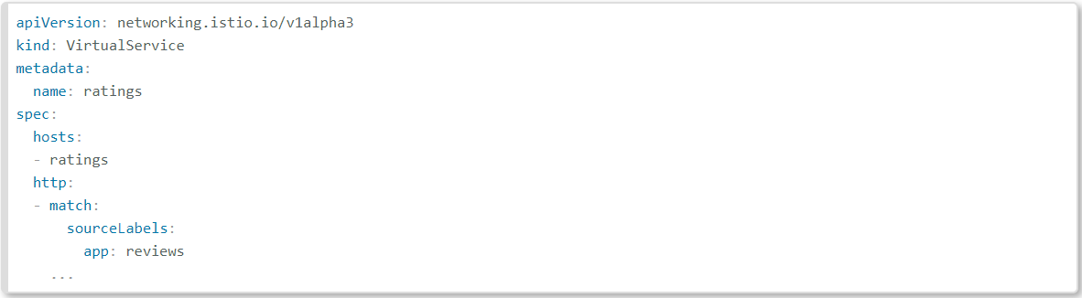
Route traffic using workload labels

Slide 17
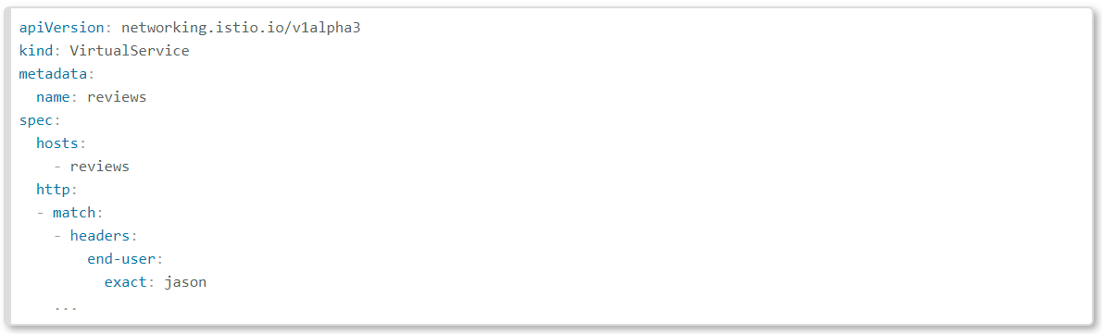
Route Traffic based on HTTP headers

Slide 18
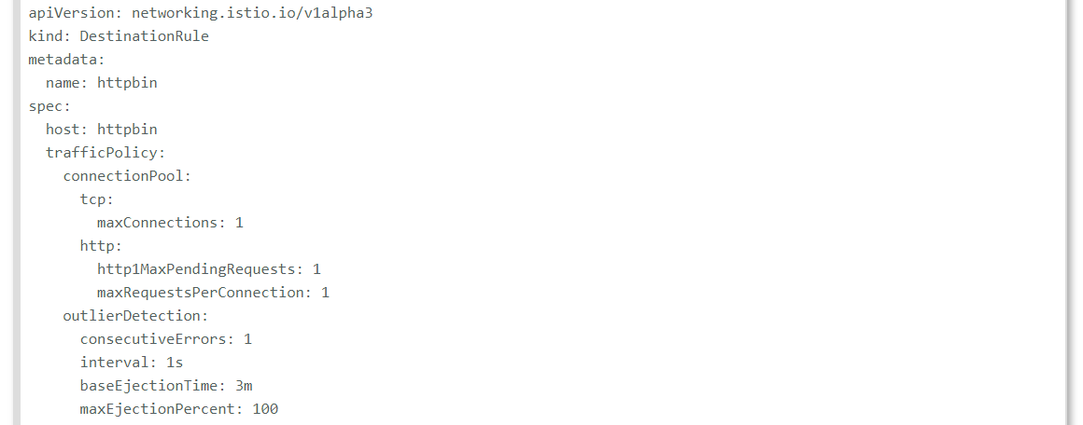
Circuit Breaking

Slide 19
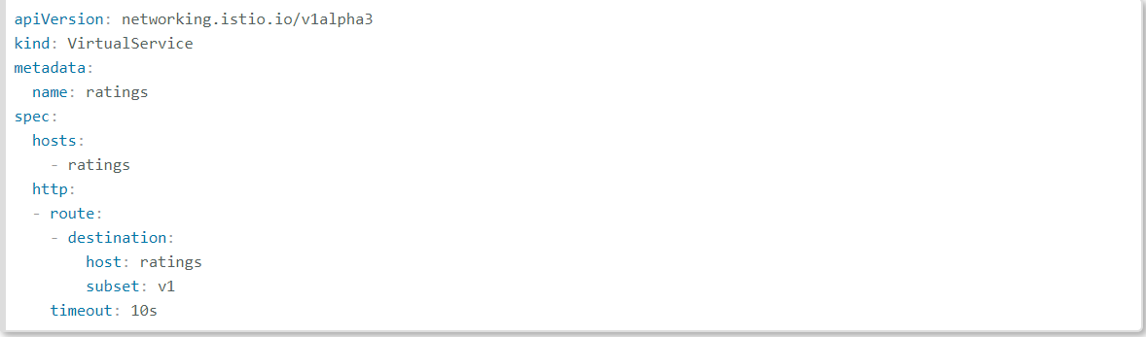
Timeout

Slide 20
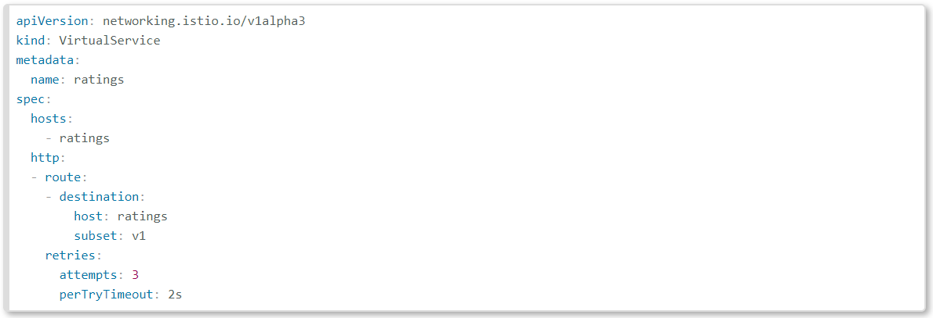
Retries

Slide 21
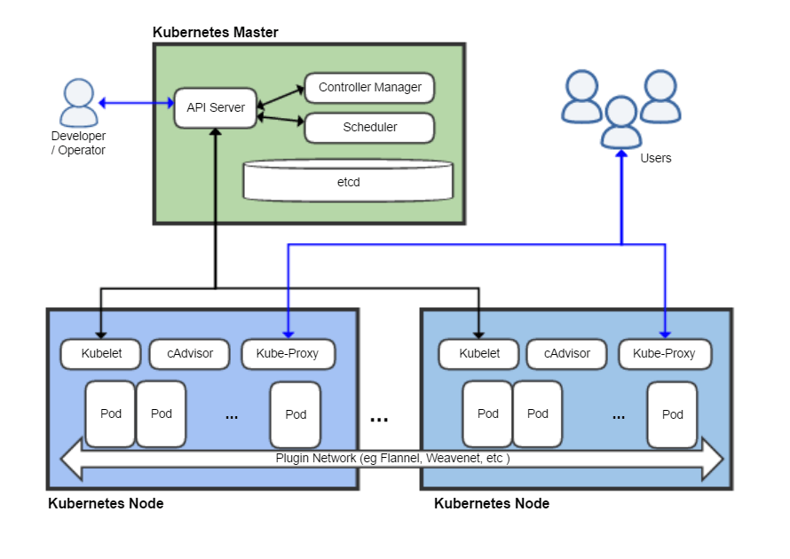
Kubernetes
Kubernetes (commonly known as K8s) is an open-source container-orchestration system for automating deployment, scaling and management of containerized applications. It was originally designed by Google and was released in 2015, and is now maintained by the Cloud Native Computing Foundation.
Kubernetes also provides features like ConfigMap and Secrets.

Slide 22
Kubernetes Features
Automated Scheduling
1
Self-Healing Capabilities
2
Automated Rollouts and Rollbacks
3
Horizontal Scaling
4
Service Discovery and load balancing
5

Slide 23
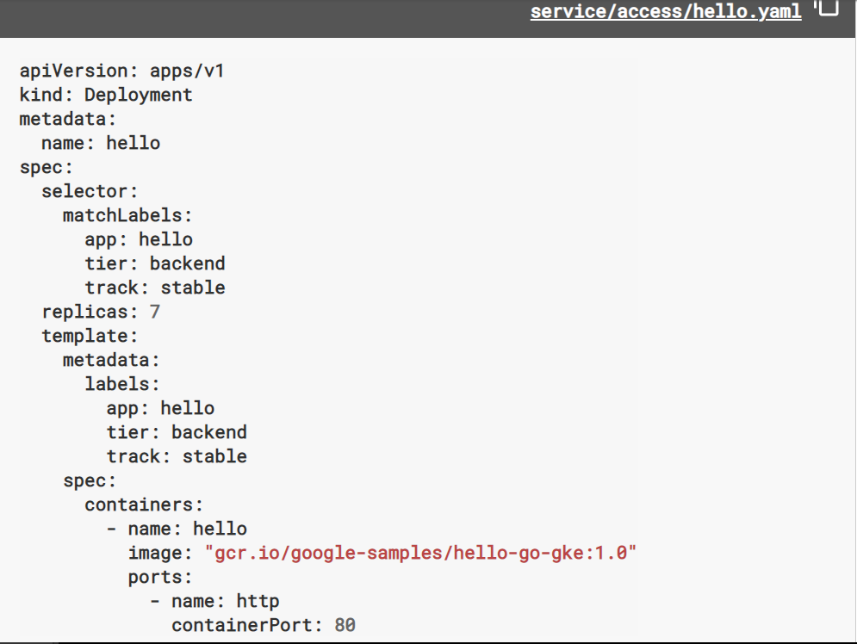

Slide 24
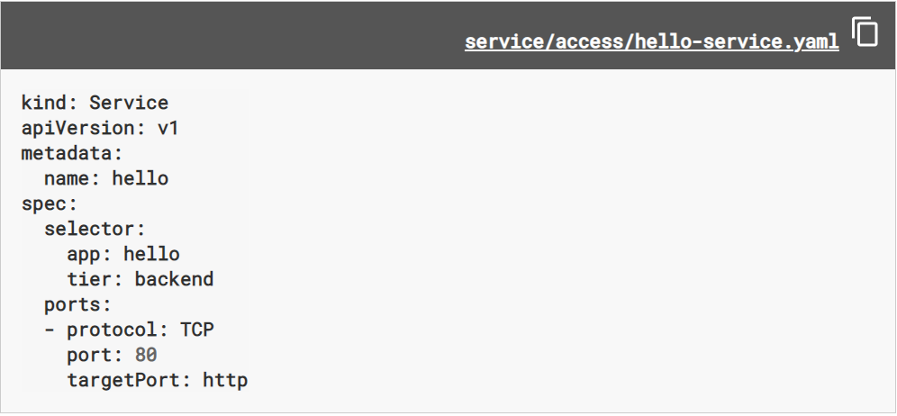

Slide 25
Amazon Elastic Container Service for Kubernetes (Amazon EKS)
Amazon Elastic Container Service for Kubernetes (EKS) is a managed Kubernetes service that makes it easy for you to run Kubernetes on AWS without needing to install, operate, and maintain your own Kubernetes control plane (Master Node).
Amazon EKS runs Kubernetes control plane instances across multiple Availability Zones to ensure high availability.
01
Amazon EKS automatically detects and replaces unhealthy control plane instances.
02
It provides automated version upgrades and patching for them.
03
Applications running on any standard Kubernetes environment are fully compatible and can be easily migrated to Amazon EKS.
04
Amazon EKS is generally available for all AWS customers.
05

Slide 26
Amazon EKS Features
Managed Kubernetes Control Plane
Networking and Security
VPC Support
IAM Authentication
Load Balancing - Logging
Certified Conformant
Support for Advanced Workloads –Works with Community Tools

Slide 27
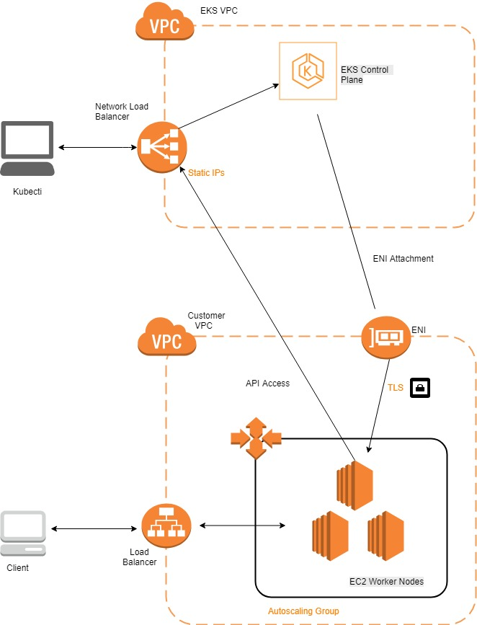

Slide 28
ECS (Amazon Elastic Container Service)
Amazon Elastic Container Service (Amazon ECS) is a highly scalable, high-performance container orchestration service that supports Docker containers and allows you to easily run and scale containerized applications on AWS.
Amazon ECS eliminates the need for you to install and operate your own container orchestration software, manage and scale a cluster of virtual machines, or schedule containers on those virtual machines.
With simple API calls, you can launch and stop Docker-enabled applications, query the complete state of your application, and access many familiar features such as IAM roles, security groups, load balancers, Amazon CloudWatch Events, AWS CloudFormation templates, and AWS CloudTrail logs.

Slide 29
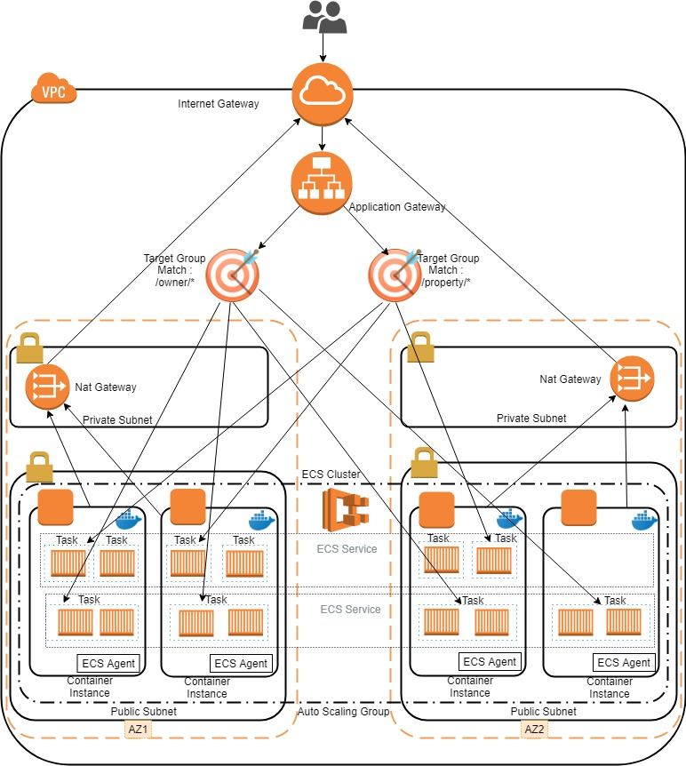

Slide 30
Features of ECS
Easy Management of clusters
Flexibility in container placement
Can be used with other AWS services
Extensible
Performance delivered even after scaling up
Secure
Programmatic control
Load balance
Monitoring
Logging
Security

Slide 31
ECS VS EKS
Factors | ECS | EKS
Load Balancer | It provides an integration with the Application Load Balancer (ALB), the Network Load Balancer (NLB) as well as the Classic Load Balancer (CLB) | It supports the Network Load Balancer(NLB) and the Classic Load Balancer(CLB). Application Load Balancer is available from version 1.0.0 https://aws.amazon.com/about-aws/whats-new/2018/11/amazon-eks-adds-alb-support-with-aws-alb-ingress-controller/
Elastic Network Interface (ENI) | In ECS as each task - a group of containers - is assigned to a separate ENI. Maximum of 15 tasks you can place per instance with ECS | In EKS some pods share the network interface with each other. As EKS is sharing ENIs between pods, you can place up to 750 pods per instance.
IAM | ECS supports IAM Roles for Tasks which is great to grant containers access to AWS resources. For example, to allow containers to access S3, DynamoDB, SQS, or SES at runtime. | Unfortunately, EKS does not support IAM for pods out-of-the-box at the moment.
Pricing | ECS is free. For both, EKS and ECS you have to pay for the underlying EC2 instances and related resources. | Each EKS cluster costs you 0.20 USD per hour which is about 144 USD per month
Compatibility | ECS is only available on AWS | EKS is an option at other cloud providers, on-premises, or even on your developer machine

Slide 32
Advantages of Kubernetes Over Amazon ECS
EKS
ECS
Clouds. (anywhere you can run x86 servers, or even on your laptops)
Wide variety of storage options, including on-premises SANs and public clouds.
Largest community among container orchestration tools. Over 50,000 commits and 1200 contributors.
Vendor lock-in.
External storage is limited to Amazon, including Amazon EBS.
Validated within Amazon. ECS is not publicly available for deployment outside Amazon.
Much of ECS code is not publicly available. Parts of ECS, including Blox, a framework that helps customers build custom schedulers, are open source.

Slide 33
Disadvantages of Kubernetes
EKS
ECS
Lack of single vendor control can complicate a prospective customer’s purchasing decision
Do-it-yourself installation can be complex for Kubernetes.
Single vendor control may allow for accountability with bug fixes and better coordination with feature development.
ECS does not require installation on servers. ECS CLI installation is simple

Slide 34

Thank You! Any Questions

