Slide 1

SUPPLY CHAIN MANAGEMENT PRESENTATION
SCHOOL OF DATA SCIENCE AND FORECASTING, DAVV
SUBMITTED BY:
DHIRAJ KALA
AASHI GUPTA
ROSHNI RATHORE
ARUNDHATI TIWARI
NIHARIKA SHRIVASTAVA
HEMANT SETHIYA
SUBMITTED TO: MR. SUSANTA MISHRA
MBA SESSION 2019 - 2021

Slide 2
IKEA!!
INGVAR KAMPRAD ELMTARYD AGUNNARYD

Slide 3

“GOOD QUALITY AT LOW PRICE”
CREATING A BETTER EVERYDAY LIFE FOR MANY PEOPLE.

Slide 4
INTRODUCTION
1
IKEA is a home furnishing company founded in Sweden in 1943, by INGVAR KAMPRAD.
2
IKEA is a multinational conglomerate that designs and sells ready to assemble furniture, kitchen appliances and home accessories.
3
It has more than 300 stores in more than 35 countries and more than 1,30,000 co-workers.
4
IKEA closes up the top of the World’s most valuable brands according to Forbes rating.

Slide 5
Services
“LONG LIVE THE HOME”
KITCHEN AND BATHROOM INSTALLATION
HOME DELIVERY
PICK UP AND TRANSPORT
CURTAIN MAKING, ALTERATION SERVICE
OLD FURNITURE RE-USAGE
ELECTRONIC RECYCLING
FLAT PACK ASSEMBLY
KITCHEN PLANNING

Slide 6
Competitive Priorities
Cost savings in furniture design
Streamlining the IKEA supply chain
Sustainable relationship with suppliers
Cost-per-touch inventory tactic
Do-it-yourself assembly lower packaging costs
In-store logistics

Slide 7
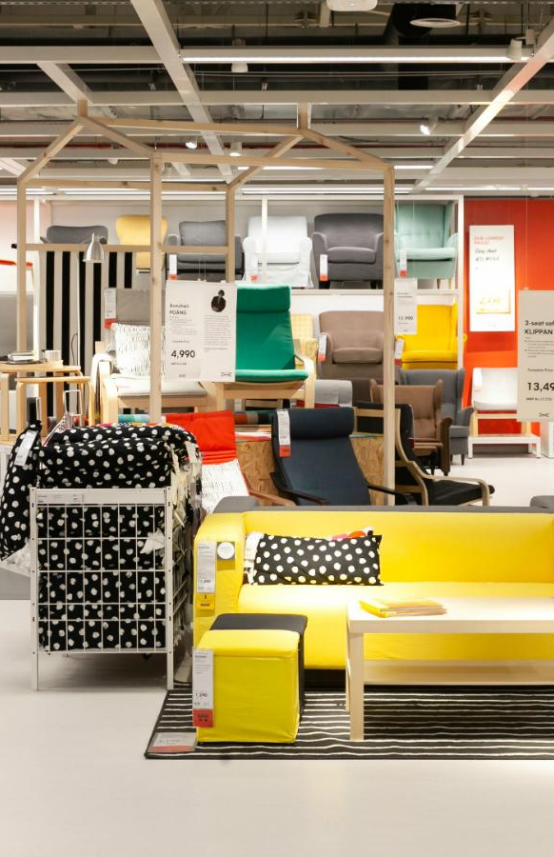

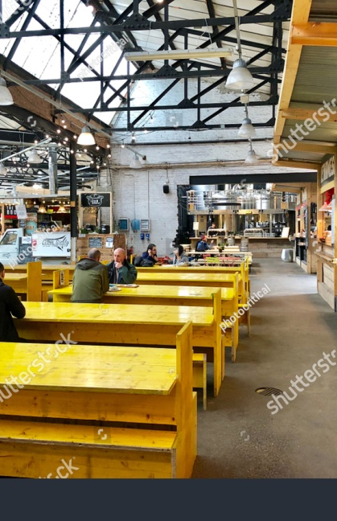
Competitive Priorities
IKEA’s competitive priorities focus around providing good quality products at low prices.
Their theme of “low price with meaning” embodies a continuous improvement and reduction of costs to pass them on to their customers.
IKEA is one of the few companies that manages to reduce
instead of increase the prices of their products over the years.
They are able to accomplish this priority of low prices through their original process of design, production, packaging, and distribution.
The processes employed by IKEA to offer products that are usually 30 to 50 percent lower in price than that of their
competition

Slide 8
Additional Features
Beyond its design process
Efficient shipping
Flat packages
It helps in not having to deal with finding a large truck to transport furniture to the clients home.
Providing big advantages to customers who now could bring furniture by themselves.
Location advantage
Space and environment friendly products
They design their store in a way where you can actually spend long periods of time in them.
More than a 50% of the products are made from recycled products.

Slide 9
PRODUCT DEVELOPMENT
STEP-1
STEP-2
STEP-3
STEP-4
Pick a price product development
Choose a manufacturer
Design the product
Ship the product
SELL IT

Slide 10
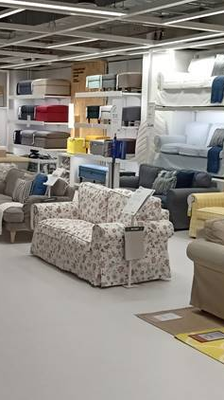
Pick A Price
Product
Development
In order to make products saleable
and right for the IKEA identity,
IKEA co-workers in product design and product development focus on price and quality, design and function, environment and health.
They scrutinize every product idea with regard to the best use of raw materials and manufacturing opportunities.
This is why elements of the design are often decided on the factory floor, where designers and manufactures work together.
IKEA
We throw in extra parts
Just to mess with you.

Slide 11
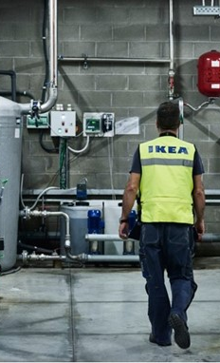
CHOOSE A MANUFACTURER
IKEA stock incurs low manufacturing costs while meeting strict requirements for function, efficient distribution, quality, and impact on the environment.
By using fewer materials, the company cuts down on transportation costs because it uses less fuel and manpower to receive materials and ship products.
A key part of IKEA’s success is credited to its communications and relationship management with materials suppliers and manufacturers to get good prices on
what it procures.
IKEA is a very high volume retailer – it buys products from more than 1,800 suppliers in 50 countries, and uses 42 trading service offices around the world to manage supplier relationships.
For example, IKEA has a code of conduct called the IKEA Way of Purchasing Home Furnishing Products (IWAY), containing minimum rules and guidelines that help manufacturers reduce the impact of their activities on the environment. The requirements within IWAY raise standards by developing sustainable business activities and leaving positive impacts on the business environment in which the suppliers operate.

Slide 12
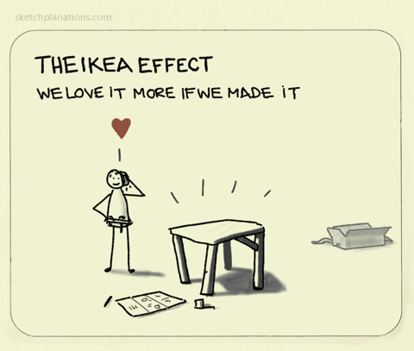
DESIGN THE PRODUCT
What makes the IKEA design process unique is that their suppliers play a very important role.
Their product developers and designers work with a diverse team of technicians, manufacturers and specialists – often right on the factory floor.
This special partnership helps keep our prices low and find the latest techniques to create products.
Good design is the right combination of form, function, quality, sustainability and a low price.

Slide 13
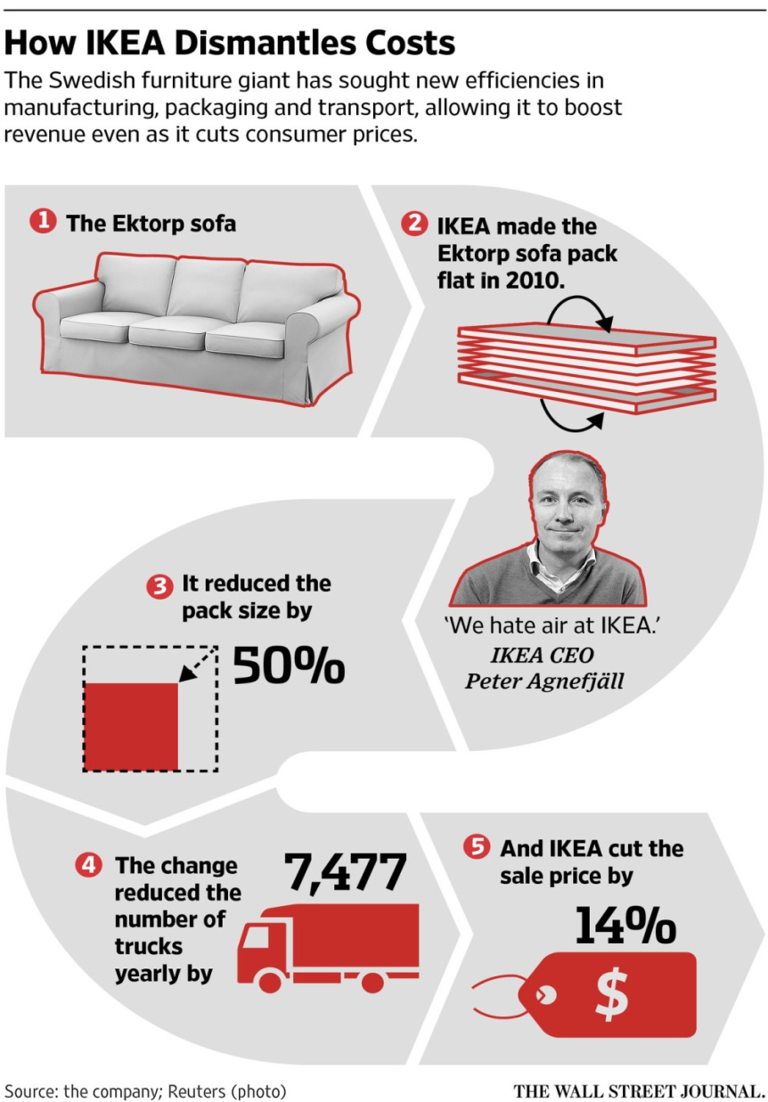
SHIPPING THE PRODUCT
IKEA is the king of flat-packing. Finding ways to flatten or otherwise
compress items allows for more efficient shipping and, notably, IKEA
is willing to share a chunk of those gains with consumers through
lower prices.
LARGE VOLUMES + FLAT PACKS = LOW COSTS
01
A Global distribution network
02
Large Volumes
03
04
Flat Packages
Low Costs

Slide 14
SELLING OF THE PRODUCT
INTEGRATING
SEVERAL CHANNELS OF
MARKETING
EFFECTIVELY APPLYING PRODUCT PLACEMENT MARKETING TECHNIQUES
FOCUSES ON 7 P’S OF MARKETING
USES MONO-SEGMENT
01
It includes place , promotion , process, people, physical evidence , price, product.
02
It has adapted the lowest cost of its product along with widest range.
03
Print and media advertising , sales promotion , event and experiences , public relations and direct marketing.
04
Such As fightclub,Cashback,500 Days Of Summer & TV programmes such as 30 rock: Blind Date etc.

Slide 15
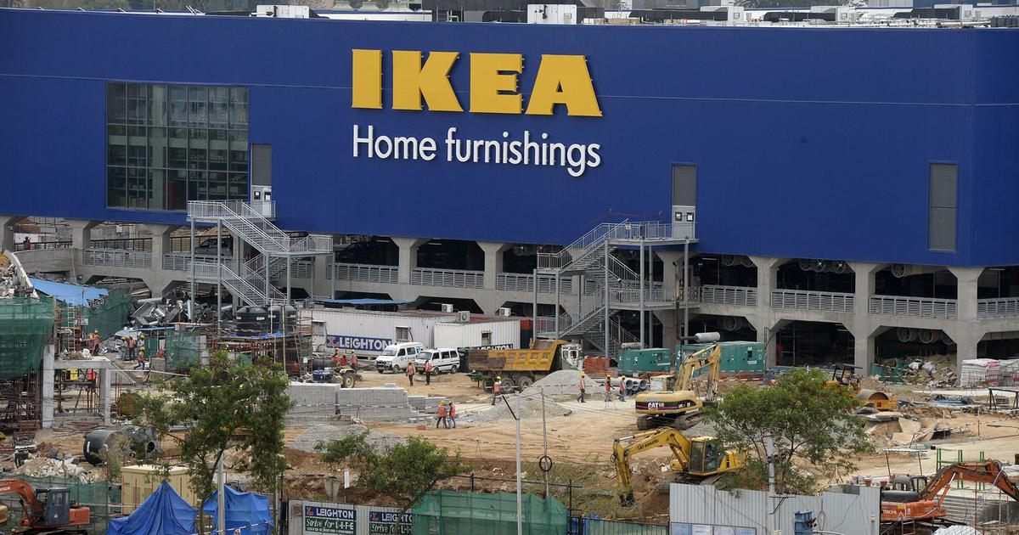
IMPORTANT CRITERIA FOR SELECTING A SITE FOR AN IKEA STORE
IKEA should focus on areas that showing a rapid rate of growth and already highly or densely populated areas.
The demographic that is more prone to buy at IKEA are young to middle age families.
Furthermore, IKEA should focus on staying in areas close to a busy intersections and main highways where the store can be easily seen. Lastly, a focus on an area that isn’t exactly near to their competition, but as close as possible to a distribution center to keep costs low
That Shows A Rapid Rate Of Growth
Focus On Highly Or Densely populated area
Areas which are close to busy intersections and main highways where the store can be easily seen
Area that isn't exactly near to their competition
Make sure the space is large enough to accomm-odate large showrooms and products

Slide 16
FACTORS ADDING IKEA SUPPLY CHAIN EFFICIENCY
1
IKEA uses a self-service model instead of appointing salespeople to attend customers.
2
Strategy of providing flat package reduces the cost of shipping, storing, construction along with assembling.
3
Quality management provides an opportunity to increase the effectiveness and productivity of the organization.
4
Effective communication between IKEA and its suppliers is a critical factor in the success of IKEA.

Slide 17
FACTORS CONSTRAINING IKEA SUPPLY CHAIN EFFICIENCY
1
IKEA should continuously review its existing strategies to survive in the changing environment and adopt new technologies.
2
It needs transformation of business to implement new production procedurealong with developing advanced analytic capabilities and implement more efficient end to end processes.
3
IKEA should also apply strategies to shorten the distance between the customers and the suppliers to achieve operational excellence.

Slide 18
THANK YOU

