Slide 1
Supply Chain Management Presentation Of ShopKirana
Submitted To- Submitted By-
Mr.Susanta Mishra Hemant Sethiya

Slide 2

ShopKirana
ShopKirana connects individual retailers with suppliers via a B2B e-commerce platform, where they can place orders, get their products delivered and make payments. The startup works with various stakeholders in the groceries, fast moving consumer goods and supply chain sectors. They connect retailers directly with brands with the help of technology & supply chain innovation to source products within 48 hrs. Their "execution on ideas" journey started in 2015... They started very first fmcg/grocery b2b multibrand platform for unorganized Kirana stores in India.

Slide 3
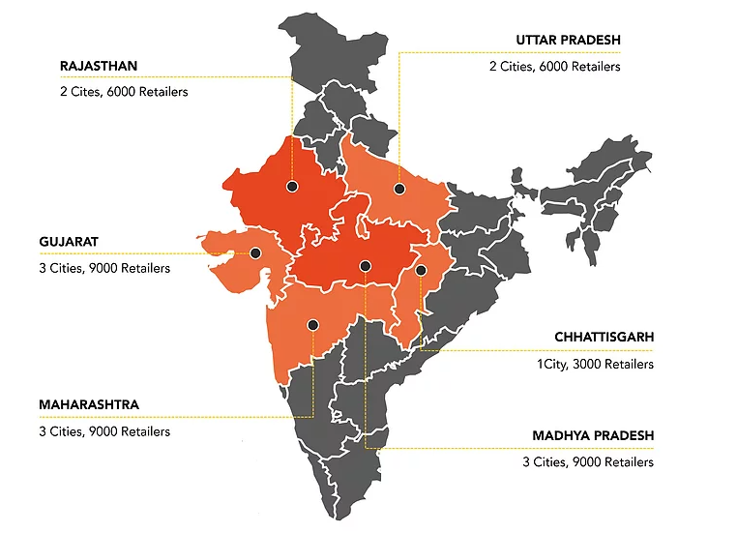
Locations :
Currently they are operating in multiple cities in India :
Indore
Bhopal
Agra
Jaipur
Meerut
Lucknow
Nagpur
Raipur
In Indore their supply
chain stores at :
Dewas Naka & Chota Bangda

Slide 4
Facilities :
Multi Brand
Delivery
Multi Brand in a single platform & their own private level also( Kisan Kirana )
They are commitment on 48 Hours delivery facility
Daily Ordering
Fastest
They have daily ordering facility
They are fastest Go-To channel market

Slide 5
Inventory They kept inventory with hygiene, dust free & follow all fssai norms
They says that they are 0(zero) inventory model but kept difference of MOQ(minimum order quantity) items. How they Maintain : They divide their products code wise and when there is new product entered in their list they give a code name to those product which helps them to find easily. And they also divide products by their category like spices at one place, cosmetics at one place, in these way they handle inventory.

Slide 6
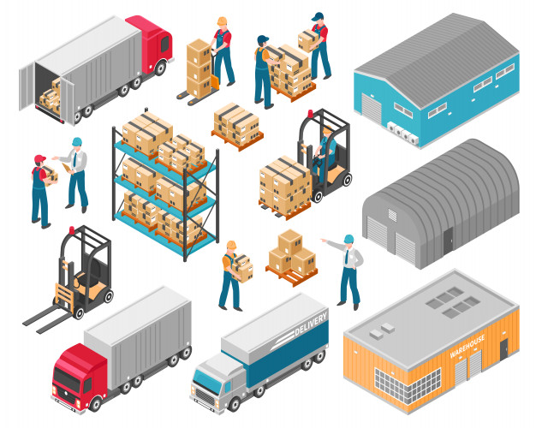
Logistic
Outbound
Inbound
Inbound gives material to outbound for delivering products to the customers, for this they have their own transporters and they divide cities cluster wise so it is easy to delivery products and collects money also and for all of these they have software.
For this they did deal with dealers, they use their own transports for moving products from their place to them.

Slide 7
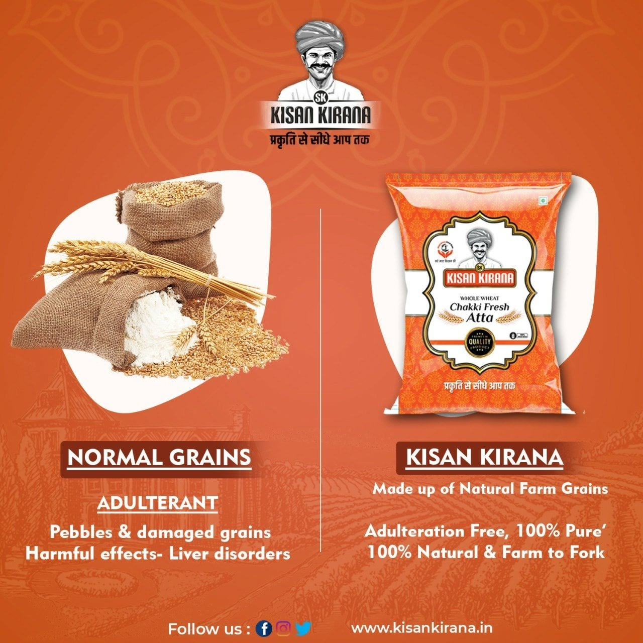
Outsourcing
For their home brand(Kisan Kirana) they does outsourcing for this they tie-up with a third party they give them readymade products with their branding.
They also does outsourcing for money collection.

Slide 8
Risk Management
ShopKirana has a problem of holding inventory as most of the dairy products doesn’t get consumed the same day, which leads to wastage of products so to overcome this they hold the inventory of dairy products at low quantity. For this they have food management department.
And for other risk’s they have a department:
LP( loss & profit ) Department.

Slide 9
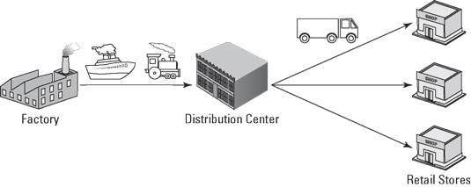
Supply & Distribution
For their own brand they have multiple suppliers like farmers, after getting raw material they have also packing partners, they prepare their product and supply at warehouse.
And for distribution of orders they have area wise distributers which helps them to distribute products.

Slide 10
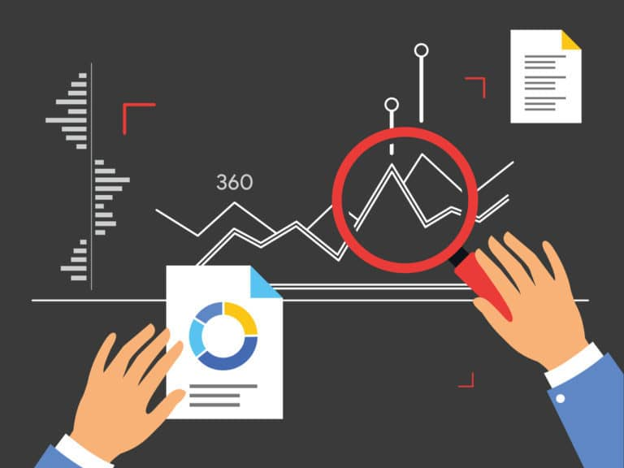

Forecasting
They does forecasting of all the departments.
For this first they create a rough plan & if it is successfully work then they work on it. For an example they forecast the purchasing of product that means in how much quantity they have to buy raw materials .

Slide 11
Economics
Sourcing Cost
Digital Sales Cost
Purchase Cost
1%
0.5%
0.48%
Inbound Cost
Outbound Cost
Sales Cost
1.5%
1.8%
1%

Slide 12
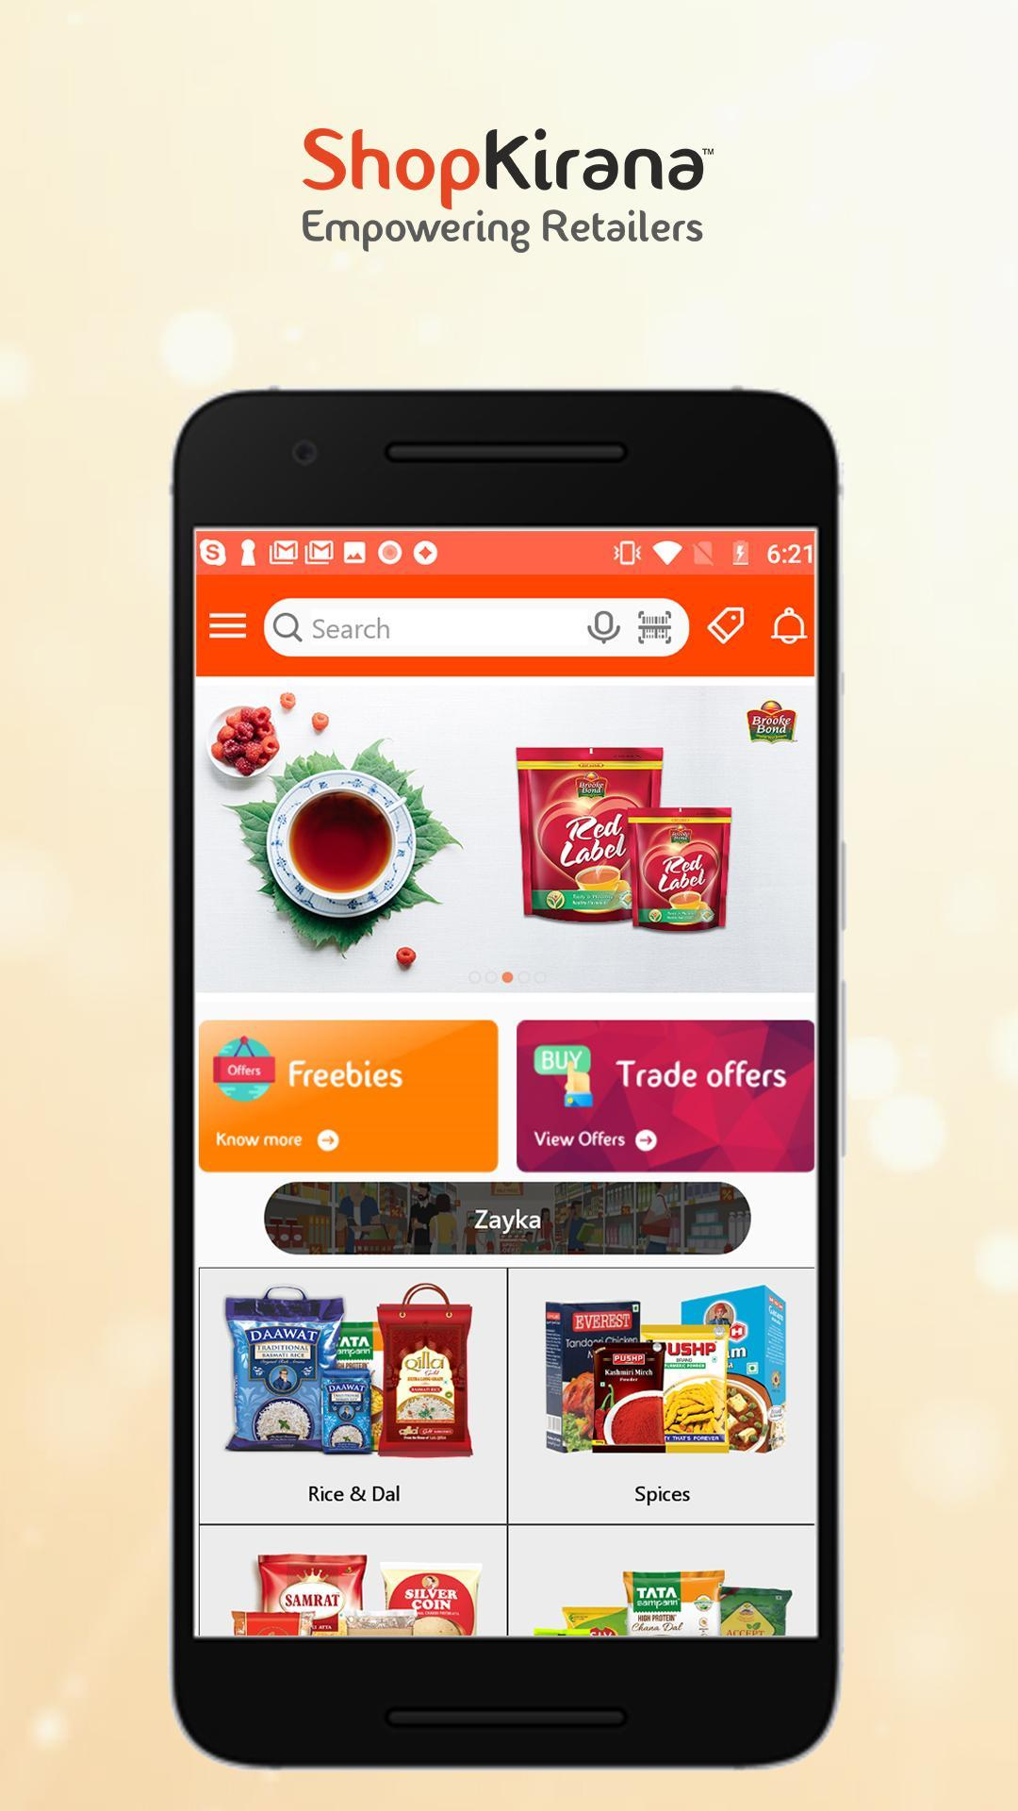
Technology
They are startup so they use technology at every place from supply chain to retailers.
(Sales app, Delivery app, Agent app, Retailers app, Distributer app, Supplier app)
For backend they use .net, python, Al
And their application is Andriod based

Slide 13
THANKS!
Credit : Mr. Deepak Dhanotiya
(Head of ShopKirana Supply Chain)
Please keep this slide for attribution.

