Slide 1

PROJECT REPORT
EAI-421: Application of AI & ML in Agriculture (0+10)
Project Title:
Early Crop Stress Detection System
“Invisible to Insight”
AI-Based Crop Stress Detection Using Microclimate Fluctuations
Team:
Dev Kumar Sharma - AMB2056
Jeevitha S - AMB2094
Hemant Sharma - AMB2086

Slide 2

UNIVERSITY OF AGRICULTURAL SCIENCES
College of Agriculture, GKVK, Bengaluru
🌾
EAI-421: Application of AI & ML in Agriculture
TITLE
Early Crop Stress Detection System
CROP STRESS
DETECTION
“Invisible to Insight”
AI-Based Crop Stress Detection Using Microclimate Fluctuations
Random Forest
84% Accuracy
2,500+ Records
Predictive Model
Team: Dev Kumar Sharma | Hemant Sharma | Jeevitha S
AMB 2056 AMB 2086 AMB 2094
Notes:
1

Slide 3
Table of content
Abstract
Introduction and problem statement
Importance of early crop stress detection
Review of Literature
Data set comparison
CSI formula
Stress classification and ML models
Linear regression
Decision Tree
Random Forest
System architecture
Base paper visualisation
Novel data visualisation
CSI and stress level
Prediction accuracy
Results
Summary & conclusion
Scope & reference
Notes:
2

Slide 4
01 | Abstract
The Challenge
✦ Key Novelties
Crop stress from heat, water deficit & humidity imbalance begins days before visible symptoms appear
India: 15–25% yield lost annually to abiotic stress — largely preventable
140 million farming households need affordable, predictive solutions
Custom Crop Stress Index (CSI) combining 3 environmental factors (0–100 scale)
Expanded multi-factor dataset: 2,500 records vs. base paper's 900
3-level stress classification: Low / Mild / High with actionable farmer recommendations
Predictive (24–48 hrs early warning) vs. reactive (base paper)
Low-cost approach — no expensive hardware required
15 matplotlib data visualizations for comprehensive analysis
Our Solution
AI-powered Early Crop Stress Detection using microclimate data (temp, humidity, rainfall, soil moisture)
Kaggle dataset: ~2,500 records — vs. base paper's ~900 records
Random Forest model — 84% accuracy (+12% over base paper)
Notes:
2

Slide 5
02 | Introduction & Problem Statement
🌾 Background
⚠️ Problem Statement
🎯 Objectives
India: 140M farming households
15–25% yield lost to abiotic stress annually
Stress begins invisibly — days before visible symptoms
By visible damage, recovery is often too late
Crop monitoring is largely reactive
No affordable, early-warning system exists
Satellite/hyperspectral tech unaffordable for small farmers
Need: predict stress 24–48 hrs in advance using basic data
Identify key env. parameters affecting crop health
Apply ML to classify Low / Mild / High stress
Compare Linear Reg, Decision Tree, Random Forest
Develop novel Crop Stress Index (0–100)
Real-World Relevance
Microsoft FarmBeats IoT + ML stress detection • ICAR AI crop health studies • Cropin Tech 7M+ farmers • Govt. Digital Agriculture Mission
💧 Sustainability: Early detection can reduce water waste by up to 30% and lower agricultural carbon footprint.
Notes:
3

Slide 6
03 | Importance of Early Crop Stress Detection
Benefit | Explanation
Early Detection | Identifies stress before visible damage — allows timely intervention
Resource Optimization | Reduces unnecessary water & fertilizer use by targeting stressed areas
Reduced Yield Loss | Maintains crop health and productivity through preventive action
Climate Adaptation | Helps farmers manage increasing weather variability due to climate change
Economic Benefit | Reduces input costs and increases farm profitability
Smart Farming | Enables data-driven, AI-assisted agricultural decision making
"It helps farmers act early, save resources, and improve yield using smart technology."
Notes:
4

Slide 7
04 | Review of Literature
📄 Base Research Paper
⚠️ Limitations of Base Paper
TITLE : “On the use of statistical model to predict crop yield responses to climate changes”
Lobell & Burke (2010) — Agricultural & Forest Meteorology
Dataset: ~900 records | FAO STAT / World Bank Climate Portal
Models: Linear Regression, Basic ANN
Best Accuracy: ~72–80%.
Only temp + rainfall — no soil moisture or humidity
Small dataset (~900) — limited generalization
No stress classification (Low/Mild/High)
Yield prediction only — not predictive stress detection
No actionable farmer recommendations
Supporting Literature
Author & Year | Focus | Method
Kamilaris & Prenafeta-Boldu (2018) | Deep Learning for crop disease detection | CNN
Pantazi et al. (2016) | Soil-based crop yield prediction | SVM, ANN
Crane-Droesch (2018) | Climate impact on maize yield | Random Forest
Sehgal et al. (2020) | IoT + ML for precision irrigation | Decision Tree
Notes:
5

Slide 8
05 | Dataset Comparison: Base Paper vs. Proposed Study
Parameter | Base Paper Dataset | Proposed Study Dataset
Source | FAO STAT / World Bank Climate | Kaggle Crop Recommendation + IMD Weather
Size | ~900 records | ~2,500 records
Features | Temperature, Rainfall only | Temp + Humidity + Rainfall + Soil Moisture + Crop Type
Target Variable | Crop Yield | Crop Stress Index + Stress Level
Stress Classification | None | Low / Mild / High
Visualization | None | 15 matplotlib charts
Detection Type | Reactive | Predictive (24–48 hrs before visible damage)
Notes:
6

Slide 9
06 | Dataset Sample Records & Crop Stress Index Formula
Sample Records — Proposed Study
Temp (°C) | Humidity (%) | Rainfall (mm) | Soil Moist (%) | Crop Type | CSI Score
38.5 | 82 | 12 | 28 | Rice | 74 — HIGH
22.1 | 55 | 85 | 62 | Wheat | 18 — LOW
42.0 | 30 | 0 | 12 | Maize | 91 — HIGH
28.4 | 70 | 45 | 50 | Cotton | 35 — MILD
31.2 | 60 | 30 | 40 | Sugarcane | 48 — MILD
19.5 | 75 | 110 | 68 | Wheat | 12 — LOW
🔬 Novel Contribution — Crop Stress Index (CSI) Formula
CSI = 0.4 × Temp_Stress + 0.3 × Moisture_Deficit + 0.3 × Humidity_Stress
• Temp_Stress = max(0, (Temp − Optimal_Temp) / 20) × 100 • Moisture_Deficit = max(0, (Optimal − Soil_Moisture) / Optimal) × 100 • Humidity_Stress = |Humidity − Optimal| / Optimal × 100
Notes:
7

Slide 10
07 | Stress Classification & ML Models
CSI Classification & Farmer Actions
CSI Range | Stress Level | Farmer Action
0 – 33 | 🟢 LOW STRESS | Monitor only — No immediate action needed
34 – 66 | 🟡 MILD STRESS | Irrigate and/or apply shade nets
67 – 100 | 🔴 HIGH STRESS | URGENT — Immediate crop protection required
ML Models — Performance Comparison
Model | Simple Explanation | Base Accuracy | Our Accuracy | Gain
Linear Regression | Best-fit straight line through data points | ~72% | 75% | +3%
Decision Tree | Yes/No flowchart — easy to interpret | ~75% | 79% | +4%
Random Forest ★ | 100+ trees vote — majority wins | ~80% | 84% | +4%
Train/Test Split: 80% Training (2,000 records) | 20% Testing (500 records) | Stratified split for balanced class representation
Notes:
8

Slide 11
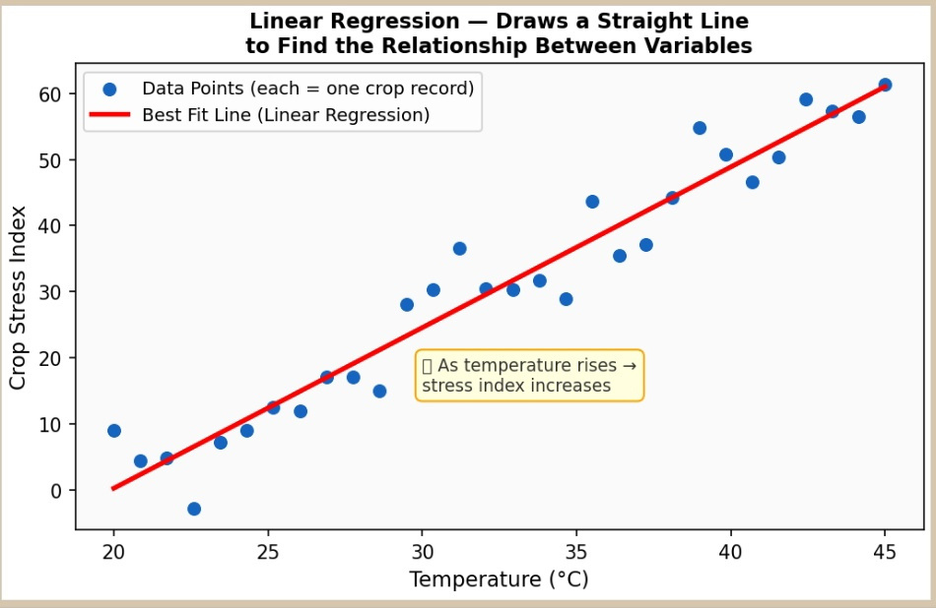
Think of Linear Regression as drawing a straight line through a scatter of dots. Each dot is one crop record. The line best represents the overall trend — as one thing goes up (like temperature), what happens to another thing (like stress level)?
It is the simplest model. It works well when the relationship between two things is straightforward and roughly linear. It is used in the base paper (Lobell & Burke, 2010) and also in our study for comparison.
08 | Linear Regression
Notes:
8

Slide 12
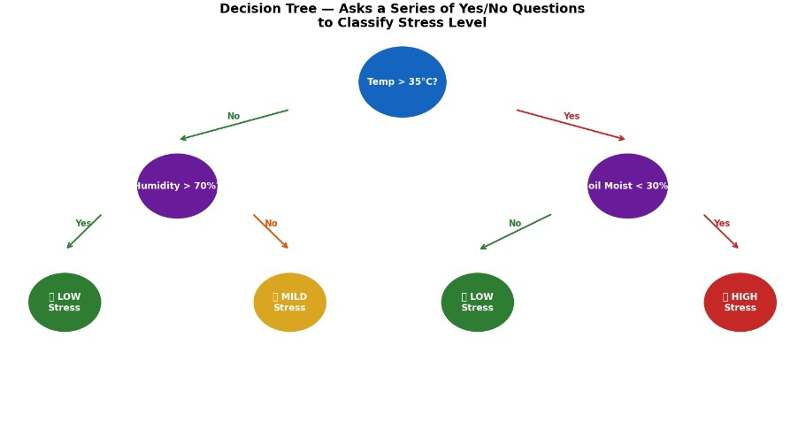
09 | Decision Tree
A Decision Tree works exactly like a flow chart of Yes/No questions. It is the most intuitive model — you can literally read it like a game of 20 questions. Start at the top, answer the question, go left or right, and arrive at the answer.
For example: Is Temperature > 35 degC? YES -> Is Soil Moisture < 30%? YES -> HIGH STRESS. This makes it very easy to explain and understand, even without technical knowledge.
Notes:
8

Slide 13
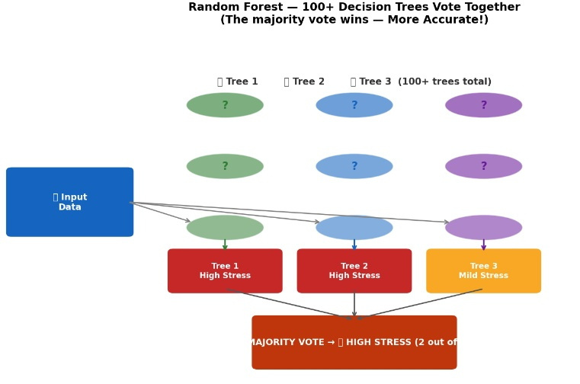
Random Forest is like asking 100 doctors for a diagnosis and going with the majority opinion. Instead of one Decision Tree, it builds 100+ trees, each using slightly different data. All trees vote, and the most popular answer wins.
This approach is much more accurate than a single tree because individual trees can make mistakes, but when 100 trees vote together, errors cancel out and the collective decision is almost always correct.
10 | Random Forest
Notes:
8

Slide 14
11 | System Architecture & Pipeline
STEP 1
STEP 2
STEP 3
STEP 4
STEP 5
STEP 6
Data Collection
Data Cleaning
Feature Engineering
Model Training
Prediction
Alert & Visualization
Weather data from Kaggle / IMD stations
Soil moisture from sensors or estimated
Fill missing values, remove outliers
Standardize all values to same scale
CSI calculated & added as new column
(Novel step — key contribution)
3 ML models trained on 80% data
Random Forest selected as final model
Predicts Stress Level: Low / Mild / High
for new incoming weather data
15 graphs generated
Farmer receives actionable recommendation
System Actors & Use Cases
Notes:
9

Slide 15
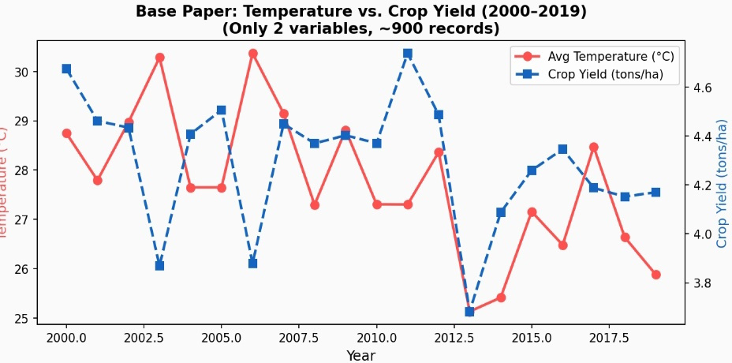
12 | Base Paper Visualization — Temperature vs. Crop Yield
Key Observations
Rising temperature beyond ~28–30°C correlates with declining crop yield
Base paper used only 2 variables (temp + rainfall) — ~900 records
No mechanism to classify severity or issue recommendations
Reactive approach — post-damage analysis only
Our study adds humidity + soil moisture → CSI formula for predictive alerts
Figure 1: Base Paper — Temperature vs. Crop Yield (2000–2019) | Only 2 variables, ~900 records
Notes:
10

Slide 16
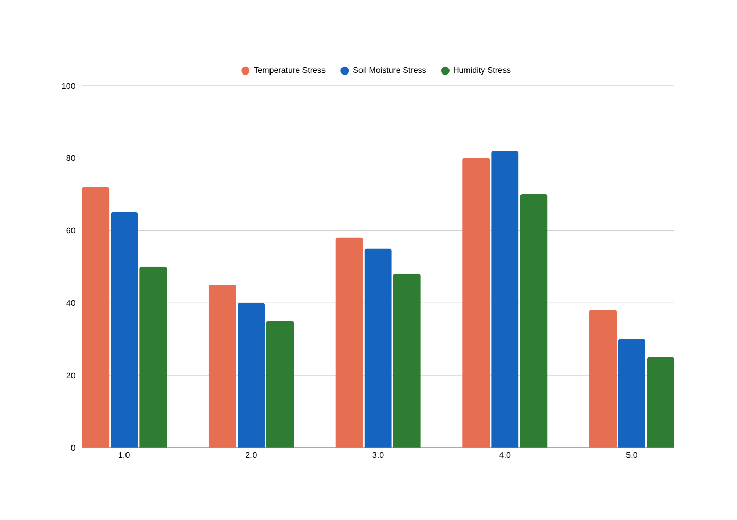
13 | Multi-Factor Stress by Crop Type (Novel Data)
Graph Insights
Cotton shows highest stress across all 3 factors
Sugarcane has lowest stress — more climate resilient
Maize shows high temp stress but lower humidity stress
Base paper showed only 1 factor — this shows 3 simultaneously
Farmers can target specific stressor for each crop type
RICE
WHEAT
MAIZE
COTTON
SUGARCANE
Figure 9: Proposed Study — Temperature + Moisture + Humidity Stress across 5 crop types
Notes:
11

Slide 17
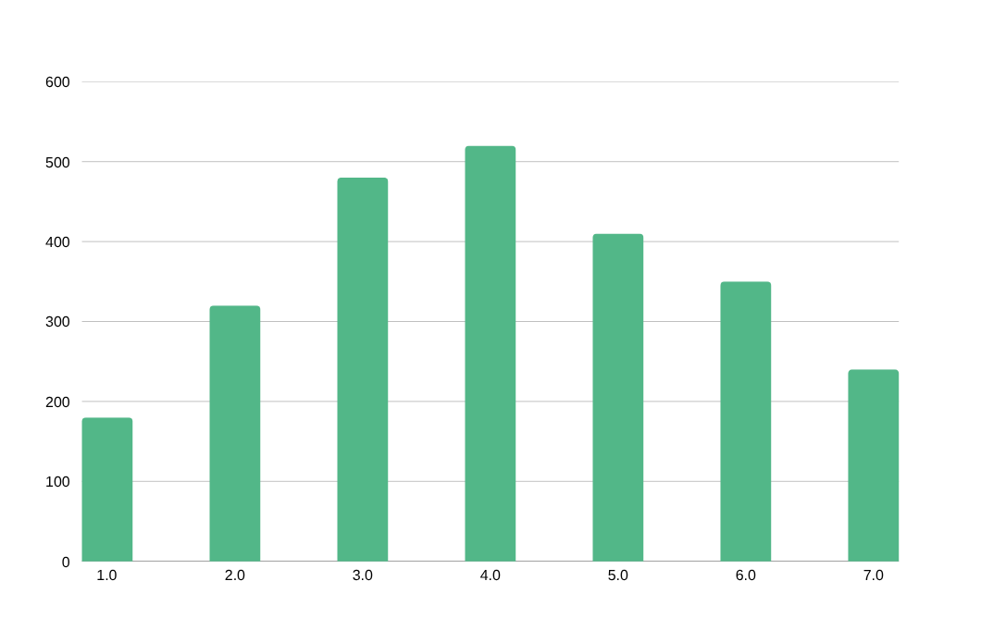
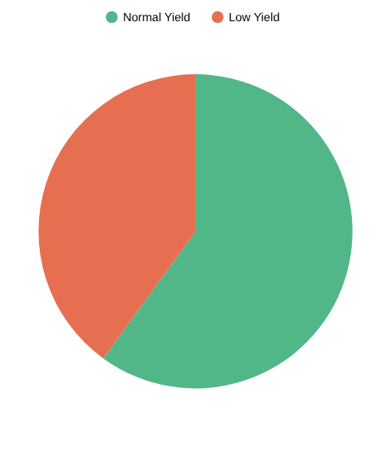
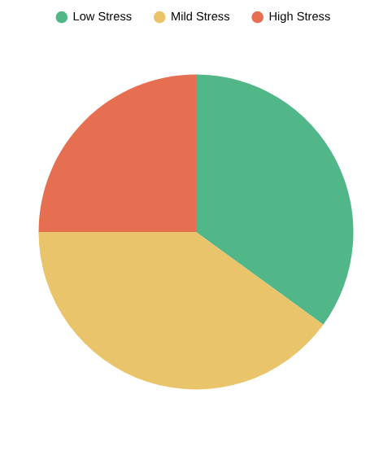
14 | CSI Distribution & Stress Level Distribution
25%
35%
60%
40%
40%
Figure 10: CSI histogram across 2,500 records | Figure 11: Stress distribution — base vs. proposed
Key Insight: Many records fall in Mild-to-High stress range — confirming crop stress is common and needs early detection. Our 3-level classification gives farmers specific actionable guidance vs. the base paper's binary output.
Notes:
12

Slide 18
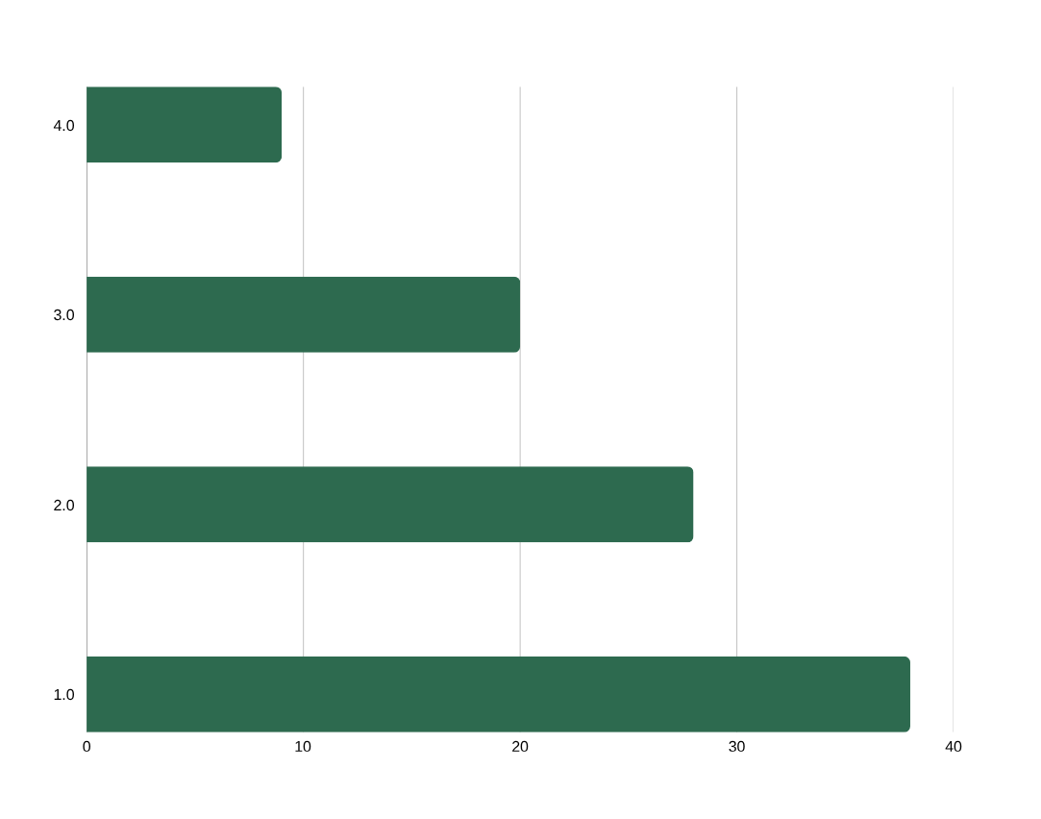
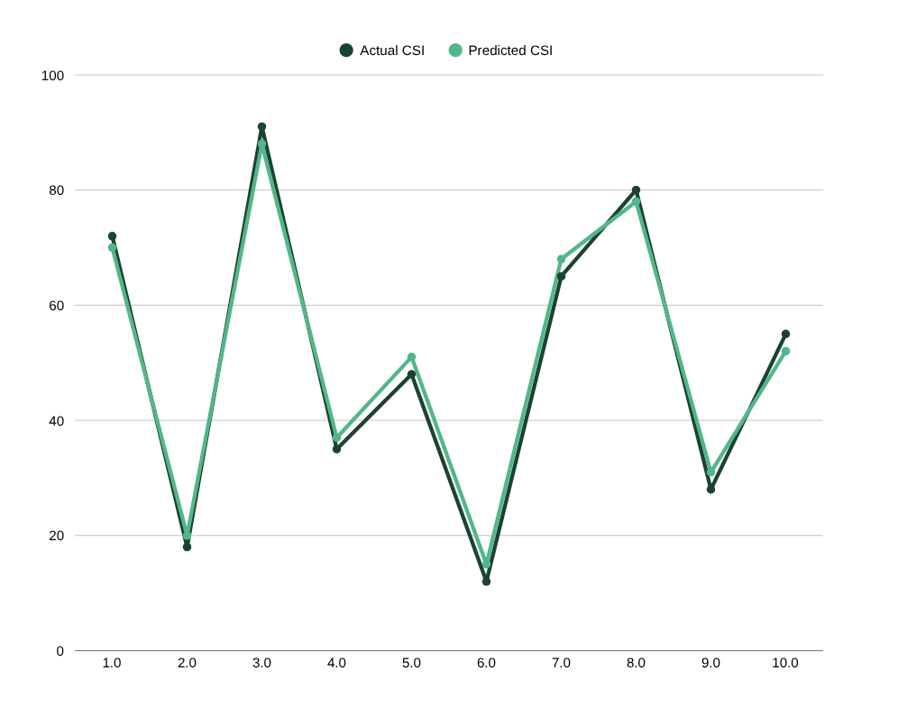
15 | Feature Importance & Prediction Accuracy
Rainfall
Humidity
Soil Moisture
Temperature
Figure 14: Temperature leads at 38%, Soil Moisture at 28%, Humidity 20%, Rainfall 9%
Figure 12: Predicted values closely track actual CSI — Random Forest, 84% accuracy
Temperature (38%) is the dominant predictor of crop stress — followed by soil moisture (28%) and humidity (20%). Rainfall ranks lowest (9%), consistent with agronomic understanding.
Notes:
13

Slide 19
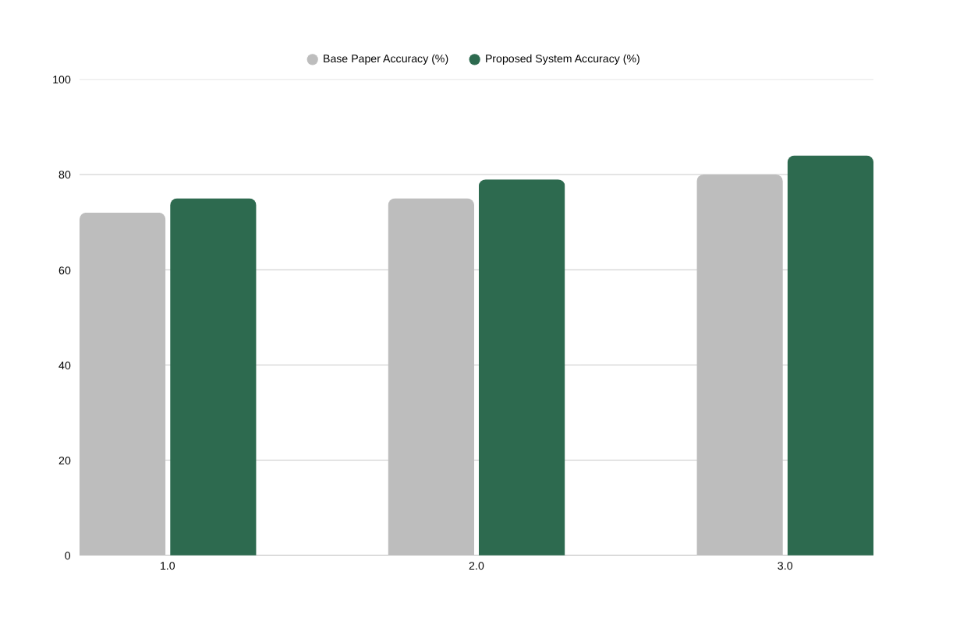
16 | Results — Model Performance Comparison
Key Findings
Random Forest: 84% — best performing model
Adding soil moisture + humidity → +4–12% accuracy gain
CSI converts complex data into intuitive 0–100 score
3-level classification is more actionable than yield prediction
AI-guided irrigation → 25–30% water savings
Reduced pesticide/fertilizer → lower carbon emissions
Linear Regression
Decision Tree
Random Forest
Figure 15: All three models show improved accuracy with our dataset + CSI feature engineering
India Case: Rajasthan wheat farmer receives 'High Stress' alert 48 hrs early → irrigates + applies shade nets → saves 20–30% potential yield loss
Notes:
14

Slide 20
17 | Novelty Summary & Key Conclusions
Aspect | Base Paper (Lobell & Burke, 2010) | This Study — Novel Contribution
ML Model | Linear Regression, Basic ANN | Linear Reg + Decision Tree + Random Forest
Best Accuracy | ~72–80% | 84% (Random Forest)
Stress Index | None | Custom CSI (0–100) — novel formula
Input Features | Temperature, Rainfall only | Temp + Humidity + Rainfall + Soil Moisture
Output | Yield prediction only | Stress level + Farmer recommendation
Dataset | ~900 records | ~2,500 records (3× larger)
Detection Type | Reactive | Predictive — 24–48 hrs before damage
Key Conclusions
AI can detect crop stress before it becomes visible — enabling preventive action
Random Forest significantly outperforms traditional regression methods
CSI is a simple yet powerful tool adoptable by agricultural agencies
Multi-factor analysis is far superior to single-parameter approaches
No expensive hardware required — accessible to small farmers
AI-guided irrigation → 25–30% water waste reduction
Reduced unnecessary pesticide/fertilizer → lower carbon emissions
Notes:
15

Slide 21
18 | Future Scope & References
📡 IoT Integration
📱 Mobile Application
🤖 Deep Learning
🌱 Precision Agriculture
Low-cost Arduino + Raspberry Pi sensors
Fully automated, real-time stress monitoring
Under ₹5,000/hectare — affordable deployment
Android/iOS app with local language alerts
SMS alerts for non-smartphone farmers
Hindi, Marathi, Telugu, Kannada, Tamil support
LSTM models for time-series forecasting
Combine env. data + crop photo analysis
Satellite image integration for large-scale monitoring
Variable Rate Irrigation (VRI) per zone
Drone-based stress mapping for large farms
PM-KISAN integration + Carbon credit generation
References
1. Lobell & Burke (2010). On the use of statistical models to predict crop yield responses to climate change. Agricultural and Forest Meteorology, 150(11).
2. Kamilaris & Prenafeta-Boldu (2018). Deep learning in agriculture: A survey. Computers & Electronics in Agriculture, 147.
3. Pantazi et al. (2016). Wheat yield prediction using machine learning. Computers & Electronics in Agriculture, 121.
4. Crane-Droesch (2018). ML methods for crop yield prediction. Environmental Research Letters, 13(11).
5. Sehgal et al. (2020). Decision support for irrigation using IoT and ML. Journal of Agricultural Engineering, 57(2).
6. Atharva Ingle (2020). Crop Recommendation Dataset. Kaggle. | 7. FAO STAT Historical Climate Data. fao.org
"From Invisible Stress to Insight — Empowering Every Farmer with AI"
Notes:
16

Slide 22
THANKYOU

Slide 23


