Slide 1
Name : Hemant Pralhad Tikare
Email ID: hemanttikare2@gmail.com
Project 2: Instagram User Analytics
This ppt is a exploration of Instagram User analytics based on analysis done on below points:-
Part A : Marketing Analysis:-
1. Rewarding Loyal Users
2. Reminders for Inactive Users to Start Posting
3. Contest Winners Declarations
4. Hashtag Research
5. Launch AD Campaign
Part B : Investor Metrics:-
1. User Engagement
2. Bots & Fake Accounts

Slide 2
SQL Query: select username, created_at from users order by created_at ASC limit 10;
Part A : Marketing Analysis
Rewarding Loyal Users : We will find 10 oldest Instagram user who have been using the platform since the beginning of the app launch.
To find the loyal users that is the top 10 oldest Instagram users :
1. We will be selecting the username and created_at columns from the users table.
2.Then by using the order by function we will sort the created_at column in ascending order.
3.Then by using the limit function we will pick top 10 rows of the sorted column and display the top 10 oldest Instagram users.

Slide 3
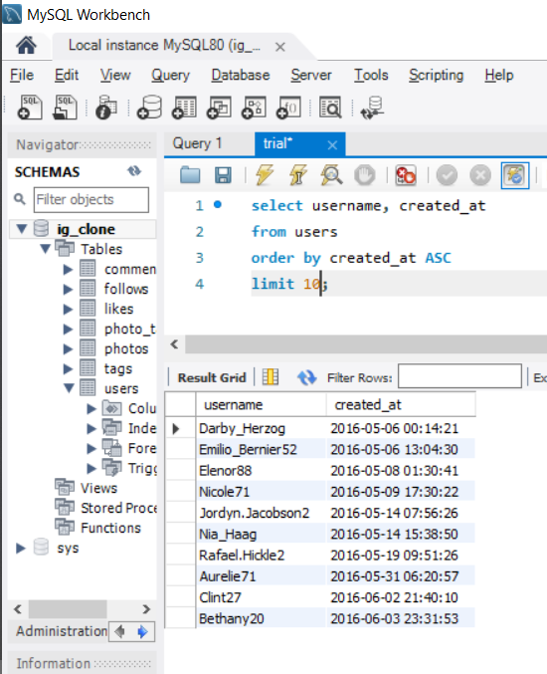
Part A : Marketing Analysis Rewarding Loyal users: SQL Query Output: Software used : MYSQL Workbench 8.0

Slide 4
SQL Query: select username, users.id as user_id from users left join photos on users.id = photos.user_id where photos.id IS NULL order by users.id;
Part A : Marketing Analysis
Reminders for Inactive Users to Start Posting : Remind Inactive users to Start Posting(Users who never posted a single photo on Instagram)
To Find the inactive users i.e. the users who have never posted a single photo on Instagram:
1.We will first select username column from the users table.
2.Then we will left join photos table on the users table, on users.id = photos.user_id because, both the users.id and photos.user_id have common contents in them.
3.Then we will find rows from the users table where the photos.id IS NULL

Slide 5
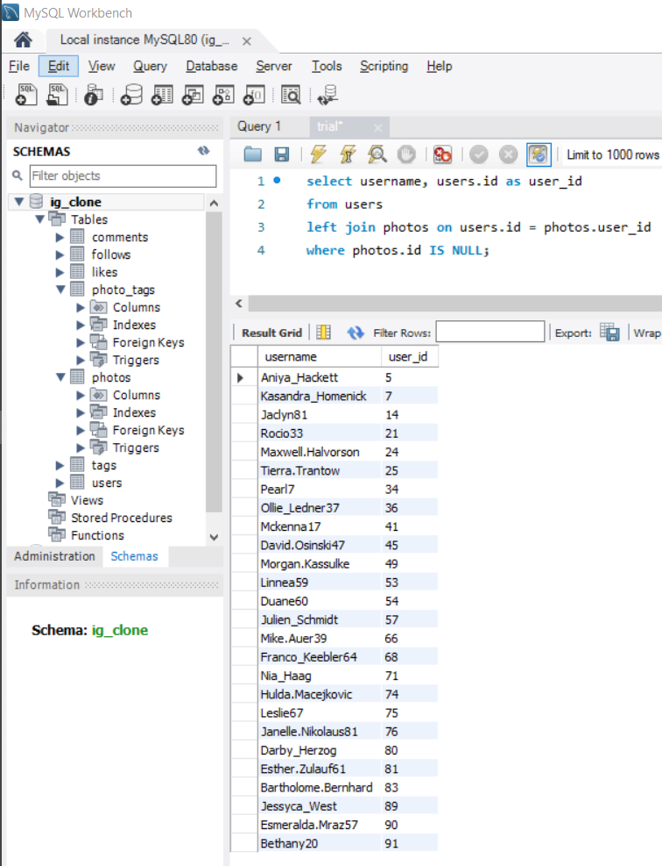
Part A : Marketing Analysis List of Inactive Users: SQL Query Output: Software used : MYSQL Workbench 8.0
So, there are in total 26 users of the 100 users who have never posted a single photo on Instagram

Slide 6
Part A : Marketing Analysis
Contest Winners Declarations : A new Mobile phone company who have collaborated with Instagram to marketize their newly launched mobile phone have started a phone giveaway contest and the top 5 users who gets the most likes on their photo will win the contest.
To Identify the winners of the contest and provide their details to the team.
1.First we will select the users.username, photos.id, photos.image_url and count(*) as total
2.Then,we will inner join the three tables wiz : photos, likes and users, on likes.photo_id = photos.id and photos.user_id = users.id
3.Then, by using group by function we will group the output on the basis of photos.id
4.Then,using order by function we will sorting the data on the basis of the total in descending order
5.Then, to find the most liked photo we will using limit function to view only the top liked photo’s information

Slide 7
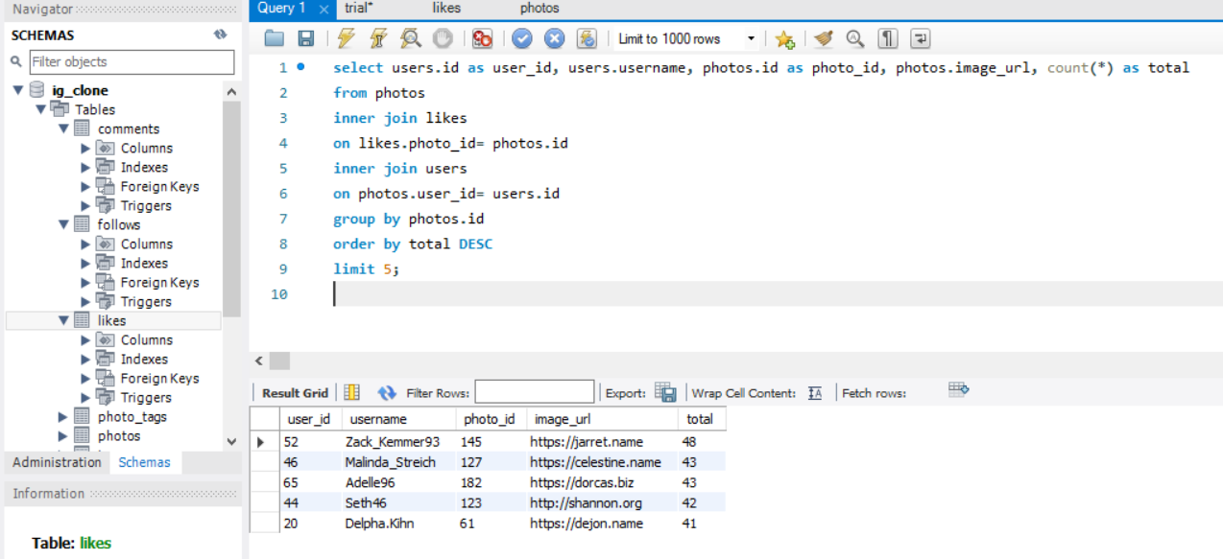
Part A : Marketing Analysis Contest Winners Declarations : SQL Query & Output: Software used : MYSQL Workbench 8.0
SQL Query:
select users.id as user_id, users.username, photos.id as photo_id, photos.image_url, count(*) as total
from photos
inner join likes
on likes.photo_id= photos.id
inner join users
on photos.user_id= users.id
group by photos.id
order by total DESC
limit 5;
Output:

Slide 8
Part A : Marketing Analysis
Hashtag Research : Lets consider Amazon is a partner brand of Instagram and wants to know most commonly used hashtags to use in the post to promote the Big Billion Days offer that most people on the platform use.
To find the top 10 most commonly used hashtags on Instagram:
1.We need to select the tag_name column from the tag table and the count(*) as total function so as to count the number of tags used individually.
2.Then,we need to jointags table and photo_tags table, on tags.id=photo_tags.tag_id cause they contain the same content in them i.e. tag_id
3.Then using the group by function we need to group the desired output on the basis of tags.tag_name
4.Then using the order by function we need to sort the output on the basis of total(total number of tags per tag_name) in descending order
5.Then,to find the top 10 most used tag names we will use the limit 10 function.

Slide 9
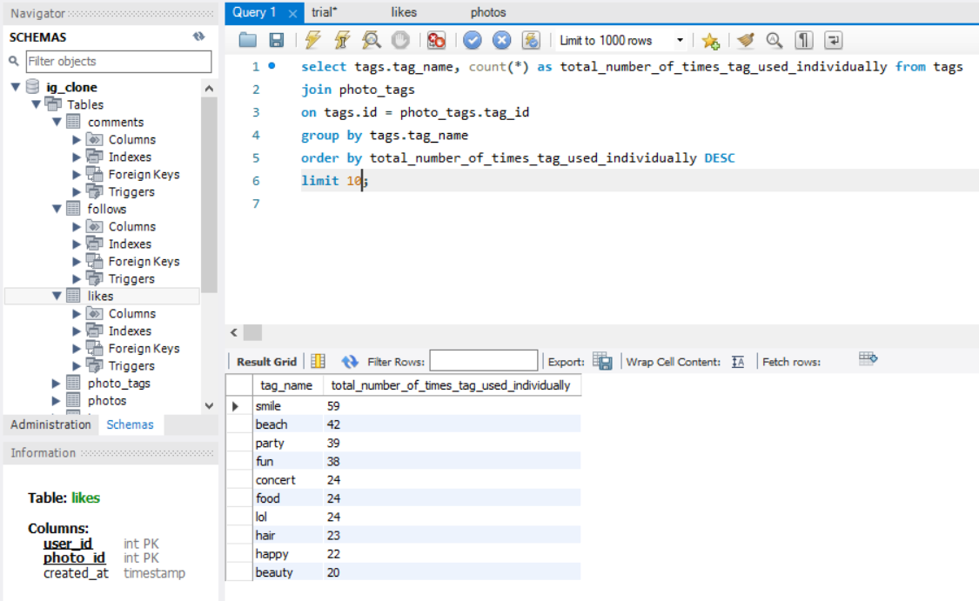
Part A : Marketing Analysis Hashtag Research : SQL Query & Output: Software used : MYSQL Workbench 8.0
SQL Query:
select tags.tag_name, count(*) as total_number_of_times_tag_used_individually from tags
join photo_tags
on tags.id = photo_tags.tag_id
group by tags.tag_name
order by total_number_of_times_tag_used_individually DESC
limit 10;
Output:

Slide 10
Part A : Marketing Analysis
Launch AD Campaign : The Instagram team wants to know which day would be the best day to promote an AD for new launched MSI Gaming laptop.
To find the day of week on which most users register on Instagram:
1.First we define the columns of the desired output table using select dayname(created_at) as day_of_week and count(*) as total_number_of_users_registered from the users table
2.Then using the group by function we group the output table on the basis of day_of_week
3.Then using the order by function we order/sort the output table on the basis of total_number_of_users_registered in descending order

Slide 11
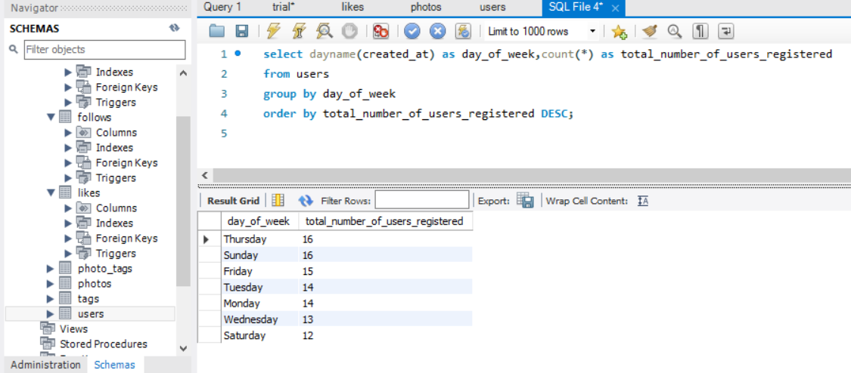
Part A : Marketing Analysis Launch AD Campaign : SQL Query & Output: Software used : MYSQL Workbench 8.0
SQL Query :
select dayname(created_at) as day_of_week,
count(*) as total_number_of_users_registered
from users
group by day_of_week
order by total_number_of_users_registered DESC;
Output:
Most of the users registered on Thursday and Sunday i.e.16 and hence it would prove beneficial to start AD Campaign on these two days.

Slide 12
Part B : Investor Metrics
User Engagement : Are users still as active and post on Instagram or they are making fewer posts. How many times does average user posts on Instagram?
Also, provide the total number of photos on Instagram/total number of users.
To find the how many times does average posts on Instagram:
1.First, we need to find first the count number of photos(posts) that are present in the photos.id column of the photos table i.e. count(*) from photos
2.Similarly, we need to find the number of users that are present in the users.id column of the users table i.e. count(*) from users
3.Next, we need to divide both the values i.e. count(*) from photos/count(*) from users and hence we would get the total number of photos / total number of users
4.To find how many times the users posts on Instagram we need to find the total occurrences of each user_id in photos table

Slide 13
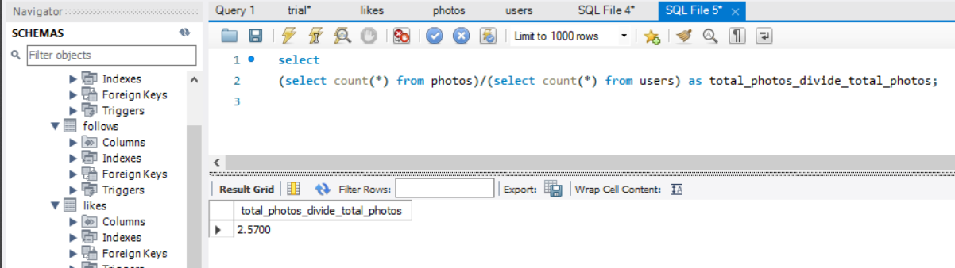
Part B : Investor Metrics User Engagement : SQL Query & Output: Software used : MYSQL Workbench 8.0
SQL Query to find (total number of photos/total number of users):
select
(select count(*) from photos)/(select count(*) from users) as total_photos_divide_total_photos;
Output:
So, there are in total 257 photos in the photos table and 100 ids in the users table which makes the desired output to be 257/100= 2.57

Slide 14
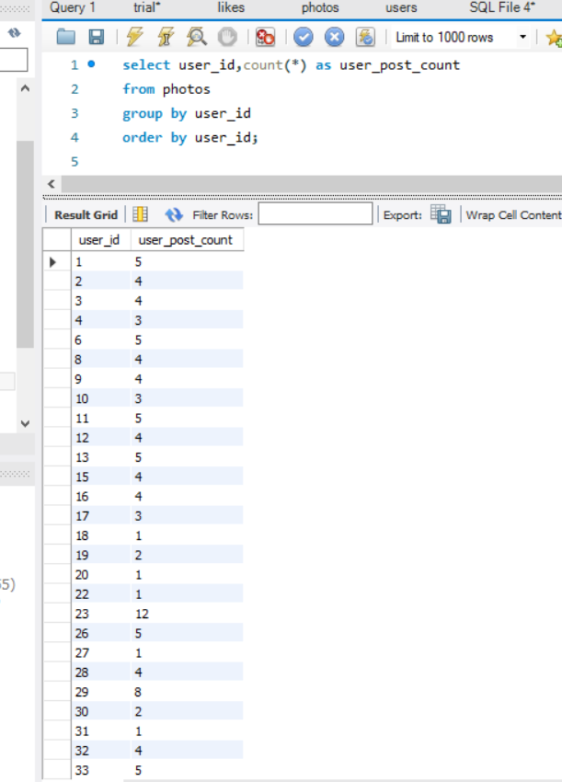
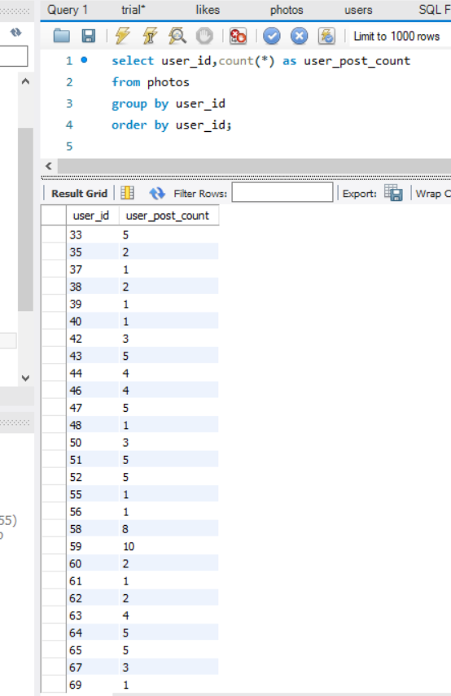
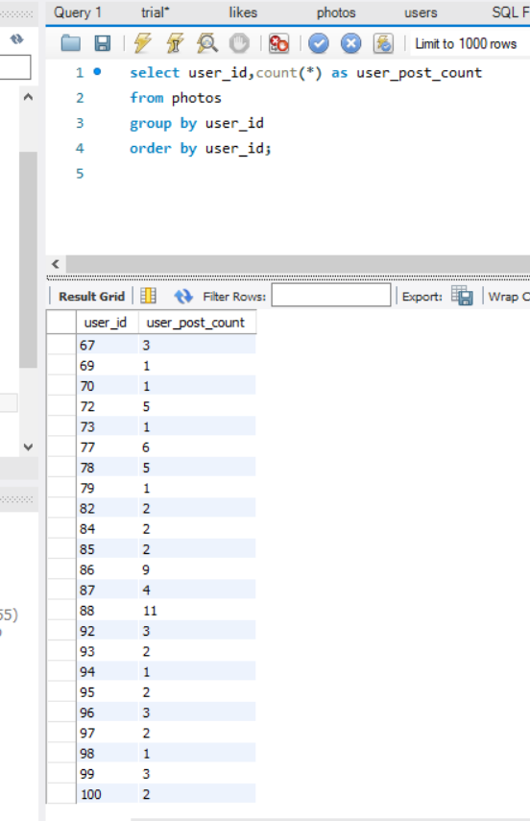
Part B : Investor Metrics User Engagement : SQL Query & Output: Software used : MYSQL Workbench 8.0
SQL Query to find the no. of times each user posts on Instagram :
select user_id, count(*) as user_post_count
from photos
group by user_id
order by user_id;
Output:
So the user_id along with the number of times each user_id has posted is provided.

Slide 15
Part B : Investor Metrics
Bots & Fake Accounts : The Instagram team is performing a sanity operation where they need to clean out the fake or dummy accounts which are being used to increase likes & hashtags to gain popularity and to promote illegal content in community.
To find the bots and fake accounts, we need find users (bots) who have liked every single photo on the site :
1.First, we select the user_id column from the photos table
2.Then we select the username column from the users table
3.Then, we select the count(*) function to count total number of likes from the likes table
4.Then we inner join users and likes table on the basis of users.id and likes.user_id, using the on clause
5.Then by using the groupby function we group the output table on the basis of likes.user_id
6.Then,we search the values from the count(*) from photos having equal values with the total_likes_per_user

Slide 16
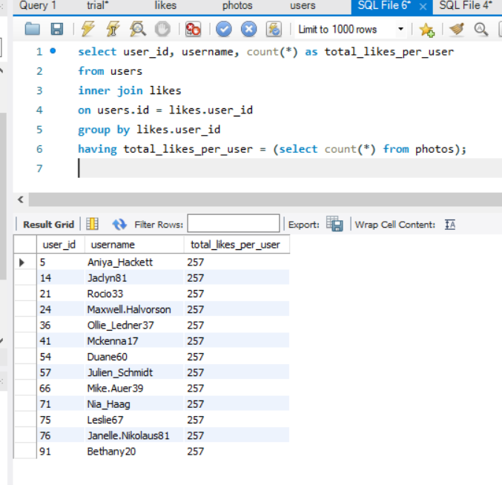
Part B : Investor Metrics Bots & Fake Accounts : SQL Query & Output:
SQL Query:
select user_id, username, count(*) as total_likes_per_user
from users
inner join likes
on users.id = likes.user_id
group by likes.user_id
having total_likes_per_user = (select count(*) from photos);
Output:
So, the users along with their respective username, user_id and total_likes_per_user have been provided. This user_ids maybe bots or fake accounts

