Slide 1
Name : Hemant Pralhad Tikare
Email ID: hemanttikare2@gmail.com
Project 3: Operation Analytics and Investigating Metric Spike
This ppt is a exploration of Operation Analytics and Investigating Metric Spike based on analysis done on below points:-
Case Study 1 : Job Data:-
1. Number of jobs reviewed : Amount of jobs reviewed over time.
2. Throughput : It is the no. of events happening per second.
3. Language Share Analysis: Share of each language for different
contents.
4. Duplicate rows : Rows that have the same value present in them.

Slide 2
Case Study 2 : Investigating metric spike:-
1. User Engagement : To measure the activeness of a user. Measuring if the user finds quality in a product/service.
2. User Growth: Amount of users growing over time for a product.
3. Weekly Retention: Users getting retained weekly after signing up for a product.
4. Weekly Engagement: To measure the activeness of a user. Measuring if the user finds quality in a product/service weekly.
5. Email Engagement: Users engaging with the email service.

Slide 3
Case Study 1 : Job Data
Number of jobs reviewed : Amount of jobs reviewed over time.
Task : Calculate the number of jobs reviewed per hour per day for November 2020?
To find the number of jobs reviewed per hour per day of November 2020:
1. We will use the data from job_id columns of the job_data table.
2. Then we will divide the total count of job_id (distinct and non distinct) by (30 days * 24 hours)for finding the number of jobs reviewed per day

Slide 4
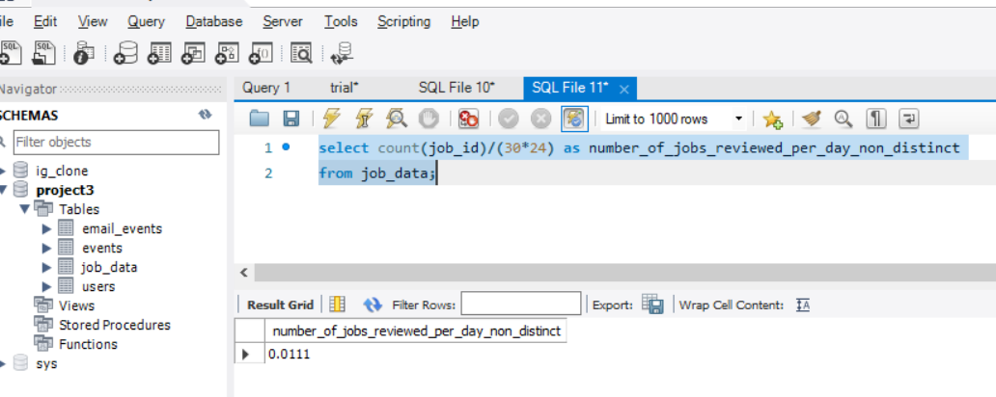
Case Study 1 : Job Data Number of jobs reviewed : SQL Query & Output: Software used : MYSQL Workbench 8.0
SQL Query (non_distinct_job_id): select count(job_id)/(30*24) as number_of_jobs_reviewed_per_day_non_distinct from job_data;

Slide 5
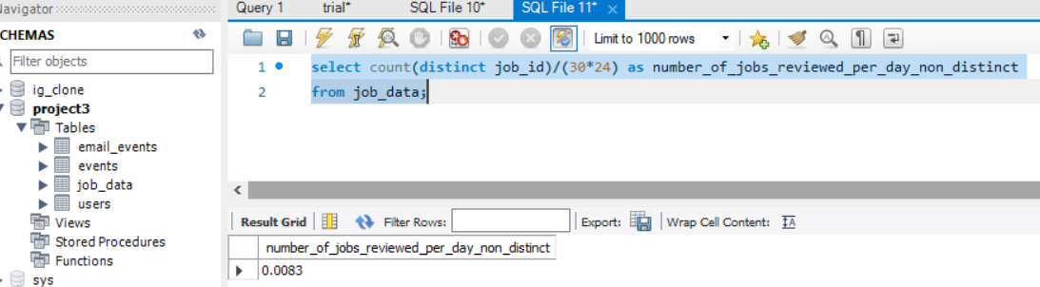
Case Study 1 : Job Data Number of jobs reviewed : SQL Query & Output: Software used : MYSQL Workbench 8.0
SQL Query (distinct_job_id): select count(distinct job_id)/(30*24) as number_of_jobs_reviewed_per_day_non_distinct from job_data;

Slide 6
Case Study 1 : Job Data
Throughput : It is the no. of events happening per second.
Task : For calculating the throughput we will be using the 7-day rolling because 7-day rolling gives us the average for all the days right from day 1 to day 7
Where as daily metric gives us average for only that particular day itself.
For calculating the 7-day rolling daily metric average of throughput:-
1. We will be first taking the count of job_id(distinct and non-distinct) and ordering them w.r.t ds (date of interview)
2. Then by using the ROW function we will be considering the rows between 6 preceding rows and the current row
3. Then we will be taking the average of the jobs_reviewed

Slide 7
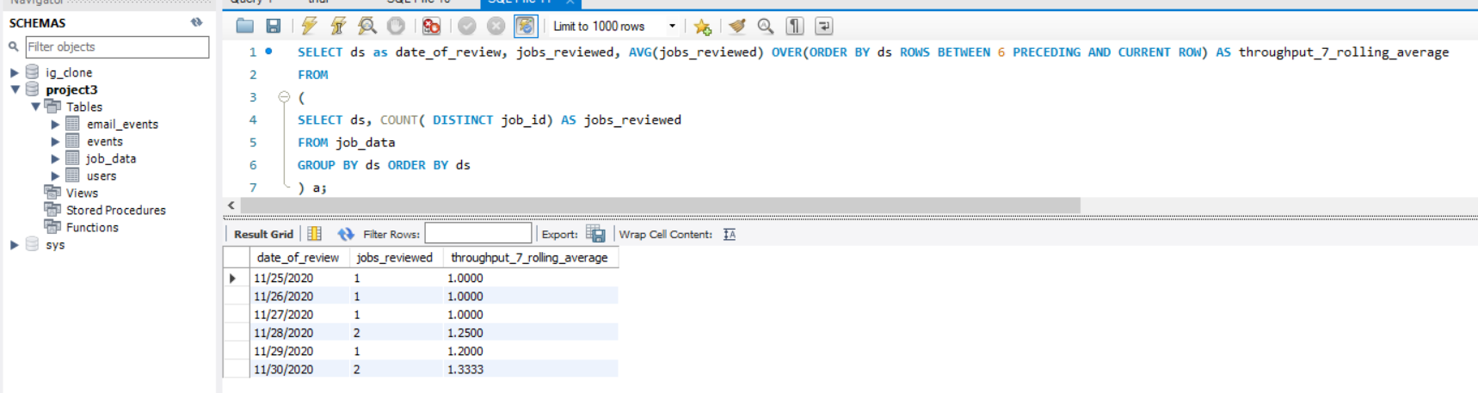
Case Study 1 : Job Data Throughput : SQL Query & Output: Software used : MYSQL Workbench 8.0
SQL Query: SELECT ds as date_of_review, jobs_reviewed, AVG(jobs_reviewed) OVER(ORDER BY ds ROWS BETWEEN 6 PRECEDING AND CURRENT ROW) AS throughput_7_rolling_average
FROM (SELECT ds, COUNT( DISTINCT job_id) AS jobs_reviewed
FROM job_data
GROUP BY ds ORDER BY ds
) a;
Output:

Slide 8
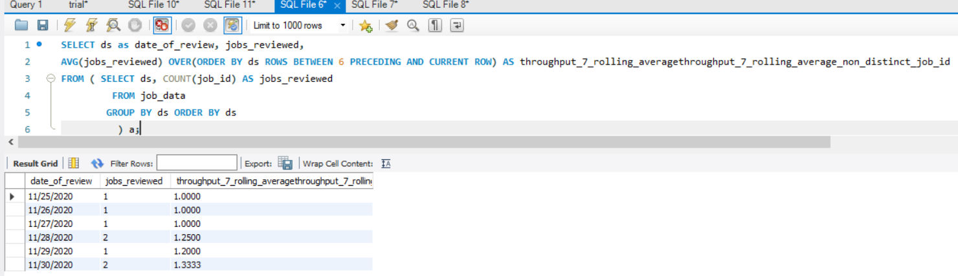
Case Study 1 : Job Data Throughput : SQL Query & Output: Software used : MYSQL Workbench 8.0
SQL Query: SELECT ds as date_of_review, jobs_reviewed, AVG(jobs_reviewed) OVER(ORDER BY ds ROWS BETWEEN 6 PRECEDING AND CURRENT ROW) AS throughput_7_rolling_averagethroughput_7_rolling_average_non_distinct_job_id
FROM ( SELECT ds, COUNT(job_id) AS jobs_reviewed
FROM job_data
GROUP BY ds ORDER BY ds
) a;
Output:

Slide 9
Case Study 1 : Job Data
Language Share Analysis: Share of each language for different contents.
Task : Calculate the percentage share of each language?
To calculate the percentage share of each language (distinct and non-distinct):-
1.We will first divide the total number of languages (distinct/non-distinct) by the total number of rows presents in the table
2.Then we will do the grouping based on the languages.

Slide 10
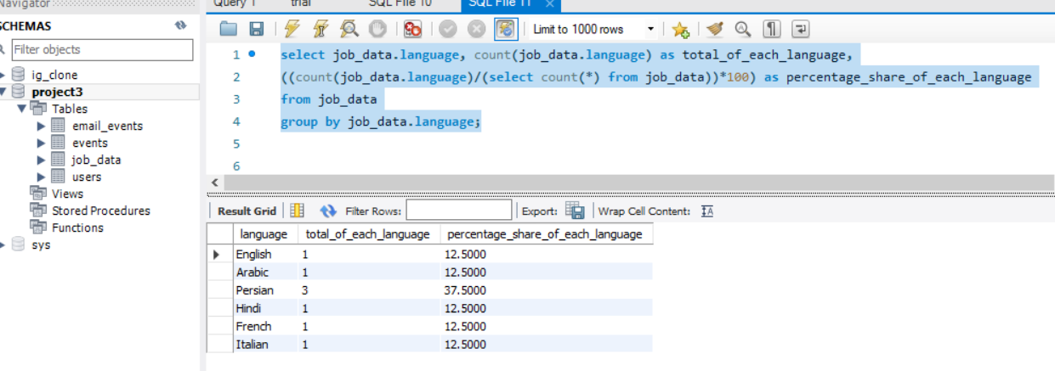
Case Study 1 : Job Data Percentage share of each language : SQL Query & Output: Software used : MYSQL Workbench 8.0
SQL Query:
select job_data.language, count(job_data.language) as total_of_each_language,
((count(job_data.language)/(select count(*) from job_data))*100) as percentage_share_of_each_language
from job_data
group by job_data.language;
Output:

Slide 11
Case Study 1 : Job Data
Duplicate rows : Rows that have the same value present in them.
Task : Let’s say you see some duplicate rows in the data. How will you display duplicates from the table?
To view the duplicate rows having the same value we will:-
1.First decide in which do we need to find the duplicate row values
2.After deciding the column(parameter) we will use the ROW_NUMBER function to find the row numbers having the same value
3.Then we will portioning the ROW_NUMBER function over the column (parameter) that we decided i.e. job_id
4.Then using the WHERE function we will find the row_num having value greater than 1 i.e. row_num> 1 based on the occurrence of the job_id in the table.

Slide 12
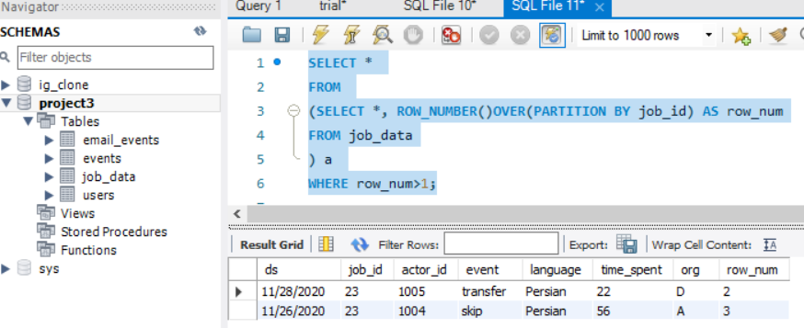
Case Study 1 : Job Data Duplicate rows : SQL Query & Output: Software used : MYSQL Workbench 8.0
SQL Query:
SELECT *
FROM
(SELECT *, ROW_NUMBER()OVER(PARTITION BY job_id) AS row_num
FROM job_data
) a
WHERE row_num>1;
Output:

Slide 13
Case Study 2 : Investigating metric spike
User Engagement : To measure the activeness of a user. Measuring if the user finds quality in a product/service.
Your task: Calculate the weekly user engagement?
To find the weekly user engagement:-
1.We will extract the week from the occurred_at column of the events table using the EXTRACT function and WEEK function
2.Then we will be counting the number of distinct user_id from the events table
3.Then we will use the GROUP BY function to group the output w.r.t week from occurred_at

Slide 14
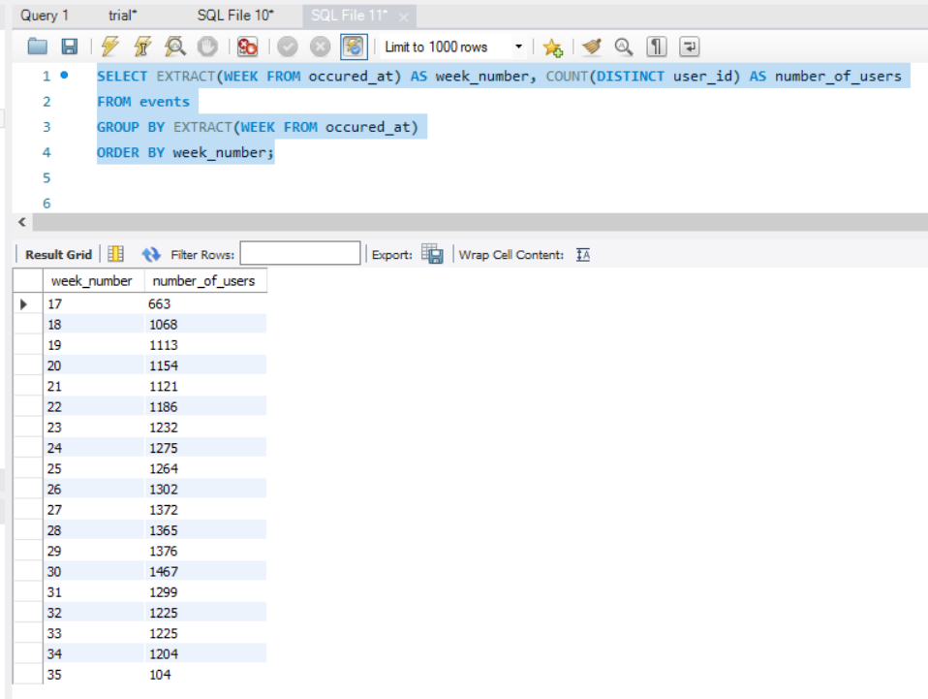
Case Study 2 : Investigating metric spike User Engagement : SQL Query & Output: Software used : MYSQL Workbench 8.0
SQL Query :
SELECT EXTRACT(WEEK FROM occured_at) AS week_number, COUNT(DISTINCT User_id) AS number_of_users
FROM events
GROUP BY EXTRACT(WEEK FROM occured_at)
ORDER BY week_number;
Output:

Slide 15
Case Study 2 : Investigating metric spike
User Growth: Amount of users growing over time for a product.
Your task: Calculate the user growth for product?
User Growth= Number of active users per week
To find the user growth (number of active users per week):-
1.First we will the extract the year and week for the occured_at column of the users table using the extract, year and week functions
2.Then we will group the extracted week and year on the basis of year and week number
3.Then we ordered the result on the basis of year and week number
4.Then we will find the cum_active_users using the SUM, OVER and ROW function between unbounded preceding and current row

Slide 16
Case Study 2 : Investigating metric spike User Growth: SQL Query & Output: Software used : MYSQL Workbench 8.0
SQL Query:
select year_num, week_num, num_active_users,
SUM(num_active_users)OVER(ORDER BY year_num, week_num ROWS BETWEEN UNBOUNDED PRECEDING AND CURRENT ROW) AS cum_active_users
from
(
select
extract(year from a.activated_at) as year_num, extrac (week from a.activated_at) as week_num,
count(distinct user_id) as num_active_users
from users a
WHERE state = 'active'
group by year_num, week_num
order by year_num, week_num
) a;

Slide 17
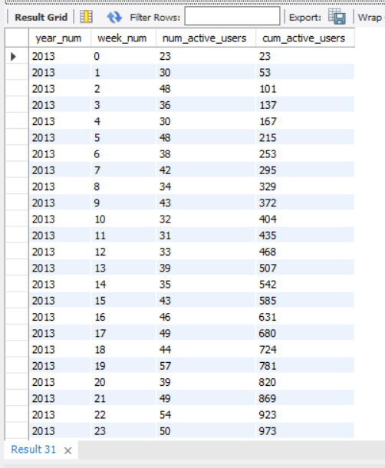
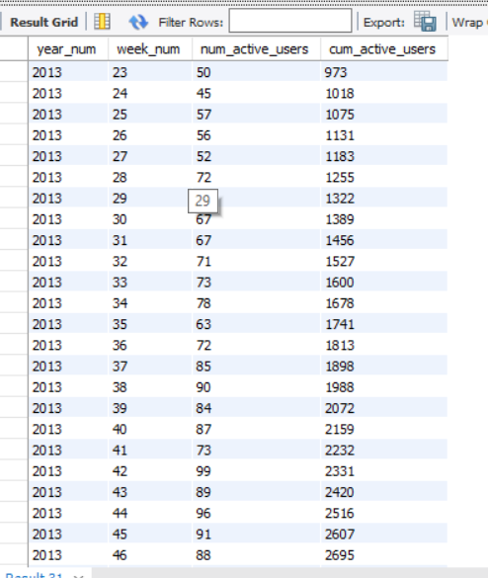
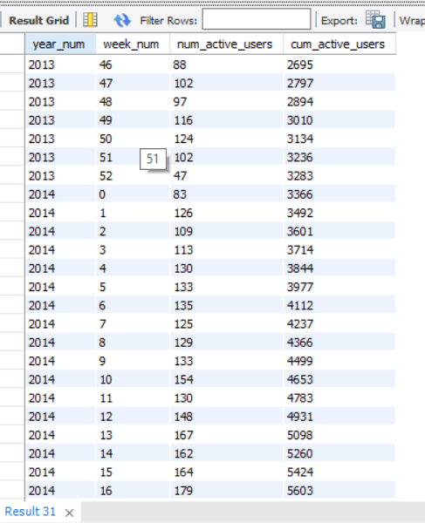
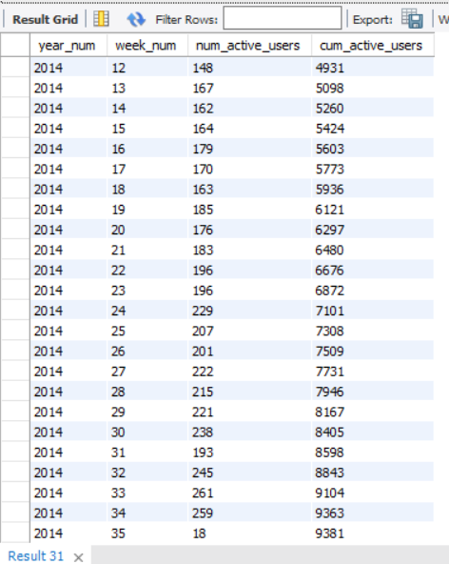
Case Study 2 : Investigating metric spike User Growth: SQL Query & Output: Software used : MYSQL Workbench 8.0
SQL output:

Slide 18
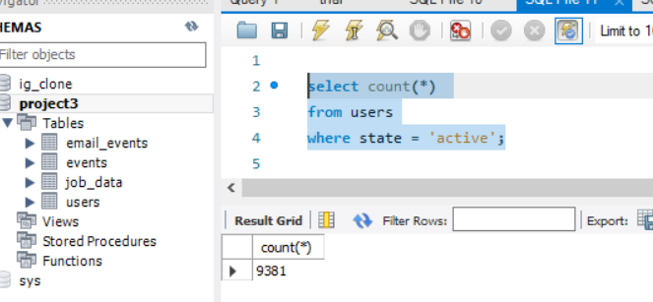
Case Study 2 : Investigating metric spike User Growth: SQL Query & Output: Software used : MYSQL Workbench 8.0
SQL Query :
select count(*)
from users
where state = 'active';
Output:

Slide 19
Case Study 2 : Investigating metric spike
Weekly Retention: Users getting retained weekly after signing up for a product.
Task: Calculate the weekly retention of users sign up cohort?
The weekly retention of users sign up cohort can be calculated by two means i.e. either by specifying the week number (18 to 35) or for the entire column of occured_at of the events table.
1. Firstly we will extract the week from occured_at column using the extract, week functions
2. Then, we will select out those rows in which event_type = ‘signup_flow’ and event_name = ‘complete_signup’
3. If finding for a specific week we will specify the week number using the extract function
4. Then using the left join we will join the two tables on the basis of User_id where event_type = 'engagement’
5. Then we will use the Group By function to group the output table on the basis of User_id
6. Then we will use the Order By function to order the result table on the basis of User_id

Slide 20
Case Study 2 : Investigating metric spike Weekly Retention: SQL Query & Output:
SQL Query(Without Specifying the week number):
SELECT
distinct User_id, COUNT(User_id), SUM(CASE WHEN retention_week= 1 Then 1 Else 0 END) as per_week_retention
FROM
(SELECT
a.user_id, a.signup_week, b.engagement_week, b.engagement_week-a.signup_week as retention_week
FROM
((SELECT distinct User_id, extract(week from occured_at) as signup_week
FROM events
WHERE event_type= ‘signup_flow’ and event_name= ‘complete_signup’
)a
LEFT JOIN
(SELECT distinct user_id, extract(week from occured_at) as engagement_week
FROM events
where event_type= ‘engagement’
)b
on a.User_id= b.User_id
)
)d
group by User_id
order by User_id;

Slide 21
Case Study 2 : Investigating metric spike Weekly Retention: SQL Query & Output:
Output(Without Specifying week Number) :
Click Link for result:- Weekly retention

Slide 22
Case Study 2 : Investigating metric spike Weekly Retention: SQL Query & Output:
SQL Query (Specifying the week number as 18) :
SELECT
distinct User_id, COUNT(User_id), SUM(CASE WHEN retention_week= 1 Then 1 Else 0 END) as per_week_retention
FROM
(SELECT
a.User_id, a.signup_week, b.engagement_week, b.engagement_week-a.signup_week as retention_week
FROM
((SELECT distinct User_id, extract(week from occured_at) as signup_week
From events
WHERE event_type= 'signup_flow’ and event_name= 'complete_signup’ and extract(week from occured_at) = 18
)a
LEFT JOIN
(SELECT distinct User_id, extract (week from occured_at) as engagement_week
FROM events
where event_type= 'engagement’
)b
on a.User_id= b.User_id
)
)d
group by User_id
order by User_id;

Slide 23
Case Study 2 : Investigating metric spike Weekly Retention: SQL Query & Output:
Output(Specifying the week number as 18):
Click Link for result:- Weekly Retention2

Slide 24
Case Study 2 : Investigating metric spike
Weekly Engagement: To measure the activeness of a user. Measuring if the user finds
quality in a product/service weekly.
Task: Calculate the weekly engagement per device?
To find the weekly user engagement per device:
1. Firstly we will extract the year_num and week_num from the occurred_at column of the events table using the extract, year and week function
2. Then we will select those rows where event_type = 'engagement’ using the WHERE clause
3. Then by using the Group By and Order By function we will group and order the
result on the basis of year_num , week_num and device

Slide 25
Case Study 2 : Investigating metric spike Weekly Engagement: SQL Query & Output:
SQL Query:
SELECT
extract(year from occured_at) as year_num, extract(week from occured_at) as week_num,
device, COUNT(distinct User_id) as no_of_users
FROM events
where event_type= 'engagement'
GROUP by 1,2,3
order by 1,2,3;
Output:
Click Link for result:- Weekly Engagement

Slide 26
Case Study 2 : Investigating metric spike
Email Engagement: Users engaging with the email service.
Your task: Calculate the email engagement metrics?
To find the email engagement metrics(rate) of users:
1. We will first categorize the action on the basis of email_sent , email_opened and email_clicked using the CASE, WHEN, THEN functions
2. Then we select the sum of category of email_opened divide by the sum of the category of email_sent and multiply the result by 100.0 and name is as email_opening_rate
3. Then we select the sum of category of email_clicked divide by the sum of the category of email_sent and multiply the result by 100.0 and name is as email_clicking _rate
4. email_sent = (‘sent_weekly_ sent_reengagement_email’)
5. e mail_opened email_open
6. e mail_clicked email_clickthrough

Slide 27
Case Study 2 : Investigating metric spike Email Engagement: SQL Query & Output:
SQL Query:
SELECT
100.0*SUM(CASE when email_cat= 'email_opened' then 1 else 0 end)/SUM(CASE when email_cat= 'email_sent' then 1 else 0 end) as email_opening_rate,
100.0*SUM(CASE when email_cat= 'email_clicked' then 1 else 0 end)/SUM(CASE when email_cat= 'email_sent' then 1 else 0 end) as email_clicking_rate
FROM
(SELECT *,
CASE
WHEN action in ('sent_weekly_digest','sent_reengagement_email')
then 'email_sent'
WHEN action in ('email_open')
then 'email_opened'
WHEN action in ('email_clickthrough')
then 'email_clicked'
end as email_cat
from email_events
) a;

Slide 28
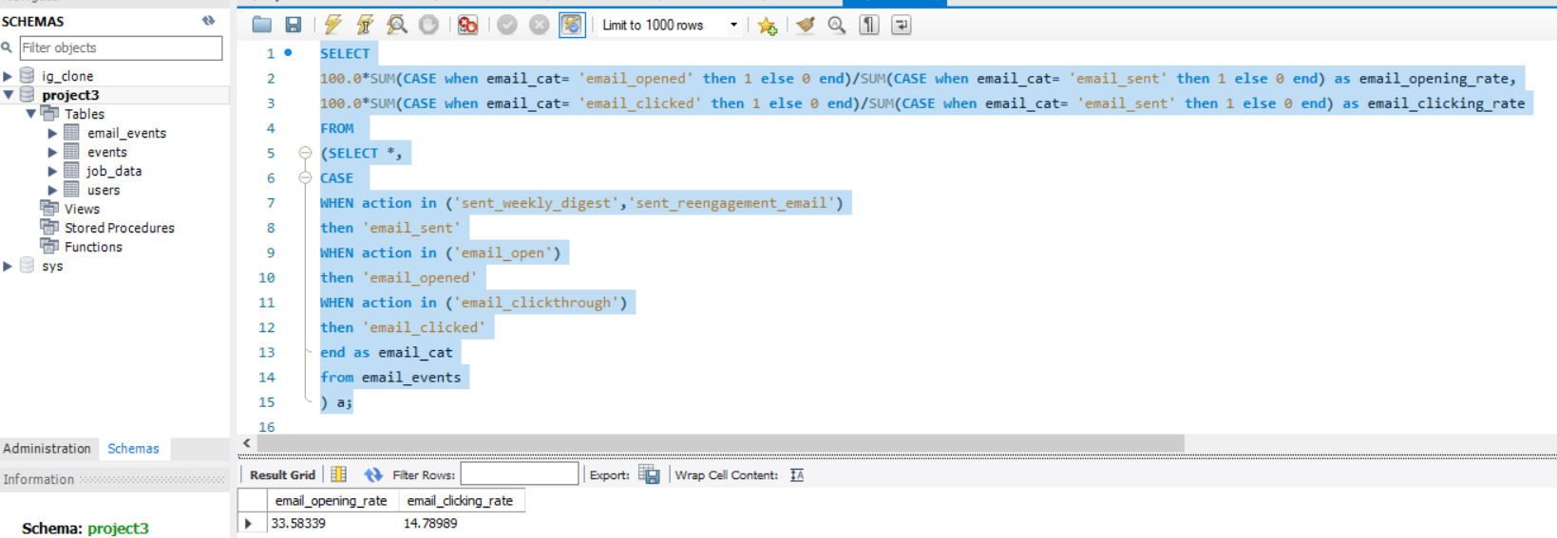
Case Study 2 : Investigating metric spike Email Engagement: SQL Query & Output:
Output:

