Slide 1
Name : Hemant Pralhad Tikare
Email ID: hemanttikare2@gmail.com
Project 4: Hiring Process Analytics
This ppt is a exploration of Hiring Process Analytics based on analysis done on below points:-
1. Hiring: Process of intaking of people into an organization for different kinds of positions.
2. Average Salary: Adding all the salaries for a select group of employees and then dividing the sum by the number of employees in the group.
3. Class Intervals: The class interval is the difference between the upper class limit and the lower class limit.
4. Charts and Plots: This is one of the most important part of analysis to visualize the data.
5. Charts : Use different charts and graphs to perform the task representing the data.

Slide 2
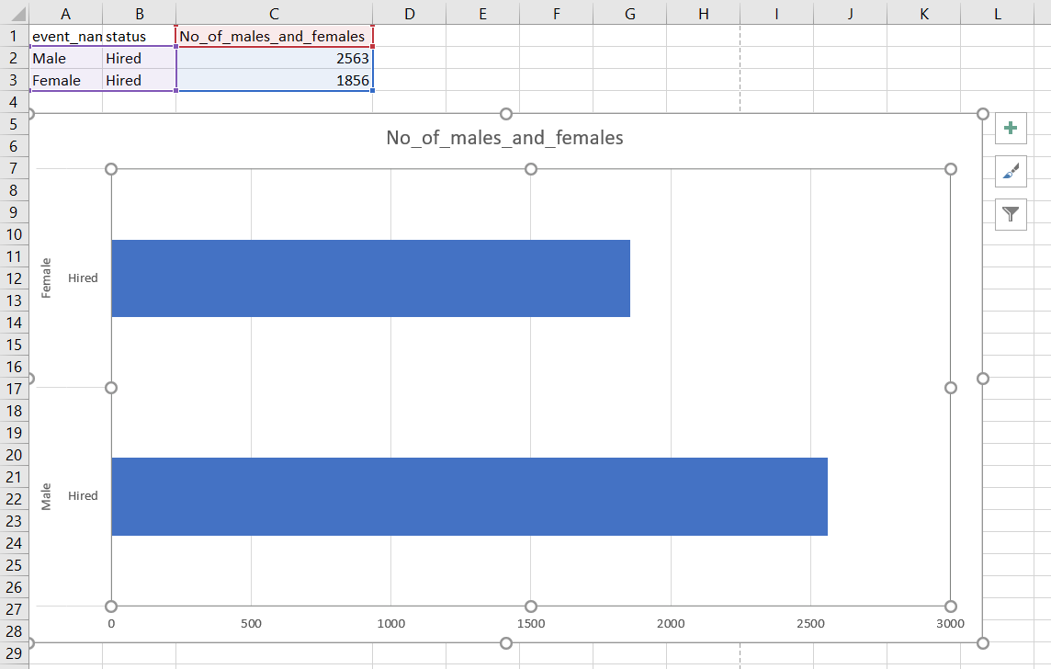
Hiring Analysis
Hiring: Process of intaking of people into an organization for different kinds of positions.
Task : Determine the gender distribution of hires. How many males and females have been hired by the company?

Slide 3
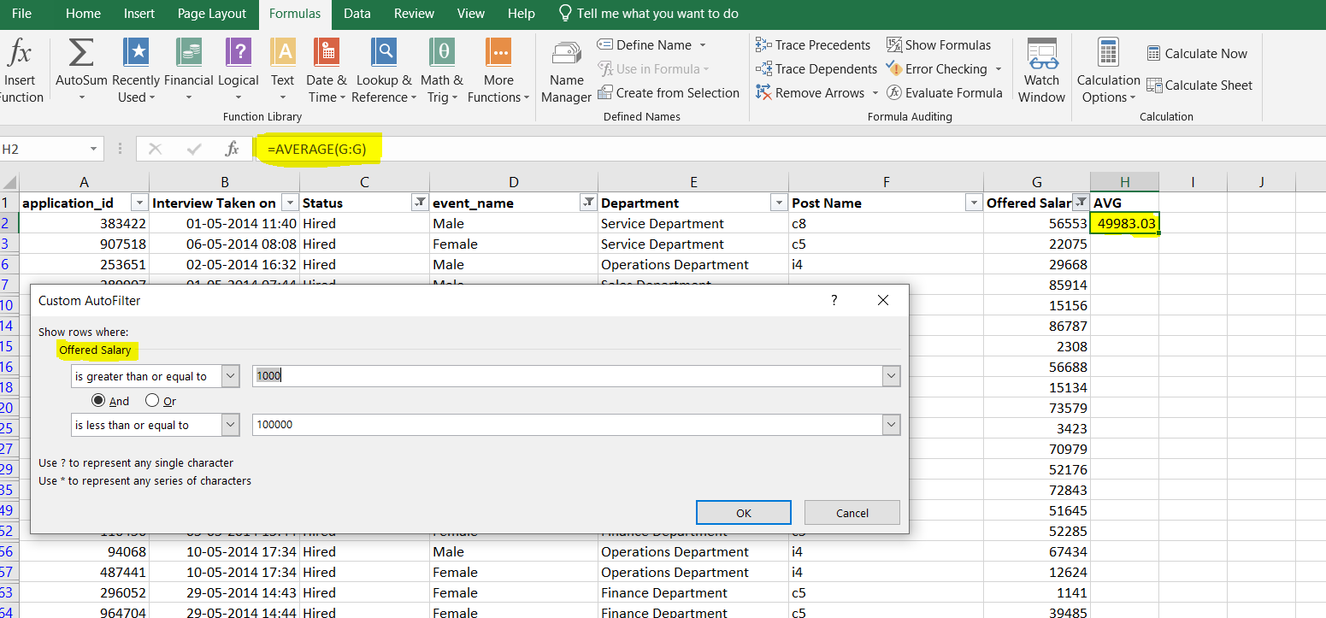
Salary Analysis
Average Salary: Adding all the salaries for a select group of employees and then dividing the sum by the number of employees in the group.
Task : What is the average salary offered by this company? Use Excel functions to calculate this
To find the average salary offered in this company:
1. First, we need to remove the outliers i.e. to remove the salaries below 1000
and above 100000
2. Then using the formula
=AVERAGE(entire column of salary after removing outliers)

Slide 4
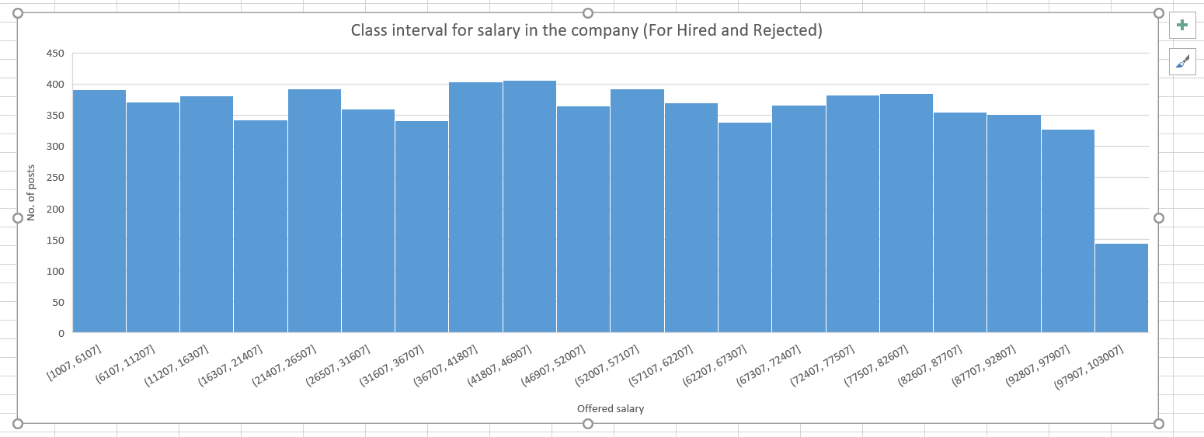
Salary Distribution
Class Intervals: The class interval is the difference between the upper class limit and the lower class limit.
Task : Create class intervals for the salaries in the company. This will help you understand the salary distribution.

Slide 5
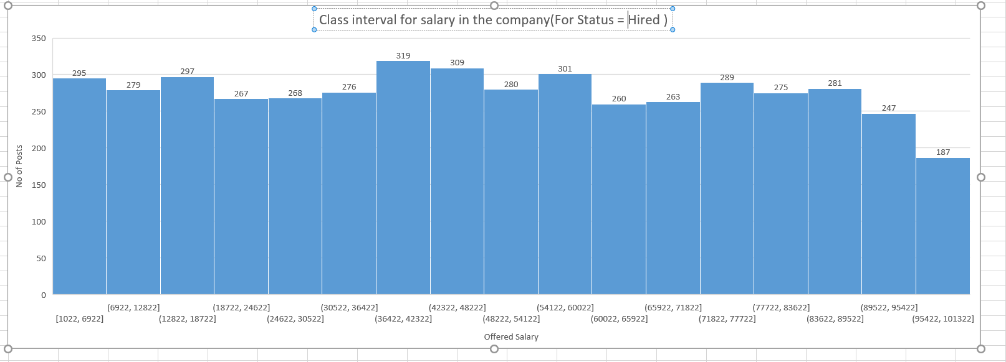
Salary Distribution
Class Intervals: The class interval is the difference between the upper class limit and the lower class limit.
Task : Create class intervals for the salaries in the company. This will help you understand the salary distribution.

Slide 6
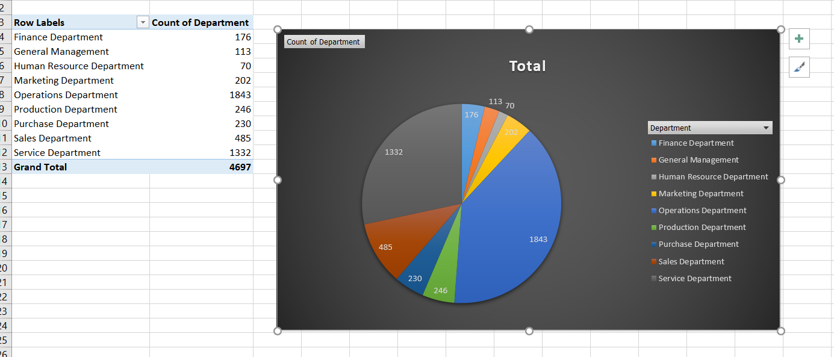
Departmental Analysis
Charts and Plots: This is one of the most important part of analysis to visualize the data.
Task : Use a chart or graph to represent the different position tiers within the company. This will help you understand the distribution of positions across different tiers.

Slide 7
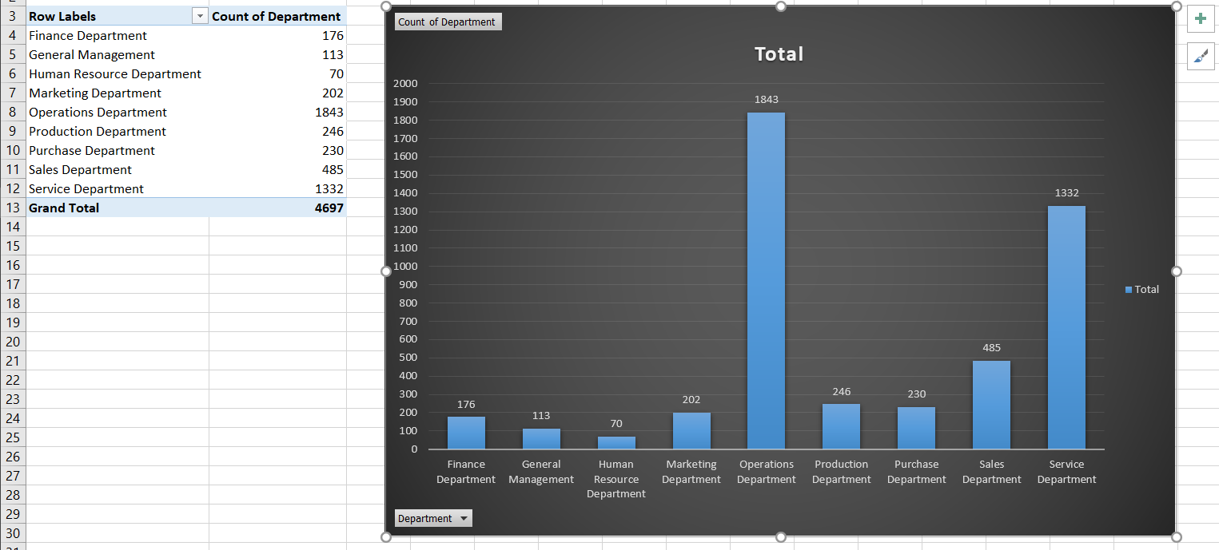
Departmental Analysis
Charts and Plots: This is one of the most important part of analysis to visualize the data.
Task : Use a chart or graph to represent the different position tiers within the company. This will help you understand the distribution of positions across different tiers.

Slide 8
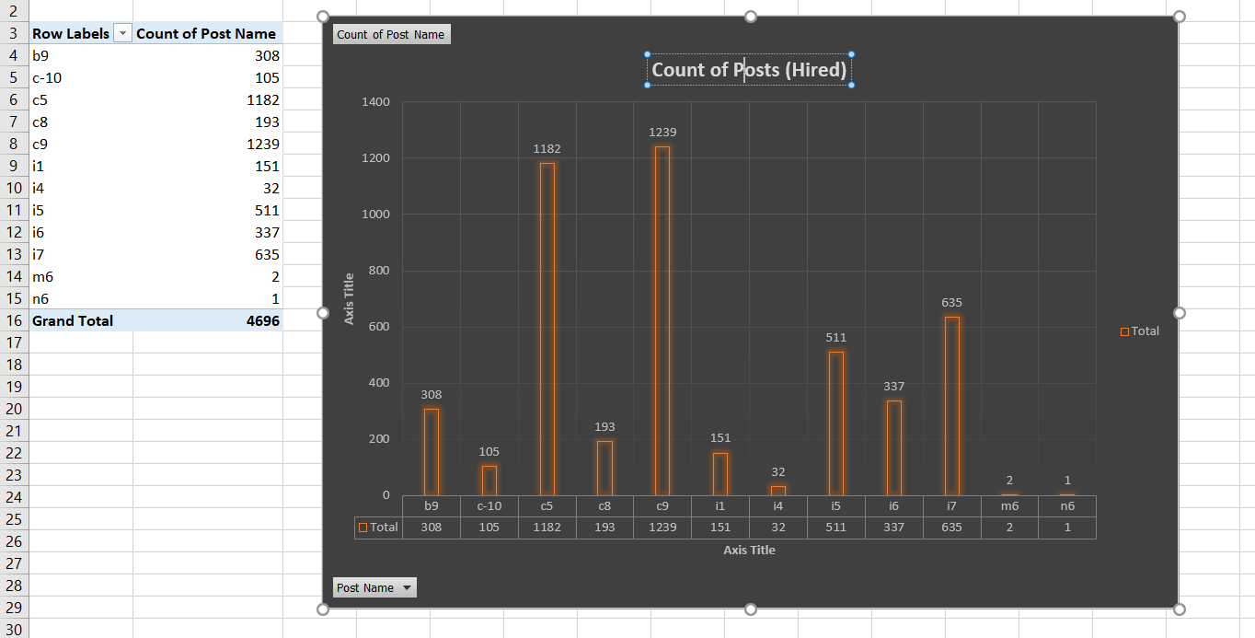
Position Tier Analysis : Charts(Hired)
Charts: Use different charts and graphs to perform the task representing the data.
Task: Use a chart or graph to represent the different position tiers within the company. This will help you understand the distribution of positions across different tiers.

Slide 9
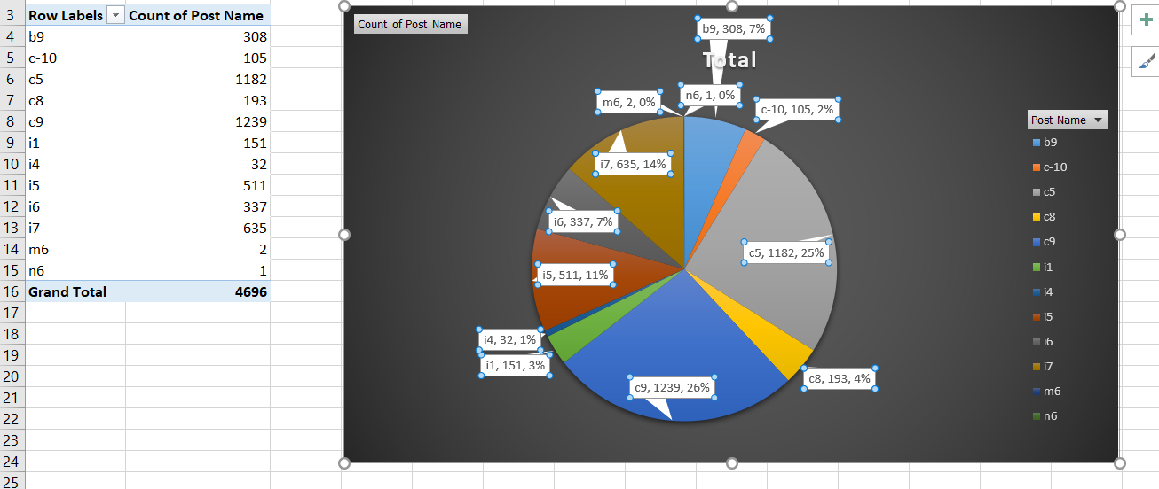
Position Tier Analysis : Charts(Hired)
Charts: Use different charts and graphs to perform the task representing the data.
Task: Use a chart or graph to represent the different position tiers within the company. This will help you understand the distribution of positions across different tiers.

Slide 10
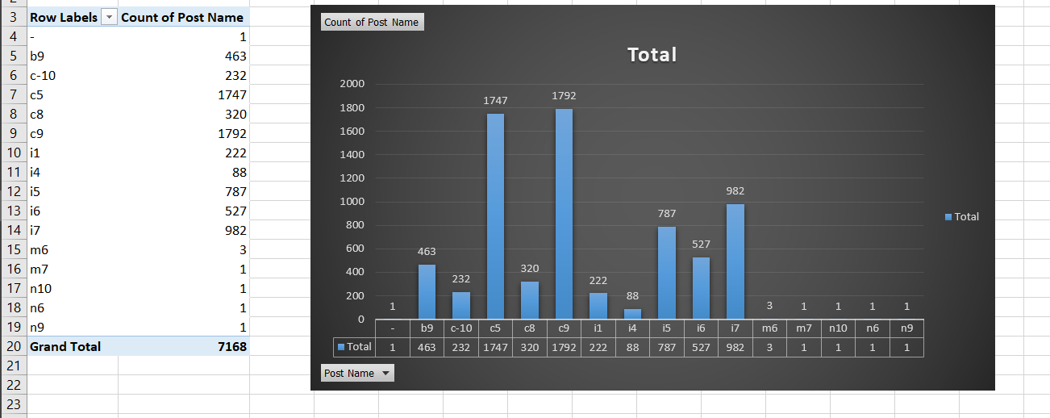
Position Tier Analysis :Charts(Hired+Rejected)
Charts: Use different charts and graphs to perform the task representing the data.
Task: Use a chart or graph to represent the different position tiers within the company. This will help you understand the distribution of positions across different tiers.

Slide 11
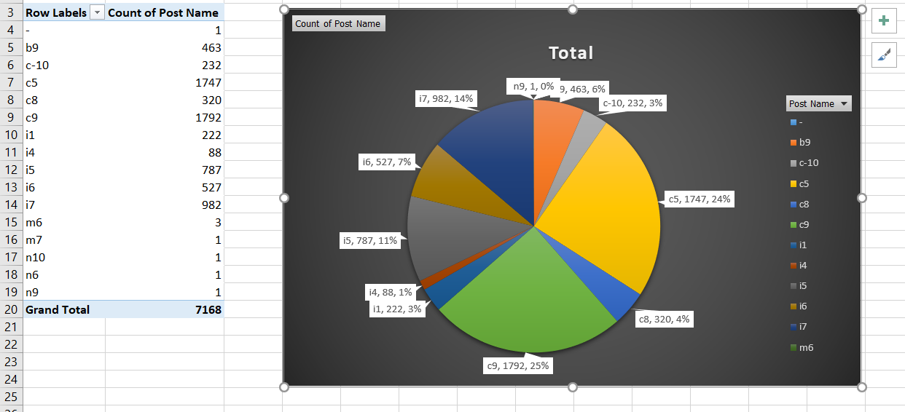
Position Tier Analysis :Charts(Hired+Rejected)
Charts: Use different charts and graphs to perform the task representing the data.
Task: Use a chart or graph to represent the different position tiers within the company. This will help you understand the distribution of positions across different tiers.

