Slide 1
Name : Hemant Pralhad Tikare
Email ID: hemanttikare2@gmail.com
Project 5: IMDB Movie Analysis
This ppt is a exploration of IMDB Movie Analysis based on analysis done on below points:-
1. Top 10 common Movie Genres: Analyze the distribution of movie genres and their impact on the IMDB score.
2. Movie Duration Assessment: Analyze the distribution of movie durations and its impact on the IMDB score.
3. Top 10 common Languages : Examine the distribution of movies based on their language.
4. Top 10 Best Directors : Influence of directors on movie ratings.
5. Top 5 Movies with Highest profit: Explore the relationship between movie budgets and their financial success.

Slide 2

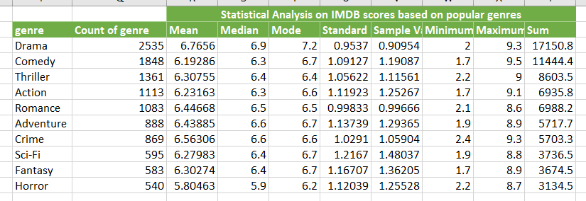



Movie Genre Analysis
Top 10 common Movie Genres: Analyze the distribution of movie genres and their impact on the IMDB score.
Task : Determine the most common genres of movies in the dataset. Then, for each genre, calculate descriptive statistics (mean, median, mode, range, variance, standard deviation) of the IMDB scores

Slide 3
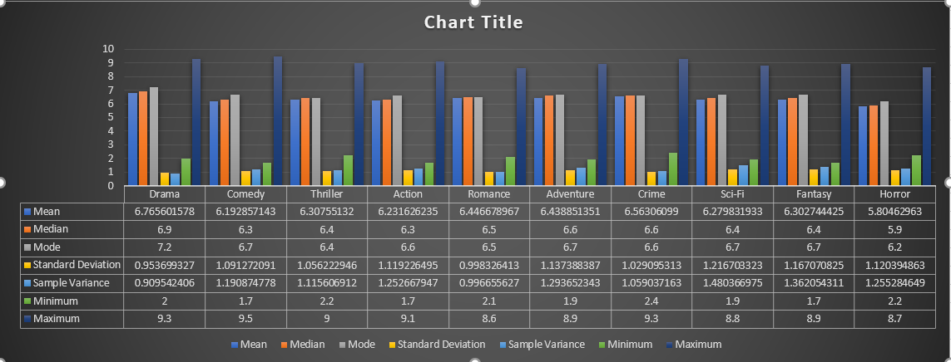
Movie Genre Analysis
Task : Determine the most common genres of movies in the dataset. Then, for each genre, calculate descriptive statistics (mean, median, mode, range, variance, standard deviation) of the IMDB scores.
Top 10 common Movie Genres : Analyze the distribution of movie genres and their impact on the IMDB score.

Slide 4
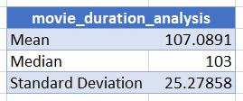
Movie Duration Analysis
Movie Duration Assessment : Analyze the distribution of movie durations and its impact on the IMDB score.
Task : Analyze the distribution of movie durations and identify the relationship between movie duration and IMDB score.

Slide 5
Movie Language Analysis
Top 10 common Languages : Examine the distribution of movies based on their language.
Task : Determine the most common languages used in movies and analyze their impact on the IMDB score using descriptive statistics.

Slide 6
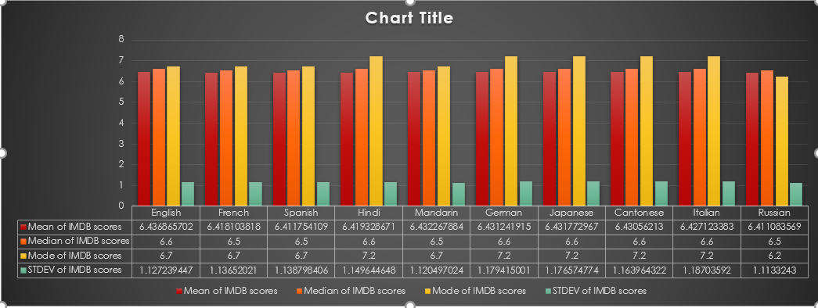
Movie Language Analysis
Following chart shows Statistical Analysis of various languages in which the movies are released.
Task : Determine the most common languages used in movies and analyze their impact on the IMDB score using descriptive statistics.

Slide 7
Movie Directors Analysis
Top 10 Best Directors : Influence of directors on movie ratings.
Task : Identify the top directors based on their average IMDB score and analyze their contribution to the success of movies using percentile calculations.
The given table shows top 10 directors based on the average of IMDB scores scored by all those movies directed by respective director

Slide 8
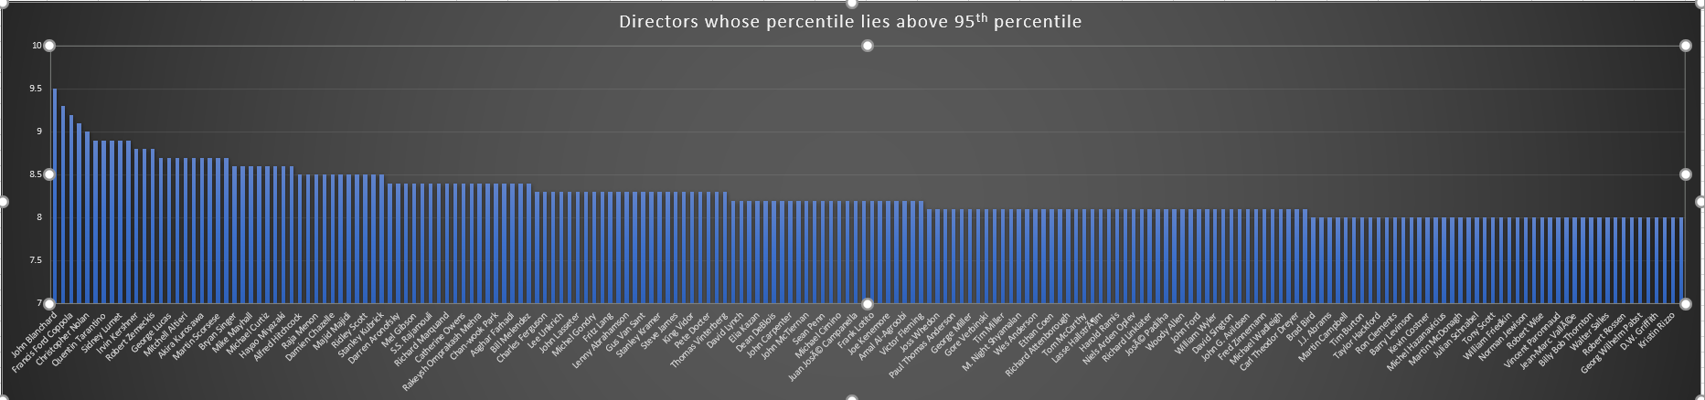
Movie Directors Analysis
Following chart shows those tops directors whose percentile lies above 95th percentile which is above 8 IMDB score.
Task : Identify the top directors based on their average IMDB score and analyze their contribution to the success of movies using percentile calculations.

Slide 9
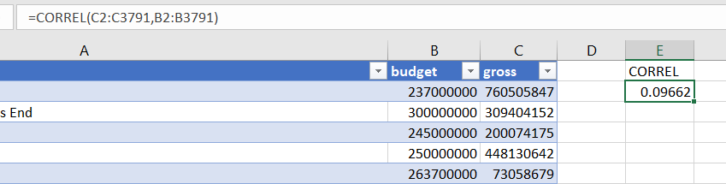
Movie Budget Analysis
Top 5 Movies with Highest profit: Explore the relationship between movie budgets and their financial success.
Task : Analyze the distribution of movie durations and identify the relationship between movie duration and IMDB score.
Correlation coefficient between movie budgets and gross earnings is 0.096619736
Top 10 highest profit margin movies are shown in given Table

Slide 10
Movie Budget Analysis
Following chart shows Budget, Gross and Profit earned by top 10 movies
Task : Analyze the distribution of movie durations and identify the relationship between movie duration and IMDB score.

