Slide 1
Name : Hemant Pralhad Tikare
Email ID: hemanttikare2@gmail.com
Project 6: ABC Call Volume Trend Analysis
Project Description:
The attached dataset is of Inbound calls of an ABC company from the insurance category consists of a Customer Experience (CX) Inbound calling team for 23 days. Data includes Agent_Name, Agent_ID, Queue_Time [duration for which customer have to wait before they get connected to an agent], Time [time at which call was made by customer in a day], Time_Bucket [for easiness we have also provided you with the time bucket], Duration [duration for which a customer and executives are on call, Call_Seconds [for simplicity we have also converted those time into seconds], call status (Abandon, answered, transferred).
A customer experience (CX) team consists of professionals who analyze customer feedback and data, and share insights with the rest of the organization. Typically, these teams fulfil various roles and responsibilities such as: Customer experience programs (CX programs), Digital customer experience, Design and processes, Internal communications, Voice of the customer (VoC), User experiences, Customer experience management, Journey mapping, Nurturing customer interactions, Customer success, Customer support, Handling customer data, Learning about the customer journey.
Interactive Voice Response (IVR), Robotic Process Automation (RPA), Predictive Analytics, Intelligent Routing are some of the most impactful AI-empowered customer experience tools we can use in this project.
In a Customer Experience team there is a huge employment opportunities for Customer service representatives A.k.a. call center agents, customer service agents. Some of the roles for them include Email support, Inbound support, Outbound support, social media support.
Inbound customer support is defined as the call center which is responsible for handling inbound calls of customers. Inbound calls are the incoming voice calls of the existing customers or prospective customers for our business which are attended by customer care representatives. Inbound customer service is the methodology of attracting, engaging, and delighting our customers to turn them into our business' loyal advocates. By solving our customers' problems and helping them achieve success using our product or service, we can delight our customers and turn them into a growth engine for our business

Slide 2
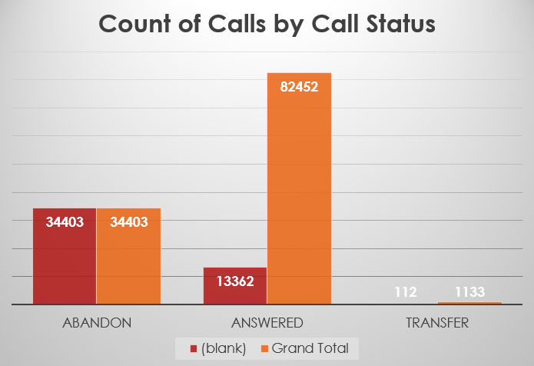
DATA CLEANING
We see that we have N/A in the Agent Name and Agent ID Columns. These N/A’s are not abnormal values these are for the calls which were Abandon. Since the calls were abandon & had no call duration, hence they were not transferred to any agent and hence they do not have any Agent ID or Agent Name.
We then analyze Null values in Wrapped By column. As we can see in the chart, all the abandon calls are Nulls, these were replaced by Abandoned Call. The Nulls in answered & transfer category were replaced by Mode (Agent).

Slide 3
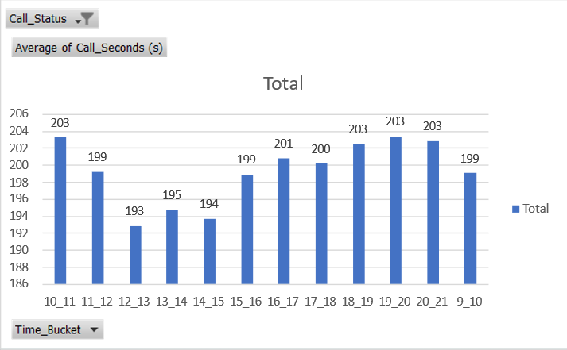
A. Calculate the average call time duration for all incoming calls received by agents (in each Time_Bucket).

Slide 4
Insights:
In the given data analysis scenario, the Time_Bucket is measured in the Rows, the average of Call_Seconds is measured in the Values section, and the Call_Status is placed in the Filters section.
Throughout the data, the total average call time duration for calls answered by the agents is calculated to be 198.6 seconds.
Further analysis reveals that the average call time duration for incoming calls received by agents is highest between 10 am to 11 am and from 7 pm to 8 pm.
Conversely, the average call time duration for incoming calls received by agents is found to be the least between 12 noon to 1 pm.
These insights provide valuable information about the distribution of call durations throughout the day, helping to identify peak and off-peak periods in terms of call handling.

Slide 5
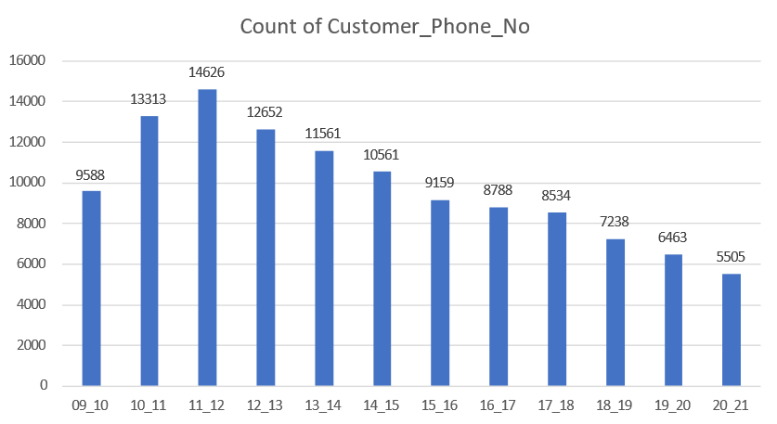
B. Show the total volume/ number of calls coming in via charts/ graphs [Number of calls v/s Time]. You can select time in a bucket form (i.e., 1-2, 2-3, …..)

Slide 6
Insights:
In the given data analysis scenario, we plotted the Time_Bucket in the rows and measured the count of Customer_Phone_No and count of Time in the Values section. We expressed the count of Time as a percentage of the column total.
Based on the analysis, it was observed that customers make the highest number of calls between 11 am to 12 noon. This time period sees the highest customer engagement and interaction.
On the other hand, the analysis also revealed that customers make the least number of calls between 8 pm to 9 pm. During this time, there is a decrease in customer call activity, possibly due to various factors such as dinner time or reduced availability of customer service.
These insights provide valuable information about customer call patterns throughout the day, highlighting peak and low activity periods. This information can be used to optimize staffing and resources to ensure efficient customer service and satisfaction.

Slide 7
C. As we can see current abandon rate is approximately 30%. Propose a manpower plan required during each time bucket [between 9am to 9pm] to reduce the abandon rate to 10%. (i.e., We must calculate minimum number of agents required in each time bucket so that at least 90 calls should be answered out of 100.)
Assumptions & Calculations :
Work Hours : | 9
Break : | 1.5
Actual Working Hours : | 7.5
Occupancy : | 60%
Total Working Seconds as per Occupancy: | 16200
Average Call Time/Agent : | 199
Call Capacity of an Agent/day : | 81
Call Capacity of an Agent/Hour : | 18

Slide 8
C. As we can see current abandon rate is approximately 30%. Propose a manpower plan required during each time bucket [between 9am to 9pm] to reduce the abandon rate to 10%. (i.e., We must calculate minimum number of agents required in each time bucket so that at least 90 calls should be answered out of 100.)
The graph represents the abandon percentage of the calls according to the time bucket, and an interesting trend is that the abandon percentage of the calls between 12- 8 PM is almost half that of other time buckets. The management has to take a good look as to why the abandon percentage is so high during the other time buckets.

Slide 9
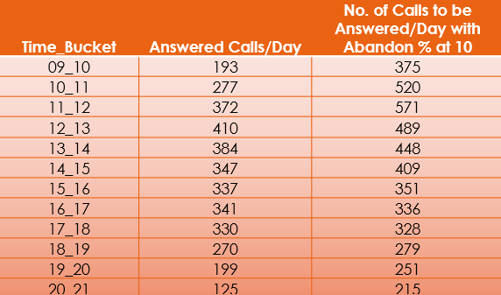
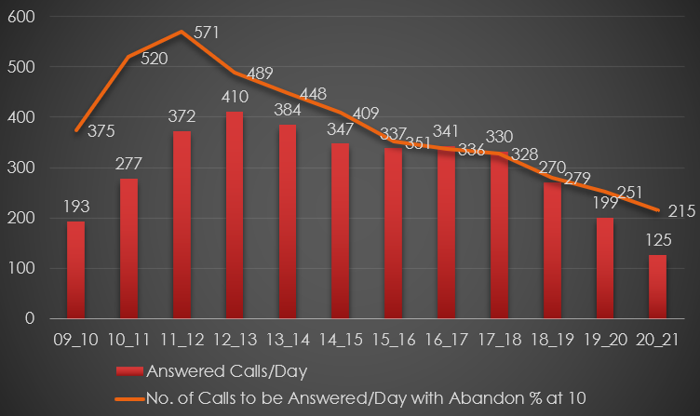
C. As we can see current abandon rate is approximately 30%. Propose a manpower plan required during each time bucket [between 9am to 9pm] to reduce the abandon rate to 10%. (i.e., We must calculate minimum number of agents required in each time bucket so that at least 90 calls should be answered out of 100.)
In the table above, we see the comparison of current calls Vs the updated call numbers per day for each time bucket as per the new Abandon Rate. Based on which we’d be calculating the number of Agents needed in each time bucket.

Slide 10
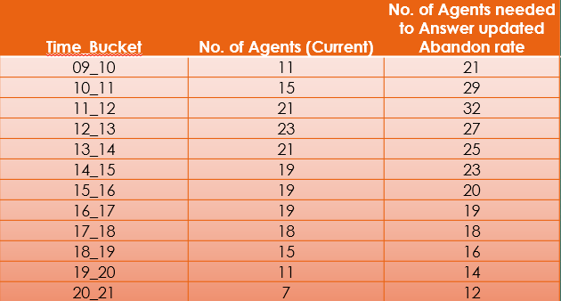
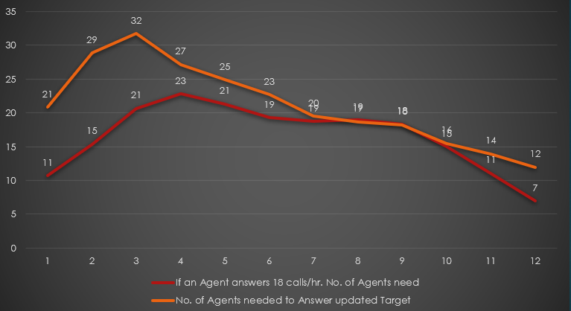
Manpower Plan for the Day :
In the table above, we see the comparison of current calls Vs the updated call numbers per day for each time bucket as per the new Abandon Rate. Based on which we’d be calculating the number of Agents needed in each time bucket.

Slide 11
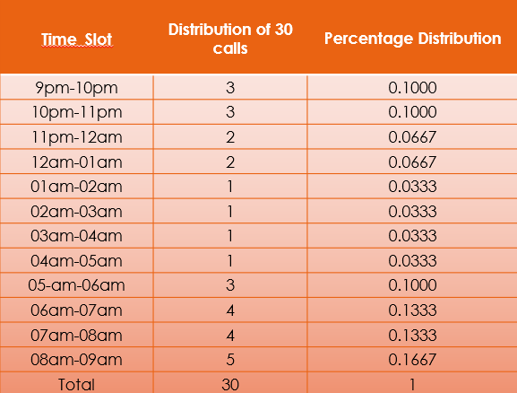
Let’s say customers also call this ABC insurance company in night but didn’t get answer as there are no agents to answer, this creates a bad customer experience for this Insurance company. Suppose every 100 calls that customer made during 9 Am to 9 Pm, customer also made 30 calls in night between interval [9 Pm to 9 Am] and distribution of those 30 calls are as follows:
Now propose a manpower plan required during each time bucket in a day. Maximum Abandon rate assumption would be same 10%.

Slide 12
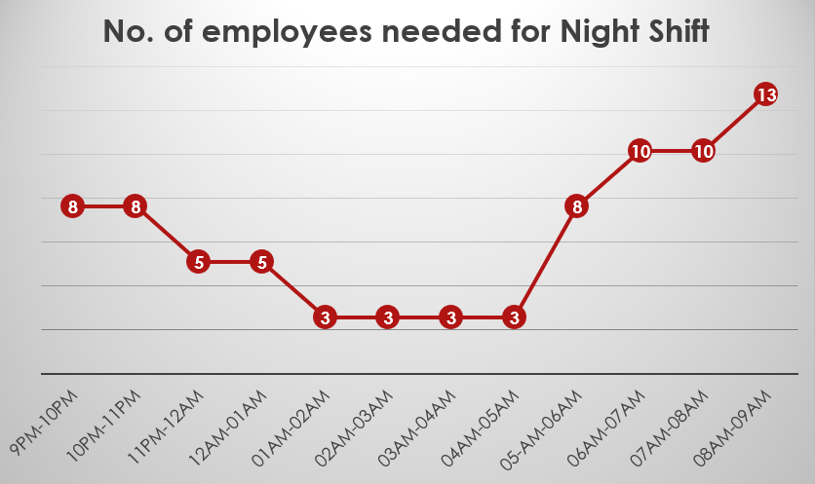
Manpower Plan for an Night :
Calculations :
Total Calls answered with 10% abandon rate on an average/day : 4573
We know 30% of calls received during the day are received during Night Hence calculating the expected calls during night
Total Calls answered on an average/night : 4573*0.3 = 1372
Multiplying the Total Calls with percentage distribution, we get the total calls expected/time slot.
As we know the number of calls an Agent can answer/hr. is 18, dividing the No. of Calls by 18, we get the number of agents required.

Slide 13
Manpower Plan for an Entire Day :

