Slide 1

Exploratory Data Analysis
Hate speech detection

Slide 2

Agenda
Problem Statement
EDA
EDA Summary
Recommendations

Slide 3
Background
Group Name: The Survivor
Names: Abdelrahman Atef Abouzid
Email: Hemanysat@gmail.com
Country: Egypt
College: Ain Shams University
Specialization: NLP
Data storage location: hemany1/Hate-speech-classification (github.com)
Problem Statement
The term hate speech is understood as any type of verbal, written or behavioural communication that attacks or uses derogatory or discriminatory language against a person or group based on what they are, in other words, based on their religion, ethnicity, nationality, race, colour, ancestry, sex or another identity factor. In this problem, We will take you through a hate speech detection model with Machine Learning and Python.

Slide 4
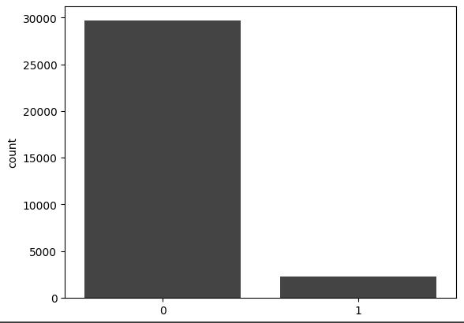
EDA
. This problem is important for businesses and organizations that rely on social media for communication and marketing, as hate speech can damage their reputation and negatively impact their customer base. By developing a hate speech classifier, businesses can proactively address hate speech and take appropriate actions to ensure that their online community remains inclusive and respectful. Additionally, the hate speech classifier can be used by social media platforms to automatically identify and remove hate speech content, which can improve user experience and mitigate the negative impact of hate speech on their platform.
Hate speech distribution in tweets

Slide 5
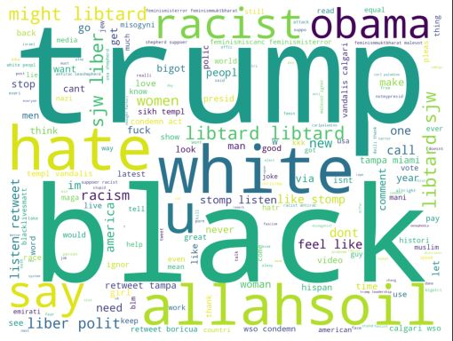
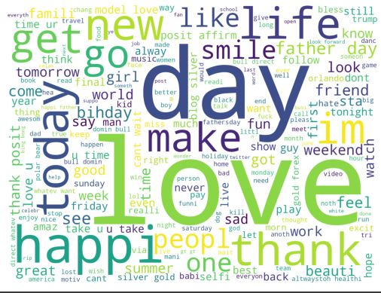
EDA
The man goal is to reach a world with no hate.

Slide 6
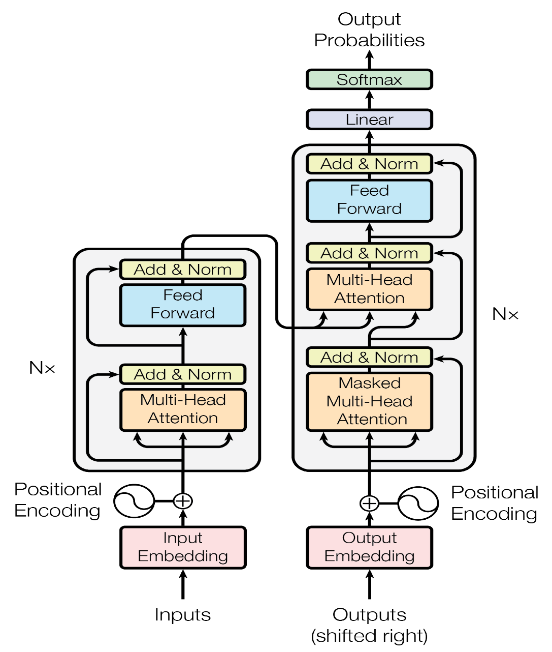
EDA
Model Recommendation:
I recommend building a custom hate speech detection model from scratch using PyTorch to optimize for the specific task requirements and potentially incorporate domain-specific knowledge.

Slide 7
Thank You

