Slide 1

Exploratory Data Analysis
Hate speech detection

Slide 2

Agenda
Problem Statement
EDA
EDA Summary
Preprocessing
Modeling
Evaluation

Slide 3
Background
Group Name: The Survivor
Names: Abdelrahman Atef Abouzid
Email: Hemanysat@gmail.com
Country: Egypt
College: Ain Shams University
Specialization: NLP
Data storage location: hemany1/Hate-speech-classification (github.com)
Problem Statement
The term hate speech is understood as any type of verbal, written or behavioural communication that attacks or uses derogatory or discriminatory language against a person or group based on what they are, in other words, based on their religion, ethnicity, nationality, race, colour, ancestry, sex or another identity factor. In this problem, We will take you through a hate speech detection model with Machine Learning and Python.

Slide 4
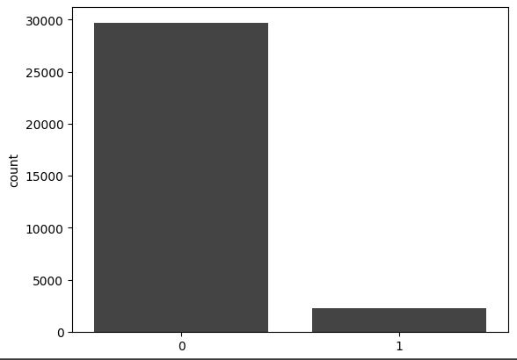
EDA
. This problem is important for businesses and organizations that rely on social media for communication and marketing, as hate speech can damage their reputation and negatively impact their customer base. By developing a hate speech classifier, businesses can proactively address hate speech and take appropriate actions to ensure that their online community remains inclusive and respectful. Additionally, the hate speech classifier can be used by social media platforms to automatically identify and remove hate speech content, which can improve user experience and mitigate the negative impact of hate speech on their platform.
Hate speech distribution in tweets

Slide 5
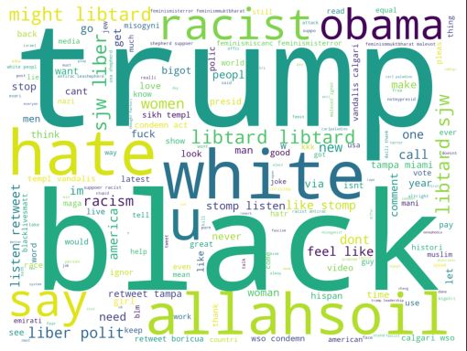
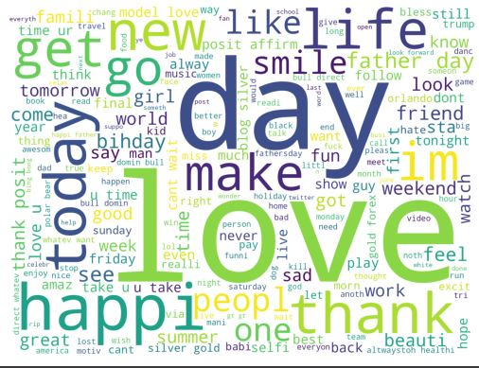
EDA
The man goal is to reach a world with no hate.

Slide 6
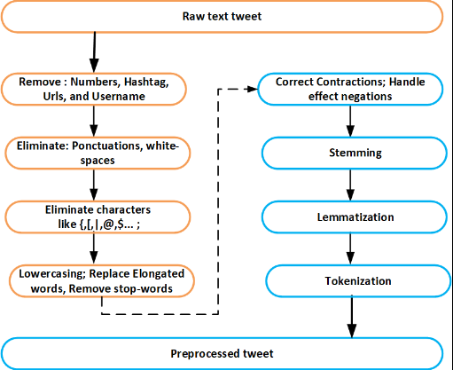
Preprocessing
The preprocessing steps may include tasks such as tokenization, stop word removal, stemming or lemmatization, removing punctuation and special characters, converting text to lowercase, and dealing with misspellings and abbreviations. These techniques help to standardize the text and reduce the number of unique features, making it easier for machine learning models to handle.
In this project, I applied text preprocessing on the tweets before splitting the data into train and validation sets.

Slide 7
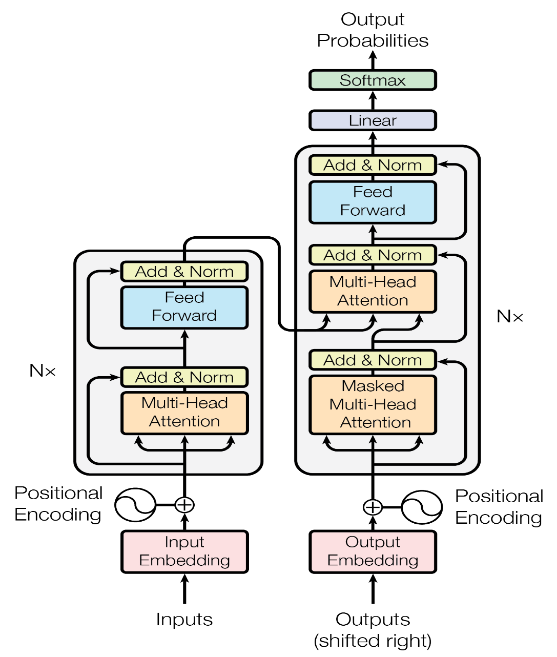
Modeling 1
The first model I used is a neural network that uses a transformer-based architecture built from scratch to analyze input text and predict whether it contains hate speech.
The model takes in a sequence of text and applies two embedding layers to map each word in the input sequence to a vector representation, and add information about the position of each word in the sequence. The embeddings are concatenated to form the input sentence, which is then passed through a transformer encoder layer.
The transformer encoder layer applies a series of self-attention operations to the input sentence, allowing the model to capture complex relationships between words in the sentence. The output of the transformer layer is then passed through two linear layers, followed by a sigmoid activation function that produces a probability score between 0 and 1, indicating the likelihood that the input sequence contains hate speech.
During training, the model uses cross-entropy loss to minimize the difference between predicted and actual labels. To achieve good performance, the model needs to be trained on a large, diverse dataset of labeled examples of hate speech.

Slide 8

Modeling 2
The second model is a pre-trained model for text classification. Specifically, it is the BERT (Bidirectional Encoder Representations from Transformers) model, which is a state-of-the-art pre-trained language model developed by Google. BERT has been pre-trained on a large corpus of text data and has shown to be highly effective in various natural language processing tasks, including text classification. In this code, the pre-trained BERT model is fine-tuned on a dataset of labeled tweets to perform binary classification of whether a tweet contains hate speech or not.
The code first splits the labeled tweet dataset into training and validation sets. Then, it uses the BERT tokenizer to encode the text data by converting them into numerical vectors that can be inputted into the BERT model. The encoded data is further split into training and validation datasets and converted into PyTorch tensors. The code then creates PyTorch dataloaders to feed the data into the model for training and evaluation. The BERT model is loaded with the 'bert-base-uncased' configuration and is set up for sequence classification with two output labels (hate speech or not). The AdamW optimizer is used with a learning rate of 2e-5 to optimize the model.
The model's performance is evaluated based on the validation loss and F1 score, which is a measure of the model's accuracy and balance between precision and recall.

Slide 9

Evaluation
The evaluation of the two models provided shows that the second model outperformed the first one with an F1 score of 0.88, while the first model had an F1 score of 0.66. The reason for this difference in performance can be attributed to several factors.
Firstly, the second model is a pre-trained BERT model, which has been trained on a massive amount of text data, allowing it to learn a wide range of language patterns and features. On the other hand, the first model was a simple neural network that was trained from scratch, which can limit its ability to learn complex language features.
Secondly, the second model was trained for only 10 epochs, while the first model was trained for 100 epochs. This is because the pre-trained BERT model can quickly adapt to new tasks with only a few epochs of fine-tuning. In contrast, the first model needed more epochs to improve its performance as it did not have the initial knowledge of language features.
Overall, the evaluation shows that the pre-trained BERT model outperformed the first model, and this can be attributed to its ability to learn complex language features and its efficient fine-tuning process, which requires fewer epochs than a model trained from scratch.

Slide 10
Thank You

