Slide 1
EMPLOYEE DEPARTMENT DETAILS
HEMAVATHI RAMALINGAM
(176292)
04/04/2019

Slide 2
PROBLEM STATEMENT
Identify functions that you are required to code for the existing employee class to implement the following requirements:
Display employee id when given an employee name
Display an employee detail based on employee id
Display employee names based on department name

Slide 3
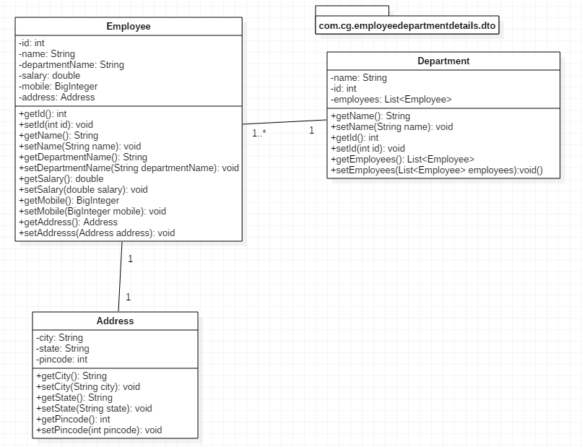
Dto

Slide 4
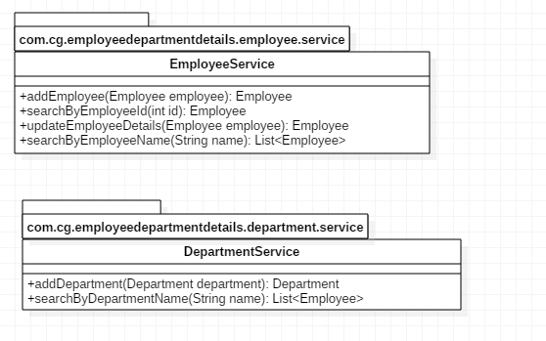
Service

Slide 5
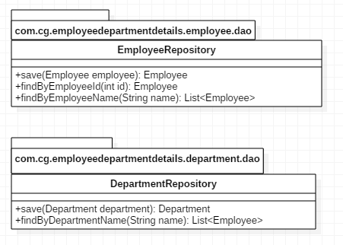
Repository

Slide 6
Thank you

