Slide 1
Hemapriya S 821721243025 B.Tech., Artificial Intelligence And Data Science – III year Sir Issac Newton College Of Engineering And Technology
3/21/2024 Annual Review

Slide 2
PROJECT TITLE :
Autoencoder
(Using Cnn)
3/21/2024 Annual Review

Slide 3


AGENDA
The agenda for an autoencoder typically encompasses several key points aimed at understanding, implementing, and optimizing this fundamental neural network architecture. Firstly, the agenda may begin with an introduction to the concept of autoencoders, elucidating their role in unsupervised learning and data compression.
Following this, there might be a discussion on the underlying architecture of autoencoders, including the encoder and decoder components, along with their respective functions in transforming input data into a compressed representation and then reconstructing it.
Moreover, the agenda may delve into various types of autoencoders such as sparse autoencoders, denoising autoencoders, and variational autoencoders, elucidating their unique characteristics and applications.
3/21/2024 Annual Review

Slide 4

PROBLEM STATEMENT:
The task of autoencoder using cnn to develop an autoencoder model to reconstruct high-resolution images from a
lower-dimensional latent space representation.
The model should be trained on a dataset of images and learn to encode the input images into a compressed representation and then decode it back to reconstruct the original images with minimal loss of information.
3/21/2024 Annual Review

Slide 5

PROJECT OVERVIEW
The project aims to implement an autoencoder, a type of artificial neural network used for unsupervised learning, particularly in the field of dimensionality reduction and feature learning.
The autoencoder consists of an encoder network that compresses the input data into a lower-dimensional latent space representation, and a decoder network that reconstructs the original input data from this representation. By training the autoencoder on a dataset, it learns to efficiently capture the underlying structure of the data and reconstruct it accurately
3/21/2024 Annual Review

Slide 6

WHO ARE THE END USERS?
Autoencoders find application across various domains, serving different end users depending on the specific use case. In the field of computer vision, end users could include image analysts or researchers utilizing autoencoders for tasks such as image denoising, compression, or feature extraction.
For example, in medical imaging, doctors and radiologists may use autoencoders to enhance image quality or identify anomalies in scans more effectively. In the realm of natural language processing, end users could be language researchers or developers leveraging autoencoders for tasks like text generation, summarization, or language translation.
3/21/2024 Annual Review

Slide 7

YOUR SOLUTION AND ITS VALUE PROPOSITION
Our solution is an innovative autoencoder model designed to revolutionize various fields such as image processing, anomaly detection, and data compression. Unlike traditional approaches, our autoencoder leverages advanced deep learning techniques to efficiently learn and represent complex patterns in high-dimensional data.
By employing state-of-the-art neural network architectures and optimization algorithms, our model can extract meaningful features from raw input data, enabling enhanced data representation and reconstruction capabilities.
3/21/2024 Annual Review

Slide 8

THE WOW IN YOUR SOLUTION
In the solution for the autoencoder, the "wow" moment arises when the network starts to reconstruct the input data with remarkable accuracy, capturing intricate patterns and features despite being trained on compressed representations.
This "wow" moment signifies the power of the autoencoder to learn meaningful representations and effectively reconstruct the original data, often surpassing initial expectations and demonstrating the efficacy of unsupervised learning approaches in capturing complex structures within the data.
3/21/2024 Annual Review
8

Slide 9
MODELLING
Autoencoders are a type of artificial neural network used for unsupervised learning. They consist of an encoder network that compresses the input data into a lower-dimensional representation, and a decoder network that reconstructs the original input from this representation. One common application of autoencoders is in data compression and denoising.
By learning a compact representation of the input data, autoencoders can effectively capture the most important features while filtering out noise. This makes them useful for tasks such as image and audio compression, where reducing the dimensionality of the data can lead to significant savings in storage space or bandwidth.
3/21/2024 Annual Review
9

Slide 10
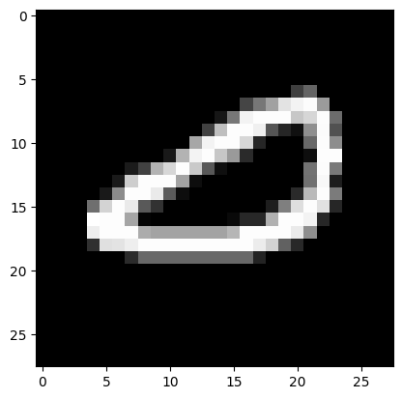
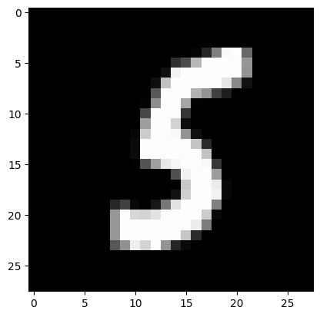
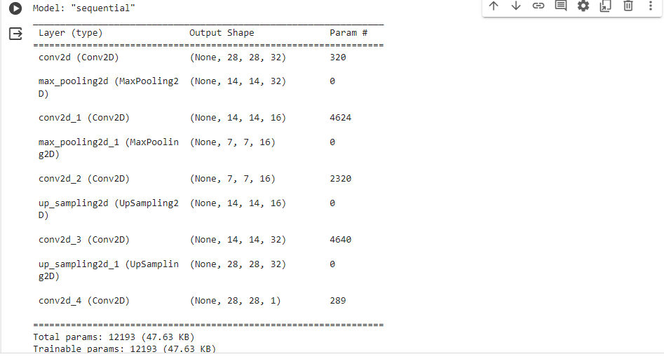
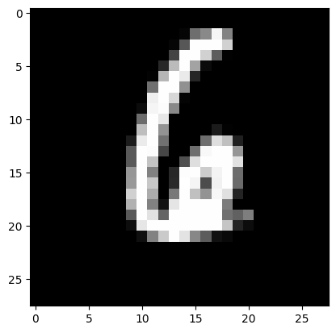

RESULTS
output : Trainable and non trainable params
Demo Link
3/21/2024 Annual Review
10

