Slide 1
Employee Data Analysis using Excel
STUDENT NAME: HEMA PRIYA M
REGISTER NO:312209798
DEPARTMENT:B.COM COMPUTER APPLICATIONS
COLLEGE:ANNA ADARSH COLLEGE FOR WOMEN

Slide 2
PROJECT TITLE
Employee Performance Analysis using Excel

Slide 3


AGENDA
Problem Statement
Project Overview
End Users
Our Solution and Proposition
Dataset Description
Modelling Approach
Results and Discussion
Conclusion
3/21/2024 Annual Review

Slide 4

PROBLEM STATEMENT
In modern organizations, effectively assessing and managing employee performance is crucial for maintaining productivity and achieving strategic goals. Traditional performance review methods can be cumbersome and often lack comprehensive insights into employee effectiveness. This project aims to address these challenges by leveraging Excel to analyze and visualize employee performance data, providing actionable insights for better decision-making.

Slide 5

PROJECT OVERVIEW
The project involves developing an Excel-based system to analyze employee performance metrics. By utilizing advanced Excel functions and features, the system will enable organizations to evaluate employee performance, identify high performers, and pinpoint areas needing improvement. The goal is to streamline the performance review process and offer data-driven recommendations to enhance overall organizational efficiency.

Slide 6

WHO ARE THE END USERS? 1.HR Manager: To facilitate efficient performance reviews and identity training needs. 2.Senior Management: To make Strategic decisions regarding promotion,bonuses and resource allocation. 3.Employees: To gain insights into their performance and understand areas for improvement. 4.Team Leaders:To monitor team performance and recognize top performer
.

Slide 7

OUR SOLUTION AND ITS VALUE PROPOSITION
We propose an Excel-based performance analysis tool that integrates various performance metrics into a cohesive dashboard. Key features will include:
Data Input and Management: Simple data entry forms for performance metrics such as productivity, attendance, and quality of work.
Performance Metrics Calculation: Automated calculations for key performance indicators (KPIs) using Excel formulas and functions.
Visualizations: Dynamic charts and graphs to represent performance trends and comparisons.
Reports and Dashboards: Interactive dashboards to summarize performance data and generate reports for review.

Slide 8
Dataset Description
Employee dataset from kaggle
26 features available, but considered only 9 features,They are:
EmpID = Numeric
FirstName = Text
LastName = Text
BusinessUnit = Text
EmployeeStatus = Text
EmployeeType = Text
EmployeeClassificationType = Text
Performance Score = Text
Current Employee Rating = Numeric

Slide 9

THE "WOW" IN OUR SOLUTION
In developing our Excel-based Employee Performance Analysis tool, we have integrated several innovative features that set our solution apart from traditional performance review systems. The "wow" factors of our solution include:
Performance level Calculation:
=IFS(Z2>=5,”very high”,Z2>=4,”high”,Z2>=3,”med”,”True”,”Low”)
3/21/2024 Annual Review
9

Slide 10
MODELLING
Data Collection:
1) Download data from Skillsbuild platform.
2) Extracted the Zip. File.
3) Save the data into a excel file.
Feature Collection:
1) 26 Features in the dataset,but selected only 9 out of it.
Data Cleaning:
1) Highlighted the Missing Value in the given Dataset using Condiional Formatting.
2) Filtered the Blank cells using filter option.
Performance Level Calculation:
1) Using =IFS(Z2>=5,”very high”,Z2>=4,”high”,Z2>=3,”med”,”True”,”Low”) formula we calculated the Performance level.
2) Using Autofill we done the same thing to other rows.
Pivot Table:
We summarized the dataset.
Graph Chart:
1) Data visualization.
10

Slide 11
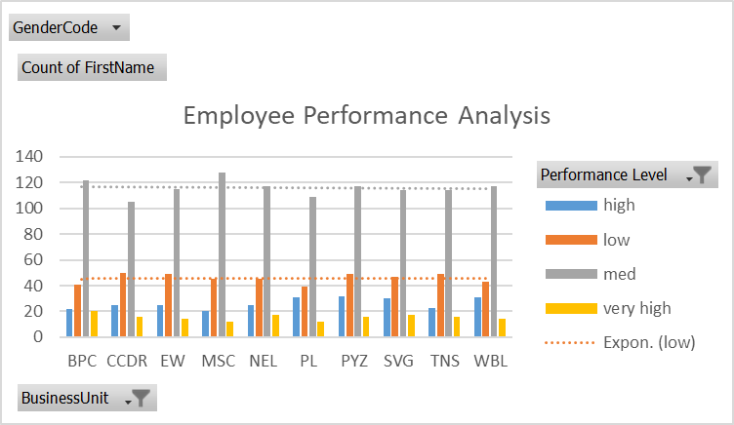
RESULTS
11

Slide 12
conclusion
The Excel-based performance analysis tool effectively streamlines the process of evaluating employee performance. By automating calculations, visualizing data, and providing actionable insights, it supports HR managers, team leaders, and senior management in making informed decisions. This approach not only enhances the performance review process but also contributes to the overall improvement of organizational productivity and employee satisfaction.

