Slide 1




ZOMATO_REVIEWSYSTEM

Slide 2

AGENDA
IntroDUCTION
Problem statement
Procedure to analysis
Importing data
Data cleaning
Algorithm
Conclusion
references

Slide 3
ZOMATO is India’s largest and most successful startup company where food industry meets technology and connects thousands of restaurant with one thread.
Listed with more than 1.5 millions restaurants in 23 countries and still counting..
Over 2000 passionate and strong ZOMANS in 23countries representing 32 nationalities and become a more attractive Employer.

Slide 4
Problem statement
To predict the review of the restaurtant given by customers as postive or negative or neutral on the basis of collected dataset of zomato system

Slide 5


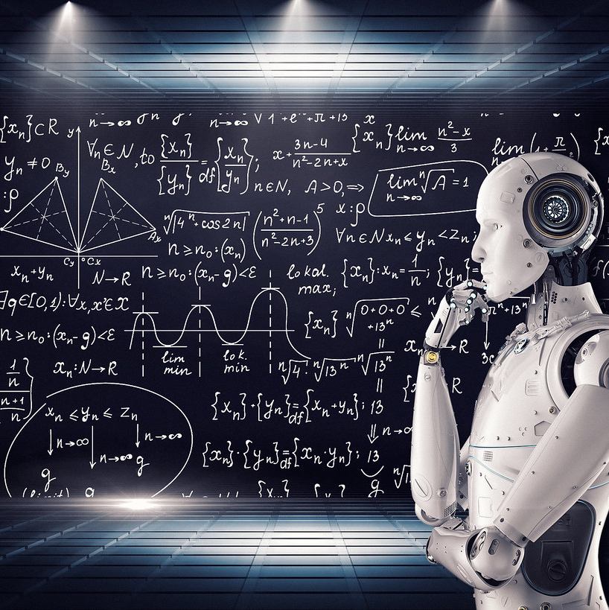



Procedure to analysis
DATA COLLECTION
IMPORTING DATA
DATA CLEANING
Applying the algorithm
Predicting output
: The Data Collection is a process by which the researcher collects the information from all the relevant sources to find answers to the research problem, test the hypothesis and evaluate the outcomes.
By using pandas library we imported the csv file
Cleaning and filling the data by classifying the imported data
A sequence of steps to be carried out for a required output from a certain given input
Which gives the required output

Slide 6
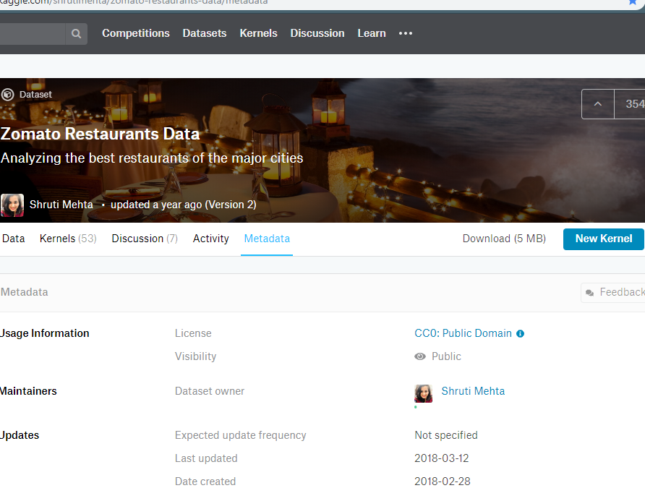
DATA COLLECTION
https://www.kaggle.com/shrutimehta/zomato-restaurants-data/data#zomato.csv
The data was duly collected from the above link and reverified for changed attributes by visiting different zomato APIs and checking for latest changes

Slide 7
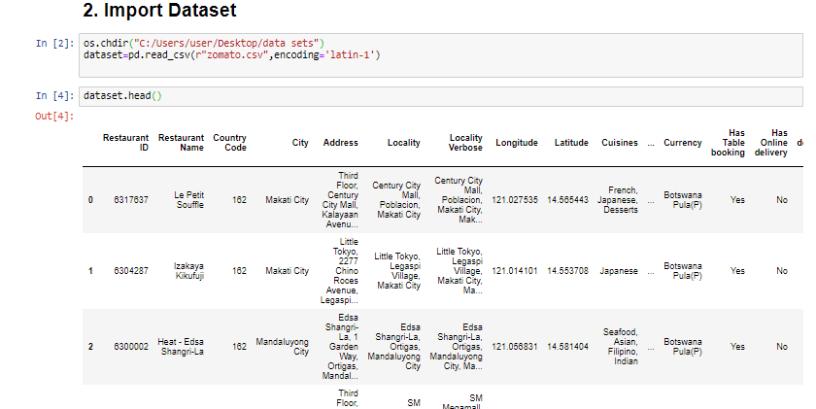
IMPORTING DATA

Slide 8
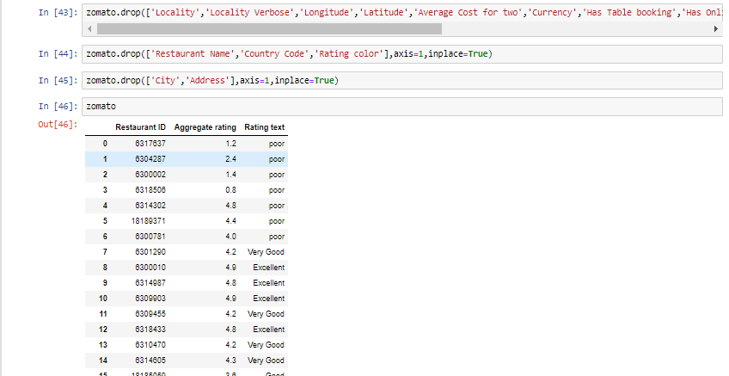
Data cleaning

Slide 9
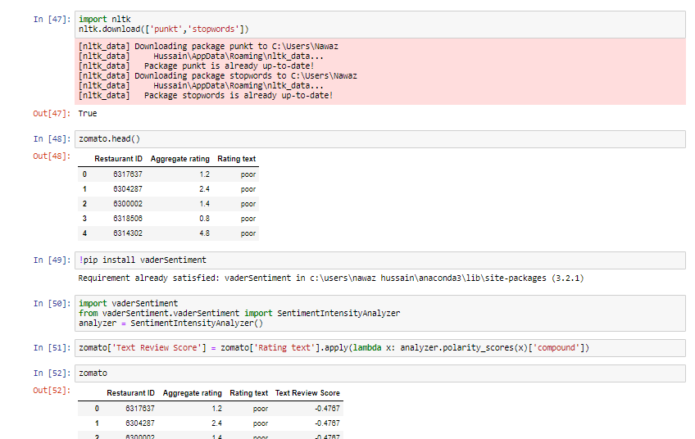
algorithm
Install VaderSentiment and Import Sentiment Intensity Analyzer
Using VanderSentiment Assign the scores to the text and label them.
Predict the system on basis of scores

Slide 10
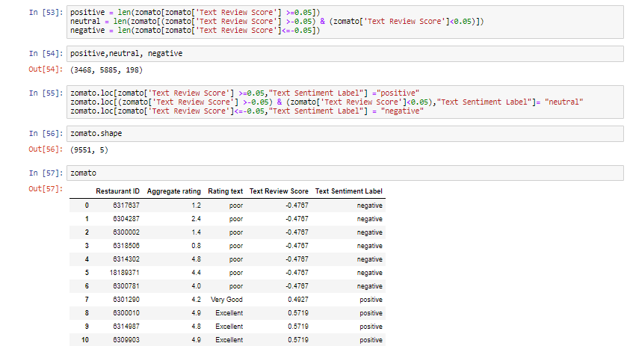
Applying the algorithm

Slide 11

Conclusion
The conclusion of the Project “ ZOMATO REVIEW SYSTEM” is Prediction of Customer reviews whether they are positive or negative on the basis of ratings.

Slide 12
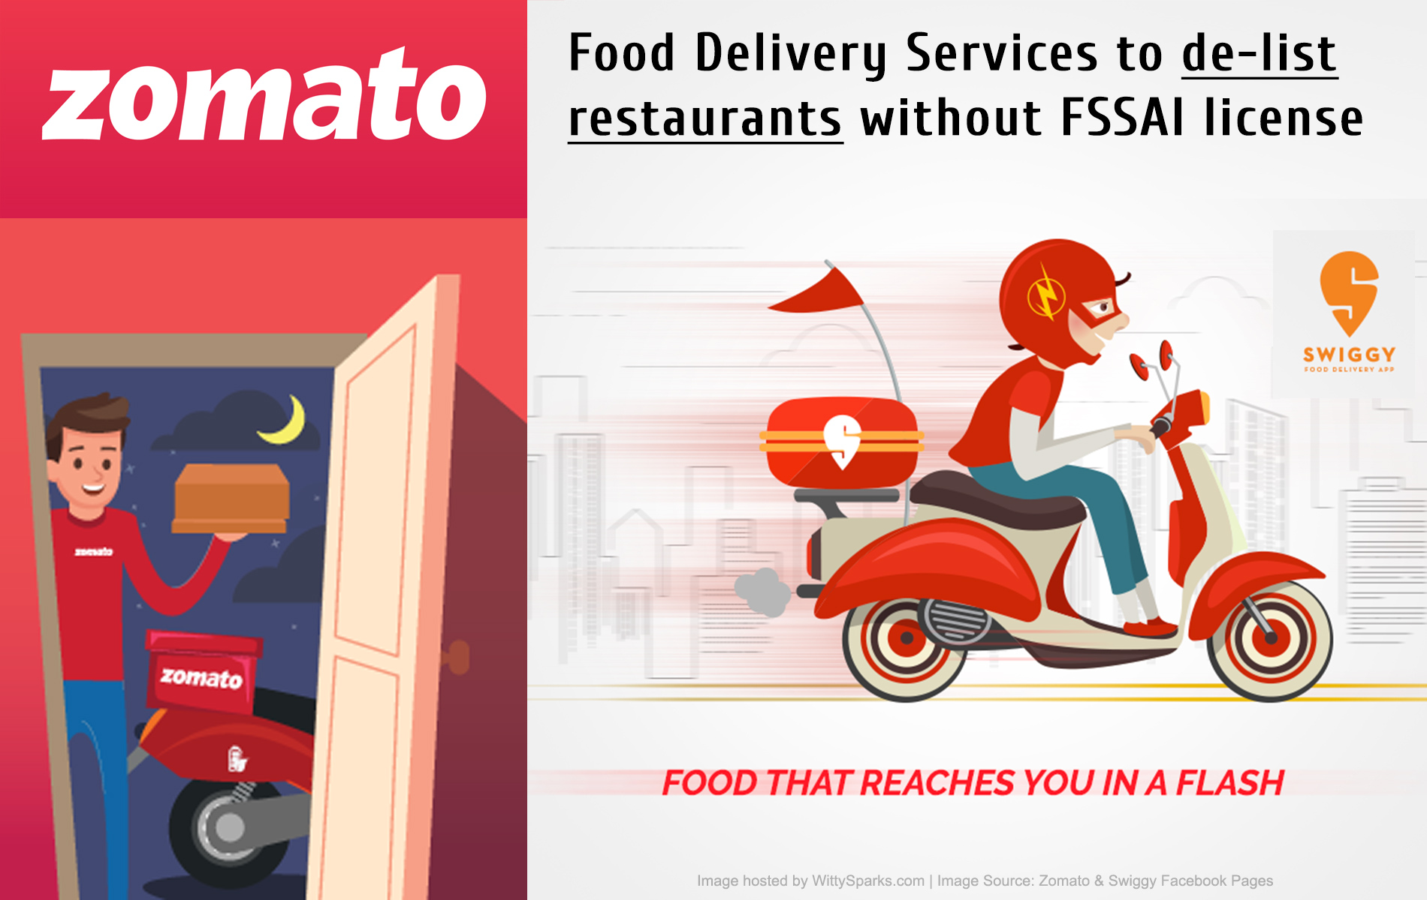
references
https://www.kaggle.com/shrutimehta/zomato-restaurants-data/data#zomato.csv
www.geeksforgeeks.com
www.stackoverflow.com

Slide 13




Thank You
Shaik.Nawaz Hussain
P.Hemalatha
Sai Veda
Guru.

