Slide 1
Enhancing Text Composition: A Transformer-based Approach to Sentence Auto-completion 21AIE314 AI IN NATURAL LANGUAGE PROCESSING END SEMESTER PROJECT

Slide 2
Team Members
01
02
Hema Radhika
Gajula Sri Vatsanka
2XXX
cb.en.u4aie21010
Cb.en.u4aie21050

Slide 3
Introduction
Sentence auto-completion plays a crucial role in boosting communication efficiency by suggesting the next word based on context, reducing typos, and even sparking creativity.
Traditional methods struggle with capturing long-term dependencies within sentences.
Transformer models, with their powerful LSTMs, address this by considering the entire sentence to predict the most likely continuations, leading to more relevant and accurate auto-completions.
This technology has valuable applications in search engines, writing assistants, and various communication tools.

Slide 4
PROBLEM STATEMENT:
The aim of this project is to enhance text composition by developing a transformer-based model for sentence auto-completion. Traditional methods often fail to capture the nuanced context and semantics required for natural language generation. This project leverages the power of transformer architectures, such as GPT, to predict and generate coherent sentence continuations. By improving sentence auto-completion, the tool aims to assist writers in generating text more efficiently and effectively. The ultimate goal is to provide a seamless and intuitive writing aid that enhances productivity and creativity.

Slide 5
Dataset Description
The "Tweets Blogs News - Swiftkey Dataset 4million" is a dataset containing text and metadata from various online sources, most likely intended for training natural language processing (NLP) models.
Source: The data includes text from three sources: Tweets, Blogs, and News articles. This suggests a variety in writing styles, formality, and topics.
Size: The dataset contains 4 million entries, which is a considerable size and can be beneficial for training robust NLP models.
Content: The description mentions "text and metadata." This implies that each entry likely contains the actual text content (e.g., tweet message, blog post content, news article text) along with additional metadata associated with it. This metadata could include information like source URL, publication date, author information (for blogs/news), hashtags (for tweets), etc

Slide 6
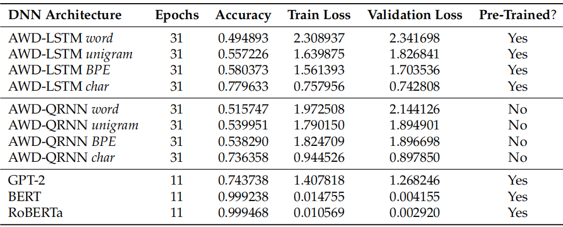
LITERATURE REVIEW :
Automated Source Code Generation and Auto-Completion Using Deep Learning: Comparing and Discussing Current Language Model-Related Approaches
This paper compares different neural network architectures like Average Stochastic Gradient Descent (ASGD) Weight-Dropped LSTMs (AWD-LSTMs), AWD-Quasi-Recurrent Neural Networks (QRNNs), andTransformer while using transfer learning and different forms of tokenization.
Results:

Slide 7
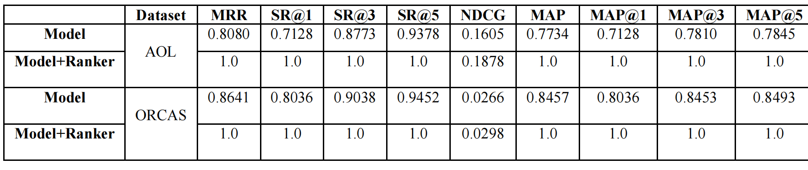
Long Short-Term Memory Based Query Auto_x0002_Completion
Long Short-Term Memory (LSTM) based Query Auto-Completion (QAC) has been proposed to generate a query completion list using input prefix. The performance of the QAC system has been evaluated by using the relevancy score, and the quality of the QAC generation system.

Slide 8
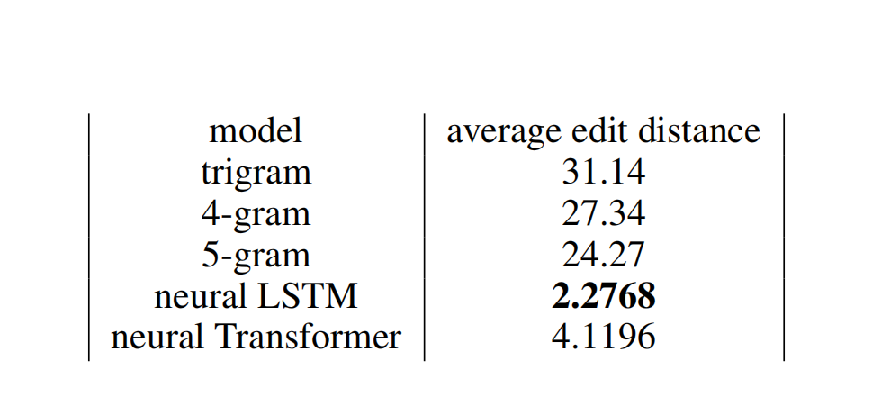
BASE PAPER:
Aguiar, Rui, and Faraz Fadavi. "CS 224N Custom Project: Keyword-based Code Auto-Complete."
CS 224N Custom Project: Keyword-based Code Auto-Complete.
Sequence-to-sequence models are adept at learning relationships between sequences.
Communication game model with a transformer encoder.
Evaluation:The paper compares the performance of these neural models against a naive baseline n-gram model. N-gram models are simpler statistical methods that predict the next element (code token) based on the n preceding elements.The paper likely evaluates the models based on the percentage of tokens kept in the auto-completed code that are correct. This suggests they assess how well the models predict the remaining code snippet accurately.

Slide 9
Limitations of Traditional Methods:
Tokenization:
Can lead to loss of meaning and context, especially in complex languages and when dealing with r are or compound words.
Out of Vocabulary (OOV) Words:
Models struggle with unseen words, leading to degraded performance and inability to understand novel input.
N-Gram Models:
Unable to capture long-range dependencies in text.
High memory requirements for large n-grams, resulting in inefficiency and data sparsity.

Slide 10
Transition to Transformer-based Approaches

Slide 11
LSTM
2XXX
1
2
3
Preprocessing
Cleaning Data
Model Building
5
4
Model Evaluation
Model Training

Slide 12
01
Pre-processing
Technology

Slide 13
Pre-processing
We create a Pre-processing function which contains
Splits The datasets By the \n Character.
Remove emojis and special characters.
Remove leading and trailing spaces.
Drop empty sentences
Tokenize sentences
After Pre-processing we split the data into train,test and validation sets

Slide 14
02
Cleaning the data
Consulting

Slide 15
Pre-processing
We create a cleaning function which contains
Creating a Frequency Dictionary(use words that appear n times)
Out of Vocabulary words
Adding Unique Tokens (which are not in oov)
Using these function we update the train, test and validation sets using a count frequency

Slide 16
04
Train Model
2XXX

Slide 17

N-Gram
Pre-processing
In Building a model we use the below functions
Count-n-grams
The code counts the occurrences of n-grams (sequences of n tokens) in a given dataset of sentences and calculates the conditional probabilities of words following given n-grams.

Slide 18

N-Gram
Pre-processing
In Building a model we use the below functions
Maximum Likelyhood calculation with k smoothing
It then uses these probabilities to suggest the most likely next word based on the previous tokens, considering optional starting characters.
K-smoothing helps to handle the problem of zero probabilities in probability estimation.
Where,
count(previous n,w) is the count of the n+1-gram (previous n,w).
count(previous n) is the count of the n-gram previous n.

Slide 19

N-Gram
Pre-processing
In Building a model we use the below functions
Word suggestion
The code can generate multiple suggestions using different n-gram models and their respective counts.

Slide 20
LSTM
Pre-processing
LSTM is a type of recurrent neural network (RNN) designed to capture long-term dependencies in sequential data. It overcomes the limitations of traditional RNNs by mitigating the vanishing gradient problem.
KEY COMPONENTS
Cell State: Maintains long-term memory.
Forget Gate: Decides what information to discard from the cell state.
Input Gate: Determines which new information to add to the cell state.
Output Gate: Controls the output based on the cell state and the input.

Slide 21
How LSTM Works?
Information Flow: Information flows through a series of gates that regulate the addition or removal of information to the cell state.
Example: In processing the sentence "The cat sat on the mat," the LSTM can remember the subject "The cat" even after several words, aiding in tasks like predicting the next word or generating sentence continuations.

Slide 22
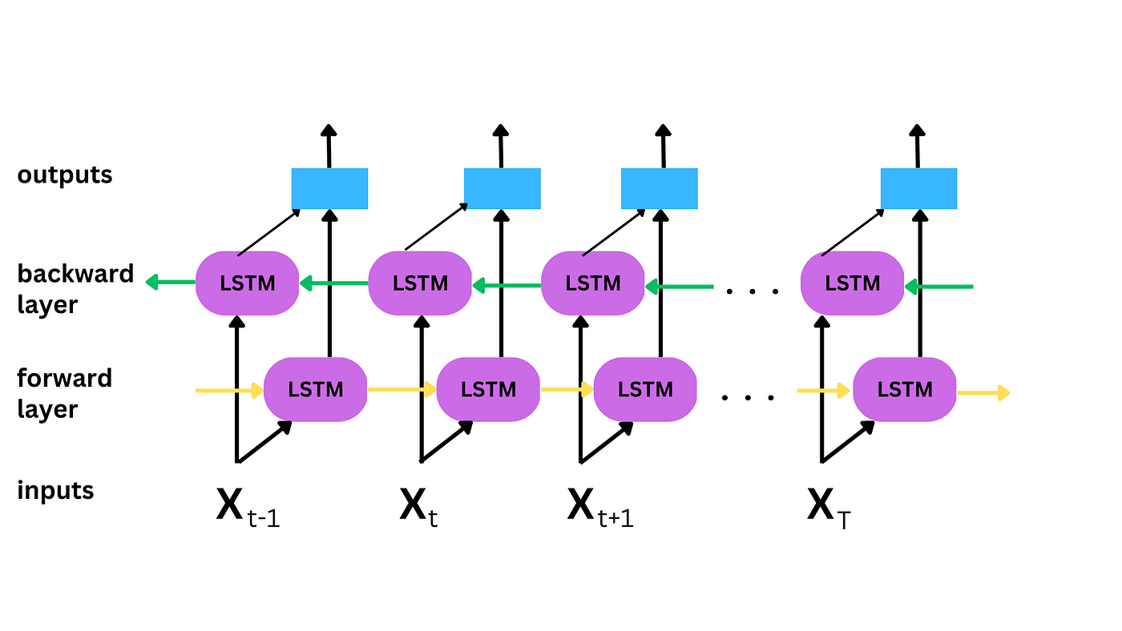
BILSTM
BiLSTM extends LSTM by processing data in both forward and backward directions, allowing the model to have information from both past (left context) and future (right context) relative to a specific point in the sequence.

Slide 23
Advantages of BiLSTM:
Enhanced Contextual Understanding: By considering both previous and following words, BiLSTM captures a more comprehensive context.
Example: For the sentence "The bank will close at 5 PM," BiLSTM can use the surrounding context to distinguish between "bank" as a financial institution and "bank" as a riverbank.
Benefits for Sentence Auto-completion
Handling Sequential Dependencies
LSTM:
Retains important information over long sequences, making it effective for maintaining context in text generation.
BiLSTM:
Uses information from both directions, enhancing the model’s ability to predict the next word by leveraging full sentence context.
Further improves sequence modeling by integrating information from both directions, ensuring better context capture even in complex sentences.

Slide 24

05
Test Model
Management

Slide 25
RESULTS

Slide 26
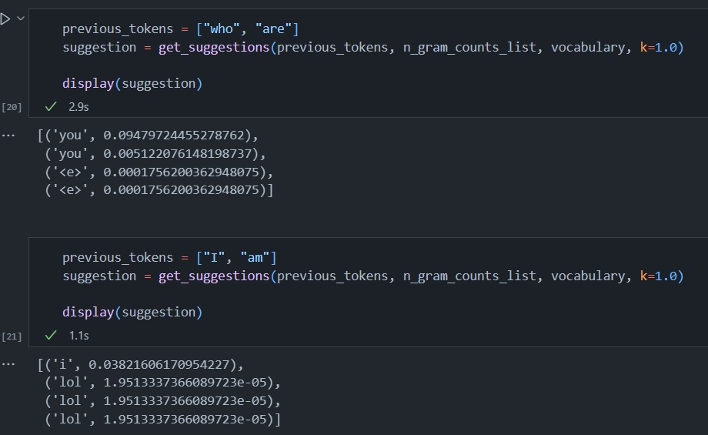
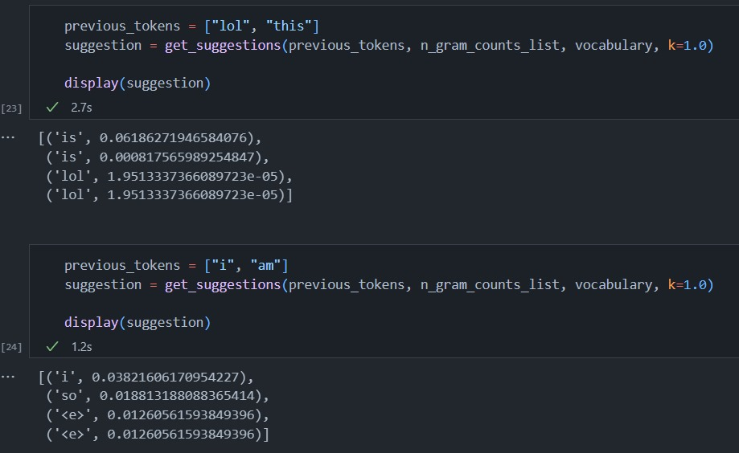
N-gram

Slide 27
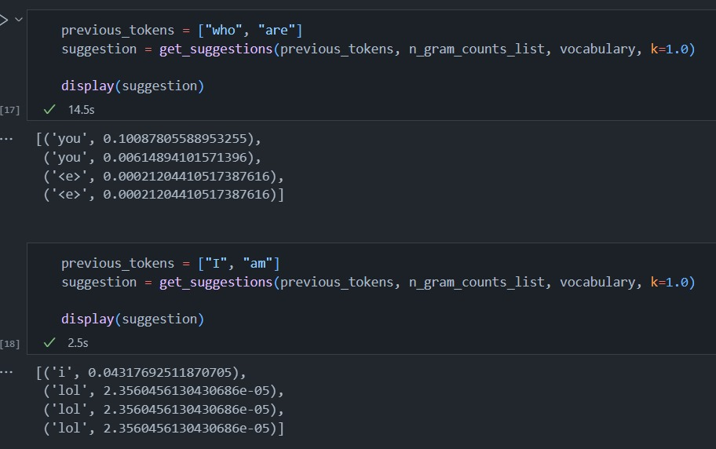
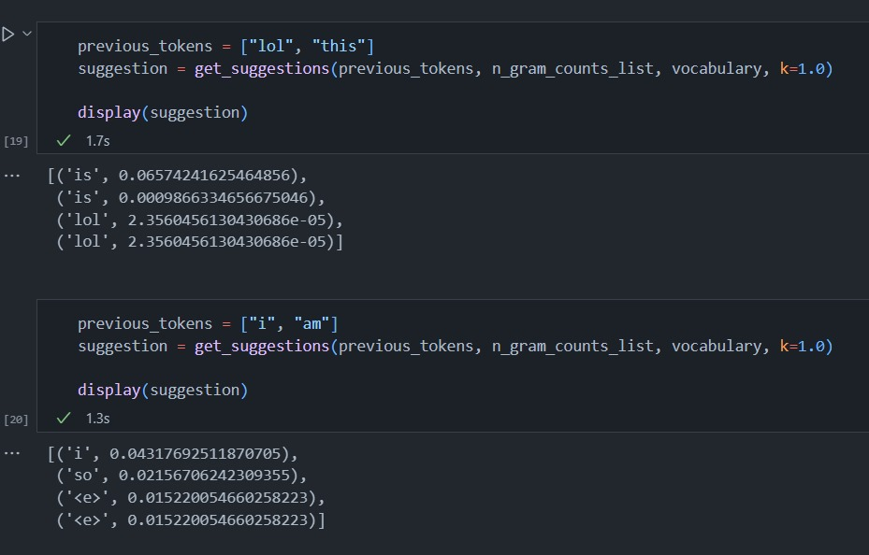
N-gram

Slide 28
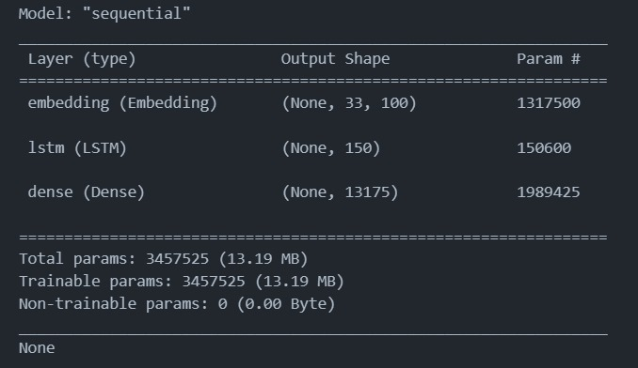
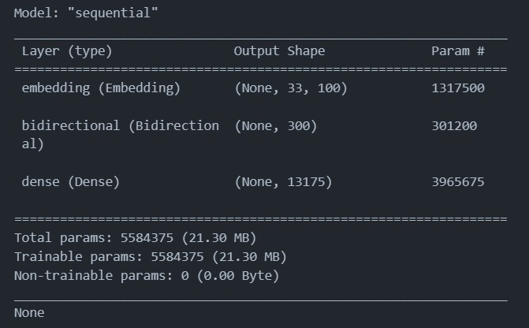
Model Summary:

Slide 29
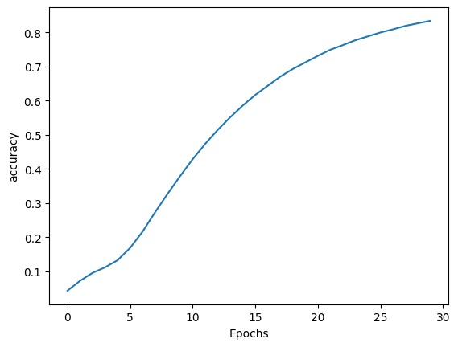
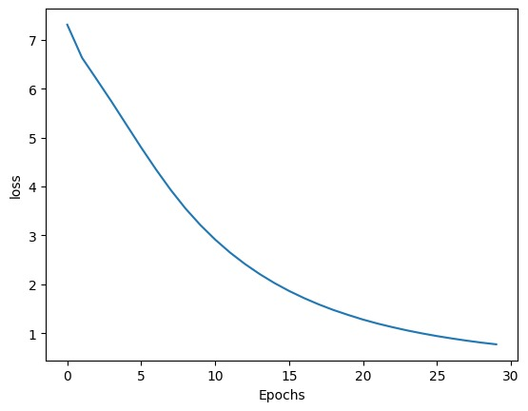
BILSTM
Accuracy of Model:
Training Loss:

Slide 30
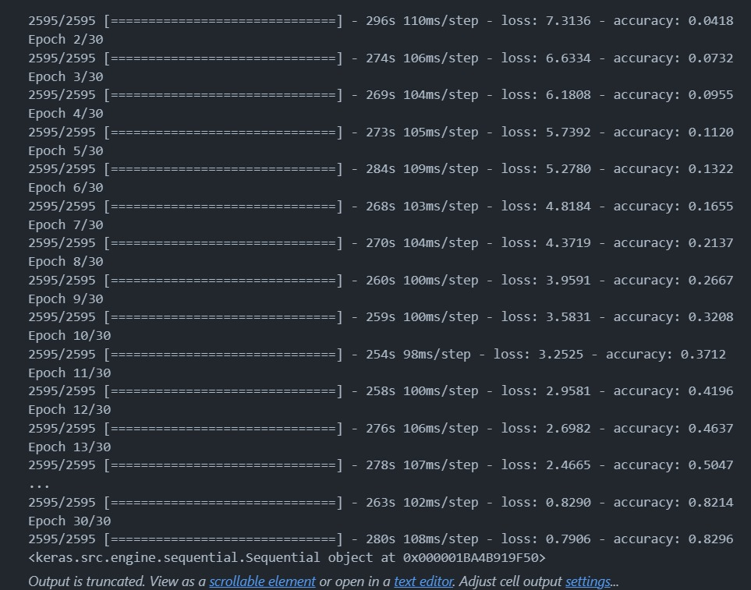
BILSTM:

Slide 31
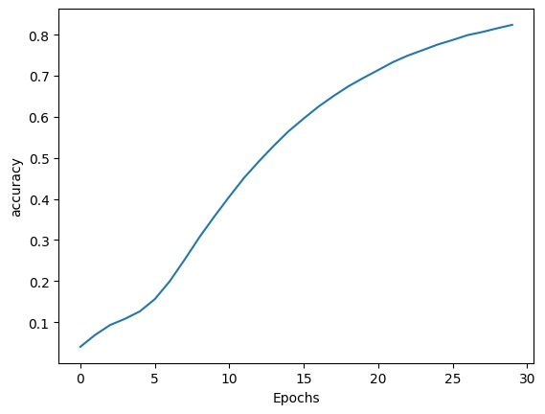

BILSTM
Accuracy of Model:
Training Loss:

Slide 32
Conclusion and Future Work:
Current Achievements: Summarize the improvements observed with LSTM and BiLSTM models in sentence auto-completion tasks.
Discuss potential enhancements, such as integrating transformer-based models for further performance gains or exploring hybrid architectures combining LSTM/BiLSTM with transformers.

Slide 33
THANK YOU

