Slide 1
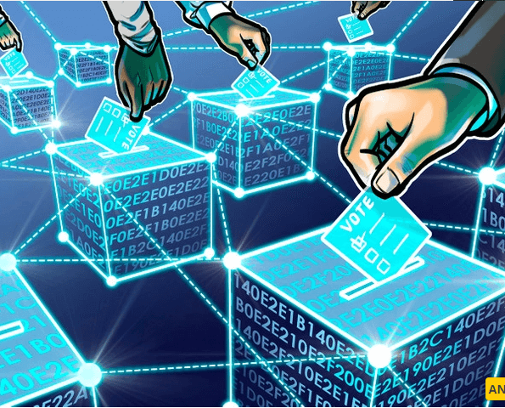
BLOCKCHAIN BASED E-VOTING SYSTEM
Ensure Secure And Transparent Elections
Notes:
NOTE:
To change the image on this slide, select the picture and delete it. Then click the Pictures icon in the placeholder to insert your own image.

Slide 2




TEAM MEMBERS:
Sykam Sumanjali
CB.EN.U4AIE21068
Suda Haripriya
CB.EN.U4AIE21067
Reddy Hema Radhika
CB.EN.U4AIE21050
Souvik Gorain
CB.EN.U4AIE21065

Slide 3
Table of Contents:
Blockchain
How does Blockchain work
Introduction to Blockchain based E-Voting System
How blockchain works in E-Voting
Traditional vs Blockchain Voting Systems
How encryption and decryption works in the system?
Secure Hash Algorithm(SHA)-256
How SHA-256 is implemented in Blockchain Technology?
Conclusion

Slide 4
BLOCKCHAIN
A blockchain is “a distributed database that maintains a continuously growing list of ordered records, called blocks.” These blocks “are linked using cryptography.
Each block contains a cryptographic hash of the previous block, a timestamp, and transaction data.
Blockchain Technology first came to light when a person or group of individuals name ‘Satoshi Nakamoto’ published a white paper on “BitCoin: A peer-to-peer electronic cash system” in 2008.
The four key concepts of Blockchain are : Shared ledger, Permission, Smart contracts, Consensus.

Slide 5
How does Blockchain Works?
A blockchain is distributed, which means multiple copies are saved on many machines, and they must all match for it to be valid.
The blockchain collects transaction information and enters it into a block, like a cell in a spreadsheet containing information.
Once it is full, the information is run through an encryption algorithm, which creates a hexadecimal number called the hash.
The hash is then entered into the following block header and encrypted with the other information in the block. This creates a series of blocks that are chained together.

Slide 6
Introduction to Blockchain Based E-Voting System:
As societies become more digital and interconnected, the need for secure, efficient, and transparent voting methods has never been greater.
Traditional voting systems face various challenges, including issues related to security, trust, and accessibility.
Current challenges in Voting Systems are:
Security Concerns
Lack of Transparency
Accessibility Issues
Slow and Manual Process
Trust and Verification

Slide 7
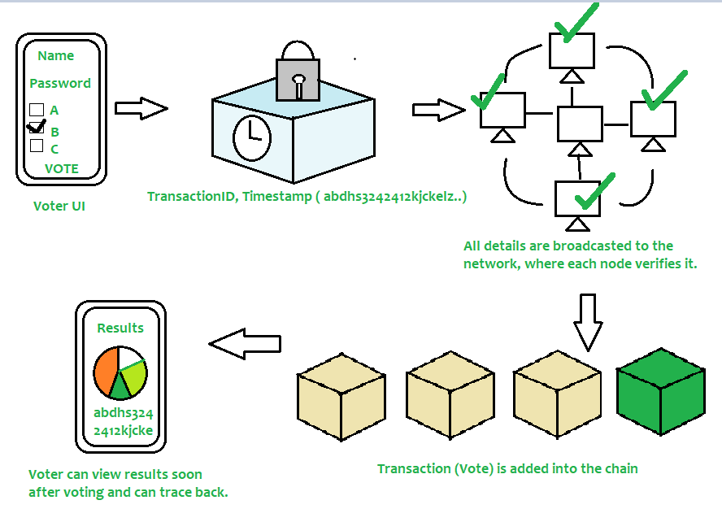
How Blockchain Works in E-Voting?

Slide 8
Contd..
Voter needs to enter his/her credentials in order to vote.
All data is then encrypted and stored as a transaction.
This transaction is then broadcasted to every node in network, which in turn is then verified.
If network approves transaction, it is stored in a block and added to chain.
Note that once a block is added into chain, it stays there forever and can’t be updated.
Users can now see results and also trace back transaction if they want.

Slide 9
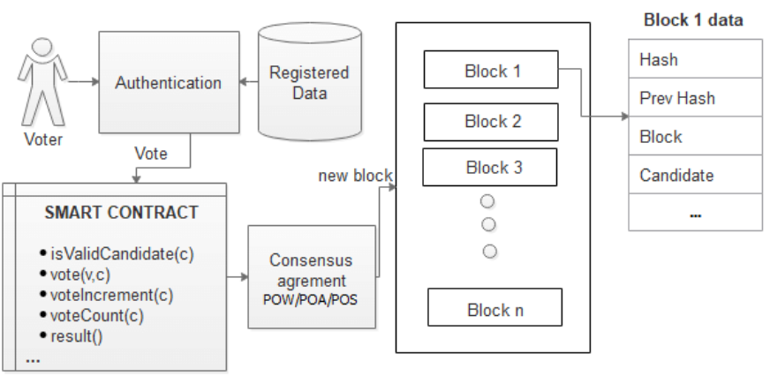
Block diagram of voting
In code represented as block chain class
Option 2 selected.
Ask for valid login id.
Option to caste a vote
candidates
Access block chain data
verification if voter already voted or not.
(not voted).
Iterate through blocks. Extract votes for each constituency.
Aggregate by cand. name
Option 4.
To exit from the current system
Compile and display the results.
Hide who voted for whom

Slide 10
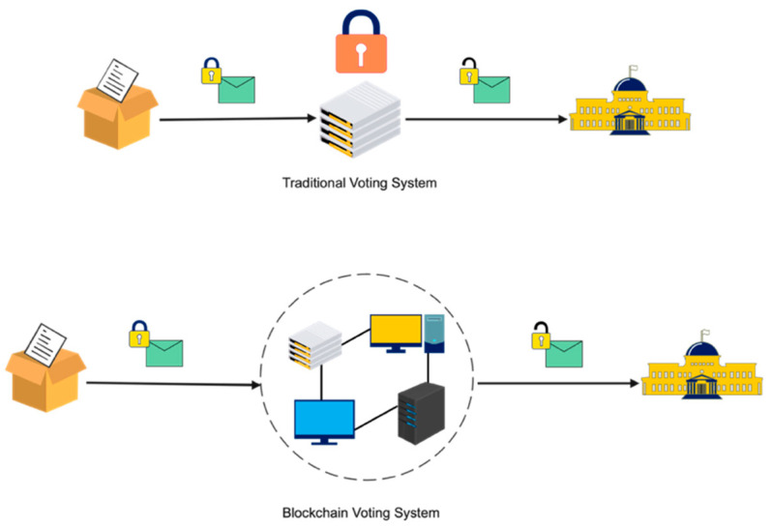
Traditional vs Blockchain Voting System:

Slide 11
How encryption and decryption works in the system?
1) Vote Encryption:
When a voter casts their vote electronically, the vote is encrypted before being transmitted to the server or the blockchain.
This is done to ensure that the vote remains confidential and cannot be intercepted or tampered with during transmission.
The encryption process may involve using the voter's public key, which is part of their cryptographic key pair (public-private key pair).
The public key is used to encrypt the vote, and only the corresponding private key, which is known only to the voter, can decrypt it.
After encryption, the vote becomes a ciphertext that can only be decrypted by someone who possesses the corresponding private key.

Slide 12
2) Vote Transmission:
The encrypted vote is transmitted securely to the server or the blockchain using secure communication protocols to prevent interception and tampering during transit.
This ensures the privacy and security of the vote while it's being sent from the voter to the server.
3) Vote Storage on the Blockchain:
Once the encrypted vote is received, it is recorded as a transaction on the blockchain.
The server or the blockchain network does not decrypt the vote.
Instead, it stores the encrypted vote as-is.
The vote remains confidential on the blockchain, and only the voter with the corresponding private key can decrypt it.

Slide 13
4) Vote Decryption:
When the voting period ends and the time comes to count the votes, the decryption of the votes typically occurs offline.
The server or an authorized authority responsible for vote counting uses the private keys to decrypt the votes.
The private keys used for decryption are securely stored and are typically held by multiple authorized individuals or entities to prevent any single point of failure or abuse of power.
Once the votes are decrypted, they can be tallied to determine the election results.
The decrypted votes are counted and the results are computed.
This combination of encryption and blockchain technology provides a secure and transparent e-Voting system that ensures the integrity of the voting process while preserving voter privacy.

Slide 14
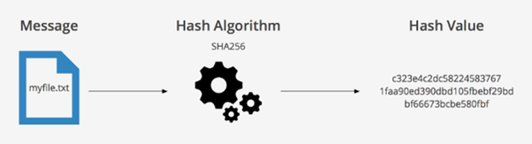
SECURE HASH ALGORITHM(SHA)-256
SHA-256 stands for Secure Hash Algorithm 256-bit.
It's a cryptographic hash function used in security applications.

Slide 15
Key Characteristics:
Produces a 256-bit hash value.
Provides data integrity and authenticity.
Used in digital signatures and blockchain technology.
Applications:
Data integrity
Verification Digital signatures
Blockchain security.
Strengths:
Highly secure and widely trusted.
Fast computation and efficient.
Central to modern cryptography.

Slide 16
How SHA-256 Is used in Blockchain technology?
Blockchain Technology uses SHA-256 to secure the integrity and immutability of data stored in blocks.
Because each block in a blockchain contains a unique digital fingerprint, nobody can change the contents of the block without changing their hashes.
In other words, by linking blocks using their hash values, the blockchain creates a transparent and tamper-proof ledger that anyone can verify.
Data Integration
Block Validation
Verification Of Votes
Identity Verification

Slide 17
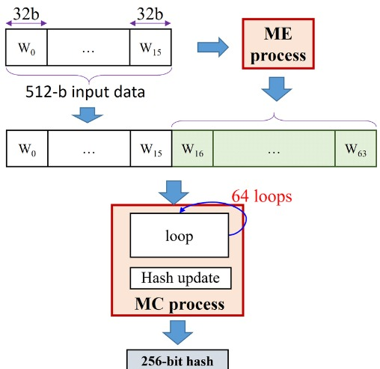
Block Diagram for SHA-256:

Slide 18
CODES:
Blockchain_voting
client_voting
server_voting
SHA-256
Blockchain_gui.py

Slide 19
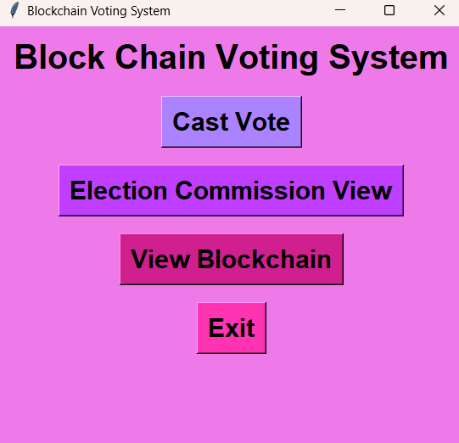
RESULTS:
If the same vote is casted again it displays a message that “Your vote is already casted”

Slide 20
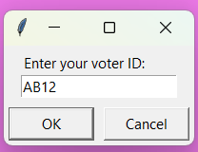
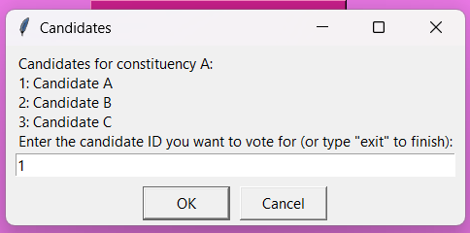
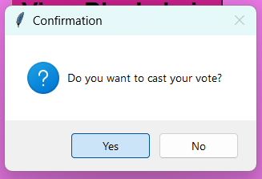
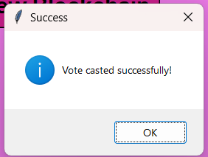
Casting a vote

Slide 21
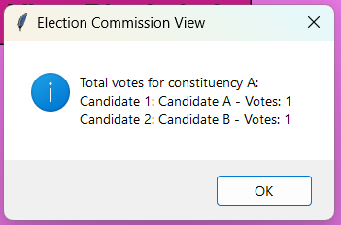
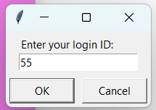
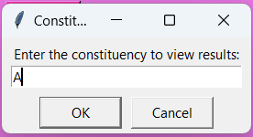
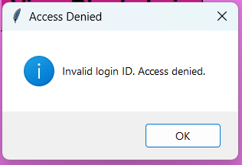
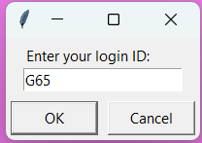
Election commission view
In case of wrong login id

Slide 22
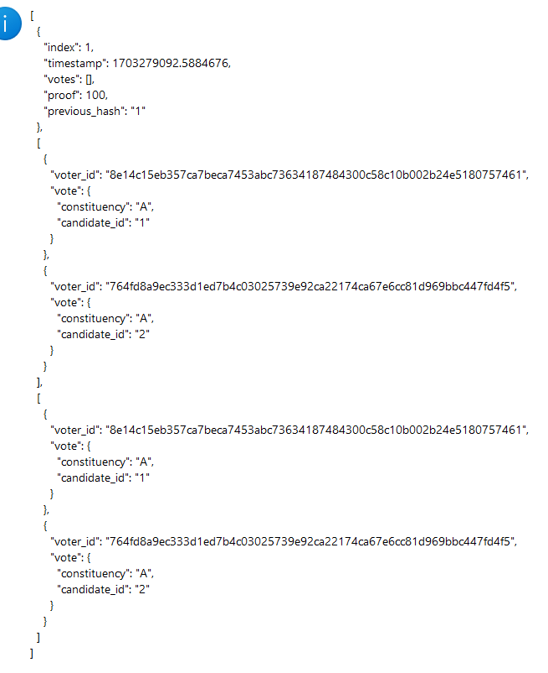
Block chain

Slide 23
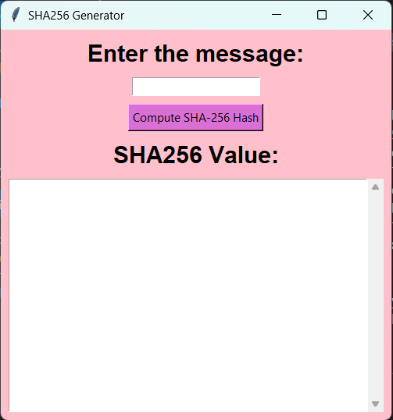
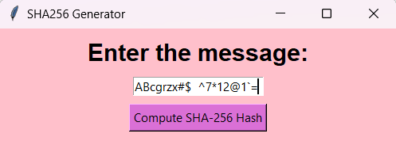
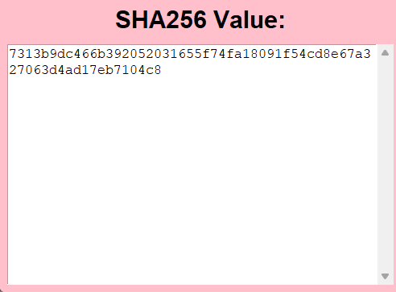
SHA 256

Slide 24
Conclusion:
In conclusion, our exploration of the blockchain-based e-voting system underscores the transformative potential of this technology in modernizing elections.
We have seen how blockchain addresses the challenges of security, transparency, and accessibility that plague traditional voting systems.
Key takeaways:
Enhanced security through decentralization and cryptographic techniques.
Unprecedented transparency, allowing voters to independently verify their votes.
Increased inclusivity, accommodating all eligible voters.
Efficient and real-time results tabulation.
Strengthened trust in the electoral process.

Slide 25
References:
https://ieeexplore.ieee.org/document/9498566
https://www.ncbi.nlm.nih.gov/pmc/articles/PMC8434614/
https://www.sciencedirect.com/science/article/pii/S1319157822002221https://www.itm-conferences.org/articles/itmconf/pdf/2020/02/itmconf_icacc2020_03001.pdf
https://www.google.com/url?sa=i&url=https%3A%2F%2Fwww.quora.com%2FWhat-is-the-difference-between-SHA-256-and-Scrypt&psig=AOvVaw2wNIT0EuARqhxi8N-rweGp&ust=1699265917501000&source=images&cd=vfe&opi=89978449&ved=0CBIQjRxqFwoTCLiVhtfSrIIDFQAAAAAdAAAAABAD

Slide 26
CONTRIBUTIONS:
Blockchain_voting - Reddy HemaRadhika, Suda Haripriya
client_voting - Souvik Gorain, Sykam Sumanjali
server_voting - Reddy HemaRadhika, Suda Haripriya
SHA-256 - Souvik Gorain, Sykam Sumanjali

Slide 27
THANK YOU

