Slide 1
Smart Campus – Student Productivity & Resource Portal
Project Presentation
Project Presentation • 1

Slide 2
Problem Statement
• Students often use separate tools for tasks, notes, schedules, study timers, and learning resources.
• This makes it difficult to organize academic activities and track productivity in one place.
• Smart Campus provides a single, responsive student productivity and resource portal.
Project Presentation • 2

Slide 3
Technologies Used
• HTML5 – page structure and semantic content
• CSS3 – custom styling, responsive layout, and dark mode
• JavaScript – interactivity, task/notes logic, search, filtering, and timer
• Bootstrap 5 – responsive UI components and grid system
• Browser LocalStorage – client-side persistence of tasks, notes, schedules, and study statistics
Project Presentation • 3

Slide 4
Features of the Project
• Dashboard with task, notes, schedule, and study-time statistics
• Task Manager for adding and tracking academic tasks
• Notes Manager for creating and storing study notes
• Schedule module for organizing classes and study sessions
• Pomodoro Study Timer with study/break sessions and progress tracking
• Resource Hub with search and category filters
• Dark mode and responsive design for different screen sizes
Project Presentation • 4

Slide 5
Project Architecture / Flow
User
HTML Pages
Bootstrap UI
JavaScript
LocalStorage
→
→
→
→
Project Presentation • 5

Slide 6
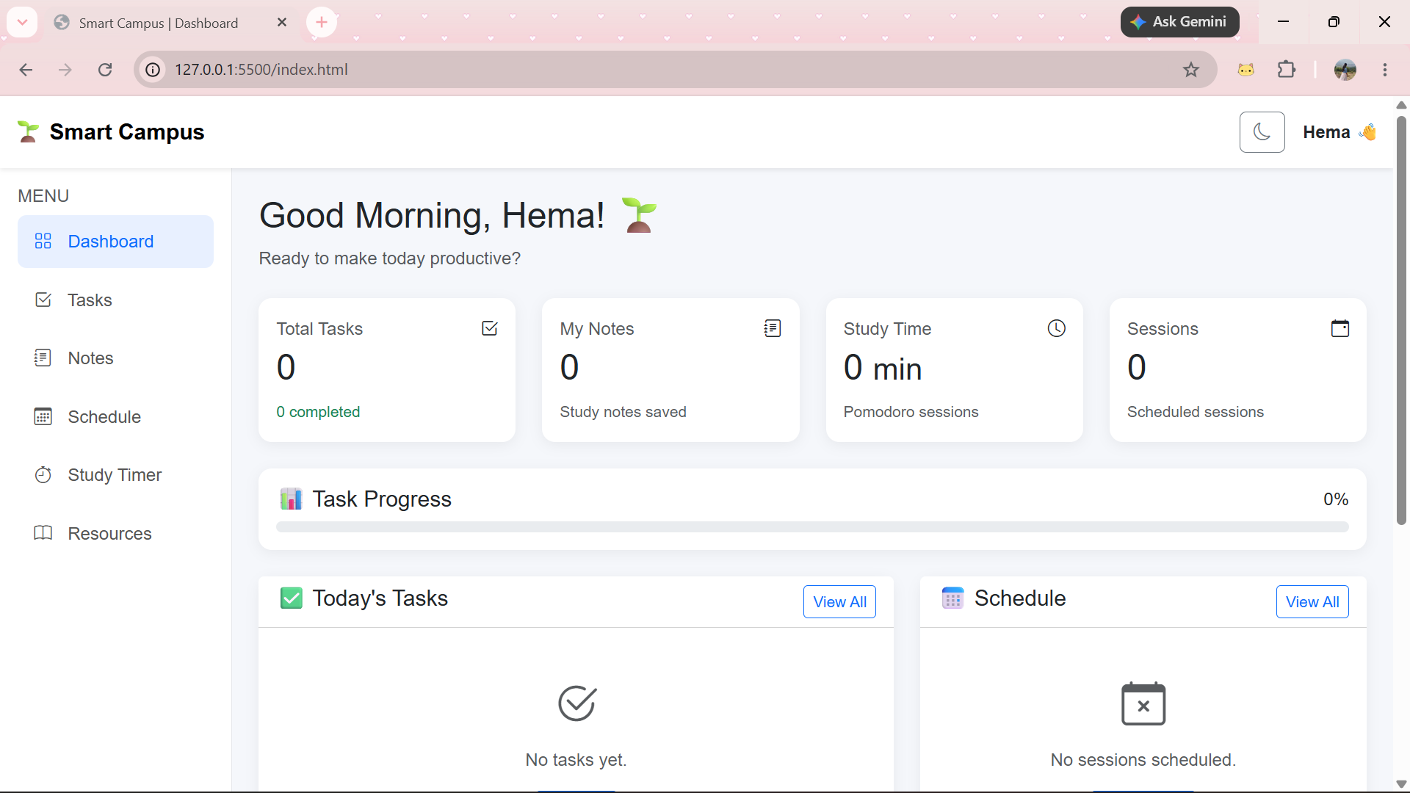
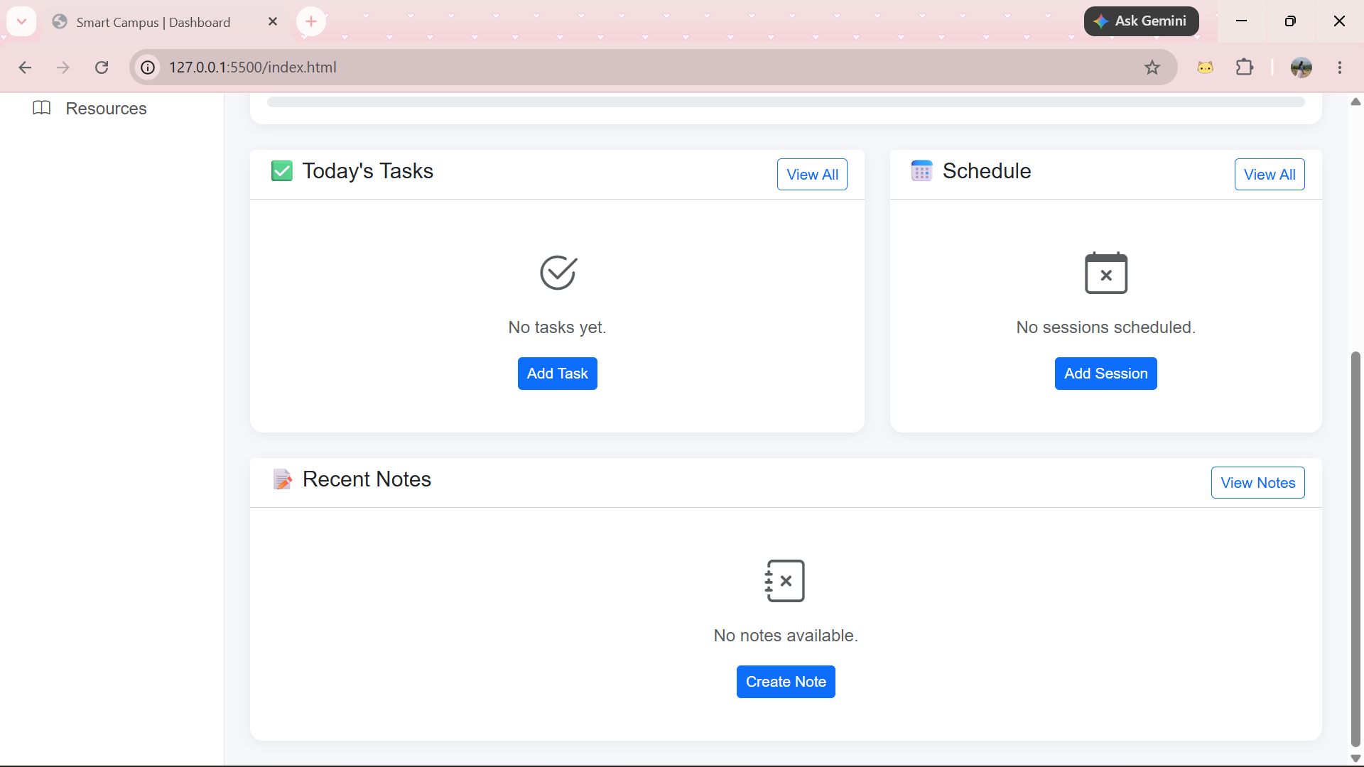
Picture / Screenshot
Project Presentation • 6

Slide 7
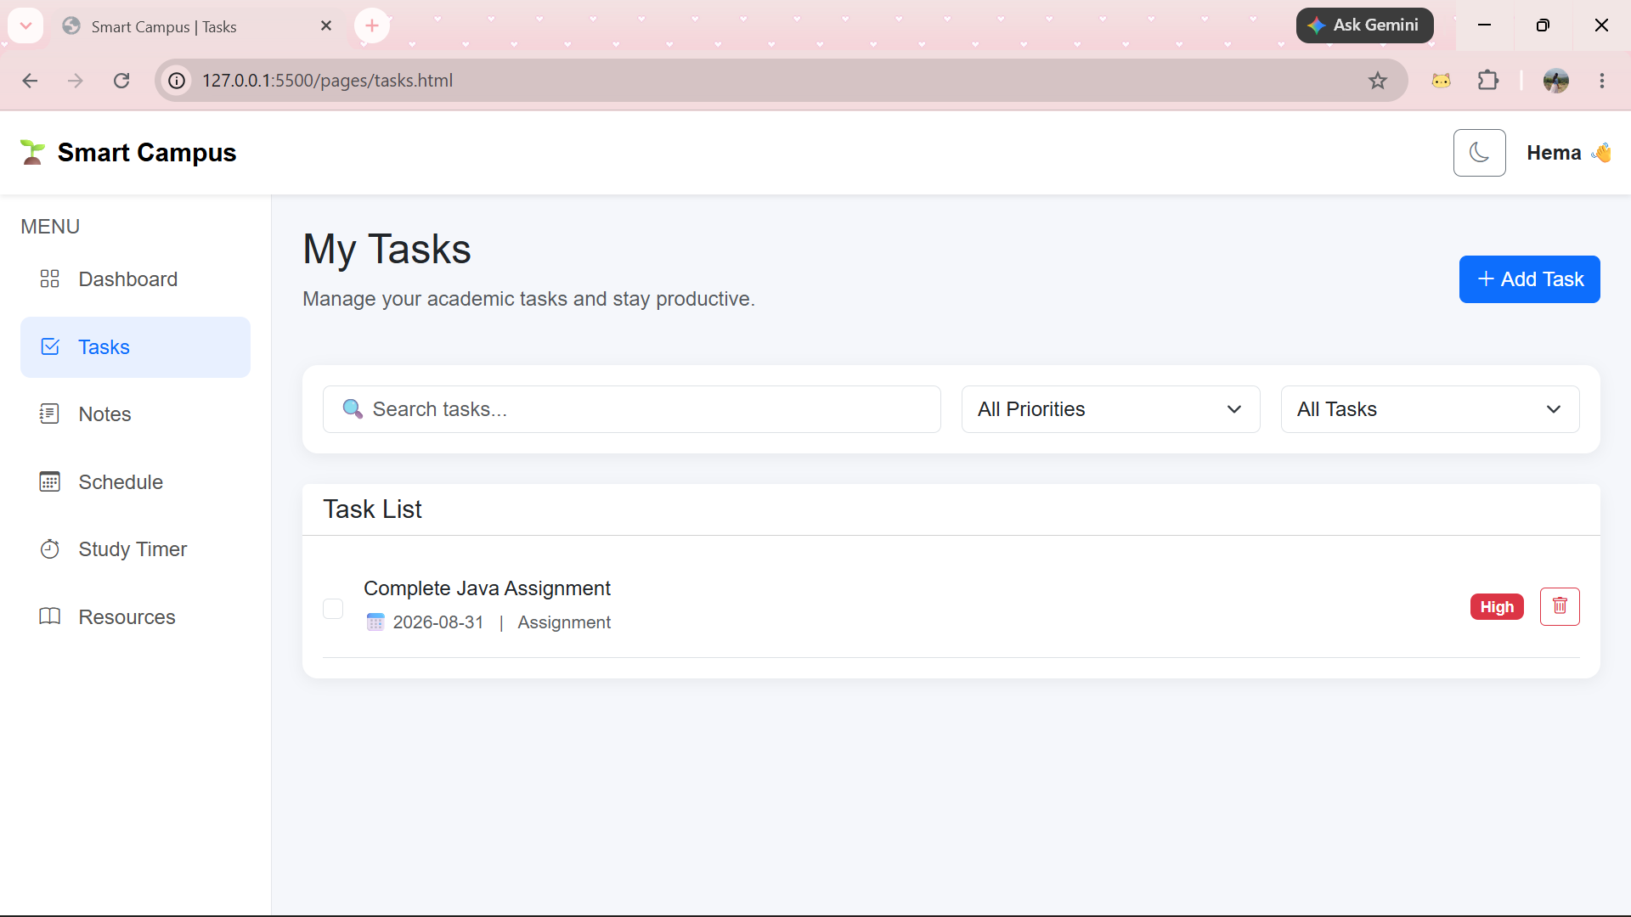
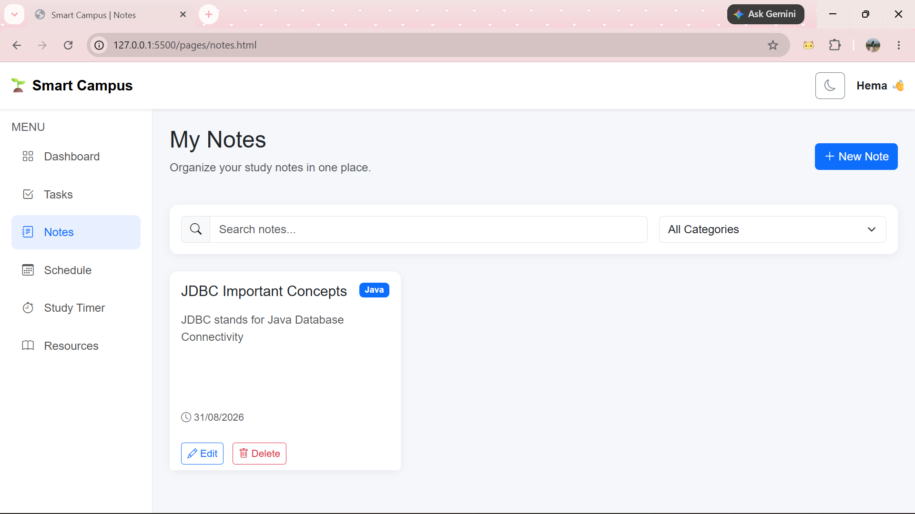
Picture / Screenshot
Project Presentation • 7

Slide 8
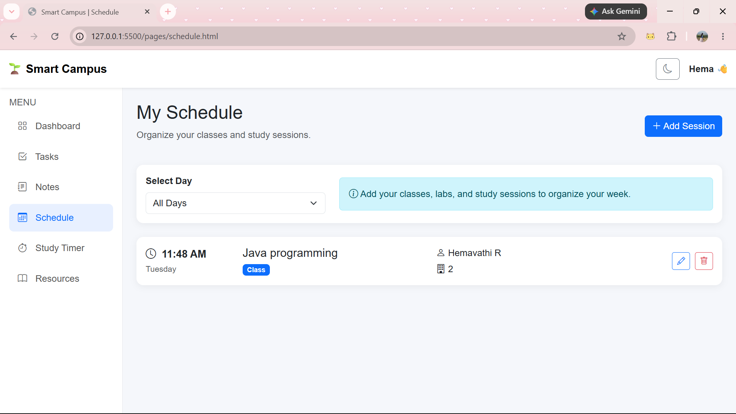
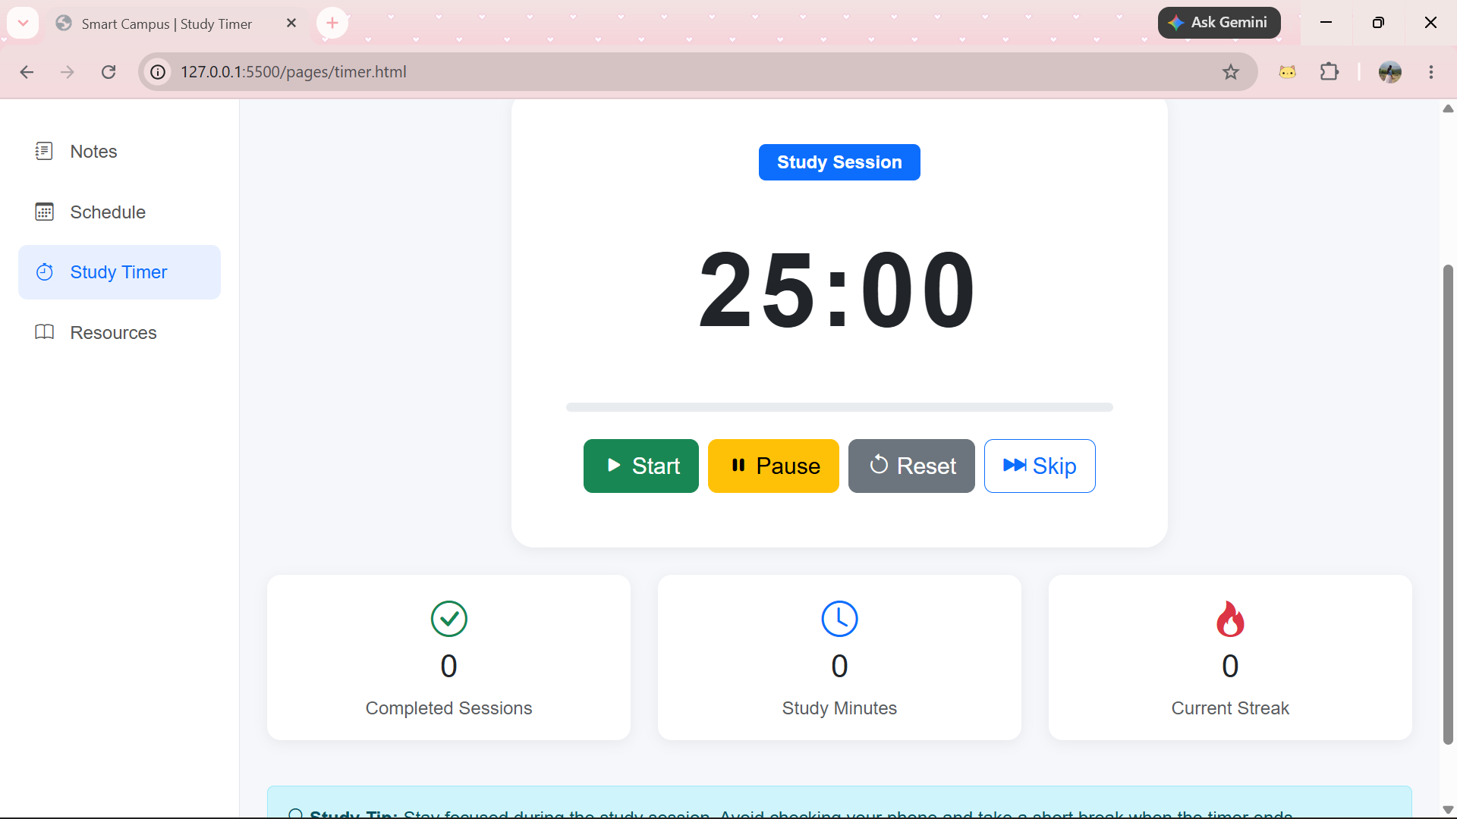
Picture / Screenshot
Project Presentation • 8

Slide 9
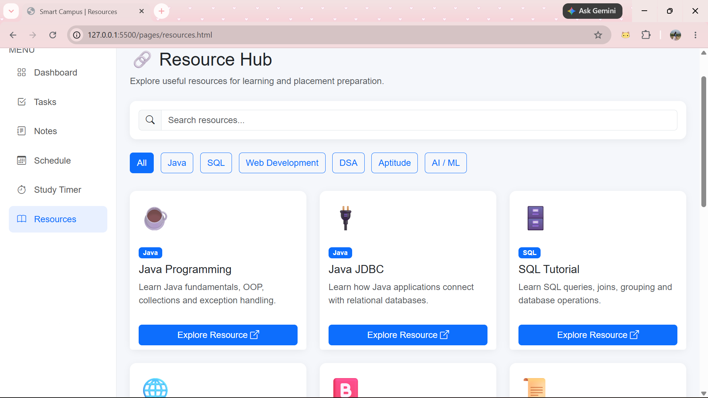
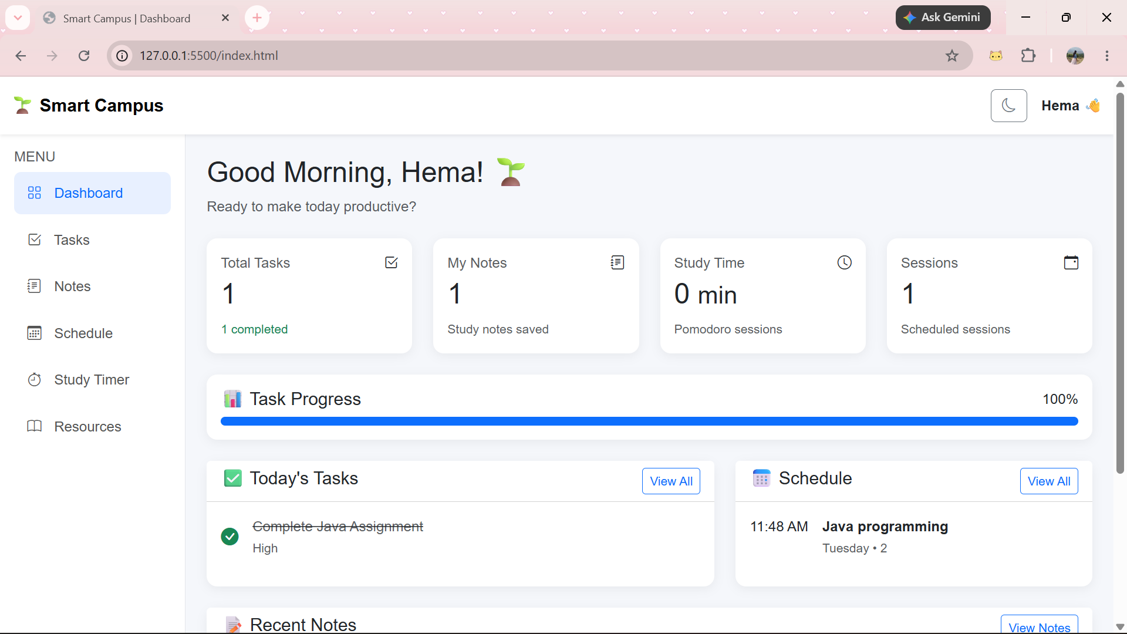
Picture / Screenshot
Project Presentation • 9

Slide 10
Future Enhancement
• Add a backend using Java/Spring Boot, Node.js, or another server-side technology
• Use MySQL/MongoDB for multi-device and permanent cloud data storage
• Add student authentication and personalized profiles
• Add notifications, reminders, analytics, and calendar integration
• Deploy the portal online for access from any device
Project Presentation • 10

Slide 11
Conclusion
• Smart Campus combines common student productivity needs into one simple web portal.
• The project demonstrates practical use of HTML, CSS, JavaScript, and Bootstrap.
• LocalStorage enables the application to preserve user data within the browser.
• The modular design provides a strong foundation for future full-stack development.
Project Presentation • 11

