Slide 1


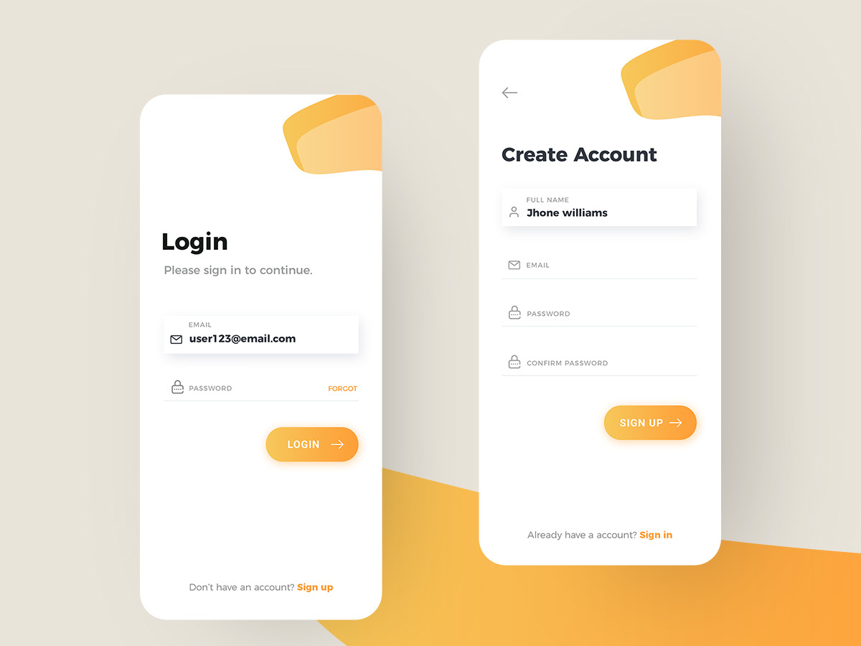
LOGIN
Login
OTP
Password
Please sign in to continue.
Please enter OTP to login.
Please enter password to login.
Email ID / Mobile number
OTP
Password
Submit

Slide 2


Login As
Login as
Please select you are user or vendor
to continue.
Vendor
User
Submit

Slide 3


SIGNUP
Sign up
OTP
Email OTP
Please sign up to continue.
Please enter OTP to login.
Please enter OTP to login.
Full Name
OTP
Password
Mobile Number
Email ID
Password
Confirm Password
Submit

Slide 4




Register as Vendor
Register Services
Register Services
Locate Me
Please select service type
Please enter details
Vendor/Shop Name
Contact Number
Address Line 1
Address Line 2
Address Line 3
City
State
Pin
Submit
Submit

Slide 5
FORGOT password
Forgot password?
OTP
Email OTP
Please enter email / mobile number
to continue.
Please enter OTP to login.
Please enter OTP to login.
Email ID / Mobile number
OTP
Password
Submit

Slide 6
RESET password
Reset Password
Please enter old and new password to
continue.
Old Password
New Password
Confirm New Password
Submit

Slide 7
RESET password
Reset Password
Please enter old and new password to
continue.
Old Password
New Password
Confirm New Password
Submit

Slide 8





List
Bike Services

Slide 9
LOGO
Hecko
SERVICES AT YOUR TIPS

