Slide 1
AI-Powered Travel Planner Agent

Slide 2

Project Title – AI-Powered Travel Planner Agent
Domain of Project – Travel & Tourism
Student Name | Recent Passport Photo | Email ID | Mobile number [WhatsApp]
Recommended font style and size:
Font Style: Arial
Font Size (Heading): 28
Font Size (Content): 20

Slide 3
Problem Statement –
Problem Statement – Travel Planner Agent
The Challenge
Planning a trip requires comparing destinations, transport, stays, routes, weather and costs across many websites. Information is scattered and can become outdated, while generic itineraries often ignore a traveller’s budget, interests, time and accessibility needs. Travellers may spend hours coordinating details and still face unexpected delays, overspending or poorly sequenced plans.
The Objective
Build an AI-powered Travel Planner Agent that turns a traveller’s preferences and constraints into a practical, adaptable trip plan. It should:
• Personalize destinations and activities using interests, dates, group size and budget.
• Create day-wise itineraries with logical routes and estimated time/cost.
• Retrieve current weather, map and transport information from external services.
• Recommend accommodation and transport options with provider links.
• Revise plans when users change preferences or live conditions change.
• Keep users in control of bookings, payments and final decisions.

Slide 4
Proposed Solution –
Proposed Solution: AI-Powered Travel Planner Agent
The solution is a modular, multi-agent travel assistant orchestrated through Langflow and powered by IBM Granite through watsonx.ai. It collects a traveller’s destination ideas, dates, budget, group size, interests and constraints, then coordinates specialized agents to produce a useful plan.
How it works
1. Profile Agent – understands preferences, trip constraints and budget.
2. Destination Discovery Agent – suggests suitable places and activities using curated travel knowledge and live search results.
3. Itinerary Planner Agent – creates a day-wise schedule and orders stops to reduce unnecessary travel.
4. Transport & Stay Agent – compares available options and provides links to trusted booking providers.
5. Weather & Alert Agent – checks forecasts and highlights conditions that may affect the plan.
IBM Granite handles intent understanding, reasoning, summarization and itinerary generation. A RAG layer retrieves relevant destination information from curated travel documents stored in IBM Cloud Object Storage Lite. External weather and map/route APIs provide current context.
Value: less research effort, clearer cost estimates, better-organized routes and an itinerary that can be revised in conversation. The agent recommends and links to booking providers; the traveller reviews and confirms every transaction.

Slide 5
Technology Used
Technology Used
IBM Granite via watsonx.ai – Core language model for understanding travel requests, reasoning over constraints, summarizing retrieved information and generating personalized itineraries.
IBM Cloud Lite – Cloud environment for the proof of concept. IBM Cloud Object Storage Lite can hold curated destination guides, FAQs and travel knowledge documents (subject to Lite-plan availability).
Langflow – Visual orchestration of the Travel Planner workflow and specialized agent steps.
RAG (Retrieval-Augmented Generation) – Retrieves relevant destination facts, local guidance and policy notes before Granite generates an answer.
External APIs – Weather service for forecasts; maps/routing service for distances and route estimates; provider search/booking links for transport and accommodation options.
Frontend – Simple web chat and itinerary view (e.g., Streamlit) for collecting preferences, showing the plan and accepting revisions.
Responsible AI – Display source and update time where available; label estimates; minimize personal data; do not make bookings or payments without explicit user confirmation.

Slide 6
Langflow component Used -
1) Chat Input – Collects destination, travel dates, number of travellers, budget, interests and special constraints.
2) IBM watsonx.ai / Granite Model – Interprets the request, reasons over constraints and generates itinerary suggestions.
3) Agent components – Profile Agent, Destination Discovery Agent, Itinerary Planner Agent, Transport & Stay Agent, and Weather & Alert Agent.
4) Retriever / Vector Store – Retrieves relevant destination guides and local information for grounded responses.
5) API / Tool components – Calls weather, maps and route services; retrieves provider options and booking links.
6) Prompt Template – Applies role instructions, output structure, budget rules and safety boundaries.
7) Chat Output – Displays the itinerary, estimated costs, source notes, alternatives and follow-up questions.

Slide 7
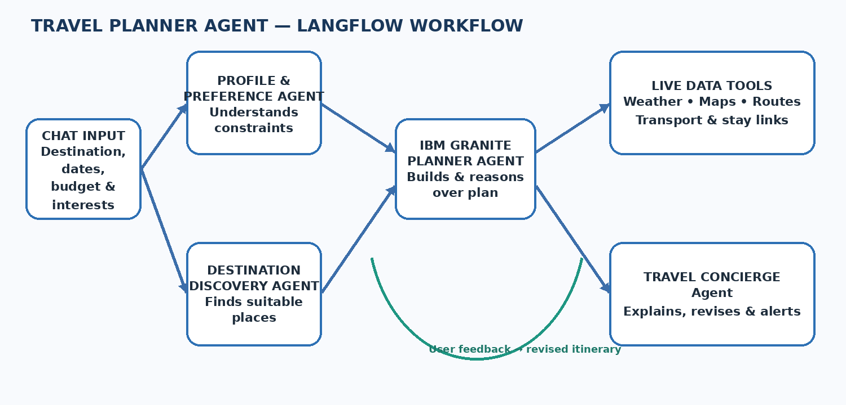

Langflow workflow -

Slide 8
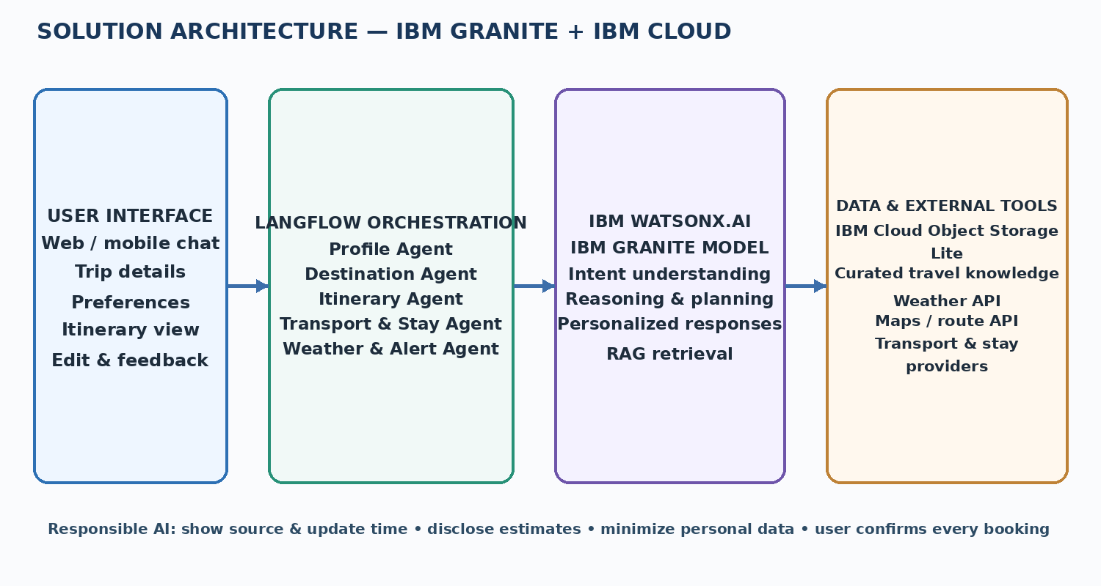

Architecture blueprint

Slide 9
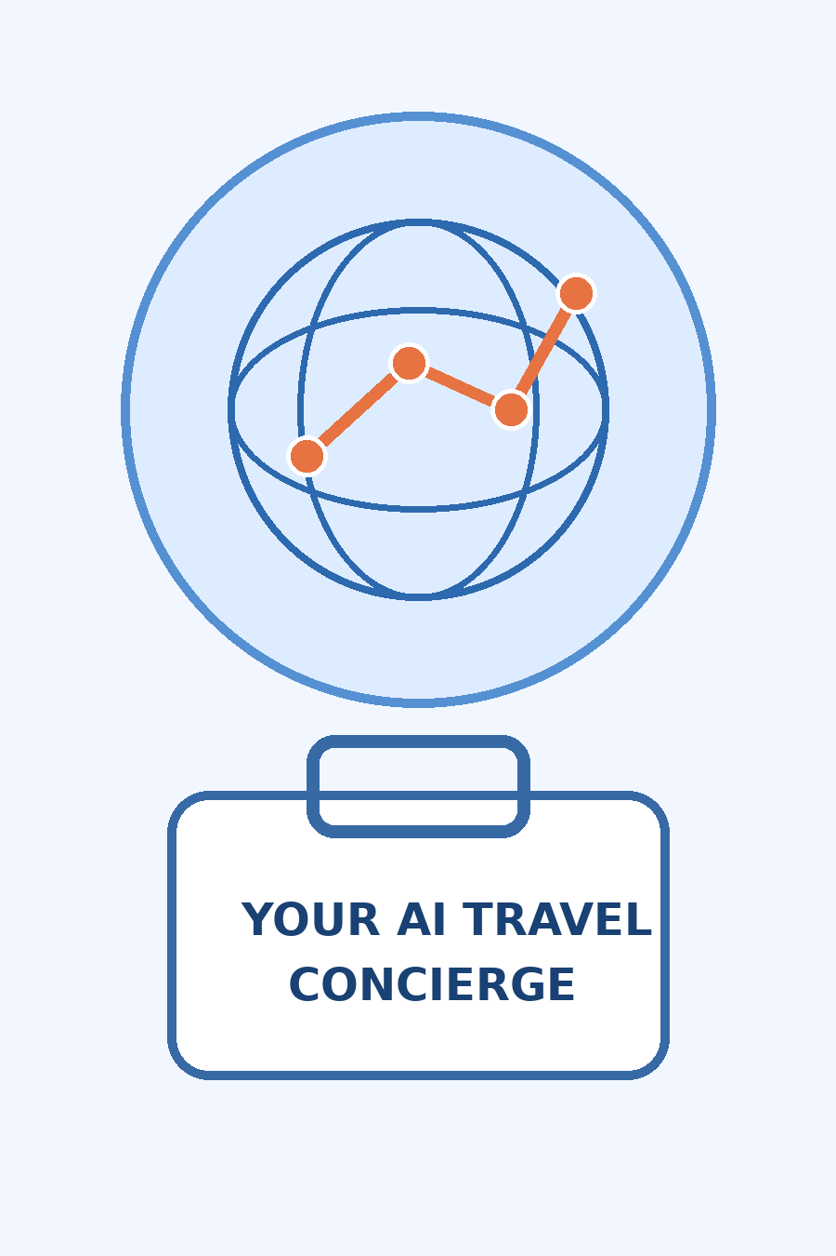

Role of Agentic AI in the Travel Planner Agent
Role of Agentic AI in the Travel Planner Agent
Agentic AI makes the solution more than a question-answering chatbot. Langflow coordinates specialized agents that work toward one travel-planning goal while IBM Granite provides language understanding and reasoning.
Each agent owns a focused task: the Profile Agent extracts preferences and constraints; the Destination Agent identifies relevant places; the Itinerary Agent arranges activities into a feasible schedule; the Transport & Stay Agent gathers options; and the Weather & Alert Agent checks conditions that may affect the trip.
The agents share the trip context, pass results between steps and revise the itinerary when the traveller changes a date, budget or interest. Tool calls bring in current external information, while RAG grounds destination guidance in retrieved documents.
The user remains in control: the system explains estimates and limitations, asks for clarification when details are missing, and never completes a booking or payment without explicit confirmation.

Slide 10
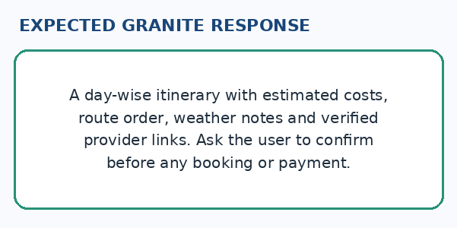
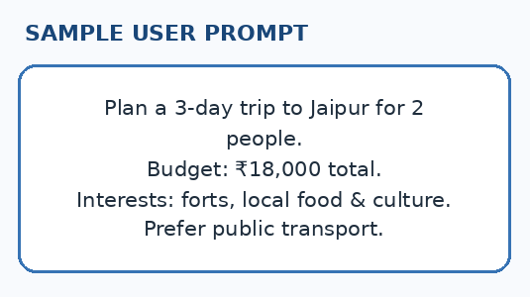


Demo / Simulation
Illustrative interaction — replace with actual test evidence
Granite Agent Output

Slide 11
Novelty and Uniqueness
The Travel Planner Agent combines Agentic AI, IBM Granite and live travel tools to make trip planning more context-aware and adaptable.
Multi-Agent Collaboration – Specialized agents divide planning into destination discovery, itinerary design, transport/stay research and weather checks.
Constraint-Aware Planning – The itinerary considers dates, budget, group size, interests and user-defined constraints instead of producing a generic list.
Live-Context Enrichment – Weather and map/route services add timely information to planning decisions.
RAG-Grounded Guidance – Curated destination knowledge is retrieved before responses are generated, helping reduce unsupported claims.
Conversational Replanning – Travellers can request changes and receive an updated schedule without restarting the planning process.
Human-Controlled Booking – The agent provides options and provider links, while users retain control over bookings and payments.
Measurable proof-of-concept goals: reduce manual planning steps, produce a complete first itinerary in one conversation, and keep estimated trip cost within the user’s stated budget.

Slide 12
GitHub Link
Public GitHub Repository URL: __________________________________________
Create a public repository and enable “Add a README file”. Add the working URL after testing.
Upload the source code, Langflow workflow export, IBM Granite prompt/configuration notes, and deployment files. Never upload API keys or personal traveller data.
• Travel Planner problem statement PDF
• Final project presentation PPTX + app files
• README: setup, architecture, APIs and limitations

Slide 13
Future Scope
Future enhancements will make the Travel Planner Agent more proactive, inclusive and useful across the full travel journey. The following features can be added after the core proof of concept is validated:
1. Real-time disruption alerts – monitor weather, delays and route changes, then suggest alternatives.
2. Voice + multilingual support – enable regional-language and hands-free trip planning.
3. Group + sustainable travel – support shared itineraries and lower-impact route options.

Slide 14

Certificates Earned:
Please add your credly certificate

Slide 15

Certificates Earned:​
Add your IBM BOB Certificate

Slide 16


