Slide 1
EVENT MANAGEMENT AND ANALYTICS PORTAL
SECTION- 3
TEAM – 6
2520030159 – B. HEMA SRI
2520030371 – P. HAVISHAA REDDY
2520030074 – K. BHARGAVI

Slide 2
ABSTRACT
Event management is a complex process that requires careful coordination of tasks such as attendee registration, scheduling, communication, and reporting. Traditionally, these activities are handled manually, which often leads to inefficiency, errors, and difficulty in maintaining accurate records. As events become larger and more diverse, organizers face challenges in ensuring smooth check‑ins, keeping participants updated, and evaluating outcomes effectively. The absence of automation and structured analytics makes it harder to measure success, identify areas for improvement, and plan future events with confidence. This creates a clear need for a system that can streamline operations, reduce manual workload, and provide meaningful insights into event performance.
The Event Management and Analytics Portal is designed as a comprehensive solution to address these challenges by digitizing the entire event lifecycle. It provides modules for attendee registration with role assignment, event creation and updates, search and filters, QR‑based check‑in, notifications, and audit logs. These features simplify routine tasks, improve transparency, and ensure accountability throughout the process. In addition, the portal includes an analytics dashboard that presents visual insights into attendance, engagement, and overall success, enabling organizers to make data‑driven decisions. By automating operations and offering real‑time updates, the portal enhances communication between organizers and participants while reducing errors and delays. Overall, it delivers a reliable and efficient system that makes event planning and execution smarter, faster, and more effective, while also supporting continuous improvement through clear reporting and analysis.

Slide 3
INTRODUCTION
Event management requires handling registrations, scheduling, communication, and reporting.
Manual methods often cause delays, errors, and difficulty in tracking important details.
As events grow larger, organizers struggle with smooth check‑ins and proper evaluation.
This project introduces a portal that digitizes the entire event lifecycle.
It streamlines operations, improves transparency, and provides analytics for better decisions.
It covers registration, event creation, check‑in, and notifications.
Analytics and reporting help measure success and improve planning.
Overall, the portal makes event management smarter, faster, and more reliable.

Slide 4
EXISTING SYSTEMS
Some of the existing and most used systems are:
Eventbrite – A popular platform that focuses on online ticketing and registration, making it easy to organize public events like concerts, workshops, and meetups.
Cvent – An enterprise‑level solution that offers end‑to‑end event management including venue sourcing, registration, logistics, and reporting for large conferences.
Bizzabo – A modern event management system designed to boost attendee engagement with features like networking tools, event apps, and analytics for professional events.

Slide 5
PROBLEM
Limited role management – Many platforms don’t provide fine‑grained role‑based access, making it harder to separate organizer, staff, and attendee permissions.
Weak accountability – Audit logs are often missing, so tracking who made changes or updates is difficult.
Fragmented lifecycle management – Existing systems may handle registration or ticketing well but lack full end‑to‑end event lifecycle coverage.
Slow or manual check‑in – QR‑based check‑in is not always integrated, leading to delays at entry points.
Basic reporting only – Analytics are often limited to attendance counts without deeper insights into engagement or performance.
Poor search and filtering – Finding specific event details or attendee records can be slow and inefficient.
Limited transparency and communication – Notifications and real‑time updates are not always reliable, leaving participants uninformed.

Slide 6
SOLUTION (PROPOSED APPROACH)
Role-based access control – Organizers, staff, and attendees have clearly defined permissions, improving security and reducing confusion.
Comprehensive audit logs – Every action is tracked, providing accountability and transparency.
End-to-end lifecycle management – The system manages events from creation to reporting in one place.
Integrated QR check-in – Speeds up entry and reduces manual errors during live events.
Advanced analytics dashboard – Provides visual insights into attendance, engagement, and performance for better decisions.
Efficient search and filters – Helps organizers quickly locate event details or attendee records.
Real-time notifications and updates – Keeps participants informed instantly, improving communication and overall experience.

Slide 7
OBJECTIVES
The objective of this project is to design a portal that digitizes the complete event management process.
It aims to reduce manual effort by automating tasks such as registration, scheduling, and check‑in.
The system seeks to improve transparency and accountability through audit logs and role‑based access.
Another objective is to provide real‑time communication and notifications to keep participants informed.
Finally, the project focuses on delivering analytics and reporting tools that help organizers evaluate success and make data‑driven decisions.

Slide 8
MODULES
Attendee Registration – Allows users to register with assigned roles for secure access.
Event Creation and Lifecycle Management – Enables organizers to create, update, and manage events from start to finish.
Search and Filter – Provides quick access to specific event details or attendee records.
QR‑based Check‑in – Speeds up entry during live events and reduces manual errors.
Notifications – Sends real‑time updates to keep participants informed.
Audit Logs – Tracks all actions for accountability and transparency.
Analytics Dashboard – Presents visual insights into attendance, engagement, and overall event performance.

Slide 9
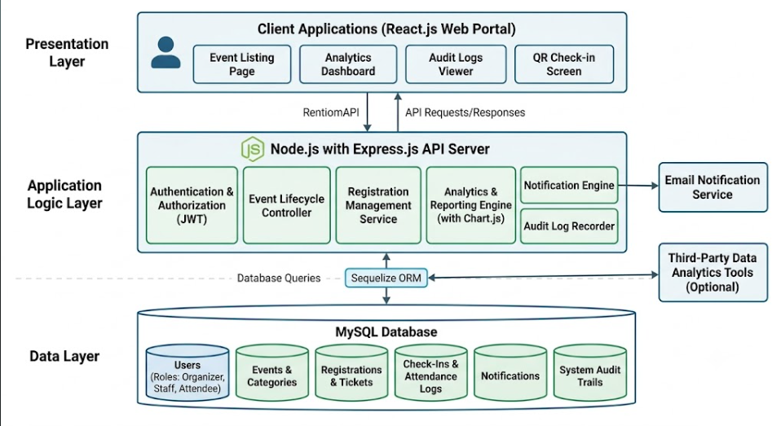
SYSTEM ARCHITECTURE

Slide 10
SOFTWARE USED
Operating System – Windows 10 or higher for development and deployment.
Front‑end – React.js for building the user interface.
Back‑end – Node.js with Express.js for server‑side logic and APIs.
Database – MySQL for structured data storage and management.
Analytics – Chart.js for generating interactive charts and dashboards.
Development Tools – Visual Studio Code (IDE), GitHub for version control.
Browser – Google Chrome or Microsoft Edge for testing and running the portal.
Package Manager – npm (Node Package Manager) for installing dependencies.

Slide 11
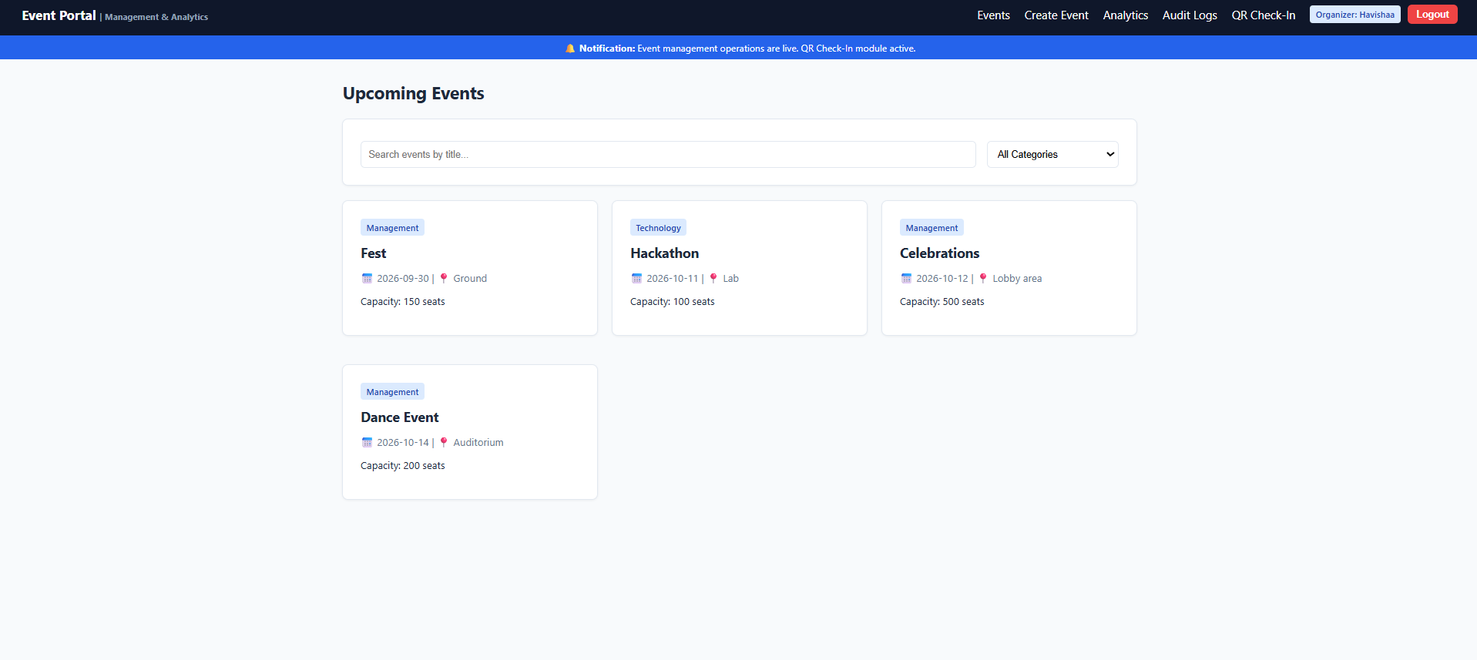
WEBSITE SNIPPETS

Slide 12
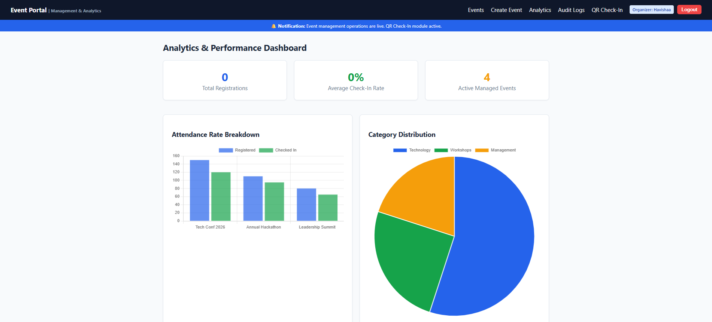

Slide 13
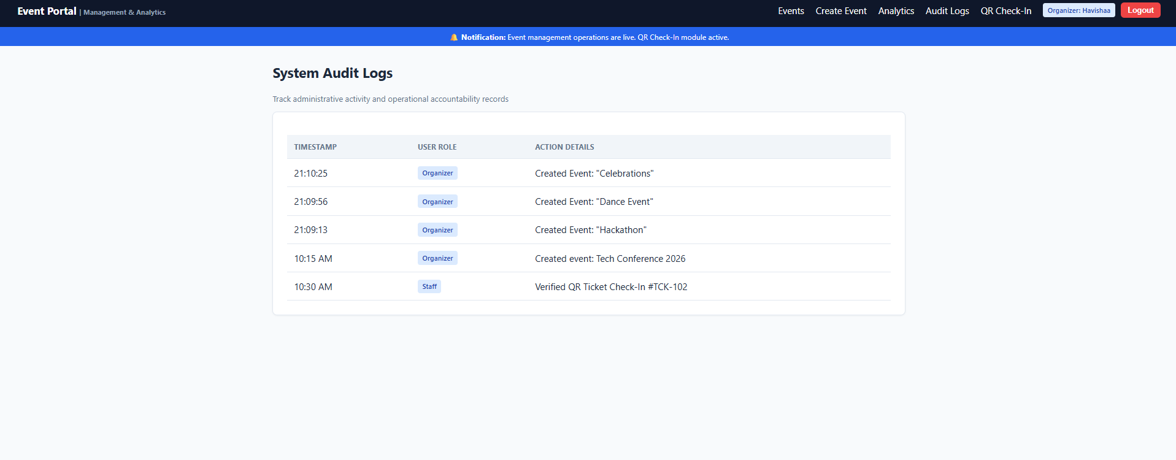
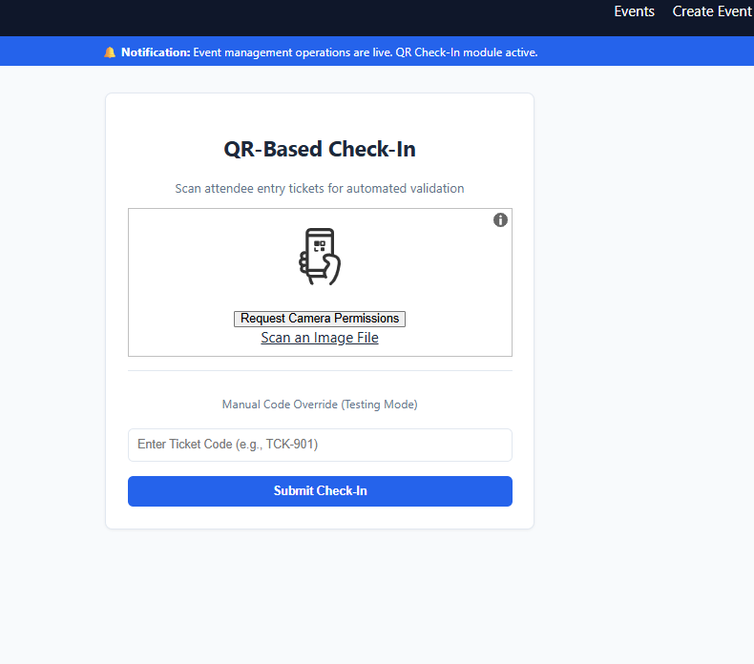

Slide 14
PROBLEMS ADDRESSED
Manual handling → Automated workflows
Limited role management → Role‑based access
Weak accountability → Audit logs
Fragmented lifecycle → End‑to‑end coverage
Slow/manual check‑in → QR instant entry
Basic reporting → Analytics dashboard
Poor search/filter → Advanced search options
Limited transparency → Real‑time notifications

Slide 15
CONCLUSION AND FUTURE SCOPE
Conclusion:
Portal makes event management faster and easier.
Ensures transparency with audit logs and role control.
Improves communication through real‑time updates.
Provides insights with analytics dashboard.
Future Scope
AI‑based recommendations for planning.
Mobile app for on‑the‑go access.
Integration with external platforms (social media).
Advanced engagement tracking features.

Slide 16
THANK YOU

