Slide 1

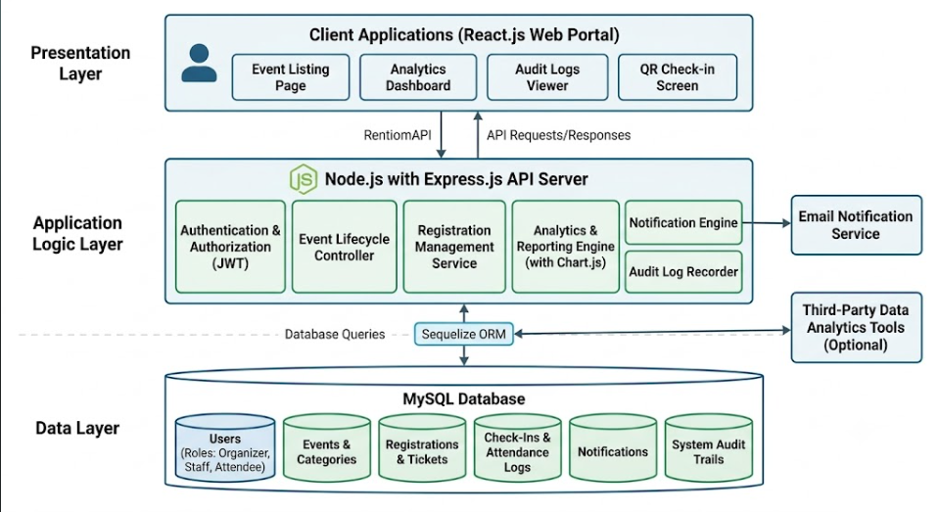
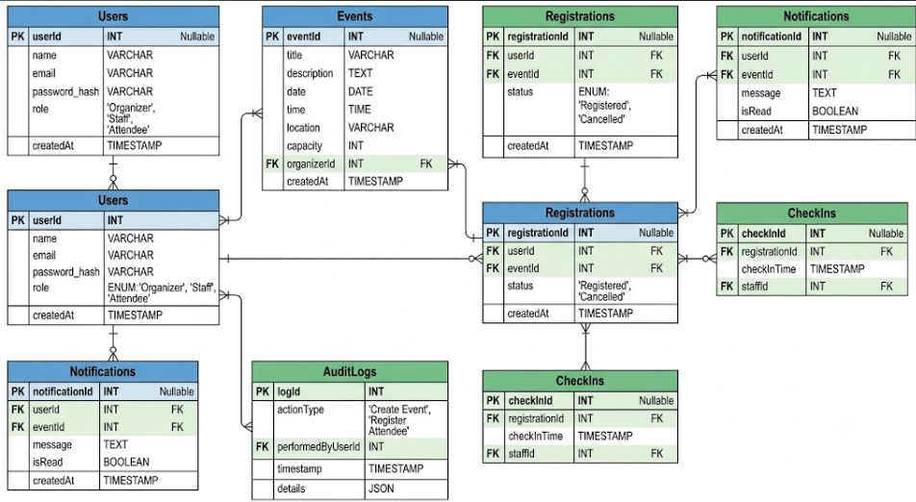
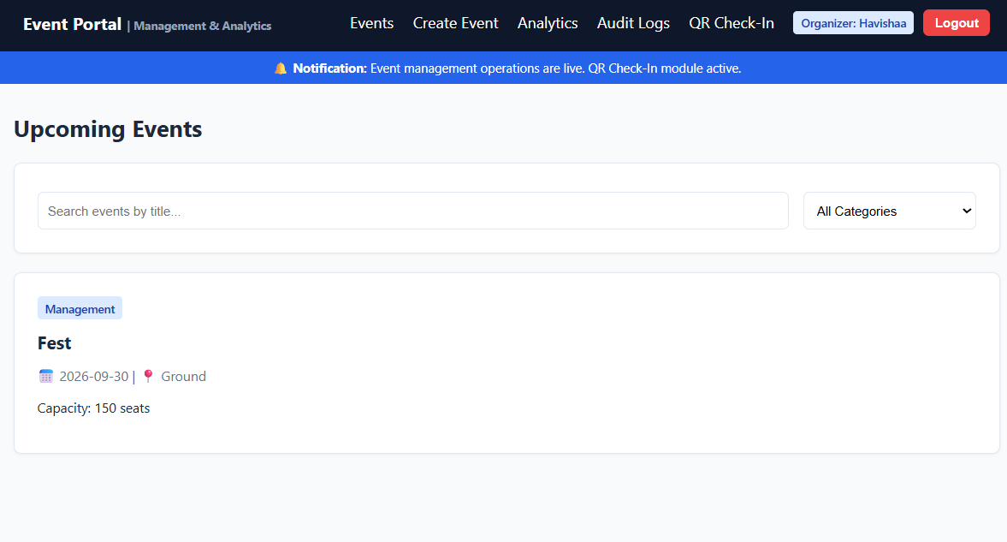
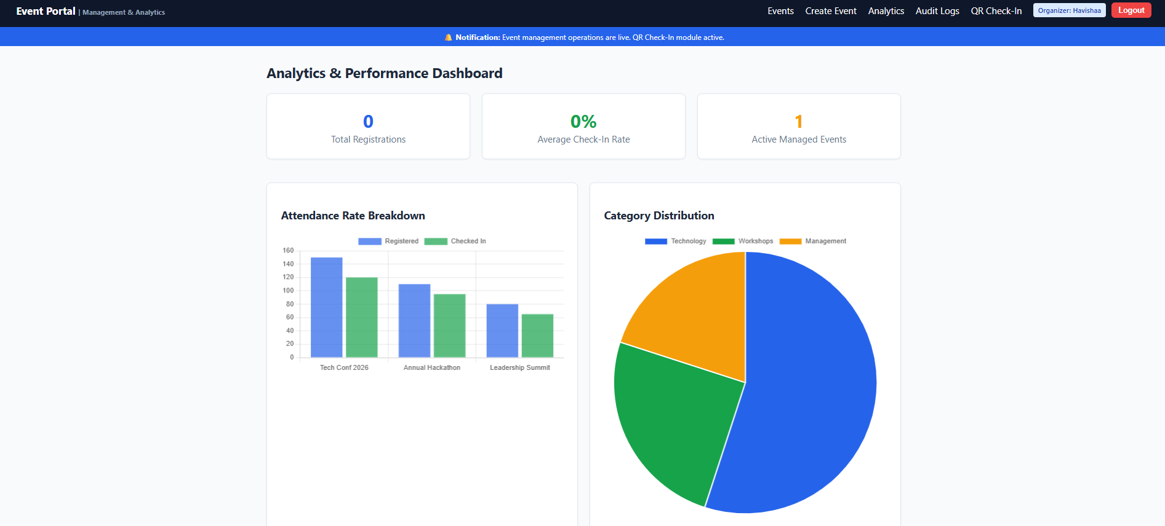
EVENT MANAGEMENT AND ANALYTICS PORTAL
Team: 6 | Section: 3 | Members: Hema Sri - 2520030159, P. Havishaa Reddy – 2520030371, K. Bhargavi - 2520030074
Database Systems Engineering and Distributed Backend Development (25CS1302E) | KLH Bachupally Campus, CSE | PBL 2026-27
Abstract
Tools & Technologies
The portal streamlines events with QR check‑ins, notifications, and analytics for organizers and participants.
Outcome: Efficient, smarter event management.
Front-End: HTML-CSS-JS
Back-End: Node.js+ REST APIs
Database: MySQL
Tools: Git & GitHub for version control, Postman for API testing, VS Code for development, Draw.io for diagrams.
Problem Statement & Objectives
Problem: Existing event systems fail to provide transparency, smooth end‑to‑end management.
Objective 1: Simplify Event Management.
Objective 2: Improve Transparency.
Objective 3: Smooth coordination.
Scope: Organizers, staff, and attendees with modules for registration, check‑in, notifications, audit logs.
System Architecture
Existing vs Proposed System
Feature | Existing System | Proposed System
Registration | Basic Forms | Smart Check‑in
Communication | Email Updates | Live Notifications
Analytics | Limited Reports | Advanced Insights
Access Control | Generic Roles | Role‑Based Security
Transparency | Low Visibility | Full Audit
ER Diagram & Database Design
Feasibility Study
Technical: Uses React, Node.js, MySQL, and Chart.js.
Economic: Built on an open‑source stack with free‑tier hosting, keeping costs minimal.
Operational: Simple interface ensures user acceptance, easy maintenance, and smooth operation.
Schedule: Designed to be completed within the semester timeline.
Implementation Screenshots
Results & Testing
Conclusion
Future Scope
System ensures transparency, accountability, analytics, notifications, secure access.
CRUD operations successful.
Achieved transparency, and analytics in event management.
Met objectives by reducing manual effort.
AI recommendations for smarter event planning.
Mobile app integration for on‑the‑go management.

