Slide 1
Deep Learning: Deep CNN Architectures
By
Dr Jyostna Devi Bodapati
Associate Professor
ACSE Department

Slide 2
Contents
ImageNEt dataset
ILSRVC
LeNet
AlexNet
VGG16
VGG19
GoogleNet
ResNet

Slide 3

ImageNet Dataset
Introduced to foster more sophisticated and robust models
ImageNet is a large dataset of annotated photographs intended for computer vision research
15+ million labeled high-resolution images
The test split contains 100K images
22000 categories of images

Slide 4
ILSVRC
Challenge
The ImageNet Large Scale Visual Recognition Challenge (ILSVRC)
Benchmark to evaluate algorithms for object detection and image classification at large scale
Uses a subset of ImageNet’s images
Targets top-1 and top-5 performance rates
To know more: http://www.image-net.org/challenges/LSVRC/

Slide 5
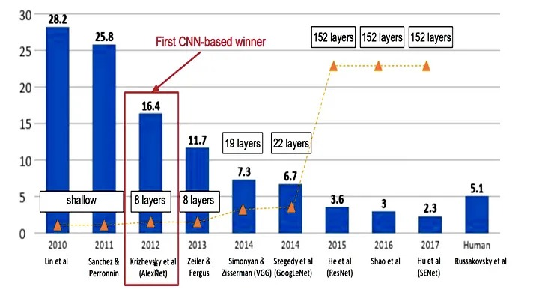
Revolution of CNN Depth

Slide 6
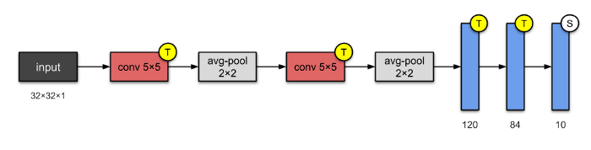
LeNEt
5 layers with 60k parameters
Average-pooling with trainable weights
This architecture has become the standard ‘template’: stacking convolutions with activation function, and pooling layers, and ending the network with one or more fully-connected layers.
Published In 1998 by Yann LeCun, Léon Bottou, Yoshua Bengio, and Patrick Haffner

Slide 7
AlexNet

Slide 8
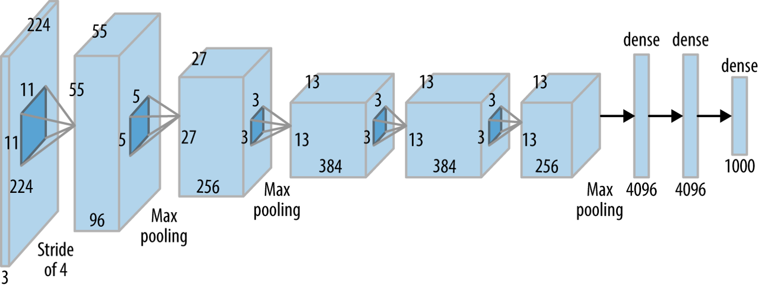
Alex Net
Five convolutional layers and three fully-connected layers
60 million parameters

Slide 9
Alex Net
Eight layers: five convolutional layers and three fully-connected layers
AlexNet surpasses the traditional machine learning models in the ILSVRC-2012 competitions by achieving 16.4% error rate
Features:
ReLU Nonlinearity
Multiple GPUs
Overlapping Pooling
Kernels of different sizes

Slide 10
Alex Net
The Overfitting Problem:
A major issue in terms of overfitting with 60 million parameters
Solutions:
Data Augmentation
Dropout

Slide 11
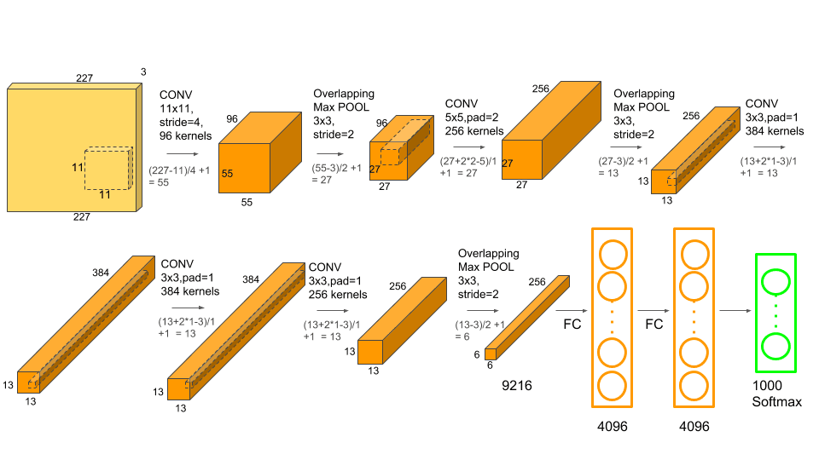
Alex Net

Slide 12
VGGNet

Slide 13
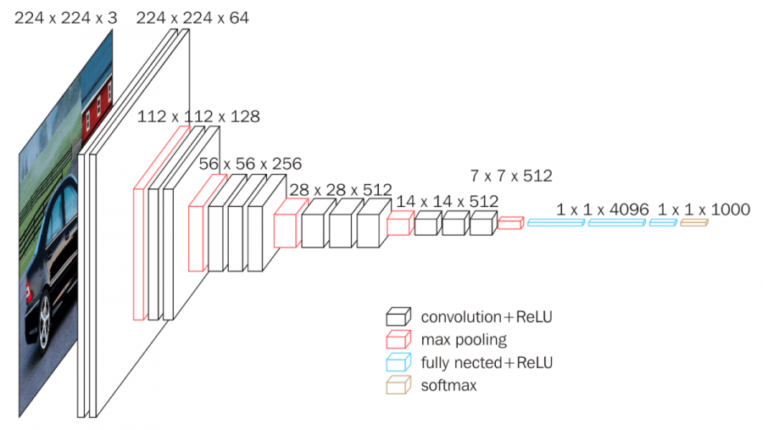
VGG16 (2013)

Slide 14
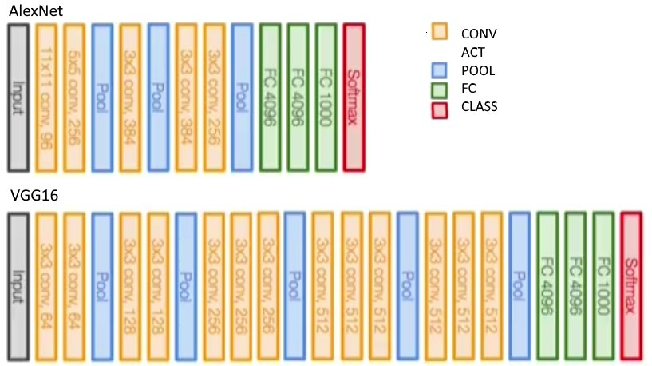
Alex Net vs VGG Net

Slide 15
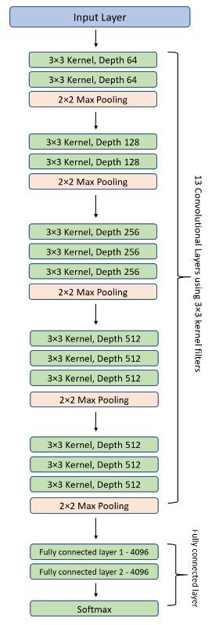
VGG16
Invented by Visual Geometry Group (VGG)
16 layers with 138M parameters
13 convolutional and 3 fully-connected layers
Use smaller size filters (2×2 and 3×3)
Small and fixed size kernels allows depth
VGG16 highly surpasses the previous versions of models in the ILSVRC-2013 competition by achieving 7.3% error rate

Slide 16
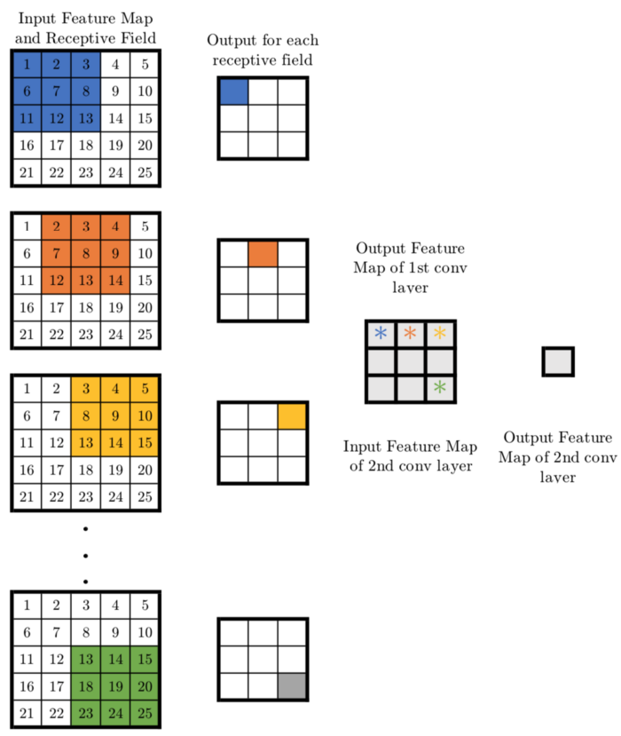
VGG16: Smaller filter sizes
Fixed size kernels: All the variable size convolutional kernels used in Alexnet (11x11, 5x5, 3x3) can be replicated by making use of multiple 3x3 kernels as building blocks
Replication of large kernel functionality with multiple small kernels: Implementing a conv layer with a kernel size of 5x5 can be obtained by implementing two 3x3 conv layers as shown on the right

Slide 17
VGG16: Smaller filter sizes
Smaller kernels allows depth and reduces parameters compared to large kernels
For a 5x5 conv layer filter, the number of parameters are 25.
On the other hand, two conv layers of kernel size 3x3 have a total of 3x3x2=18 parameters
A reduction of 28% parameters
Similarly, the effect of one 7x7 conv layer can be achieved by implementing three 3x3 conv layers with a stride of one. This reduces the number of trainable parameters by 44.9%
Similarly, the effect of one 11x11 conv layer can be achieved by implementing five 3x3 conv layers with a stride of one. This reduces the number of trainable parameters by 62.8%

Slide 18
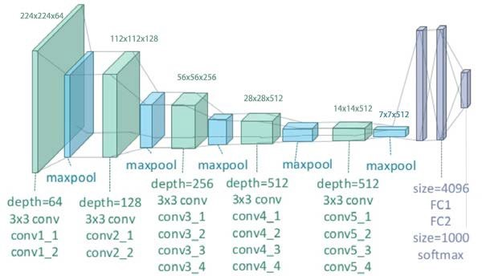
VGG19
Very much similar to VGG-16 with 3 additional convolutional layers
VGG16:
2Conv — 1Maxpool — 2Conv — 1Maxpool — 3Conv — 1Maxpool — 3Conv — 1Maxpool — 3Conv — 1Maxpool — 1FC — 1FC — 1FC
VGG19:
2Conv — 1Maxpool — 2Conv — 1Maxpool — 4Conv — 1Maxpool — 4Conv — 1Maxpool — 4Conv — 1Maxpool — 1FC — 1FC — 1FC

Slide 19
GoogleNet (InceptionNet)

Slide 20
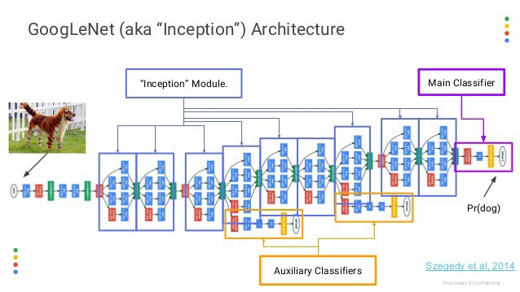
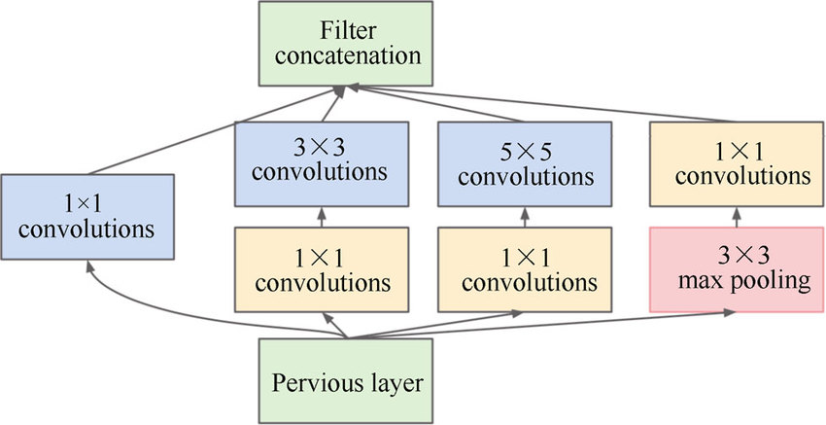
GoogLe Net - Inception

Slide 21
GoogleNet (2014)
22-layer architecture with 5M parameters
Also called the Inception-v1
leverages varying filter sizes, which are 1x1, 3x3, and 5x5
Introduced Inception modules, Each inception block is an integration of 3 ideas:
parallel towers
1×1 convolutions
auxiliary networks
Increases representational power through the implementation of embedded internal complex structures within networks
Reached human level performance on ImageNet by achieving 6.3% error rate

Slide 22
GoogleNet: 1×1 convolutions
Visualization of 3x3 vs 1x1 Convolution operation

Slide 23
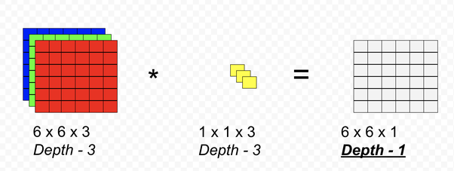
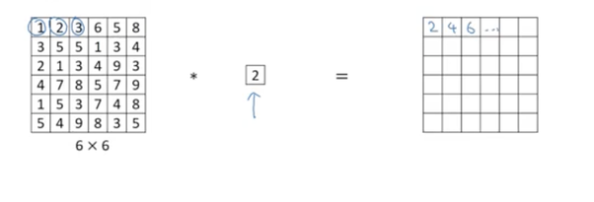
GoogleNet: 1×1 convolutions
leads to dimension reduction
The additional benefit of an increase in the width and depth of the network.
1x1 Convolution with higher strides leads to even more reduction in data by decreasing resolution, while losing very little non-spatially correlated information
Used to Down sample Feature Maps With 1×1 Filters

Slide 24
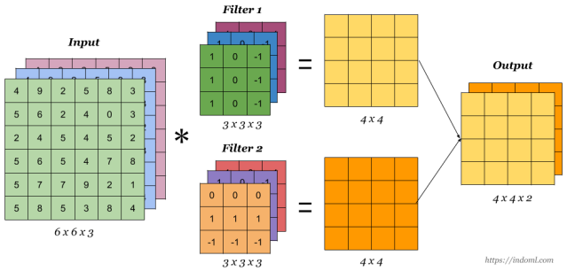
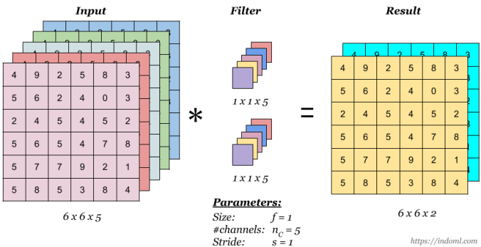
GoogleNet: Normal vs 1×1 convolutions

Slide 25
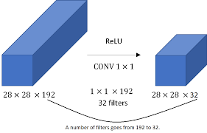
GoogleNet: 1×1 convolutions

Slide 26
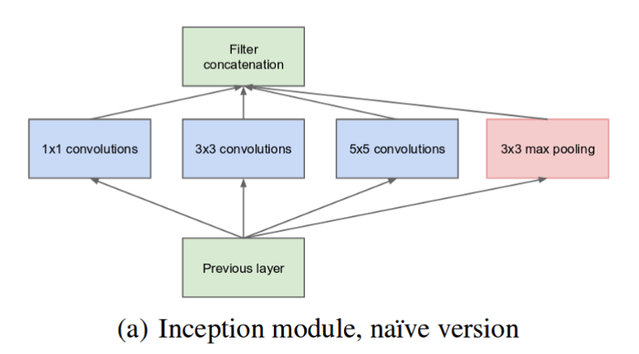
Inception Module
An Inception Module consists of the following components:
Input layer
1x1 convolution layer
3x3 convolution layer
5x5 convolution layer
Max pooling layer
Concatenation layer

Slide 27
Inception Module
Addition of more operations in each layer increases the number of parameters
To make it less computationally expensive, 1*1 Conv filter is used before the 3*3 and 5*5 convolution

Slide 28
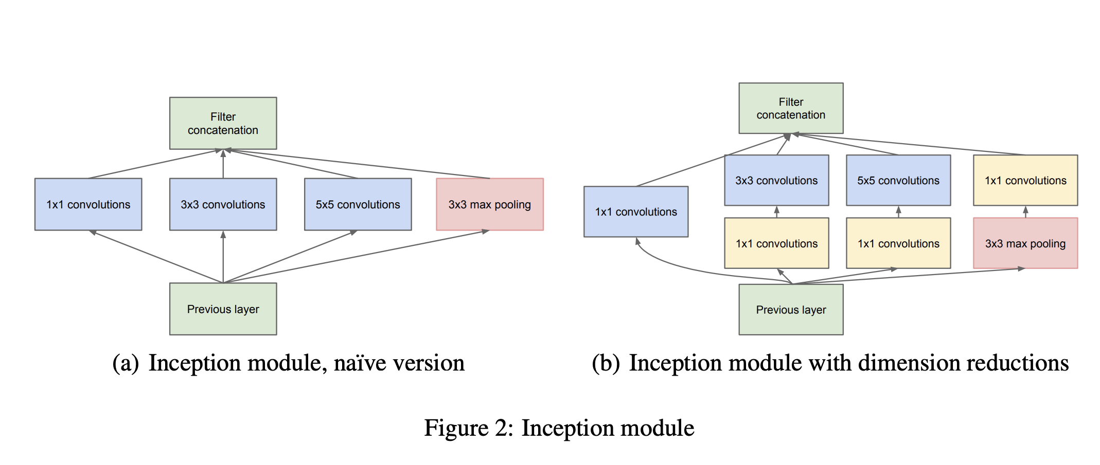
Inception Module

Slide 29
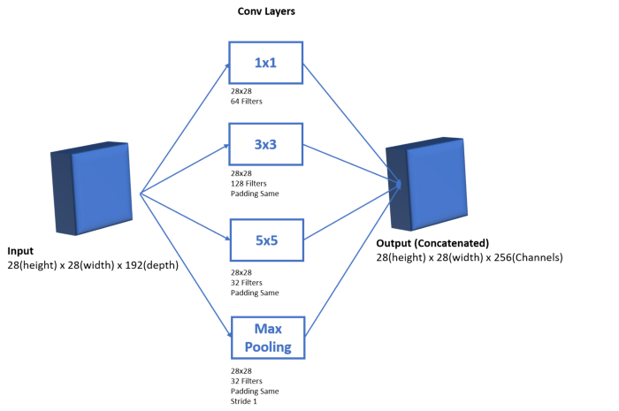
Inception Module

Slide 30
GoogleNet: Auxiliary Classifiers
Inception is a deep network
To prevent the middle part of the network from “dying out”(vanishing gradient problem), the authors introduced two auxiliary classifiers.
Softmax is applied in each of them and then Auxiliary loss is calculated on the same labels of the output classifier
The total loss function is a weighted sum of the auxiliary loss and the real loss. Total loss = real loss + (0.3 * auxiliary loss1) + (0.3 * auxiliary loss2)

Slide 31
InceptionNet Versions

Slide 32
Versions of InceptionNet
The most common Versions of Inception are:
Inception-v1
Inception-v2
Inceptio-v3
Inception-v4
Inception-Resnet-v2

Slide 33
Inception v-2
works on the same approach as Inception-v1 with some change to make it more efficient in terms of both speed and accuracy
Uses Spatial separable convolutions
5*5 convolutions are replaced with two 3*3 convolutions
Some 3*3 convolution is replaced with a combination of 1*3 and 3*1 (Spatial separable convolution)
Some 7*7 convolution is replaced with a combination of 1*7 and 7*1 convolutions (Spatial separable convolution)

Slide 34
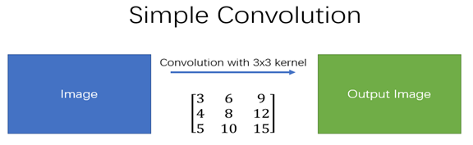
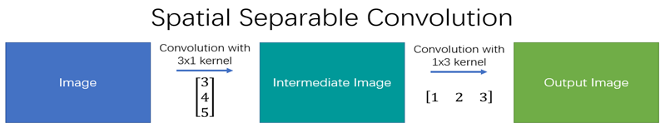
Spatial separable Convolution
Spatial separable convolution is so named because it deals primarily with the spatial dimensions
A spatial separable convolution simply divides a kernel into two, smaller kernels

Slide 35
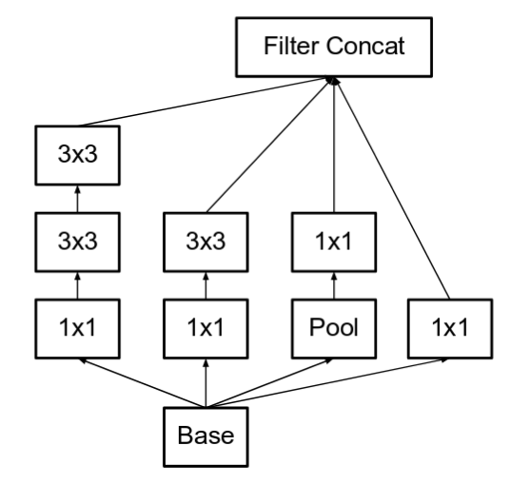
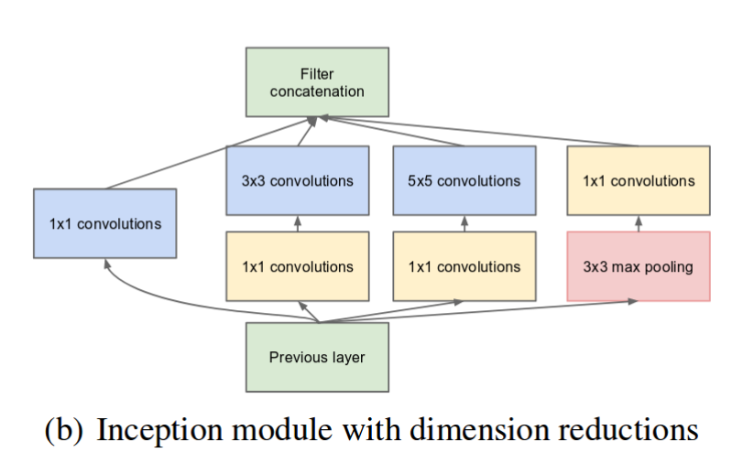
Inception v-2
5*5 convoltions are replaced with two 3*3 convolutions

Slide 36
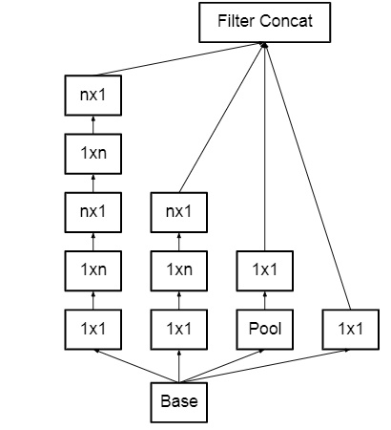
Inception v-2
Converts n x n factorization into 1 x n and n x 1 factorization
Ex: A 3×3 convolution can be converted into 1×3 then followed by 3×1 convolution which is 33% cheaper in terms of computational complexity as compared to 3×3

Slide 37
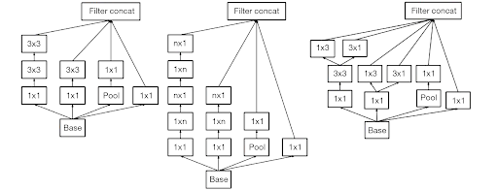
Inception v-2
To deal with the problem of the representational bottleneck, the feature banks of the module were expanded instead of making it deeper.
As a result 3 types of inception blocks and concatenate them to get Inception v2 architecture

Slide 38
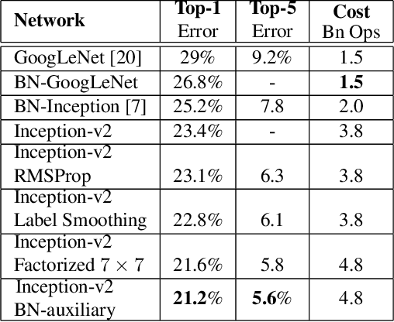
Inception versions on ImageNet

Slide 39
Inception v-3
Similar to Inception-v2 with some changes in loss functions, optimizer, and batch normalization.
RMS prop optimizer is used
Batch normalization is used in the Auxilary classifier
Label Smoothing (A type of regularizing component added to the loss function that prevents the network from over-fitting)

Slide 40
Label smoothing
Label smoothing replaces one-hot encoded label vector y_hot with a mixture of y_hot and the uniform distribution:
y_ls = (1 - α) * y_hot + α / K
where K is the number of label classes, and
α is a hyperparameter that determines the amount of smoothing.
If α = 0, we obtain the original one-hot encoded y_hot.
If α = 1, we get the uniform distribution
The original one-hot encoded labels have been "smoothed" by reducing the value of the correct class label and distributing a small portion of that confidence to the other classes.

Slide 41
Label smoothing
Label smoothing redistributes some of the confidence from the correct class to other classes, helping prevent the model from becoming overconfident and promoting better generalization
y_ls = (1 - α) * y_hot + α / K
Original one-hot encoded labels:
Class A: [1, 0, 0]
Class B: [0, 1, 0]
Class C: [0, 0, 1]
Let’s apply label smoothing with a smoothing factor of α = 0.1.
Smoothed labels for Class A: [0.9, 0.05, 0.05]
Smoothed labels for Class B: [0.05, 0.9, 0.05]
Smoothed labels for Class C: [0.05, 0.05, 0.9]

Slide 42
Inception v-4
Deeper in Inception v4 with the change in stem part
The number of Inception modules is increased
Inception modules made more uniform i.e. same numbers of filters are used in modules
Three types of inception module are named A, B, and C ( similar inception modules as that in inception-v2 )

Slide 43
Residual Network (ResNet)

Slide 44
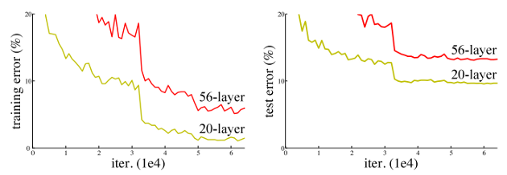
ResNet: Motivation
Deep networks are hard to train because of the notorious vanishing gradient problem
Vanishing gradient problem: As the gradient is back-propagated to earlier layers, repeated multiplication may make the gradient infinitely small.

Slide 45
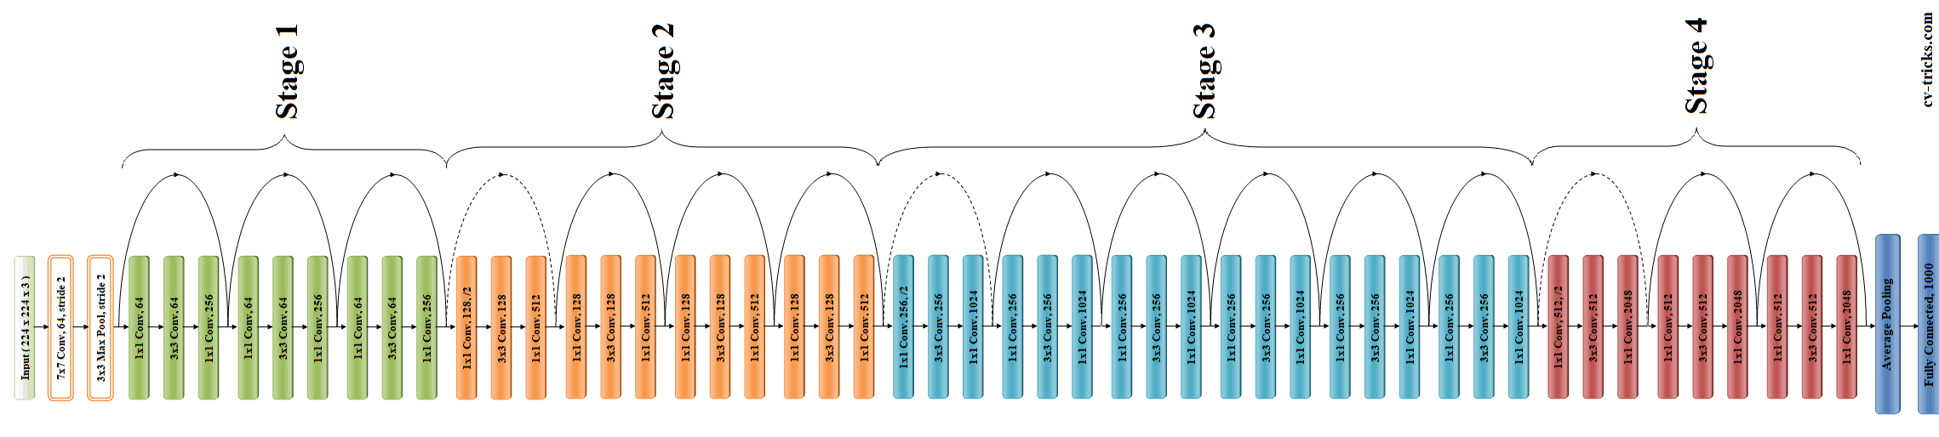
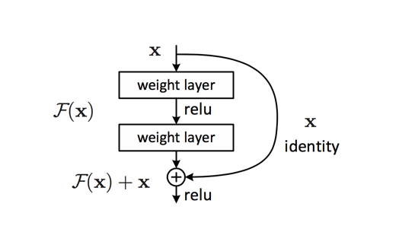
ResNet (50 Layers)

Slide 46
ResNet: Features
One of the most popular architectures in various computer vision tasks
Won the top position at the ILSVRC 2015 classification competition with an error of only 3.57%
Additionally, it also came first in the ImageNet detection, ImageNet localization, COCO detection, and COCO segmentation in the ILSVRC & COCO competitions of 2015
Introduced residual (Skip)connections
ResNets have fewer filters and lower complexity.

Slide 47
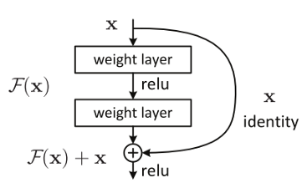
ResNet: Skip Connections
The core idea of ResNet is introducing a so-called “identity shortcut connection” that skips one or more layers
Residual connections are two way beneficial:
Alleviate the issue of vanishing gradient by setting up an alternate shortcut for the gradient to pass through
Learning an identity function ensures that the higher layers of the model do not perform any worse than the lower layers

Slide 48
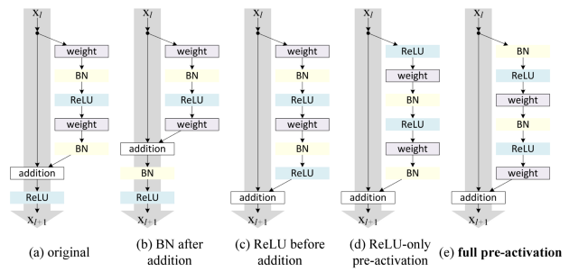
Variants of Residual Blocks

Slide 49
ResNet: Versions
Comes in different versions:
ResNet-34
ResNet-50
ResNet-101
ResNet-152

Slide 50
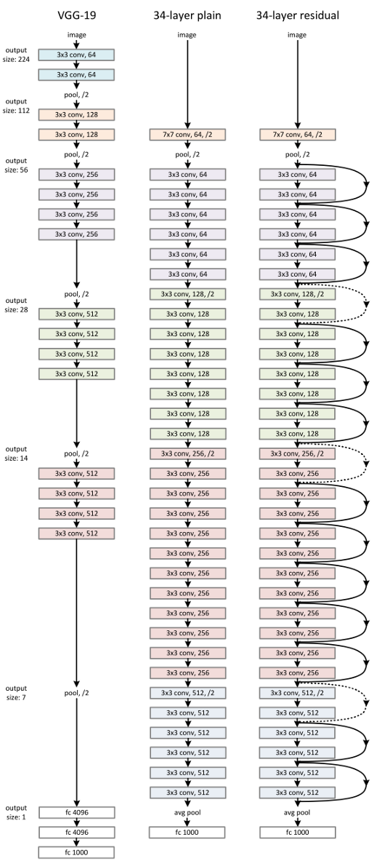
ResNet-34
Has 34 weighted layers
VGG’s plain network was taken
Skip connections were added for a block of every two convolution layers
The plain network turns into its residual network counterpart

Slide 51
ResNet-50
Has 50 weighted layers
There were concerns over the time taken to train the layers of ResNet-34
Each of the 2-layer blocks in Resnet34 was replaced with a 3-layer bottleneck block
This has much higher accuracy than the 34-layer ResNet model.

Slide 52
ResNet-101 and ResNet-152
Constructed by using more 3-layer blocks
Increased network depth
The 152-layer ResNet has much lower complexity (at 11.3bn FLOPS) than VGG-16 or VGG-19 nets (15.3/19.6bn FLOPS).

Slide 53
Inception ResNet v2

Slide 54
Inception ResNet v2
Inception Network with Residual connections in inception modules.
Pooling layer in inception block is replaced by residual connection
Network made deeper by increasing the number of Inception modules

Slide 55
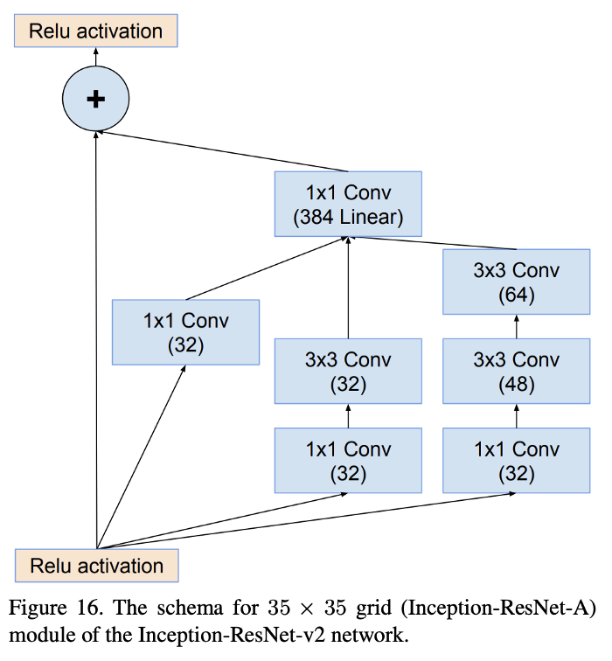
Inception ResNet v2

Slide 56
Other Pre-trained Models
Xception
InceptionResNetV2
MobileNet (V2)
EfficientNetB0-B7
NASNet (Mobile & Large)

Slide 57
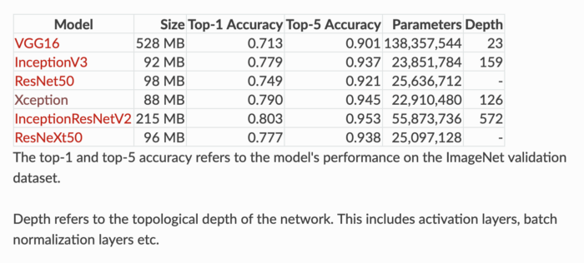
Deep CNNS Comparison

Slide 58
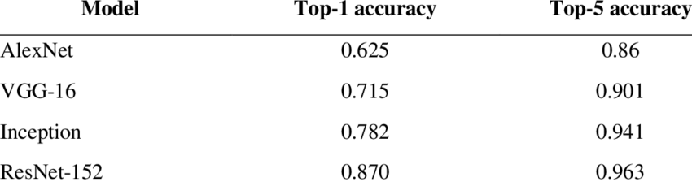
Performance of various Deep CNNs

Slide 59


