Slide 1
Machine Learning: Clustering Techniques (Hierarchical Clustering Approaches)
by
Dr Jyostna Devi Bodapati
Associate Professor, ACSE,
VFSTR Deemed to be University

Slide 2
Outline
Hierarchical Methods
Agglomerative
Single-linkage
Complete-linkage
Average-linkage
Divisive

Slide 3
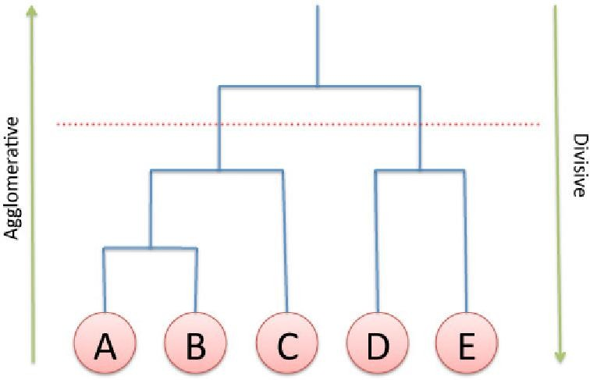
Hierarchical Clustering
These methods construct the clusters by either:
Recursively partitioning the data objects in a top-down approach
(or)
Merging data objects in a bottom-up fashion.

Slide 4
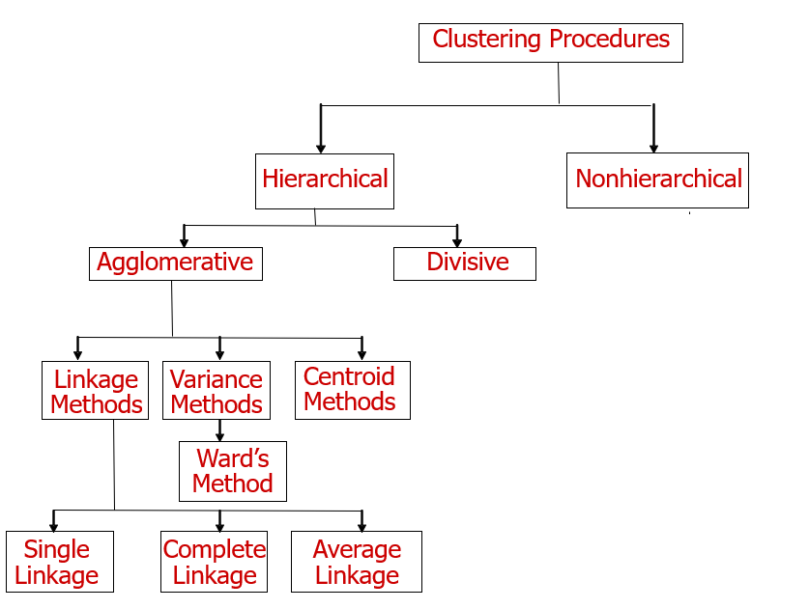
Hierarchical Clustering Methods

Slide 5
Hierarchical Methods
A hierarchical clustering method works by grouping data objects into a hierarchy or “tree” of clusters.
Can be visualized as a dendrogram
Types:
Agglomerative
Divisive

Slide 6
Types of Hierarchical Clustering
Agglomerative:
Start with each data object as individual cluster
At each step, merge the closest pair of clusters until only one cluster (or k clusters) left
Divisive:
Start assuming all the data objects form a single cluster
At each step, split the cluster until each cluster contains a single data object (or k clusters are formed).

Slide 7
Agglomerative approach
Initialization:
Each object is a cluster
Iteration:
Merge two clusters which are most similar to each other;
Until all objects are merged into a single cluster
a b c
d e
a b
a b c d e
c d e
d e
Step 0
Step 1
Step 2
Step 3
Step 4
bottom-up

Slide 8
Divisive Approach
Initialization:
All objects stay in one cluster
Iteration:
Select a cluster and split it into two sub clusters
Until each leaf cluster contains only one object
a
a b
b
a b c d e
c
c d e
d
d e
e
Step4 Step3 Step2 Step1 Step0
Top-down
8

Slide 9
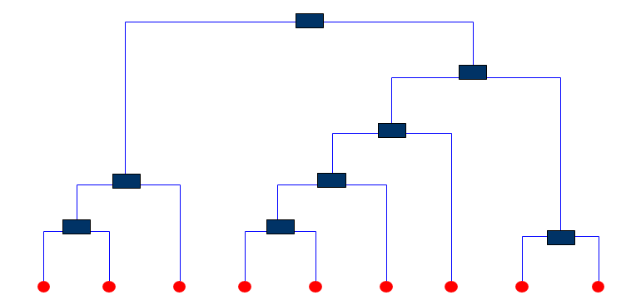
Dendrogram
A binary tree like structure
Visualizes how clusters are merged/split hierarchically
Each node on the tree can be treated as a cluster

Slide 10
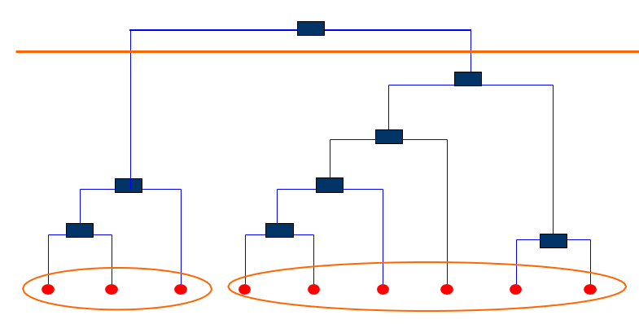
Dendrogram
Clusters can be obtained by cutting the dendrogram at the desired level, then each connected component forms a cluster
Leaf – Individual
Root-One Cluster
A cluster at level i, is the merger of its child cluster at level i+1.

Slide 11
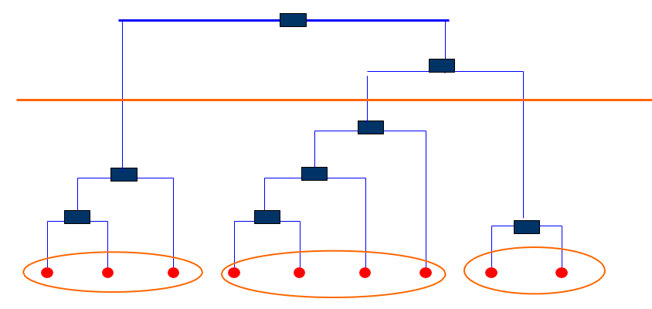
Dendrogram
Clustering is obtained by cutting the dendrogram at the desired level, then each connected component forms a cluster
Each sub-tress is a cluster

Slide 12

Agglomerative Clustering Techniques

Slide 13
Agglomerative clustering algorithm
Most popular hierarchical clustering technique
Starts with each individual item as a cluster and iteratively merge clusters until all the items belong to one cluster.
Bottom up approach is followed to merge the clusters together.
Dendrograms are pictorially used to visualize the HAC.
Key operation is the computation of the distance between two clusters

Slide 14
Agglomerative clustering algorithm
The process of merging clusters can be done using three techniques.
Single linkage.
Complete linkage
Average linkage
Different definitions of the distance between clusters lead to different algorithms

Slide 15
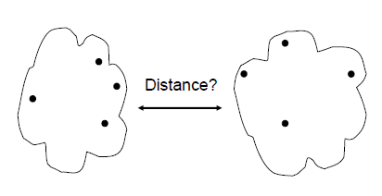
Merging Clusters
How to measure the distance between clusters?
Hint: Distance between clusters is usually defined on the basis of distance between objects.
Single-link Complete-link Average-link Centroid distance

Slide 16
Merging Clusters: Techniques
Single Linkage:
The distance between the closest members of the two clusters.
Min distance between the clusters
Complete Linkage:
This is the distance between the members that are farthest apart.
Max distance between the clusters.
Average Linkage:
Considers the distances between all pairs and averages of all of these distances.
This is also called Unweighted Pair Group Mean Averaging.

Slide 17
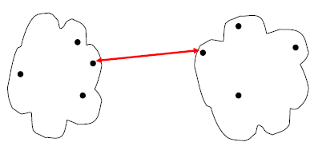

Single Link
The single link technique is based on the idea of finding maximal connected components in a graph.
The distance between two clusters is represented by the distance of the closest pair of data objects belonging to different clusters.

Slide 18
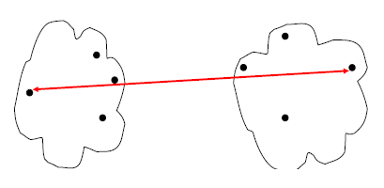

Complete Link
The distance between the members that are farthest apart is considered.
Max distance is used.

Slide 19
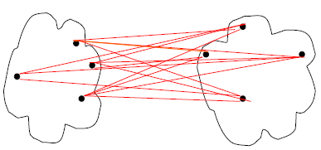
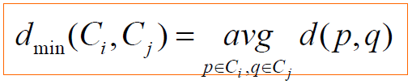
Average Link
The distance between two clusters is represented by the average distance of all pairs of data objects belonging to different clusters.

Slide 20
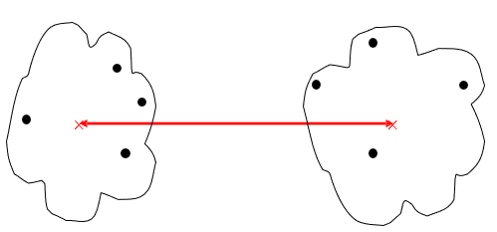
Centroid distance
×
×
m ,m are the means of C_{i}, C_{j},
i j
Single-link Complete-link Average-link Centroid distance
d_{mean} (C_{i} ,C_{j} ) = d(m_{i} , m_{j} )
The distance between two clusters is represented by the distance between the means of the cluters.
51

Slide 21
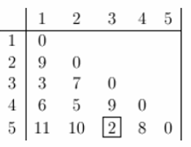
Agglomerative: Complete Linkage Example
Distance between every pair of units is given
Apply Complete Linkage Clustering
The smallest distance is between three and five and they get linked up or merged first into a the cluster '35'.

Slide 22
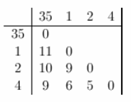
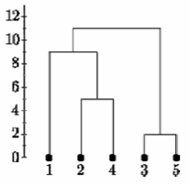
Agglomerative: Complete Linkage Example
Obtain the new distance matrix

Slide 23
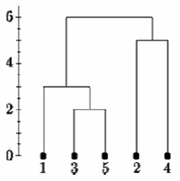
Agglomerative: Single Linkage Example
Obtain the new distance matrix

Slide 24
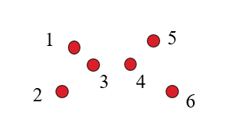
Agglomerative: Example
For the following data set, we will get different clustering results with the single-link and complete-link algorithms.

Slide 25
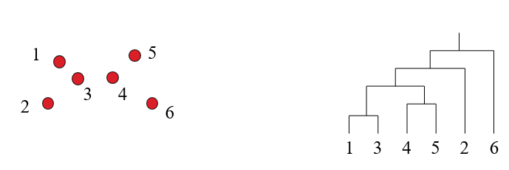
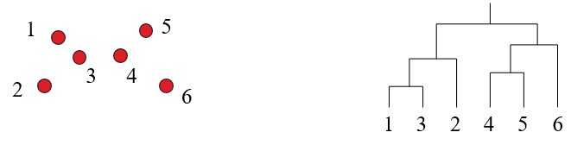
Agglomerative: Example
Result of single Linkage
Result of Complete Linkage

Slide 26
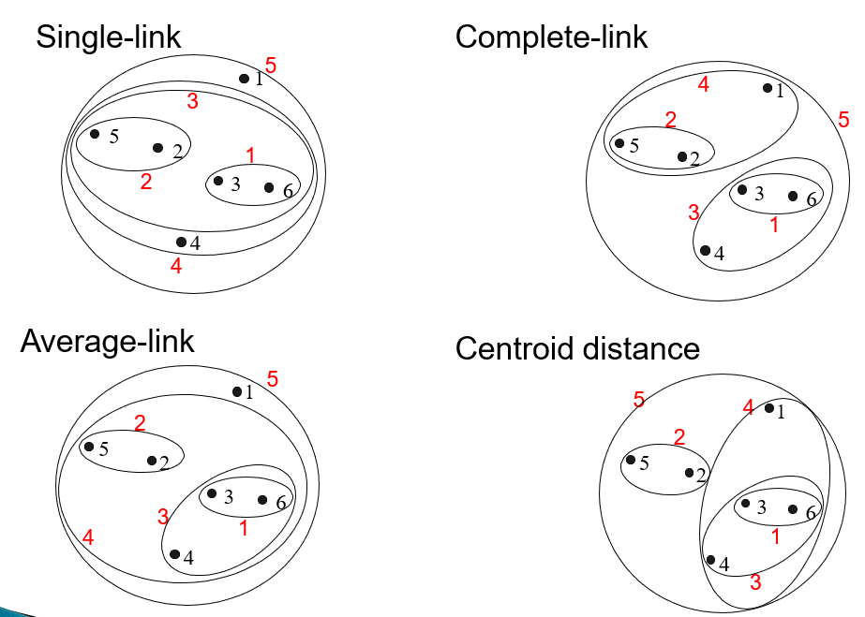
Agglomerative: Example

Slide 27
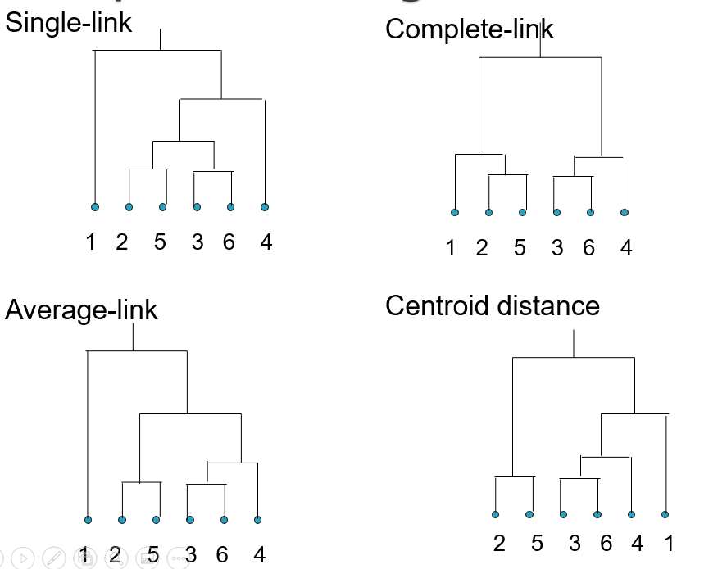
Agglomerative: Compare Dendrograms

Slide 28
Which Method is Better…?
Each method has both advantages and disadvantages;
Application-dependent
single-link and complete-link are most common methods
Single-link
Can find irregular-shaped clusters
Sensitive to outliers, suffers the so-called chaining effects
Complete-link, Average-link
Robust to outliers
Tend to break large clusters
Prefer spherical cluster

Slide 29
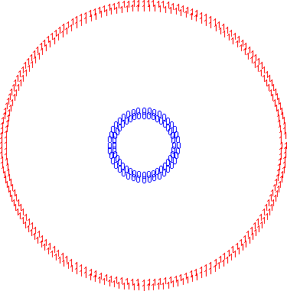
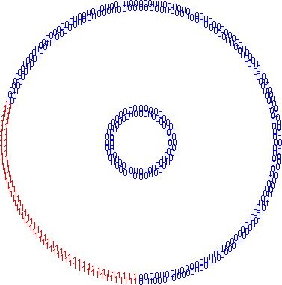
Bias towards Spherical Clusters
Single-link (2 clusters)
Complete-link (2 clusters)

Slide 30
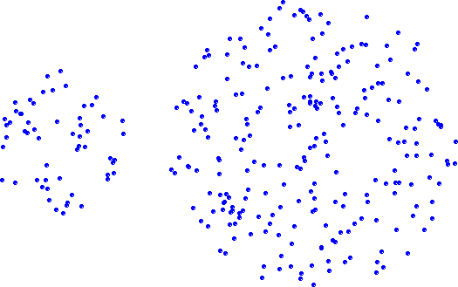
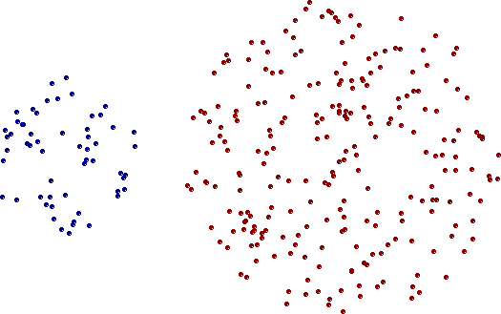
Strength of Single Linkage
Original Points
Two Clusters
Can handle non-global shapes

Slide 31
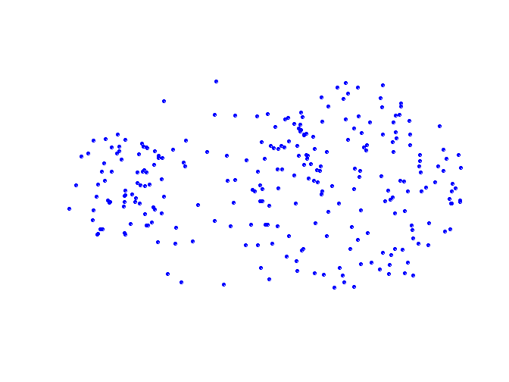
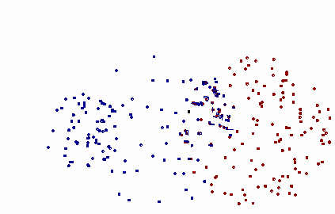
Limitations of Single-Linkage
Original Points
Original Points
Two Clusters
Sensitive to noise and outliers

Slide 32
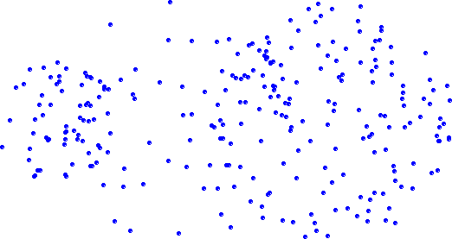
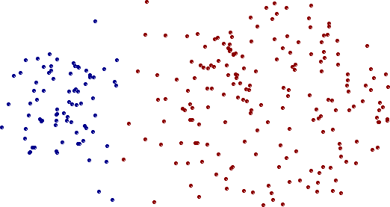
Strength of Complete Linkage
means of C_{i}, C_{j},
Original Points
Two Clusters
Less susceptible to noise and outliers

Slide 33
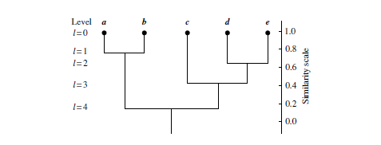
Divisive Clustering Algorithm

Slide 34
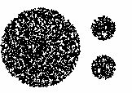
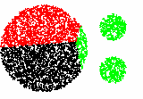
The complete-link, average-link, or centroid distance method tend to break the large cluster.

Slide 35
Strengths of Hierarchical Clustering
No assumptions on the number of clusters
Any desired number of clusters can be obtained by ‘cutting’ the dendrogram at the proper level

Slide 36
Time Complexities
The space complexity for hierarchical algorithms is O (n²) because this is the space required for the adjacency matrix.
The space required for the dendrogram is O (kn), which is much less than O (n²) .
The time complexity for hierarchical algorithms is O (kn²) because there is one iteration for each level in the dendrogram.

Slide 37
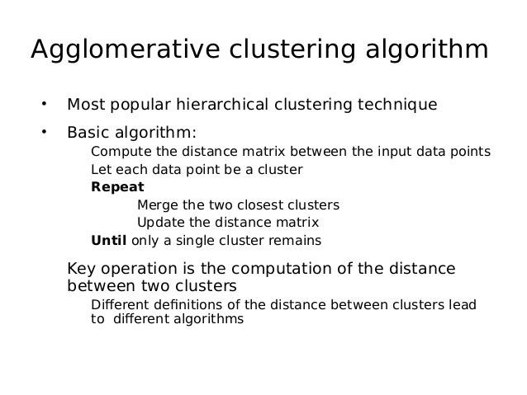

Slide 38
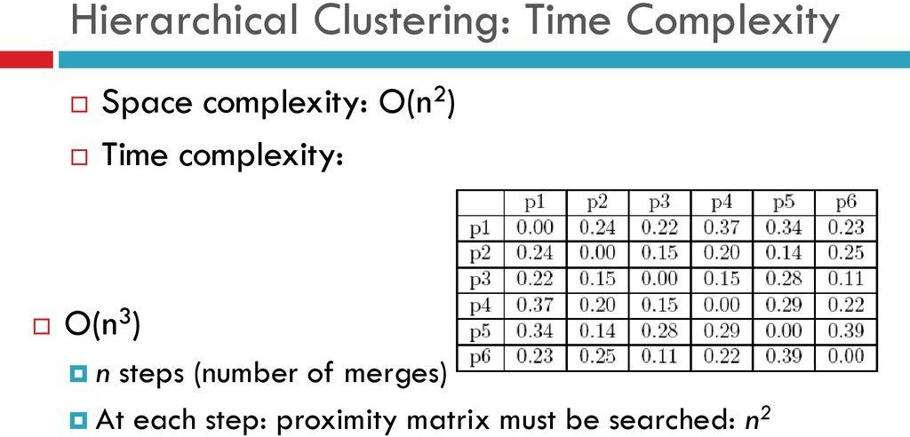

Slide 39
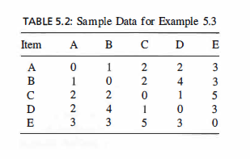
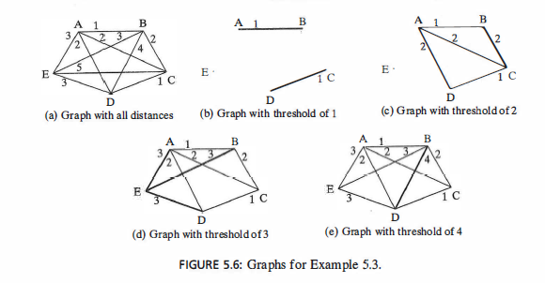
Numerical Example
Not Efficient
O(n²) space and Time Complexity

Slide 40
Numerical Examples
https://online.stat.psu.edu/stat555/node/86/
https://www.analyticsvidhya.com/blog/2021/06/single-link-hierarchical-clustering-clearly-explained/
https://www.cs.cmu.edu/~tom/10601_fall2012/hw/hw4sol.pdf
https://people.revoledu.com/kardi/tutorial/Clustering/Numerical%20Example.htm

Slide 41


Slide 42



Slide 43
Each method has both advantages and disadvantages; application-dependent, single-link and complete-link are the most common methods
Single-link
Can find irregular-shaped clusters
Sensitive to outliers, suffers the so-called chaining effects
Complete-link, Average-link, and Centroid distance
Robust to outliers
Tend to break large clusters
Prefer spherical clusters

Slide 44
